Slide 1
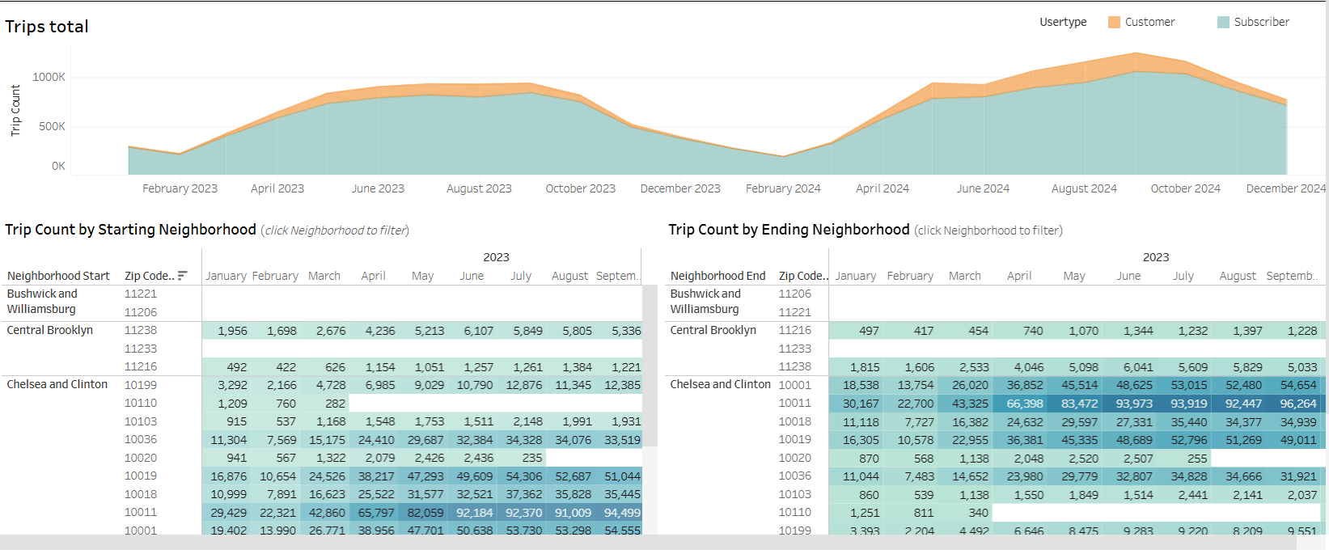
Cyclistic Project Executive Summary
Overview
Cyclistic's Customer Growth Team is creating a business plan for next year. The team wants to understand how their customers are using their bikes; their top priority is identifying customer demand at different station locations.
The Problem
To effectively develop new station locations, the team wants to:
Understand what customers want and what makes a successful product
Understand how the current line of bikes are used.
Apply customer usage insights to inform new station growth
Understand the bike usage of subscribers' vs non-subscribers
Understand how weather affects bike usage
The Solution
The business analyst will create a BI tool to gain insights related to data generated by the bikes when being used by customers. Then, this information will be used to understand what customers want, what makes a successful product, and how new stations might alleviate demand in different geographical areas.
Details
Keys to success
BI insights must clearly identify the specific characteristics of a successful product
Each trip should be evaluated using starting and ending location, duration, variables such as time of day, season, and weather.
These outcomes must prove or disprove the theory that location, time, season, and weather impact user demand.
Analyze data that spans at least one year to see how seasonality affects usage.
Total Trips 2023-2024
Reflections/
Next Steps
Subscriber conversion: Convert casual riders to subscribers
Weather strategies: Develop new strategies to maintain bike usage during different type of weathers
Type of bikes: Strategies to add different type of bikes
New station location: Add new stations at in high-demand places to alleviate congestions
Monitoring: Continously update and monitor key metrics for new patterns

