Slide 1
Machine Learning Project
Management

Slide 2
ML Project Management
Phuong Pham
phuong.pham@aalto.fi
Machine Learning Experiment Management
6/29/20
2

Slide 3
Motivation
How to collect the experimental data?
Machine Learning Experiment Management
6/29/20
3

Slide 4
Machine Learning Applications and Systems
How to manage a machine learning experiment?
Machine Learning Experiment Management
6/29/20
4

Slide 5
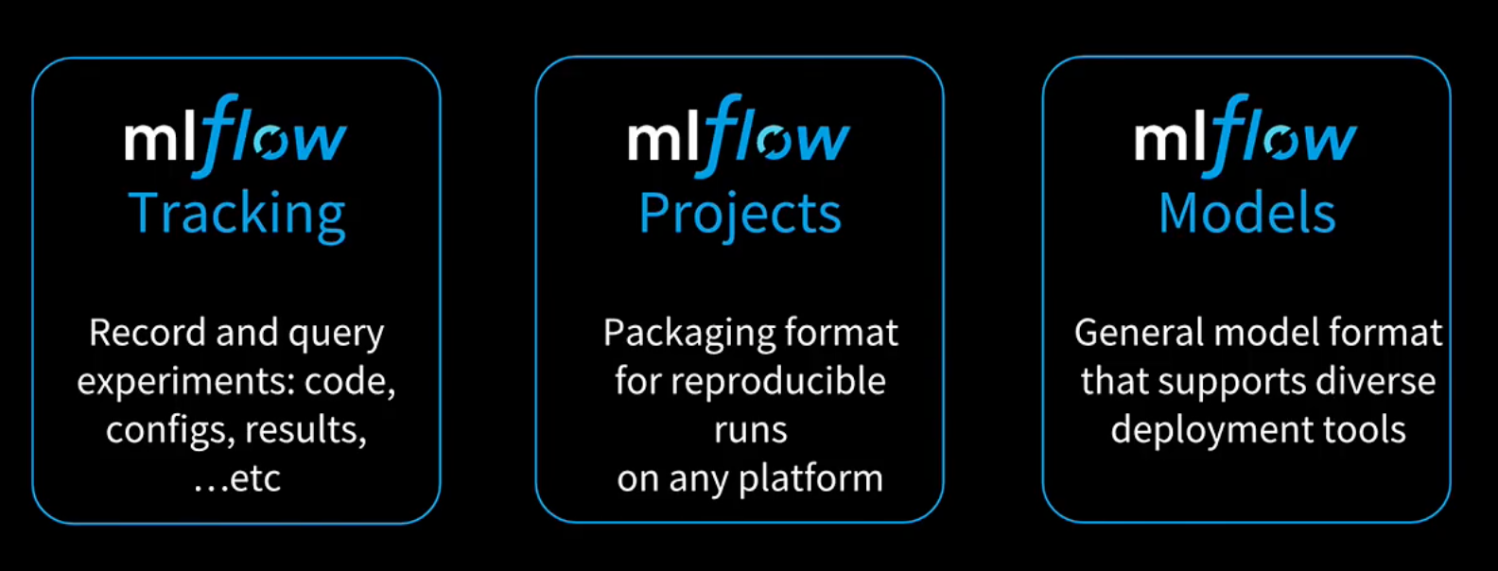
MLFlow
Machine Learning Experiment Management
6/29/20
5

Slide 6
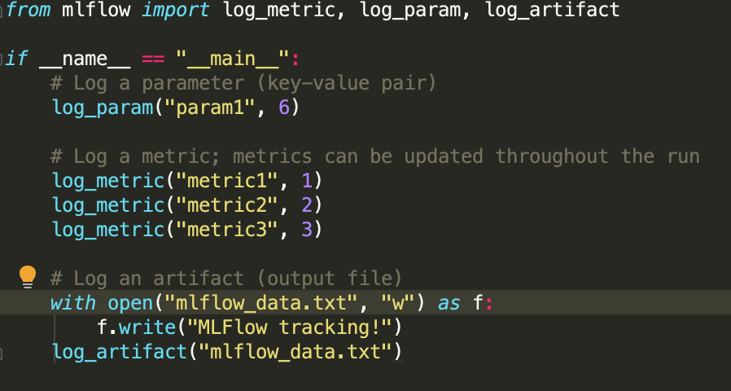
Tracking
Machine Learning Experiment Management
6/29/20
6

Slide 7
Projects
Diverse set of tools
- Keras, Pytorch, R, Tensorflow, Spark, …
Diverse set of environments
- Linux, Mac, Window, …
→ It is difficult to productionalize
Machine Learning Experiment Management
6/29/20
7

Slide 8
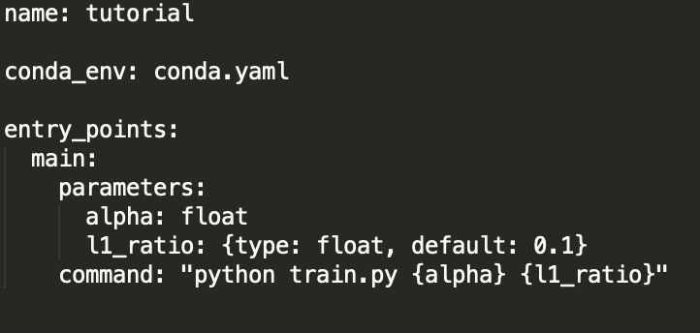
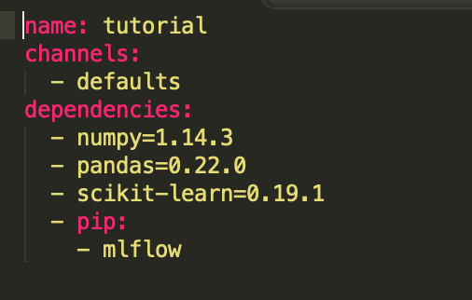
Projects
MLProject file
conda.yaml
Machine Learning Experiment Management
6/29/20
8

Slide 9
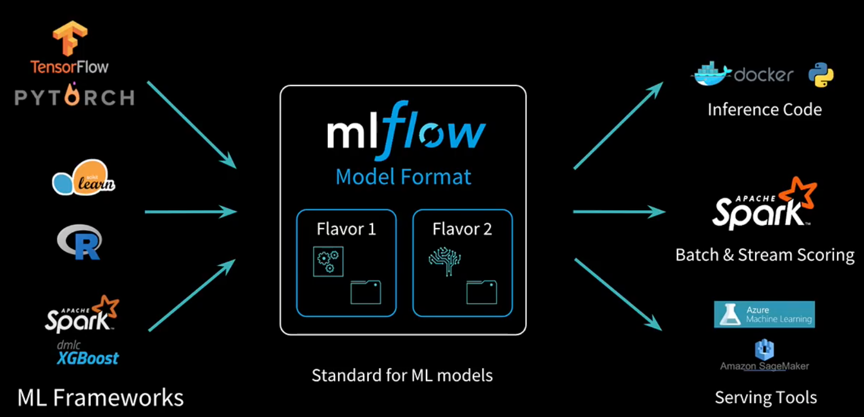
Models
A MLflow Model is a standard format for packaging machine learning models
Machine Learning Experiment Management
6/29/20
9

Slide 10
Models
- Serving the model with mlflow:
$ mlflow models serve –m /path-to-the-mlflow-model/ -p app_deployment_port
- Access the model for predicting test data:
$ curl –X POST –H “Content of data” http://server:app_deployment_port/invocations
Machine Learning Experiment Management
6/29/20
10

Slide 11
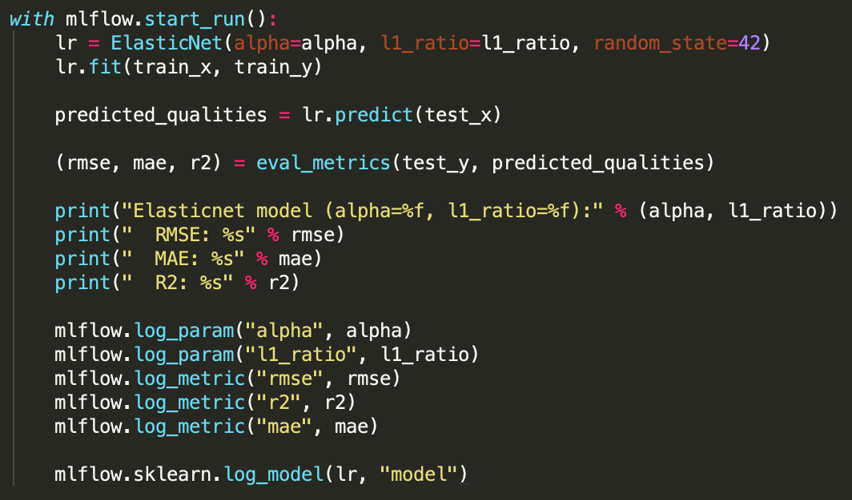
Summary
Your ML Projects
Enjoy managing your mlprojects with mlflow
Machine Learning Experiment Management
6/29/20
11

Slide 12
Discussion
Notes:
12

