Slide 1
Machine Learning Pipeline
Optimization
29.05.2020

Slide 2
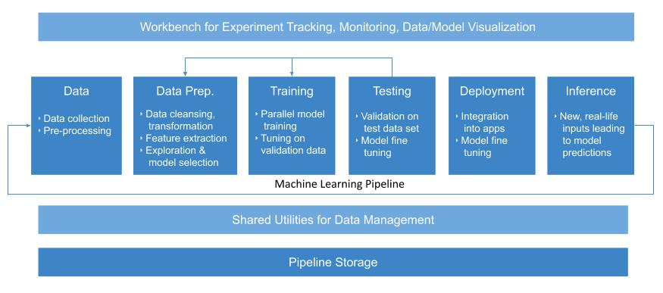
Automatic Machine Learning
Machine learning Pipeline Optimization
5/28/20
2

Slide 3
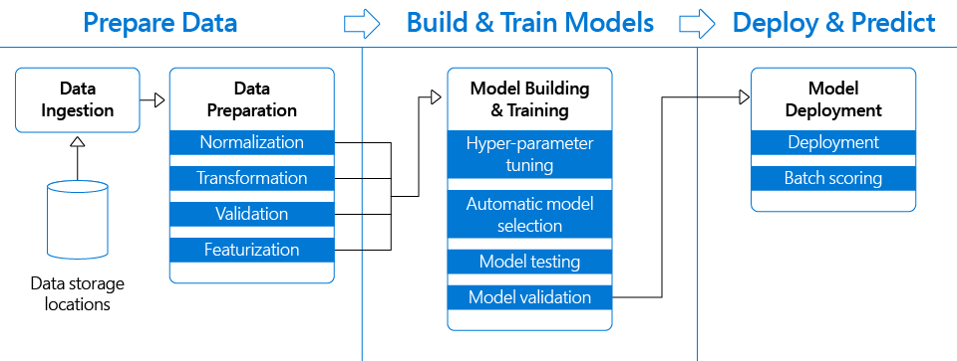
Machine Learning Pipeline Optimization
Machine learning Pipeline Optimization
5/28/20
3

Slide 4
A Self-Optimized Approach
- Data preprocessing - Machine learning algorithms - Hyper-parameter tuning
Trade-off solutions ?
Machine Learning Pipeline Optimization
5/28/20
4

Slide 5
A Self-Optimized Approach
- Study from historical data
- Study : Applications.
- Using : Machine learning algorithms - Improves the pipeline as human improves knowledge
- People: update knowledge from information
- Machine: discover knowledge from new data
Machine learning Pipeline Optimization
5/28/20
5

Slide 6
Machine Learning Deployment
- Effective execution of the pipeline
+ Input data: small, large, …, big data
+ Computing Resources: unlimited, scalable, etc.
- Scheduling machine learning pipeline
Machine learning Pipeline Optimization
5/29/20
6

Slide 7
Discussion
Notes:
7

