Slide 1
Performance Monitoring
Thanh-Phuong Pham

Slide 2
Motivation

Slide 3
Applications & Systems
“Where does our data come from?”

Slide 4
Prometheus
Monitoring system
More than a time series database
Supporting the collection of application and system data
Open Source

Slide 5
Major Components
Exporter
Pushgateway
Client libraries
- Go, Java, Python, and Ruby.
- Third-party for C#/.Net, Node.js, Haskell, Erlang and Rust
More …

Slide 6
Operation
Push
Pull
Prometheus

Slide 7
Exporter
Exporter
collect
Prometheus
get
target

Slide 8
Pushgateway
Pushgateway
collect
Prometheus
send
target

Slide 9
Instrumentation
Client libraries: Java, Go, Python, Ruby.
Third-party libraries: C#/.Net, Node.js, Erlange, etc

Slide 10
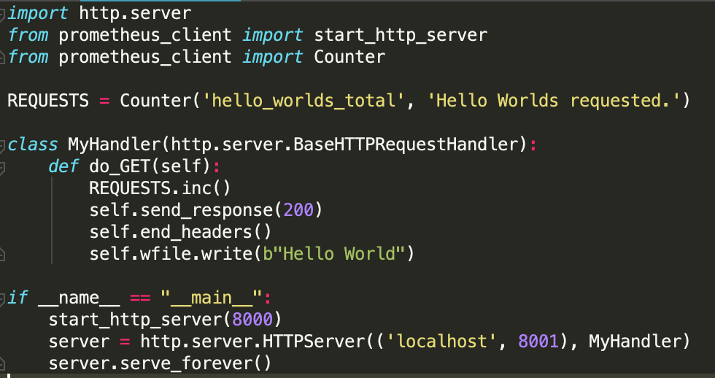
Python

Slide 11
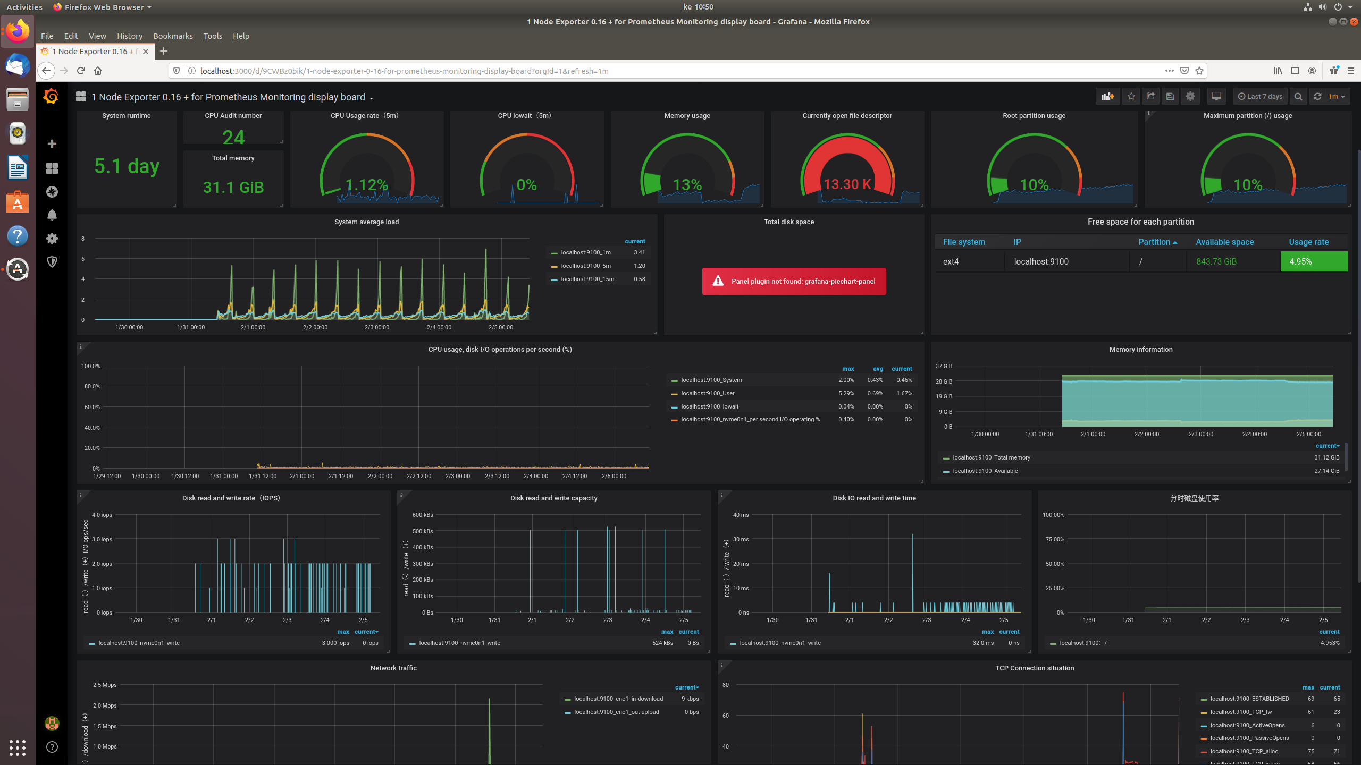
Visualization

Slide 12
Your Project
Enjoy monitoring your applications

