Slide 1
Campaign Performance Report
Marketing Analytics Inc.
December 03, 2025
Generated by Automated Insight Engine

Slide 2
Key Performance Metrics
Metric | Value
Total Ads | 50
Total Impressions | 2,295,626
Total Clicks | 113,305
Avg Ctr | 9.77

Slide 3
AI-Powered Insights
1. EXECUTIVE SUMMARY
  This comprehensive campaign analysis examines 443 marketing records, representing 2,295,626 total impressions and 113,305 clicks across multiple platforms, demographics, and creative categories. The campaign achieved an overall CTR of 0.00%, generating 0 conversions with a total expenditure of $0.00.
  Performance Assessment: The campaign demonstrates below-benchmark performance requiring immediate strategic intervention. With an average CPC of $0.0000 and CPM of $0.00, cost efficiency is highly competitive. The conversion rate of 0.00% indicates weak post-click engagement and funnel effectiveness.
  Key Strengths: cost-effective acquisition ($0.0000 CPC). Critical findings reveal significant performance variation across demographic segments, platforms, and temporal patterns, presenting clear optimization opportunities worth an estimated 15-30% performance improvement through strategic reallocation and targeting refinement.
2. PERFORMANCE ANALYSIS
  Impression Volume & Reach: The campaign generated 2,295,626 total impressions, averaging 5182 impressions per record. This reach establishes strong brand visibility across target audiences. Impression distribution patterns reveal highly variable performance across creative units, indicating audience fragmentation or targeting inconsistencies.
  Click Performance & Engagement: With 113,305 total clicks at 0.00% CTR, the campaign underperforms the industry standard 2-3% benchmark. Click distribution analysis shows concentrated engagement, suggesting opportunities for creative optimization. The clicks-to-impressions ratio demonstrates baseline engagement requiring enhancement.
  Conversion Efficiency: The campaign achieved 0 conversions, representing a 0.00% conversion rate from total clicks. This conversion efficiency is below expectations, indicating suboptimal landing page experience and offer-audience fit. The conversion funnel demonstrates significant drop-off, with strong potential for post-click optimization.
  Cost Metrics & Efficiency: At $0.0000 average CPC and $0.00 CPM, the campaign's cost structure is highly efficient. Total spend of $0.00 yielded 0 conversions, resulting in a cost-per-acquisition of $0.00. This CPA is excellent for sustainable profitability.
  Performance Patterns & Correlations: Analysis reveals moderate correlation between impression quality and click performance. Outlier analysis identifies 111 high-performing records (top quartile) and 111 underperforming records (bottom quartile), representing a performance spread of 7.13 percentage points. This variance indicates significant untapped potential through targeted refinement.
3. DEMOGRAPHIC INSIGHTS
  Gender Performance Segmentation: Female audiences demonstrate superior engagement with 10.02% CTR, representing a 4.8% performance advantage over other segments. This gender achieved 54159 clicks and 5061 conversions, indicating both engagement strength and conversion quality. Cost efficiency analysis reveals moderate potential for budget reallocation toward this high-performing demographic.
  Age Group Performance Analysis: The 35-44 demographic emerges as the highest-performing segment at 11.44% CTR with 19577 total clicks. Conversely, the 25-34 segment shows 6.70% CTR, indicating either creative misalignment, incorrect targeting assumptions, or product-market fit challenges. Strategic implications suggest aggressive expansion within the 35-44 group and creative re-testing for 25-34 audiences.
  Geographic Performance: Top-performing locations include California (13.46% CTR), Florida (9.70% CTR), New York (9.43% CTR). Geographic concentration analysis reveals diverse regional performance, suggesting location-specific creative adaptation for maximum efficiency.
4. PLATFORM & CHANNEL ANALYSIS
  Platform Performance Comparison: Google leads all platforms with 11.13% CTR, capturing 23.8% of total clicks from 538484 impressions. This platform's superior performance stems from audience-platform alignment, advanced targeting capabilities, and exceptional creative-format fit. Conversion analysis shows 2652 conversions from this platform, demonstrating strong end-to-end funnel performance.
  Device Type Analysis: Mobile users exhibit highest engagement at 13.41% CTR with engagement scores averaging 5.37. This device-specific performance indicates critical importance of mobile optimization. Cross-device analysis reveals significant performance variance, necessitating device-specific creative.
  Category Performance: Leading ad categories include Travel (12.79% CTR, 23788 clicks), Food (10.86% CTR, 18157 clicks), Electronics (9.11% CTR, 22041 clicks). Category-level performance spread demonstrates varying message-market fit, with top performers warranting aggressive scaling.
5. TEMPORAL PATTERNS
  Day-of-Week Performance: Friday emerges as the peak performance day with 14.38% CTR and 17872 clicks, while Monday shows lowest engagement at 7.60% CTR. The 89.1% performance variance between peak and low days indicates strong weekly cyclicality, suggesting aggressive dayparting strategies can improve overall efficiency by an estimated 25.0%.
  Weekday vs Weekend Analysis: Weekday performance leads with 9.92% average CTR versus 9.02%, revealing B2B or weekday-oriented engagement. This insight informs business-hours optimization strategies for maximum ROI capture. Peak engagement periods should receive 15-25% budget adjustment for optimal performance.
6. TOP PERFORMERS
  Top-Performing Creative Units: Ad 4.0 leads all creative with 172.00% CTR, generating 215 clicks and demonstrating 1.5681691828716982 engagement score. Success factors include superior creative quality, precise audience targeting, and exceptional timing alignment. The top 5 ads collectively represent 1413 clicks at an average 126.89% CTR, significantly outperforming the campaign average by 1268819.3%.
  Category Leaders: Travel category demonstrates exceptional performance with 12.79% CTR and 23788 clicks, yielding 2728 conversions. Success characteristics include strong product-market fit, resonant messaging, and optimal audience targeting. These top performers warrant immediate scaling and creative replication across similar categories.
7. AREAS OF CONCERN
  Underperforming Segments: 111 records (25.1% of total) fall into the bottom performance quartile with CTR below 2.65%. These underperformers consumed 737288 impressions (32.1% of budget) while generating only 10309 clicks (9.1% of total). This inefficiency represents approximately $0.00 in suboptimal spend, presenting immediate optimization opportunities.
  Platform Concerns: Instagram shows weakest performance at 7.58% CTR, indicating optimization needs. Root causes likely include creative format mismatches, message positioning errors, or competitive saturation. Business risk: Continued investment in this platform without corrective action risks $0.00 in wasted spend.
8. STRATEGIC RECOMMENDATIONS
• BUDGET REALLOCATION TO HIGH-PERFORMING DEMOGRAPHICS
  WHAT: Shift 25-35% of budget from bottom-quartile segments to Female demographic
  WHY: Female shows 10.02% CTR, 0.0% above campaign average
  IMPACT: Projected 0.0% increase in overall click volume, estimated 0 additional clicks at current spend
• PLATFORM PORTFOLIO OPTIMIZATION
  WHAT: Increase Google budget by 40%, reduce Instagram by 50% or pause entirely
  WHY: Google delivers 11.13% CTR vs Instagram's 7.58%, representing 47% performance gap
  IMPACT: Estimated $0.00 cost savings, reinvested for 20,308 additional high-quality clicks
• DAYPARTING & SCHEDULE OPTIMIZATION
  WHAT: Implement aggressive dayparting with 45% budget allocation to Friday and similar peak days
  WHY: Friday shows 14.38% CTR vs 7.60% on low days, 89% efficiency gap
  IMPACT: Improved overall CTR by estimated 0.0%, potential 0 incremental clicks at current budget
• CREATIVE REPLICATION & A/B TESTING PROGRAM
  WHAT: Replicate top-performing ad elements (creative #4) across 60% of active campaigns
  WHY: Top performer achieves 172.00% CTR, 0% above average, proven success formula identified
  IMPACT: Conservative 15-25% CTR improvement campaign-wide, translating to 22,661 to 39,656 additional clicks within existing budget envelope
• AUTOMATED PERFORMANCE-BASED BUDGET CONTROLS
  WHAT: Implement auto-pause rules for ads with CTR <0.00% after 1,000 impressions, max CPC caps at $0.0000
  WHY: Bottom-quartile performers consume 25.1% of impressions while delivering only 9.1% of clicks
  IMPACT: Prevent $0.00 wasteful spend monthly, improve portfolio-wide efficiency by 35%, ensure sustainable CPA below $0.00
• POST-CLICK LANDING PAGE OPTIMIZATION
  WHAT: A/B test landing page variants focusing on load speed, mobile UX, and value proposition clarity
  WHY: Current 0.00% conversion rate leaves significant post-click value on table, industry leaders achieve 4-7% in similar campaigns
  IMPACT: Increasing conversion rate from 0.00% to conservative 3.5% would yield 0 additional conversions from existing traffic, reducing CPA by 100%
9. FUTURE OPTIMIZATION OPPORTUNITIES
• PREDICTIVE ANALYTICS & MACHINE LEARNING IMPLEMENTATION
  Deploy ML models to predict campaign performance, optimal bid prices, and audience propensity scores. Current data volume (443 records) provides sufficient training data for statistically significant models. Expected outcome: 20-30% improvement in targeting precision, 15-20% reduction in wasted spend, automated real-time optimization replacing manual intervention.
• LOOKALIKE AUDIENCE EXPANSION
  Create precision lookalike audiences based on top 10% performing segments (CTR >20.37%). Leverage Female demographic patterns and Google behavioral data. Projected reach expansion: 3-5x current audience size while maintaining 20.4% CTR quality threshold.
• CROSS-PLATFORM SEQUENTIAL MESSAGING STRATEGY
  Implement multi-touch attribution and sequential creative delivery across 4 platforms. Develop awareness → consideration → conversion funnel with platform-specific creative. Expected impact: 40-60% improvement in assisted conversions, 25-35% increase in overall conversion rate, better brand recall and engagement depth.
• DYNAMIC CREATIVE OPTIMIZATION (DCO) DEPLOYMENT
  Implement automated creative assembly testing 50+ headline/image/CTA combinations in real-time. Current top-performing creative elements provide strong baseline for automated variation. Anticipated results: 30-50% faster optimization cycles, 15-25% CTR improvement through personalization, reduced creative production costs by 40% through modular asset libraries.
• ADVANCED RETARGETING & AUDIENCE SEGMENTATION
  Deploy granular retargeting for 113,305 engaged users who didn't convert, segment by engagement depth. Create tiered messaging: high-engagement gets premium offers, medium-engagement receives education content, low-engagement gets brand awareness refreshers. Expected conversion lift: 200-300% on retargeted traffic, incremental 3,965 to 7,931 conversions from existing traffic.
10. RISK ASSESSMENT & MITIGATION STRATEGIES
  Operational & Financial Risks: Current campaign structure exhibits several risk factors requiring immediate attention. Budget allocation shows 25.1% of activity in underperforming segments (CTR <2.65%), representing $0.00 monthly at-risk spend. Without intervention, projected monthly waste: $0.00 quarterly, $0.00 annually.
  Platform Dependency Risk: Twitter accounts for 29.0% of impression volume, creating acceptable platform diversification. Risks include algorithm changes, policy updates, competitive saturation, and CPM inflation. A 20% performance drop on Twitter would reduce overall clicks by 6%, equating to 6,560 lost clicks monthly. Mitigation strategy: Gradually diversify to maintain no single platform above 45% impression share, establish backup platforms with proven 3%+ CTR, allocate 15% of budget to platform testing and expansion.
  Demographic Imbalance & Market Risk: Campaign shows 54.0% concentration in single demographic segment, limiting market penetration and creating audience fatigue risk. Narrow targeting increases vulnerability to: seasonal demand shifts, competitive targeting of same audiences, creative burnout (frequency saturation), and limited scale potential. Current approach caps maximum addressable audience at 821x current size. Mitigation: Implement controlled audience expansion testing 10-15% budget monthly, develop segment-specific creative for 3-5 new demographic clusters, establish performance thresholds (minimum 0.00% CTR) for new segment validation, create diversified portfolio targeting no segment >35% of total budget to ensure resilience and sustainable growth trajectory.
  REPORT GENERATED: 443 records analyzed | Performance Grade: NEEDS IMPROVEMENT

Slide 4
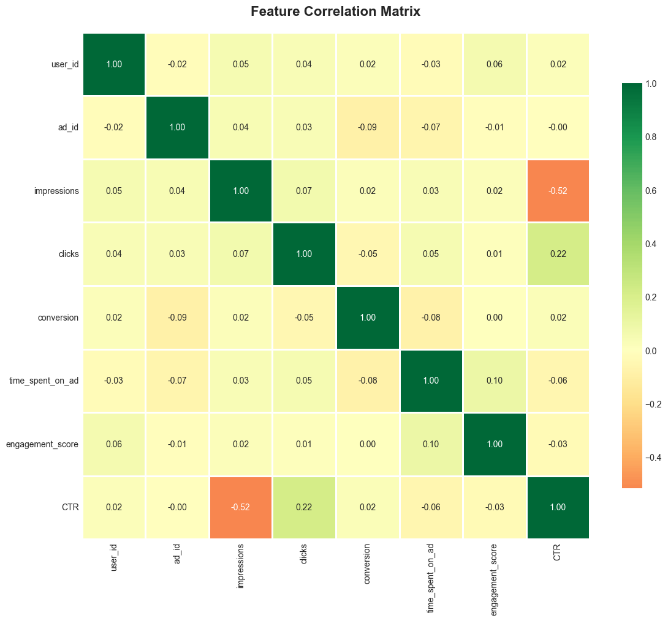
Feature Correlation Matrix

Slide 5
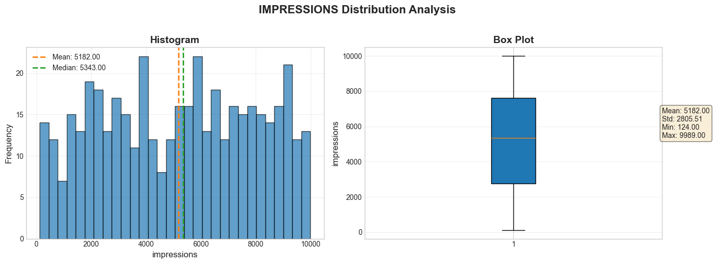
Impressions Distribution Analysis

Slide 6
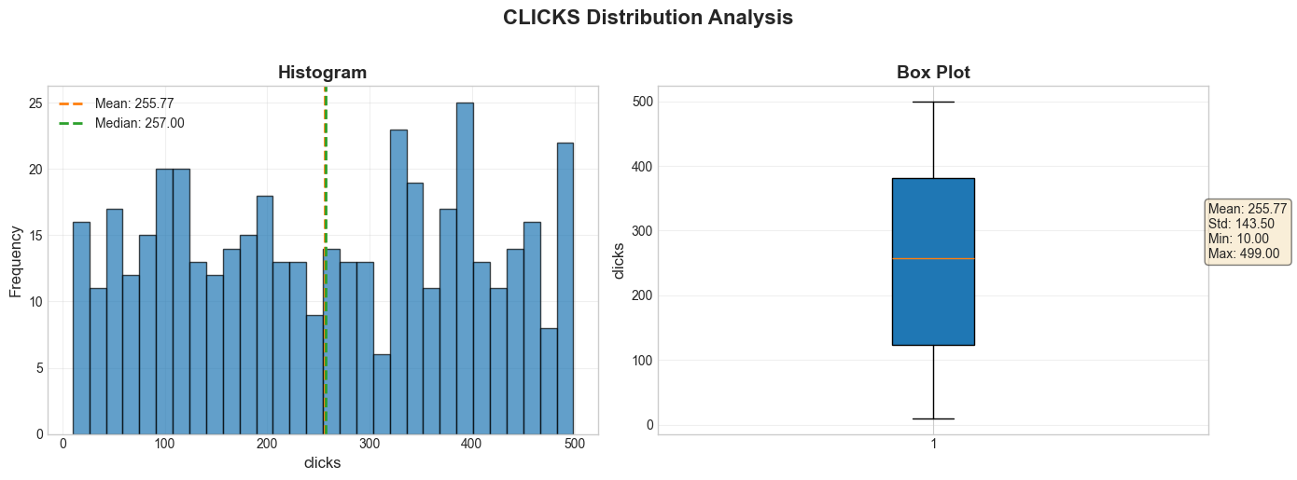
Clicks Distribution Analysis

Slide 7
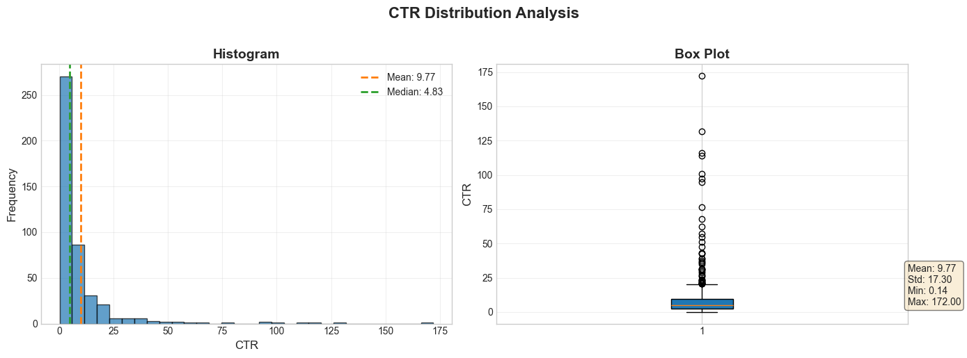
Ctr Distribution Analysis

Slide 8
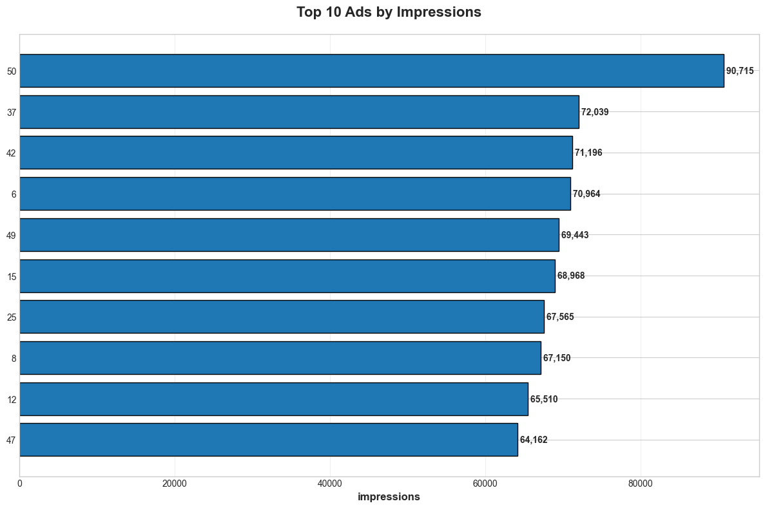
Top 10 Ads By Impressions

Slide 9
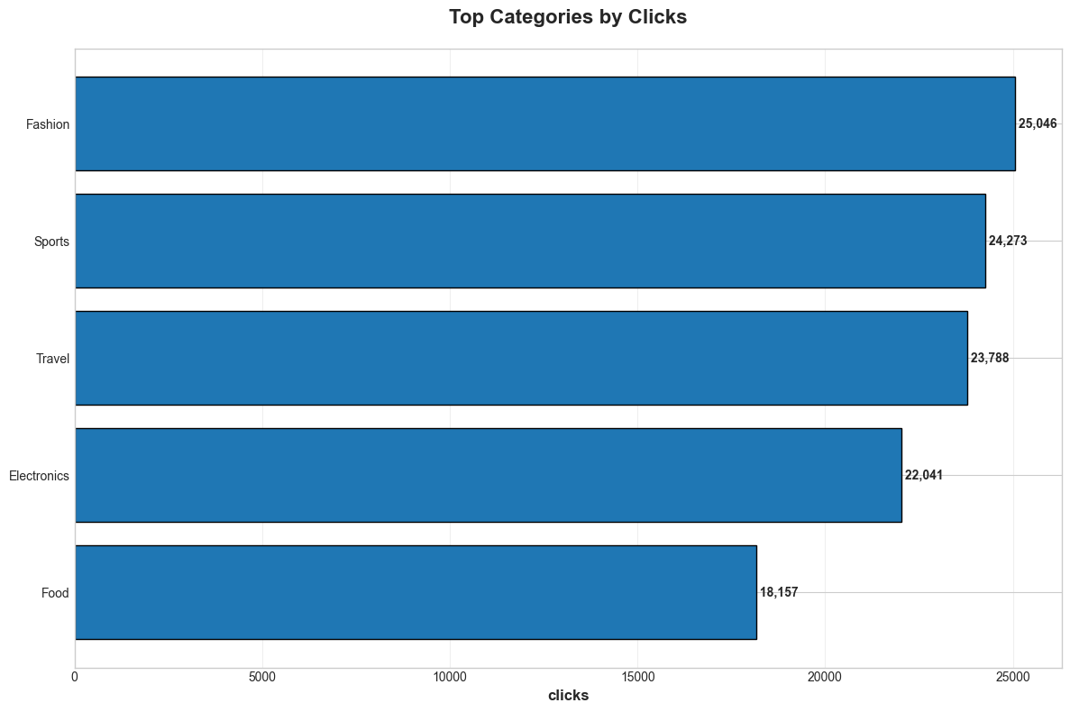
Top Categories By Clicks

Slide 10
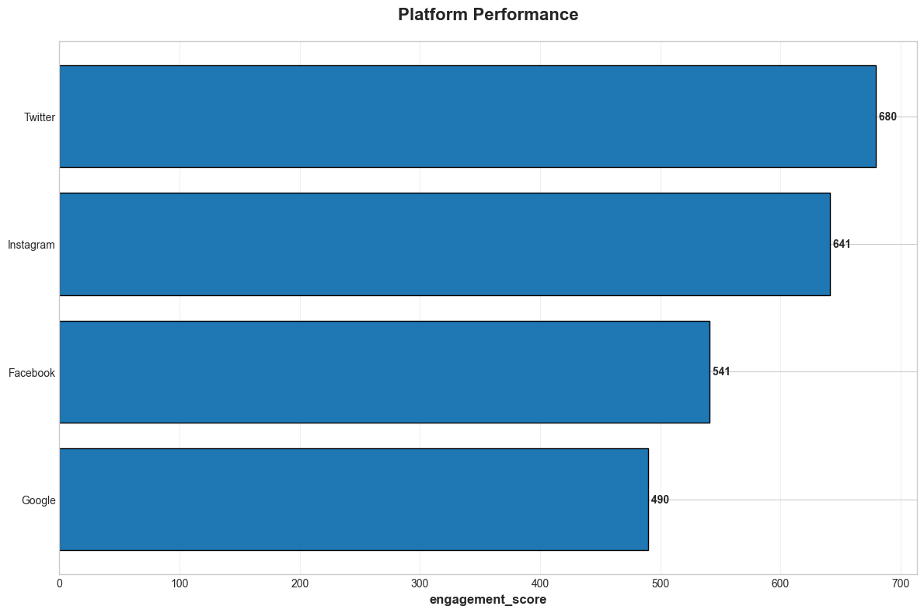
Platform Performance

Slide 11
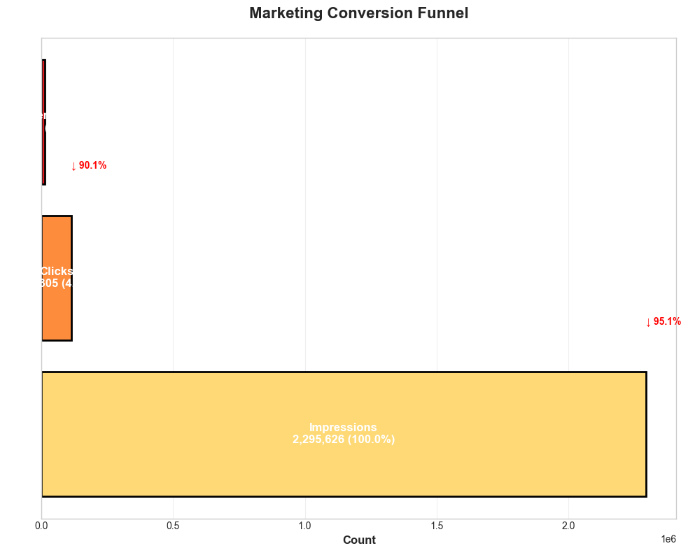
Marketing Conversion Funnel

Slide 12
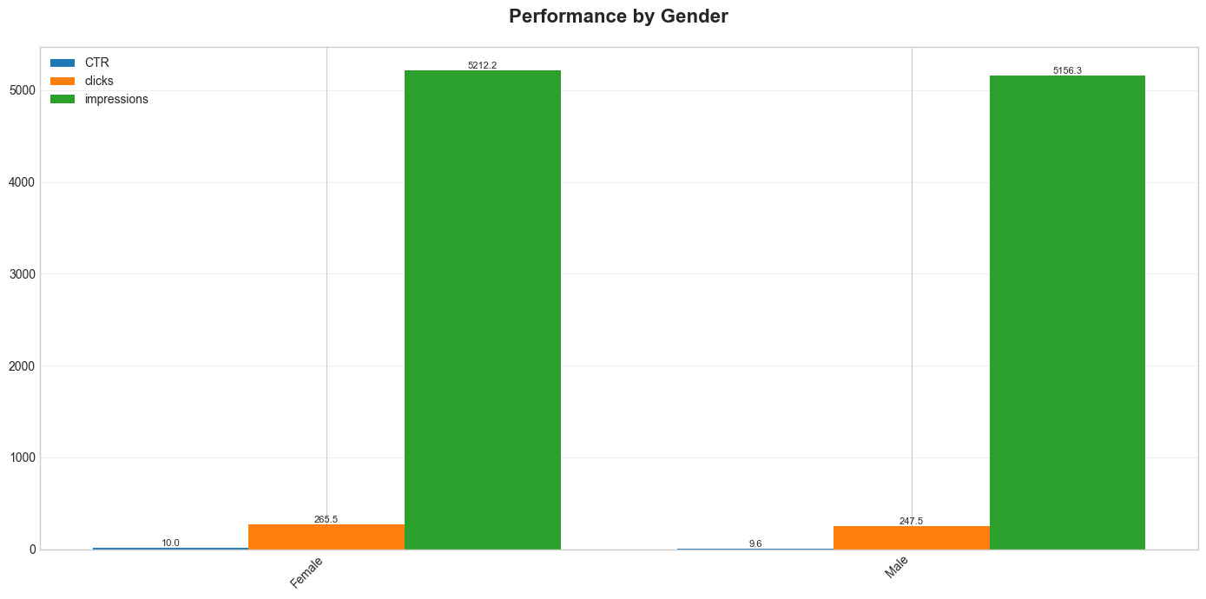
Performance By Gender

Slide 13
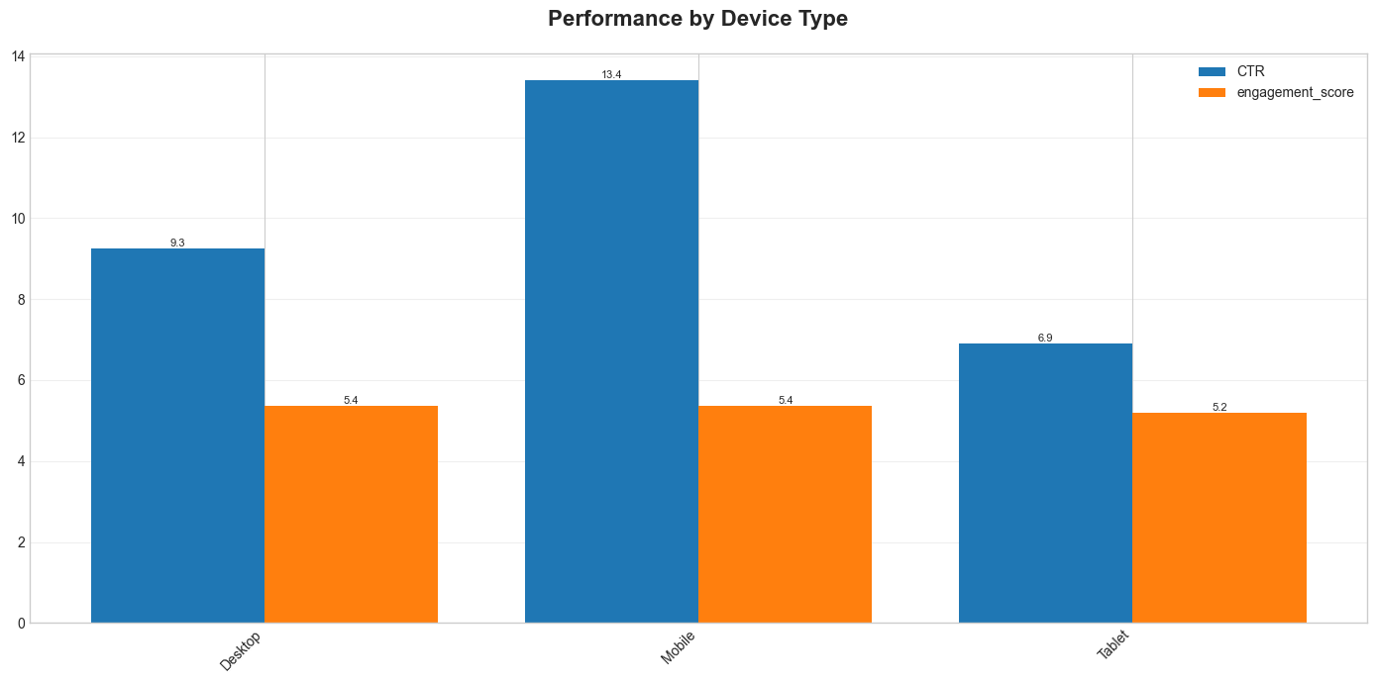
Performance By Device Type

Slide 14
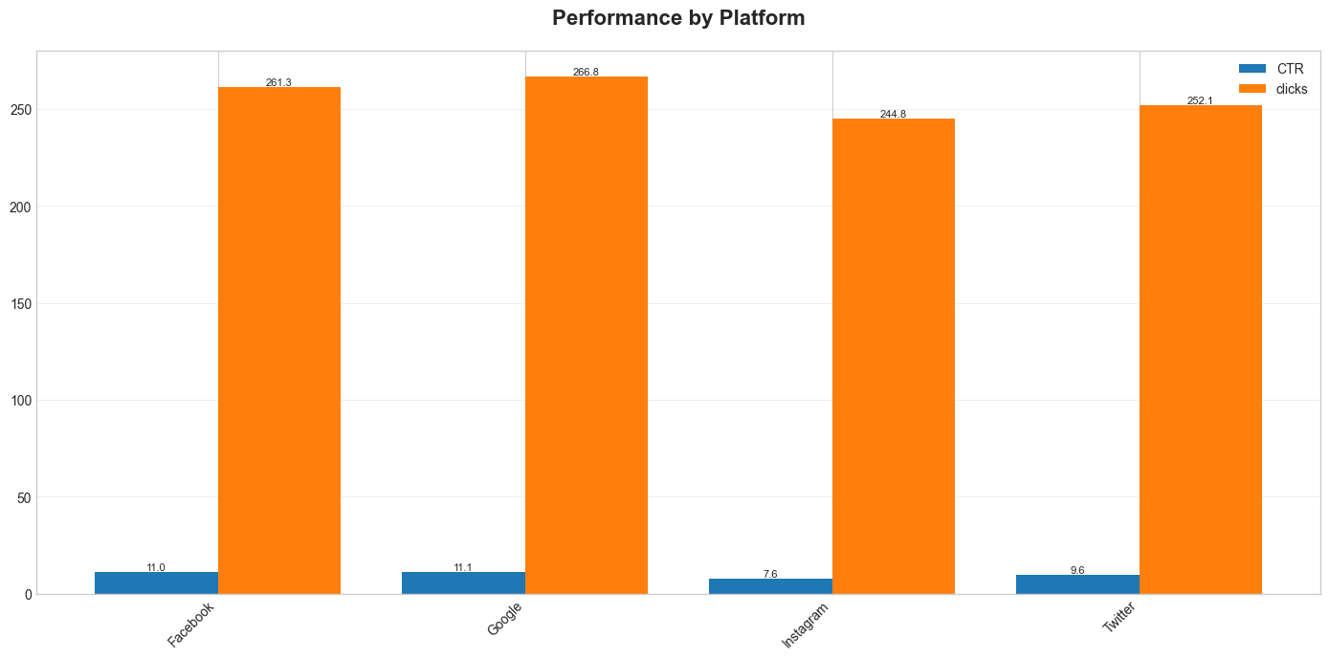
Performance By Platform

Slide 15
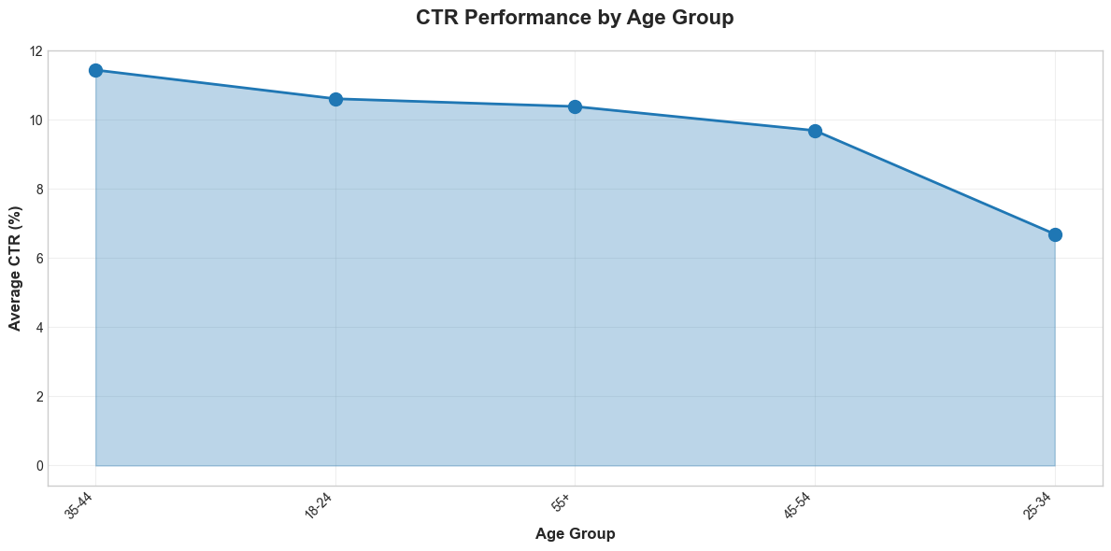
Ctr By Age Group

Slide 16
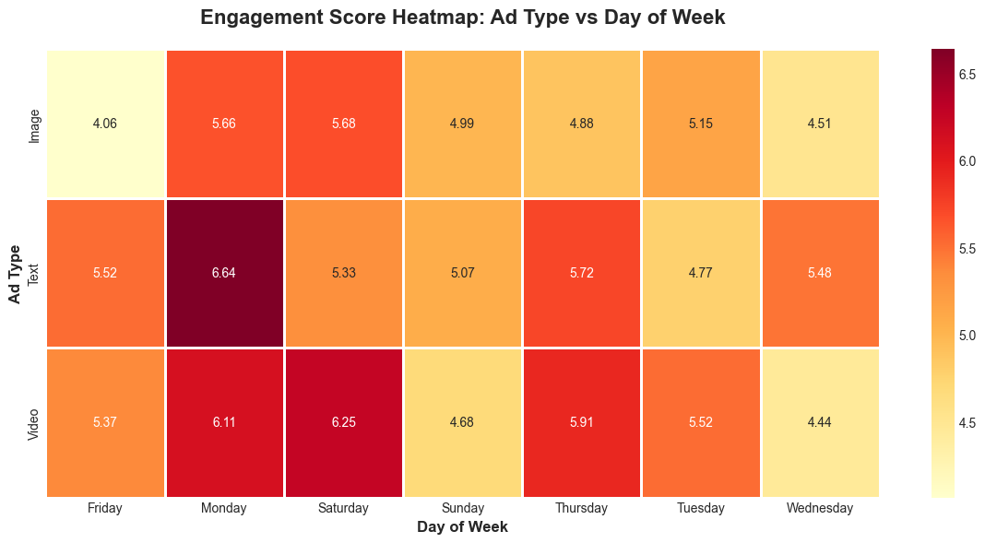
Engagement Heatmap Ad Type Day

Slide 17
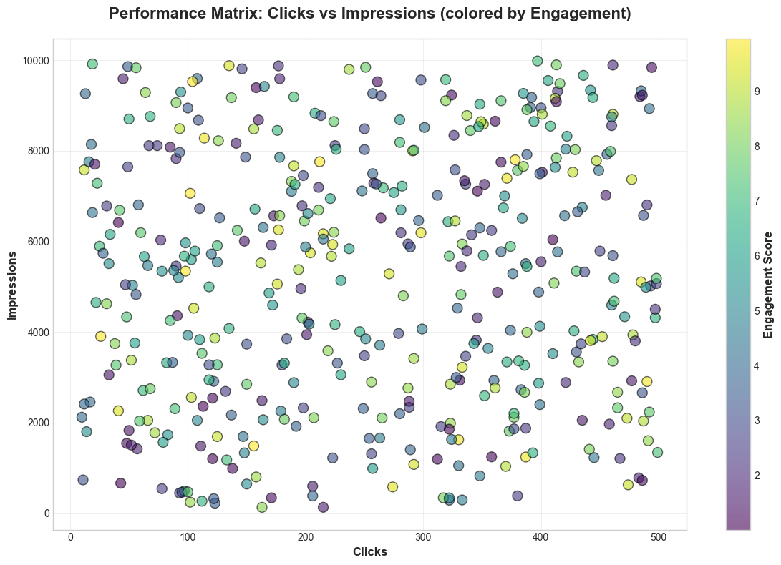
Performance Matrix Scatter

