Slide 1
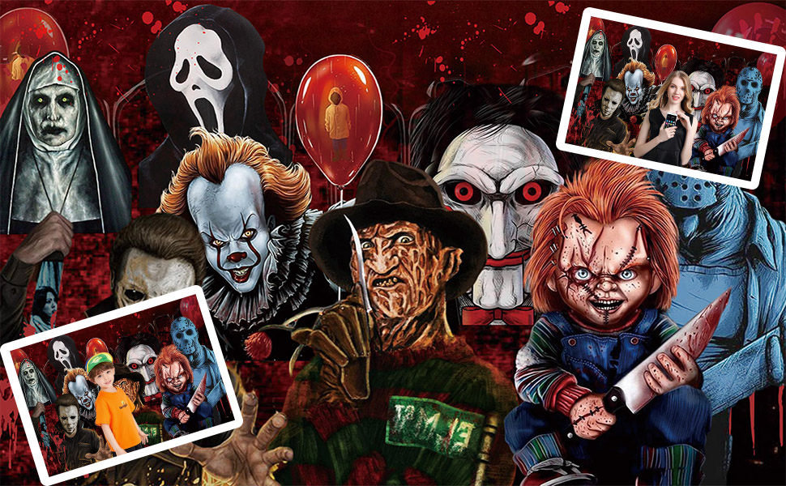
Horror Movies
Genre research

Slide 2

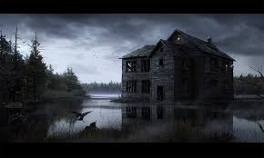
Horror
The horror gene aimed at either scaring the audience, and making them feel afraid, frightened and startling the viewer. The plot usually consists of either some sort of supernatural/unexplained force coming into our world, like ghosts, zombies, monsters and creatures. Sometimes fantasy sometimes overlaps into horror, but only in certain elements. Also normally blood and gore are evolved in many ways.

Slide 3
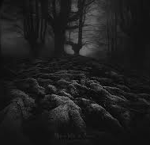
Location
Horror locations often take place in isolated dark/spooky areas, like graveyards, old houses, forests,castles. The locations are normally filmed in the dark or in very low lighting, and most locations will be some sort of place that would frighten you, or you would stay away from.

Slide 4
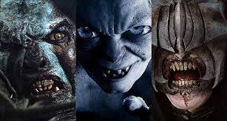
Characters
Normally in most horror films involve one or more evil enemy character, and one main protagonist that is either stalked, or a group of victims that slowly get picked off one by one until one survivor either gets away, or defeats the evil.

Slide 5

Filming style
In horror films cameras are normally focused on allot of close ups of the victims faces, lots of slow moments to build suspense then fast editing when the action is happening. Tracking shots and location shots to set the tone and atmosphere.

Slide 6
Sound
The none diegetics sound in horror films is normally very quiet and atmospheric to start off with, and then slowly builds up the suspense and then really gets loud and tense in chase scenes or encounters with the villain.
Diegetic sound is normally screams, breathing and other sound effects associated with the main character.

Slide 7
Data statistics description
id | popularity | vote_count | vote_average | budget | runtime | collection
count | 32540.0 | 32540.0 | 32540.0 | 32540.0 | 32540.0 | 32540.0 | 2306.0
mean | 445911.0 | 4.0 | 63.0 | 3.0 | 1349747.0 | 62.0 | 481535.0
std | 305745.0 | 38.0 | 421.0 | 3.0 | 14430479.0 | 41.0 | 324498.0
min | 17.0 | 0.0 | 0.0 | 0.0 | 0.0 | 0.0 | 656.0
25% | 146495.0 | 1.0 | 0.0 | 0.0 | 0.0 | 14.0 | 155421.0
50% | 426521.0 | 1.0 | 2.0 | 4.0 | 0.0 | 80.0 | 471259.0
75% | 707534.0 | 2.0 | 11.0 | 6.0 | 0.0 | 91.0 | 759067.0
max | 1033095.0 | 5089.0 | 16900.0 | 10.0 | 701842551.0 | 683.0 | 1033032.0

Slide 8
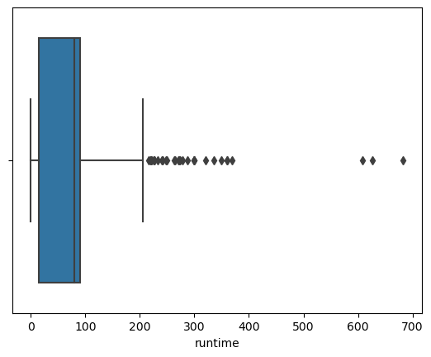
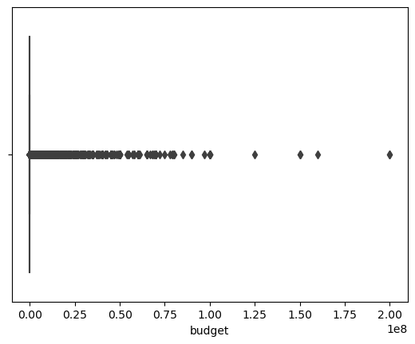
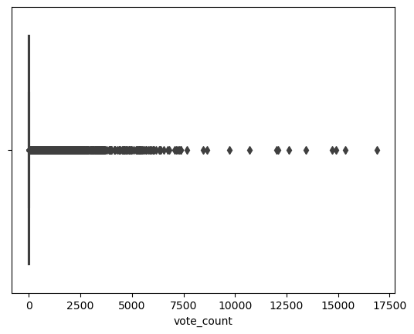
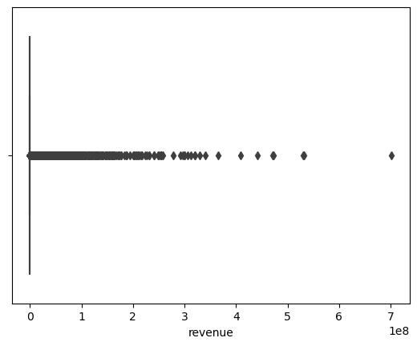
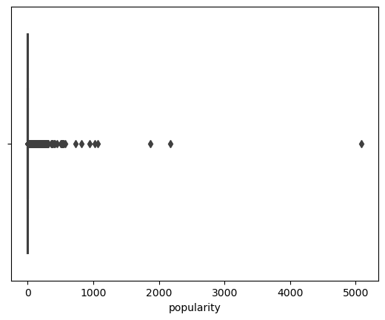
Outliers in the data

Slide 9

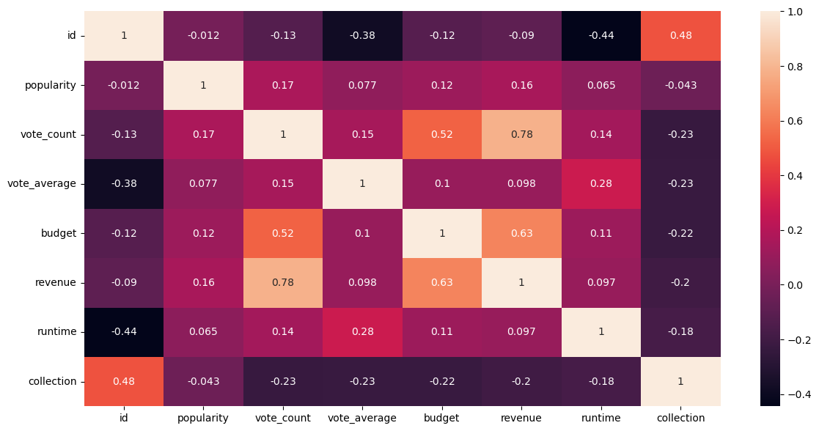
Data correlation

Slide 10
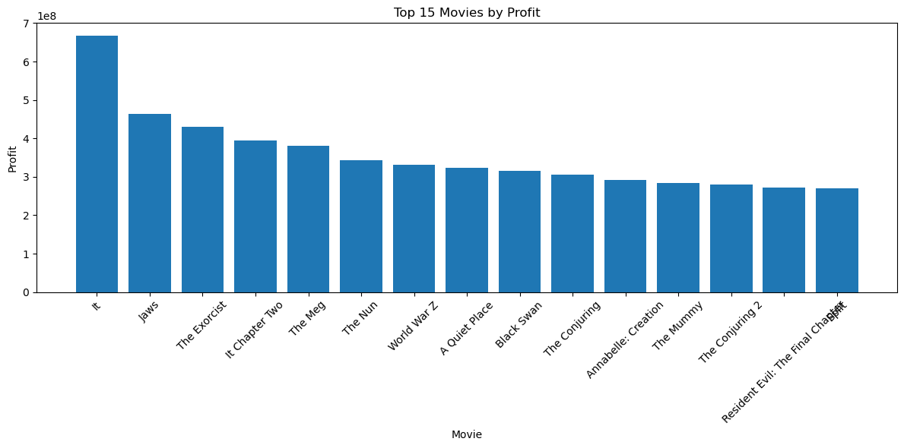
Profit for best 15 movies

Slide 11
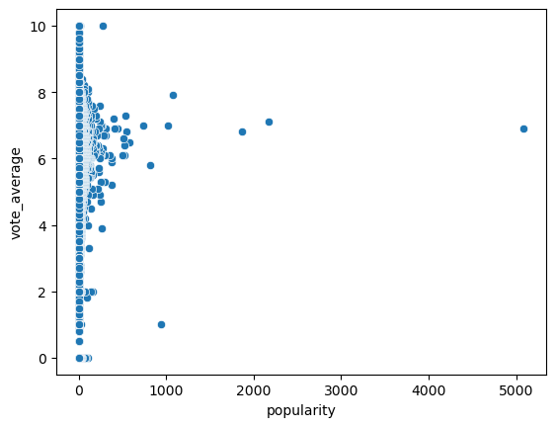
Popularity vs. Vote Average

Slide 12
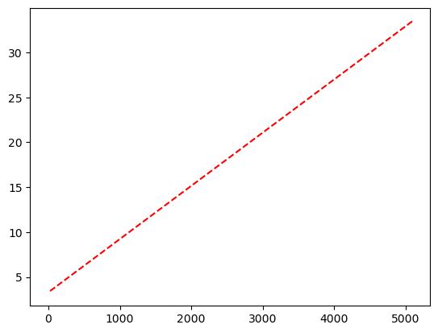
Correlations between popularity and vote average

Slide 13
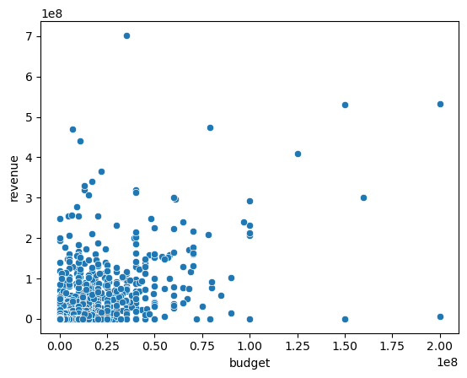
Budget vs Revenue

Slide 14
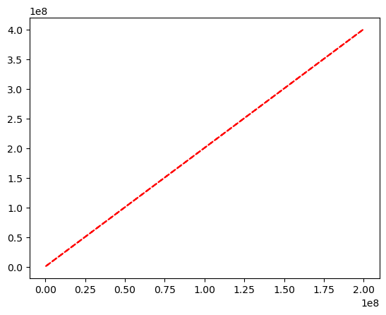
Correlations between budget and revenue

Slide 15
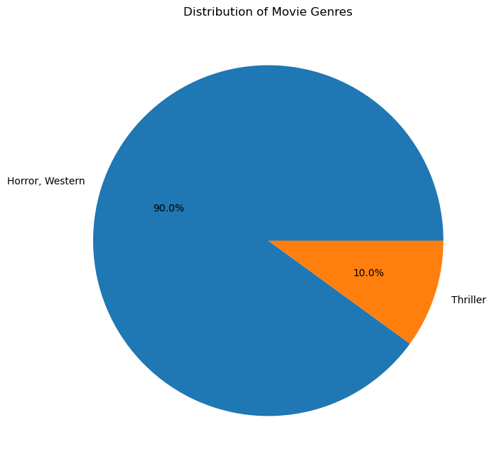
A pie chart to show the distribution of movie genres in the dataset.

Slide 16


Conclusion
The dataset provided in "horror.csv" offers a collection of horror movies released between 2022 and 2023. It encompasses various aspects of these films, including their titles, original languages, overviews, taglines, release dates, poster paths, popularity, vote counts, vote averages, budgets, revenues, runtimes, statuses, genres, collections, and financial performance.
The dataset showcases a diverse range of horror subgenres, such as psychological thrillers, supernatural horrors, and mystery-driven narratives. Each movie presents a unique storyline that captivates audiences with its suspense, terror, and chilling atmosphere. The taglines and overviews provide a glimpse into the themes and premises of the movies, setting the tone for the eerie experiences that await viewers.
Furthermore, the dataset includes information about the popularity and financial success of the movies, as indicated by their popularity scores, vote counts, revenues, and profits. This allows for an analysis of the commercial performance of the films and their reception among audiences.
Overall, "horror.csv" provides a comprehensive overview of the horror movies released during the specified timeframe, shedding light on the creative and commercial aspects of the genre. It serves as a valuable resource for movie enthusiasts, researchers, and industry professionals interested in exploring the world of horror cinema.

Slide 17

THE END

