Slide 1

Airbnb New User Bookings
Where will Airbnb new users’ first destination be?

Slide 2
The problem
Company
Context
Problem statement
Airbnb, Inc. is an online marketplace for arranging or offering lodging, primarily homestays, or tourism experiences.
By accurately predicting where a new user will book their first travel experience, Airbnb can share more personalized content with their community, decrease the average time to first booking, and better forecast demand.
Predict in which country will a new user make his or her first booking.

Slide 3

Data Analysis Pipeline

Slide 4
Visualize the data to see trends and relations and develop hypotheses.
Select the features that will be used for training a predictive model.
Data Visualization
Data Cleaning
Feature Extraction
Model Building and Testing
Transform the data into a usable format.
Build and test different predictive models on the available dataset.

Slide 5
Data Visualizations
Extracting useful information from the available datasets. This Information can then be used to select features and build hypotheses.

Slide 6
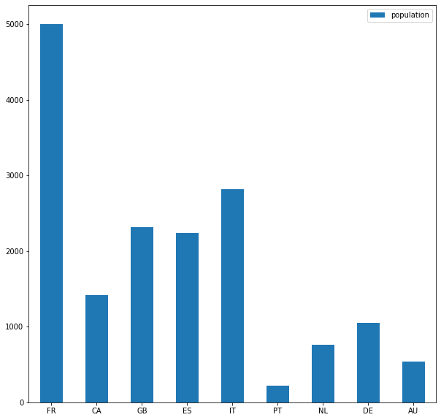
Where is the First Destination of Airbnb Users?
Most users have not made their first Airbnb reservation yet.
Of the users who made reservations, US was by far the most prevalent destination followed by “other”
Of the 9 remaining countries, France was the most common destination followed by Italy and Great Britain.

Slide 7
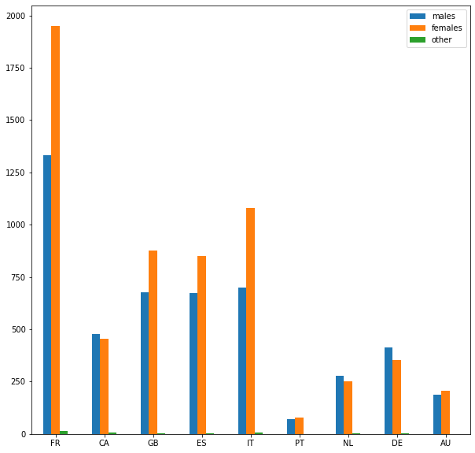
Where is the First Destination of Airbnb Users?
Female users outnumber other users in every first country destination category except for:
Canada, Netherlands, and Germany
This may be due fact that females users outnumber other users.

Slide 8
Useful Information from the Sessions Data
On average, users with Italy as the first country of destination spend most time performing cancellations and reviewing cancellation policies.
On average, users with France as the first country of destination spend most time performing changes to their reservations.
On average, users with Canada as the first country of destination spend most time performing changes to their passwords.
On average, users with Australia as the first country of destination spend most time adding friends.
On average, users with Portugal as the first country of destination spend most time viewing photos.

Slide 9
Feature Extraction
Added the recorded session times for each activity per user to the training and testing data.

Slide 10
Model
XGboost
0.883 Private Score and 0.8786 Public Score on Kaggle

Slide 11
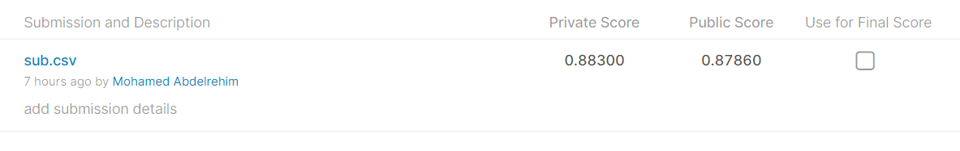
XGboost
Belongs to the class of tree classifiers.
Performs well on tabular data.
Relies on boosting:
Ensemble of weak learners that collectively perform well
Each learner learns to perform better than the one before it.
Uses gradient descent for minimizing the errors during boosting.

Slide 12
Thank You!
Mohamed Abdelrehim
m.abdelrehim97@mail.com

