Slide 1
INTERACTIVE WEB-BASED THEREMIN

Slide 2
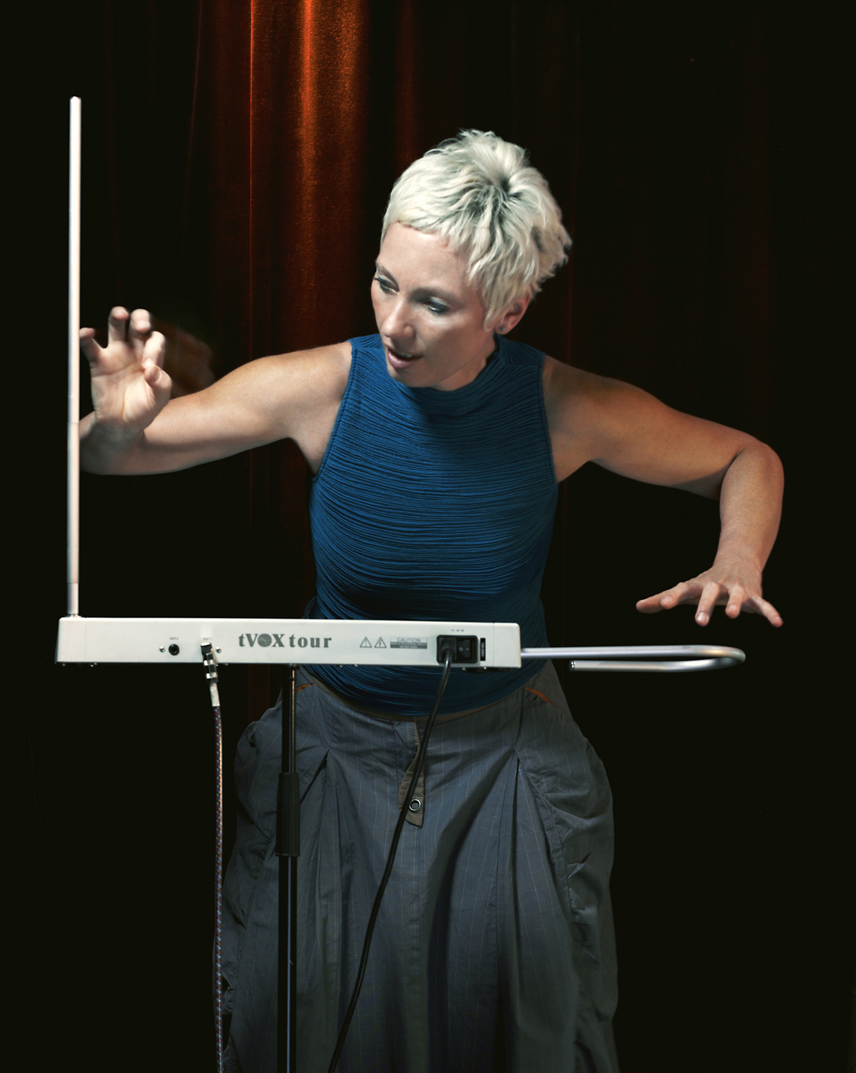
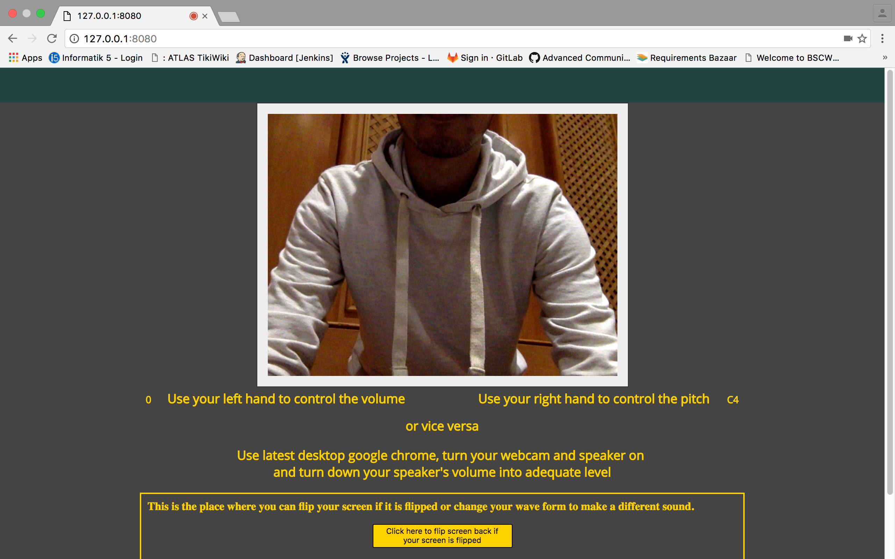
What Is Theremin ?
Our approach..
Web based, using..
Blob detection (Computer Vision)
Web Audio API HTML 5
Barbara Buchholz (1959–2012)
“One hand controls frequency, one hand controls amplitude”

Slide 3
Demo

