Slide 1

Mudjik
Tagline here

Slide 2
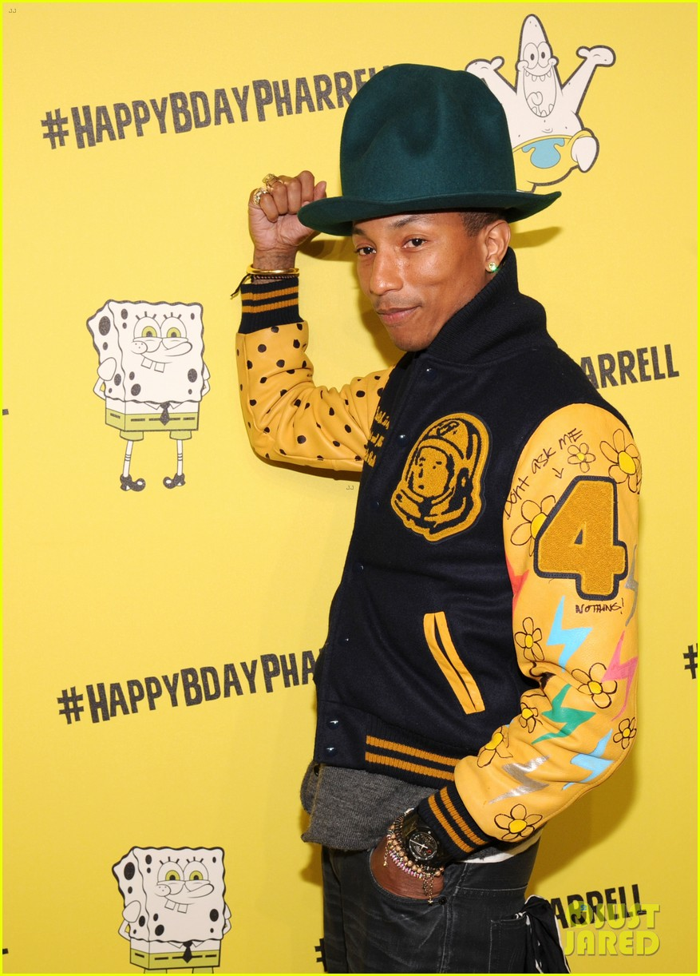
Purpose ?
FYI
ork
1000 x 1000 = 1.000.000
Some say..
“A picture is worth a thousand words”
How does it work ?
Others say..
“A song is worth a thousand words”
We say..
“A song and a picture are worth a million words”
Recognition
Generate playlist based on the context of the image.
Content means moods or the object.
Both work.
“Happy”
“Man”
Playlist generation
or
Happy song
Song about a man

Slide 3
Demo

