Slide 1
Testing Workflows Demo

Slide 2
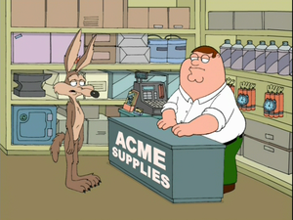
Acme Corporation

Slide 3







Customer
Customer
Sales
Finance
Engineering
Test
Production

Slide 4
Step 1
Customer Submit a production request

Slide 5

Step 2
Sales:
Reviews the request
Verifies the information
Sends to Engineering

Slide 6

Step 3
Engineering: calculates the material needed, costs.
Return to sales.

Slide 7
Step 4
Sales: sends bill to customer to confirm and pay.

Slide 8
Step 5
Customer pays the bill

Slide 9

Step 6
Financial: confirms the payment.

Slide 10

Step 7
Production: uses reports generated by Engineering and produce them.

Slide 11

Step 8
Test: test the production
Send it back to production

Slide 12
Step 9
Production: send to sales

Slide 13
Step 10
Sales: calls the customer telling your product is ready.

Slide 14
Step 11
User receives the product.

Slide 15
Customer
Sales
Engineering
Sales
Customer
Finance
Production
Test
Sales
Customer
Production

Slide 16
Test #1
Customer requests 1 product.
In Step 5, user edits request and change the product count to 10.
He pays 1 but gets 10.

Slide 17
Test #2
Production unit wants to bypass the QC test.
He sends status directly to sales.

Slide 18
Lets’ do it
coyote
coyote
emmet
emmet
roadrunner
roadrunner
panda
panda
baymax
baymax
ralph
ralph
kevin
kevin

