Slide 1
Arabic Handwritten Character Recognition

Slide 2
Introduction: Arabic Handwritten Character Recognition
This project addresses the challenge of Arabic handwritten character recognition (HWR). HWR systems aim to automatically convert handwritten Arabic text into digital format, enabling various applications like document processing, automatic mail sorting, and creating accessible interfaces for people who cannot use a keyboard.

Slide 3
Introduction: Arabic Handwritten Character Recognition
Arabic script presents unique challenges for HWR compared to Latin characters. Here are some key points:
Complex character shapes: Arabic characters can have ligatures (connections between characters) and diacritics (small marks above or below characters) that can affect recognition.
Bidirectionality: Arabic script can be written from right to left, making character segmentation and recognition more complex.
Large number of characters: Arabic has 28 letters, with additional variations depending on the context.
Despite these challenges, advancements in deep learning, particularly Convolutional Neural Networks (CNNs), have led to significant progress in Arabic HWR

Slide 4
Dataset Used: Arabic Characters MNIST
Brief description of the dataset: "The Arabic Characters MNIST dataset consists of handwritten Arabic characters in grayscale images."
Source of the dataset: The dataset was obtained from Kaggle.
Number of classes: 28
Number of samples: Provide the total number of images in the dataset.
Image dimensions: 28x28 pixels
Data preprocessing: Dataset is not in his right Form we have converted it in Structured form from unstructured form

Slide 5
Convolutional Neural Network (CNN) Architecture
Number of layers:
Convolutional Layers = 3
Max Pooling Layers = 3
Dropout Layers = 4
Dense Layers = 3
Flatten Layer = 1

Slide 6
Description of each layer
Convolutional Layers: Three convolutional layers are used, each with:
Number of Filters: The first layer has 16 filters, the second layer has 32 filters, and the third layer has 64 filters. Filters are learnable kernels that extract features from the input image.
Kernel Size: All convolutional layers use a kernel size of (3, 3). This means they look at a 3x3 window of pixels in the input image to extract features.
Activation Function: All convolutional layers use ReLU (Rectified Linear Unit) activation for introducing non-linearity.
Pooling Layers: Max pooling layers are used after each convolutional layer with a pool size of (2, 2). This reduces the dimensionality of the data by taking the maximum value from a 2x2 window.

Slide 7
Description of each layer
Dropout Layers:
Dropout layers are included after each convolutional layer and some dense layers with a rate of 0.2. Dropout helps prevent overfitting by randomly dropping a certain percentage of neurons during training.
Flatten Layer:
A flatten layer is used to transform the output from the last convolutional layer into a one-dimensional vector before feeding it into dense layers.
Dense Layers:
Three fully-connected dense layers are used with:
Number of Neurons: The first dense layer has 256 neurons, The Second dense layer has 128 neurons, The Third dense layer has 28 (Total Number of Classes) neurons,

Slide 8
Experiment Setup
This slide will discuss the results obtained by training Convolutional Neural Networks (CNNs) with varying architectures for Arabic handwritten character recognition.
Experiment Setup:
Dataset: The dataset was obtained from Kaggle.
Training/Validation Split: 80% for training, 20% for validation
Metrics: Training and validation accuracy were monitored during training. Testing accuracy will also be presented if you have a separate testing set.

Slide 9
Model Variations
Model Variations:
The script defines three CNN models with different numbers of convolutional layers:
Model 1: 1 Convolutional Layer
Model 2: 2 Convolutional Layers
Model 3: 3 Convolutional Layers (refer to slide 3 for detailed architecture)

Slide 10
Training Vs Accuracy Testing Accuracy
Aspect | Training Accuracy | Validation Accuracy
Data | Typically trained on the entire training dataset. | Evaluated on a separate dataset not seen during training.
Purpose | Used to optimize the model during training. | Used to assess the generalization performance of the model.
Expected Outcome | Expected to increase over time as the model learns. | Expected to stabilize, may slightly decrease due to overfitting.

Slide 11
Results
The table below summarizes the training and validation accuracy achieved by each model after 10 epochs of training.
Model | Convolutional Layers | Training Accuracy | Validation Accuracy
1 | 1 | 90% | 88%
2 | 2 | 97% | 80%
3 | 3 | 98% | 82%

Slide 12
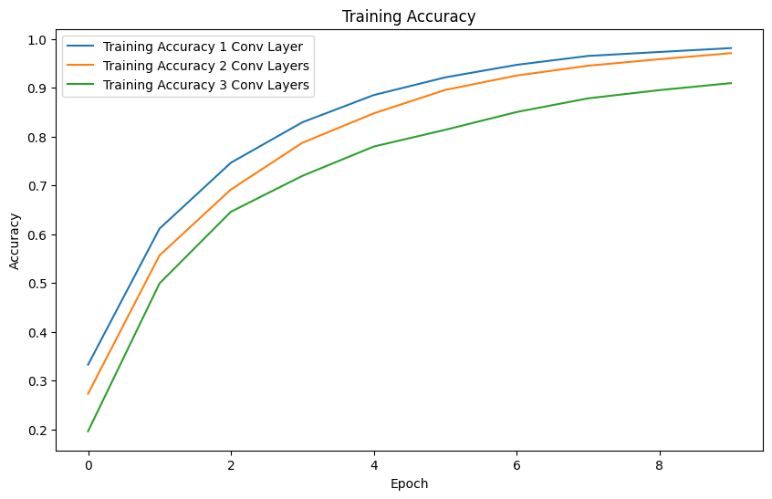
Training Accuracy With Respect to Convolutional Layers

Slide 13
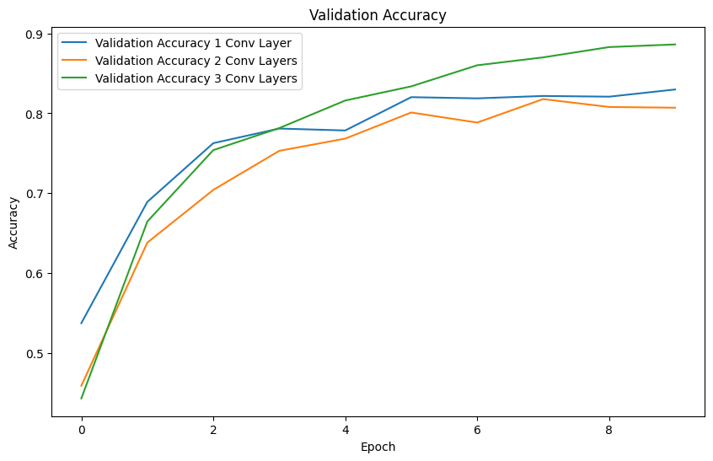
Validation Accuracy With Respect to Convolutional Layers

Slide 14
Conclusion
Convolutional Neural Networks (CNNs) have demonstrated promising results for Arabic handwritten character recognition. In this experiment, three CNN models with varying numbers of convolutional layers were trained and evaluated. The results showed that all models achieved significant improvement in accuracy over the training epochs. There was a trend of improvement in validation accuracy with an increase in convolutional layers, suggesting the model benefits from increased feature extraction capabilities.

