Slide 1
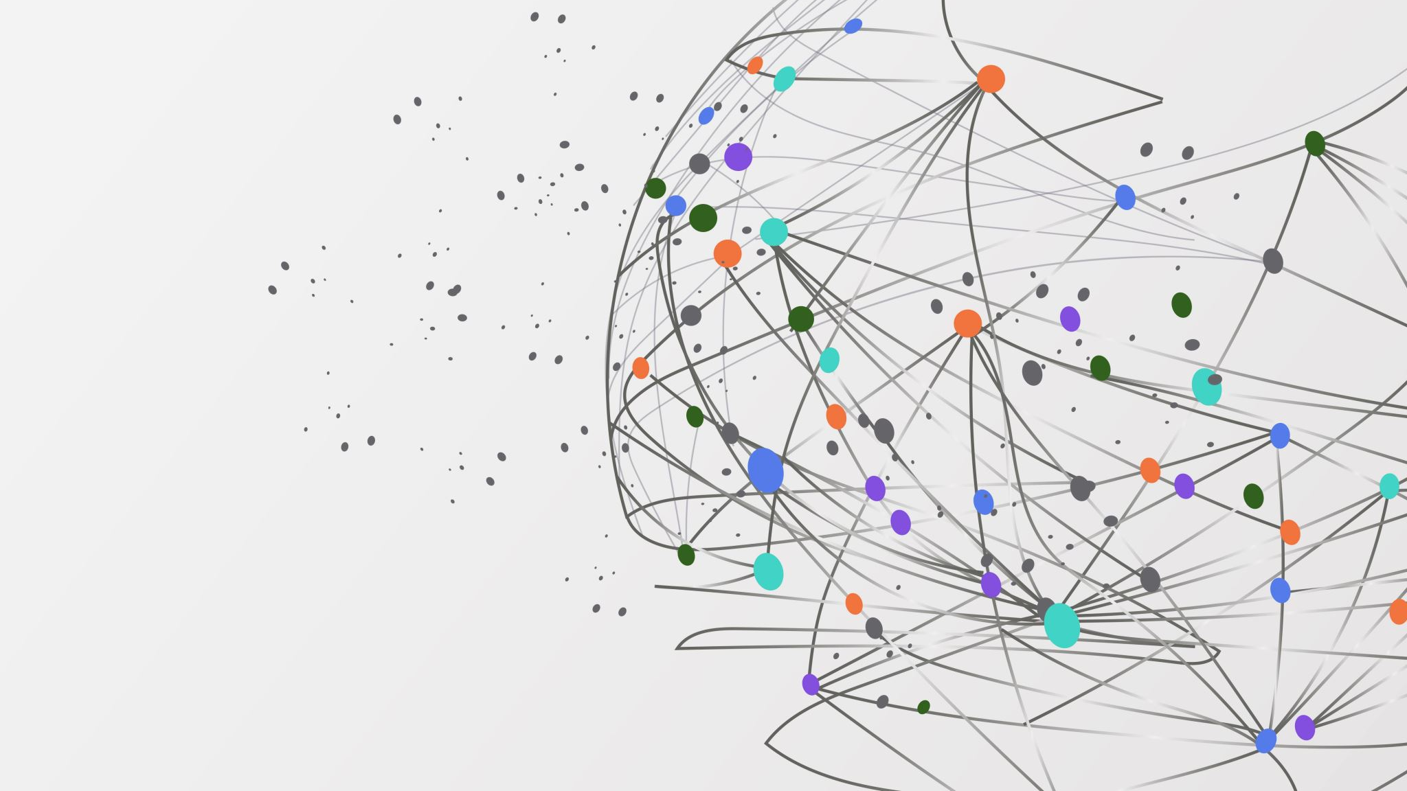
Chapter 2
Supervised Learning

Slide 2
Classification VS Regression
Prediction based on predefined possibilities
Binary Classification
Ex. Is this email spam
Multiclass Classification
Ex. Predicting the language of a website
Prediction based on continuous numbers
Requires Continuity
Ex. Predicting annual income
Notes:
Two types of Supervised Machine learning
Classification, prediction based on a predefined set of possibilities.
Has two types
Binary: A simple Yes or No
Multiclass: Much more complex, includes multiple options.
Regression, prediction based on continuous numbers such as predicting the annual income of an individual.
They are easily differentiated between by the necessity for continuity between outcomes. If the outcome can include
A range then it is Regression, if including a range would make the data unusable then it must be classification.

Slide 3
Overfitting vs Underfitting
Concept comes from the desire to make accurate predictions
A model is created based on provided test data
The model must work for new unseen data
Creation of a generalized model is the ultimate goal
Overfitting: Building a model that is too complex for the information available
Underfitting: Choosing a model that is too simple for the dataset
Notes:
Overall goal of Supervised learning is to create models that are able to make accurate predictions with as little human interaction as possible.
Given test data that has answers bundled in the model is trained on this data and then when it is fed new data that doesn’t have predefined answers the model is able to provided its own answers.
A model's ability to generalize is its ability to make accurate predictions on that new unseen data.
The more data available the better for the most part. With more info overfitting becomes a nonissue
Underfitting is always a threat.

Slide 4
Background Information
Several small and synthetic datasets
A couple real-world datasets
Wisconsin Breast Cancer dataset (cancer)
Boston Housing dataset
Several examples make use of derived features
Notes:
These synthetic datasets are brought up when needed and oftentimes only included data that is needed to make a point
Two real world datasets
Cancer: Determining between benign and malignant tumors based on 30 different aspects. Includes 569 data points
Housing: Predicts value of homes in Boston neighborhoods based on crime rates, proximity to the Charles river ect.
Derived features are those that come from the product of two features included in a data set. This is called feature engineering

Slide 5
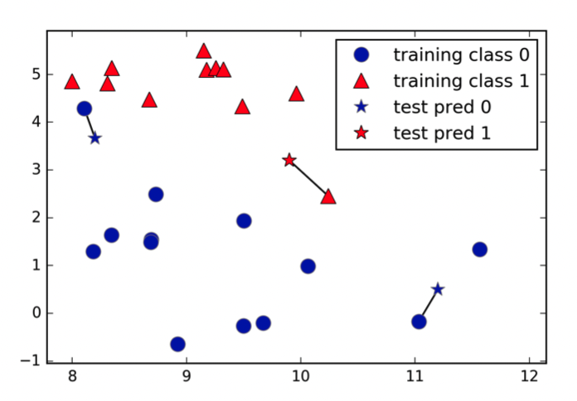
K-Nearest Neighbors 1/2
Simplest machine learning algorithm
Finds closets data points in the training dataset
Several versions exist
Two important parameters
Number of neighbors
How you measure distance
Easy to understand with respectable performance on small datasets
1-Nearest Neighbor
The simplest version
Only Makes use of one neighbor

Slide 6
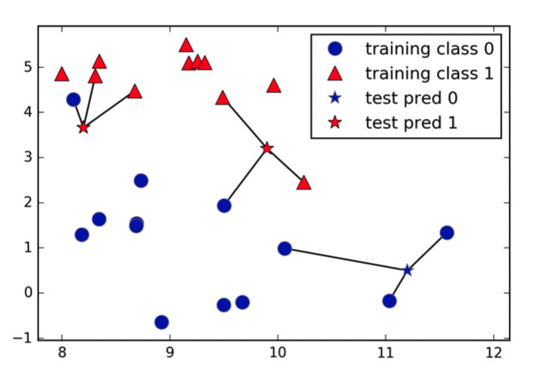
K-Nearest Neighbors 2/2
K-Nearest Neighbor
True form of the algorithm
Makes use of an arbitrary number of neighbors
This doesn’t work how you may think
Fewer neighbors corresponds to high model complexity
Many neighbors corresponds to low model complexity
There is a sweet spot between low and high that provides the greatest prediction accuracy

Slide 7
Linear Models Regression 1/4
Widely used for a plethora of use cases
The formula is largely similar to y=mx+b
More planes are added for more features
With small datasets linear models provide a skewed perspective
As datasets increase in size linear models become much more accurate
Extremely fast to train and fast to predict
Some methods create easily understood predictions
Several different methods

Slide 8
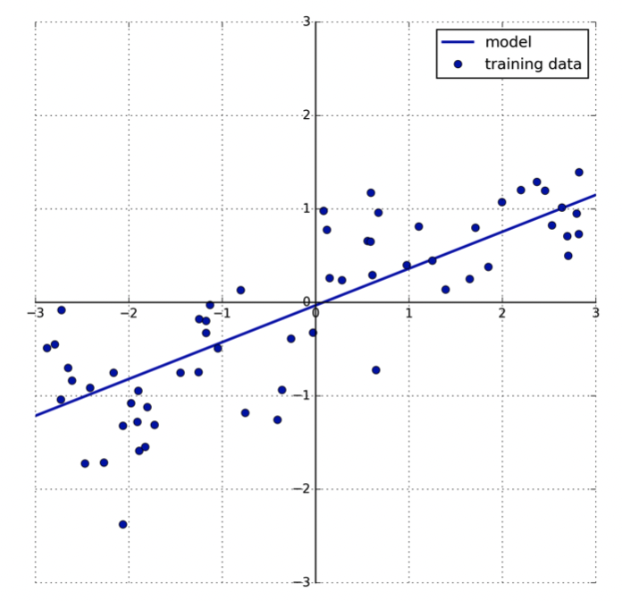
Linear Models Regression 2/4
Linear regression (Ordinary least squares)
Has no methods of controlling complexity, similar to K-nearest
Finds the parameter w and b that minimize the mean squared error

Slide 9
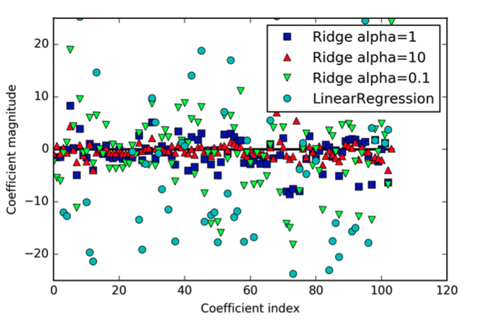
Linear Models Regression 3/4
Ridge Regression
Same idea as Standard linear regression
W coefficients are chosen to be as small as possible
Each feature has small affect on outcome
Makes use of L2 Regularization
Notes:
Explicitly restricting a model to avoid overfitting

Slide 10
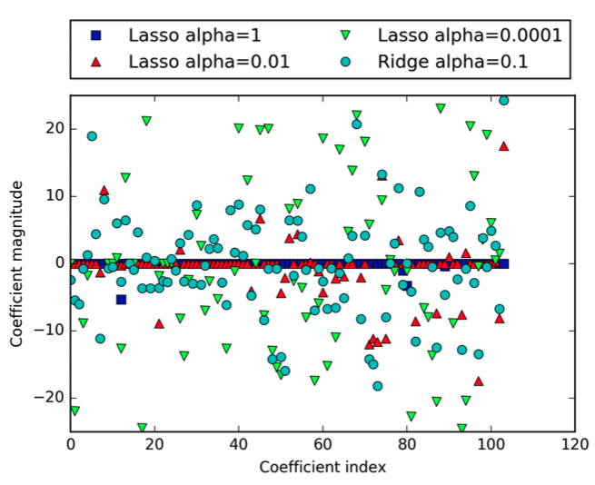
Linear Models Regression 4/4
Lasso Regression
Similar to Ridge with one key difference
Makes use of L1 regularization in which coefficients are made extremely close to zero
Often times results in many features being completely negated
Can be easier to interpret due to less data

Slide 11
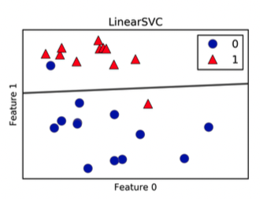
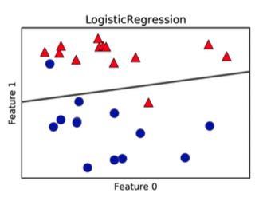
Linear Models Classification 1/2
Binary Classification
Returns the weighed sum of features with the predicted values held at zero
Two main types
Linear SVC
Logistic Regression
Both work very similarly
Includes an additional control variable C
High values fit training set best
Low values find a coefficient vector that is closets to zero

Slide 12
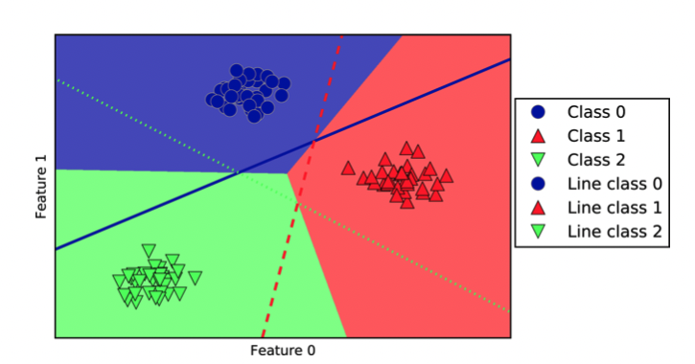
Linear Models Classification 2/2
Multiclass Classification
Logistic regression can be modified to for multiclass work
This is done through a one-vs.-rest approach
Essentially creating instances of binary models to account for all classes

