Slide 1
Evaluating the use of AWS Serverless vs. server-based architecture!
Mohammed AbdulRazzak

Slide 2
Agenda
Methodology overview
Deep-dive into Server-less
Comparison of Server-less vs Server-based architectures
Decision making process
Architecture patterns

Slide 3
Methodology Overview
Serverless
Server-based
Resource management - By cloud
Application deployment cycle:
Ship
Deploy
Pay for application run-time
Resource management - By application provider
Application deployment cycle:
Setup resource
Ship
Deploy
Pay for server up time

Slide 4
Serverless architectures gaining popularity. Why?
Better cost control
Eliminates the effort(cost) of setup and management
Only pay for run-time. No charge for idling.
Pay as you go only for used storage and compute
Automatic scale and reliability
Automatic multi-tenancy handling
Larger portion of security delegated to Cloud

Slide 5
Why “spend” for resource management for the application when cloud provides it?
Let us deep-dive before we answer!!

Slide 6
Serverless paradigm – Under the hood
Computations are defined as functions (event handler a.k.a AWS Lambda functions)
Analogous to functions in programing.
Takes input data and return processed output.
Output can be persisted (storage/DB) or delivered to the consumers
Lambda-function(event-handler) designed to perform one functional operation
No inter-dependency between event-handlers
Events trigger the event-handler(Lambda functions) execution
Event handlers are registered in the serverless framework (AWS Lambda)
“Function as a Service”
Notes:
Reducing the service down to a function! Basically event handlers for the messages/events sent by the applications!

Slide 7
Serverless paradigm – Under the hood - App code execution
Event routed to Lambda-function up on the arrival
Serverless framework (Lambda) finds the compute (runtime for Lambda function) and kicks-off event handler (lambda function) execution
When Lambda-function is running:
Events are sent to the event-handler (lambda functions) run-time instance
When lambda-function is not running:
Serverless framework allocates a run-time for the event handler(lambda function) and routes the event for execution
AWS lambda functions are allowed to idle for a limited time before the resource are re-claimed

Slide 8
Types of Serverless Functions
Mapping function
Examples : Image resizing, video transcoding, sentiment analysis,
Inline/pre-processing
Examples: Data validation, data filtering, data transformation before sending to processors down the pipeline (Analytics engines, query engines etc.) running on server-based services
Lambda pipeline (variation of above scenario)
Akin to assembly line, Lambda functions are grouped/chained to build application
Notes:
2nd – Preprocess before a handing over to massive scale job down the pipeline (Filtering etc before sending to EMR/Map-reduce)
3rd is a composition of functions i.e chaining together to dev application. For ex: Workflow handlers each portion of a workflow handled by a lambda. A set of fn needed to offer full functionality!

Slide 9
Pros-Cons: Serverless vs. Server-based
Serverless | Server-based
Resources provisioned & managed by Cloud | Resource provisioned & managed by app provider
Run-time resources are short-lived. Shut down after idle time-out | Server run-time managed by app. Not dependent on idle time-out
Invocation latency time for cold starts | No invocation latency. Service can run as long as needed
Scalability and availability managed by Cloud | Scalability and availability have to be managed by the application provider. NOTE: Even when using auto-scale, necessary configuration is required by the app provider
Data shipped to code. Inefficient for big-data processing | Can run the code at the data. Example Map-Reduce
Take Away - Serverless prevents control of cloud resources
Impact: Devoids app developer of fine-tuning, hampering precise resource optimization and responsiveness

Slide 10
Decision Making
A deliberate decision required based on target application needs

Slide 11
When should serverless “not” be used**?
- Here are a few questions to ask!
Does app needs a very fast and predictable response time?
Does app need to move large amounts of data, quickly across processing pipeline?
Is legacy code used, that needs to be deployed with minimal re-architecture?
Does app need to perform complex chain of operations within a tight time-constraint?
Is it inefficient to ship data to code due to large volumes?
Does app need very large amount of memory (FaaS has limitation on the maximum RAM size)
If “Yes” to any of these, Serverless is not for that application
** Applicable for proprietarily developed application
Discussion excludes use cases requiring custom/specialized hardware or well-defined services like AWS Kinesis.
Notes:
Given the popularity of Serverless, I am proposing to question the application needs and see if there is a gap!

Slide 12
Architecture patterns
Time to put the architecture in place

Slide 13


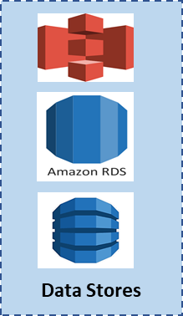


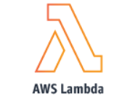


Server-Less Architecture
Data Arrival for compute
Compute Layer
Post processing layer
Messages queues as needed
Messages streams from clients
Queues
Cloud Front
When
Applicable

Slide 14



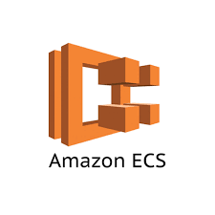



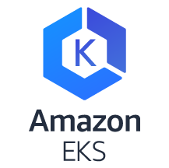

Server-based Architectures
Data Arrival for compute
Compute Layer
Post processing layer
Data Stores
Message Streams from clients
Messages queues as needed
Queues
Cloud Front When
Applicable
Amazon EMR
Notes:
Compute layer may be auto-scaled as needed!

