Slide 1
EDGE-BU-CSE
Computer Fundamentals and Office Application
Batch : 45 Roll:04
Name: Md. Abdur Rahman

Slide 2

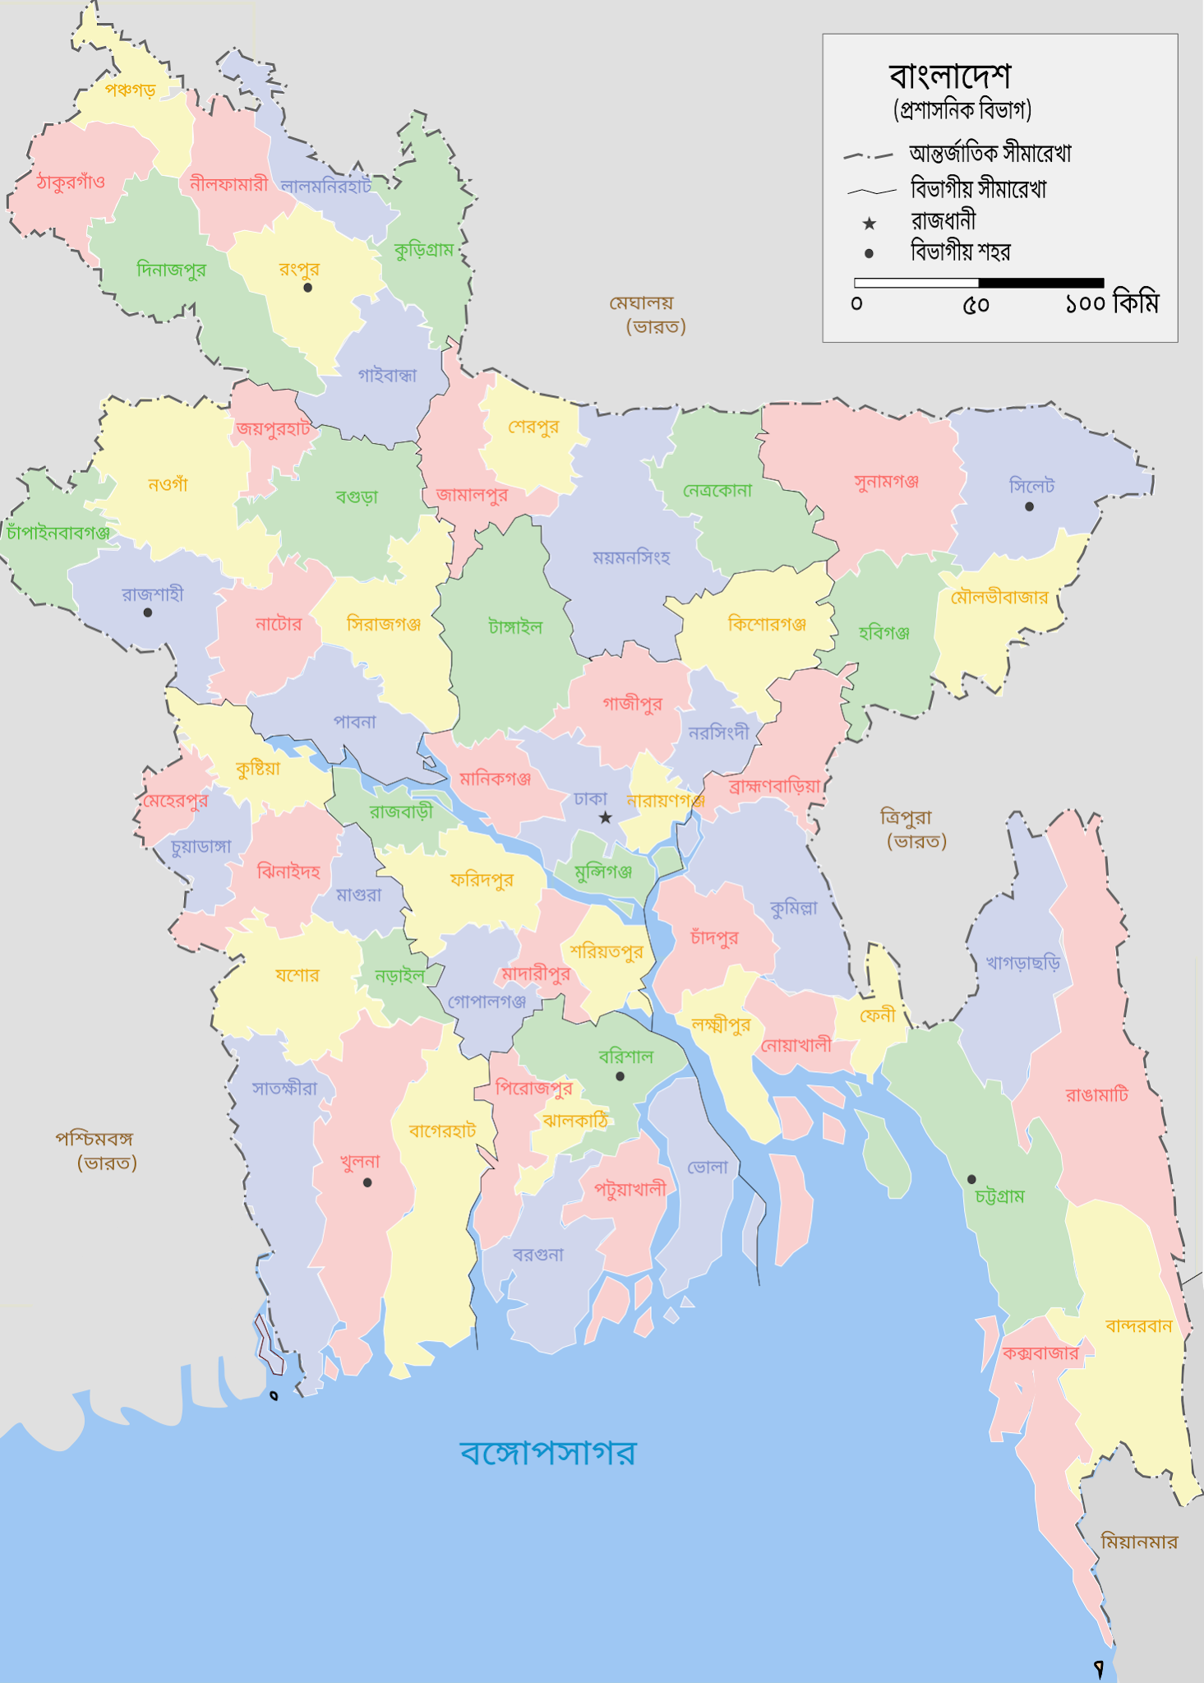
BANGLADESH LOCATION
Bangladesh lies between 20"34' and 26"38' North Latitude and 88"01' and 92"41' East Longitude with a total landmass of 1,47,570 square kilometers (56,977 Sq. miles). Bangladesh is surrounded by India on the West, North and Northeast, Myanmar on the Southeast and the Bay of Bengal on the South. Bangladesh has a strategic location and acts as bridge between South Asia and Southeast Asia. It has a population of 147 million people. In other words, it is roughly the size of New York State with half the entire population of the United States crammed into this area.

Slide 3
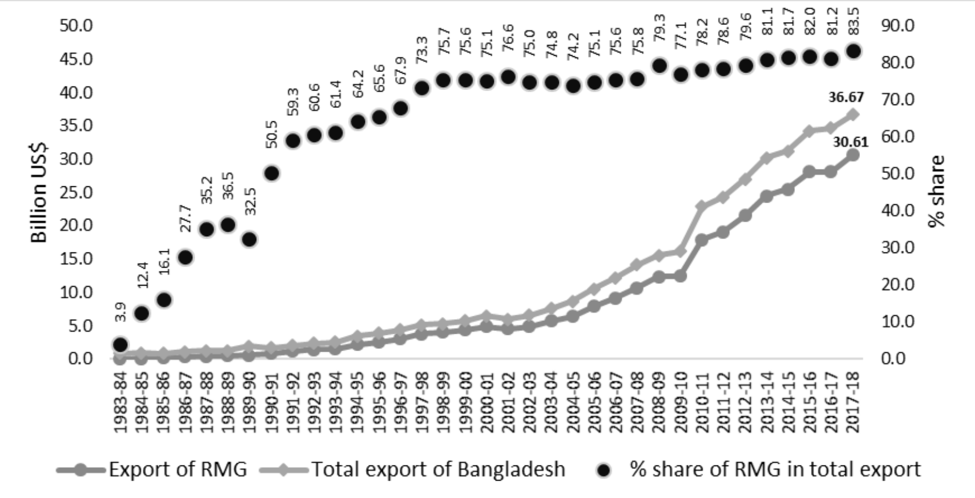
ECONOMY OF BANGLADESH
The economy of Bangladesh is a major developing mixed economy.^{[3]} As the second-largest economy in South Asia,^{[45][46]} Bangladesh's economy is the 35th largest in the world in nominal terms, and 25th largest by purchasing power parity. Bangladesh is seen by various financial institutions as one of the Next Eleven. It has been transitioning from being a frontier market into an emerging market. Bangladesh is a member of the South Asian Free Trade Area and the World Trade Organization. In fiscal year 2021–2022, Bangladesh registered a GDP growth rate of 7.2% after the global pandemic.^{[47]} Bangladesh is one of the fastest growing economies in the world.

Slide 4
POVERTY RATE
Poverty rate by division
Percent of population living on less than $2.15, $3.65 and $6.85 a day, international dollars (2017 PPP) as per the World Bank.
Division | $2.15 | $3.65 | $6.85 | Year
Barisal | 15.2% | 58.5% | 92.7% | 2016
Chittagong | 5.5% | 37.4% | 84.2% | 2016
Dhaka | 6.5% | 33.9% | 76.2% | 2016
Khulna | 16.5% | 65.1% | 93.1% | 2016
Rajshahi | 17.8% | 63.5% | 91.9% | 2016
Rangpur | 35.4% | 77.7% | 95.2% | 2016
Sylhet | 13.2% | 57.7% | 90.4% | 2016

Slide 5
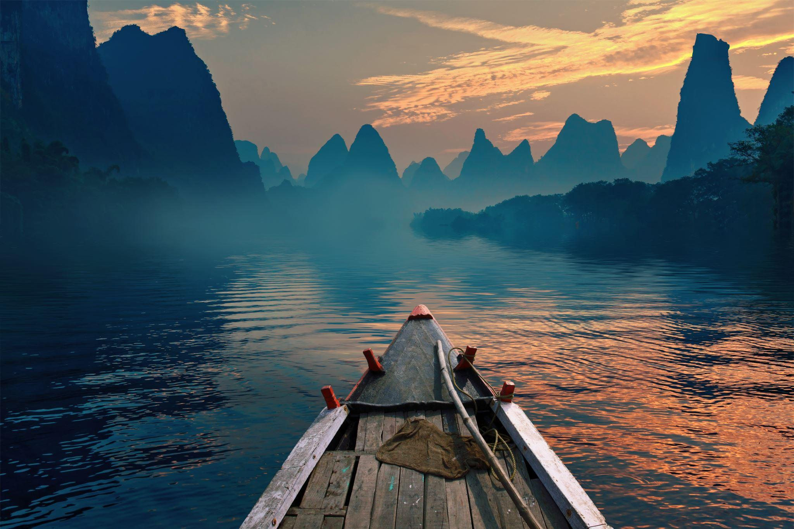
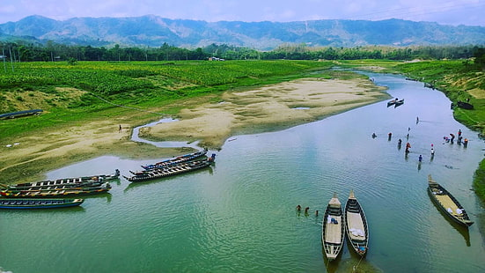
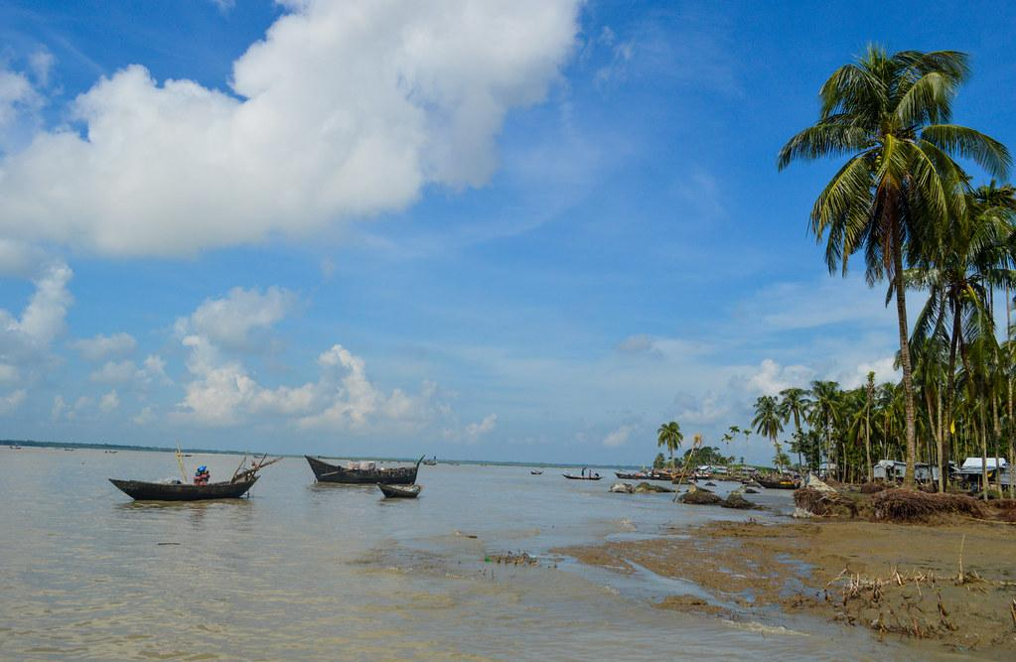
“BANGLADESH: LAND OF RIVERS”

Slide 6
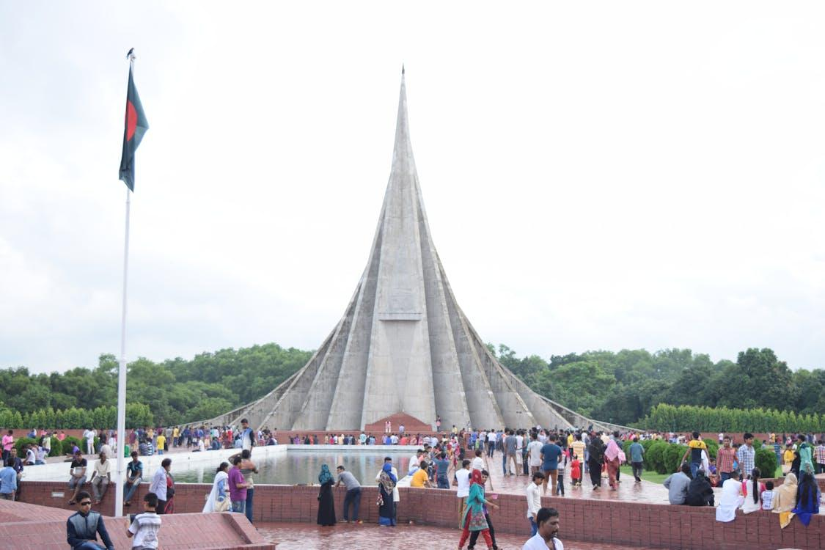
HISTORY AND CULTURE
Bangladesh's cultural heritage is deeply rooted in its ancient history, dating back to the Indus Valley Civilization. Over the centuries, the region has been influenced by various dynasties, including the Maurya, Gupta, and Mughal empires, each leaving its mark on the cultural landscape.

Slide 7

CONCLUSION
Bangladesh is on track to become an upper-middle-income country (at least ~$4,000 GDP per capita) by 2031. Bangladesh has proven resilient to global economic shocks. In 2020, Bangladesh GDP rose 3.4%, making it one of the few Asian economies to have grown during the COVID-19 pandemic

