Slide 1
Syringe Infographic
WRITE YOUR SUBTITLE HERE
Your Title
Your Title
Your Title
Your Title
Your Title
A good business plan starts with a summary
A good business plan starts with a summary
A good business plan starts with a summary
A good business plan starts with a summary
A good business plan starts with a summary

Slide 2
Syringe Infographic
WRITE YOUR SUBTITLE HERE
Your Title
Your Title
Your Title
Your Title
A good business plan starts with a summary
A good business plan starts with a summary
A good business plan starts with a summary
A good business plan starts with a summary

Slide 3
Lab Research Infographic
WRITE YOUR SUBTITLE HERE
75%
95%
A business plan is a written document that describes in detail how a business, usually a new one, is going to achieve its goals. A business plan lays out a written plan
A business plan is a written document that describes in detail how a business, usually a new one, is going to achieve its goals. A business plan lays out a written plan

Slide 4
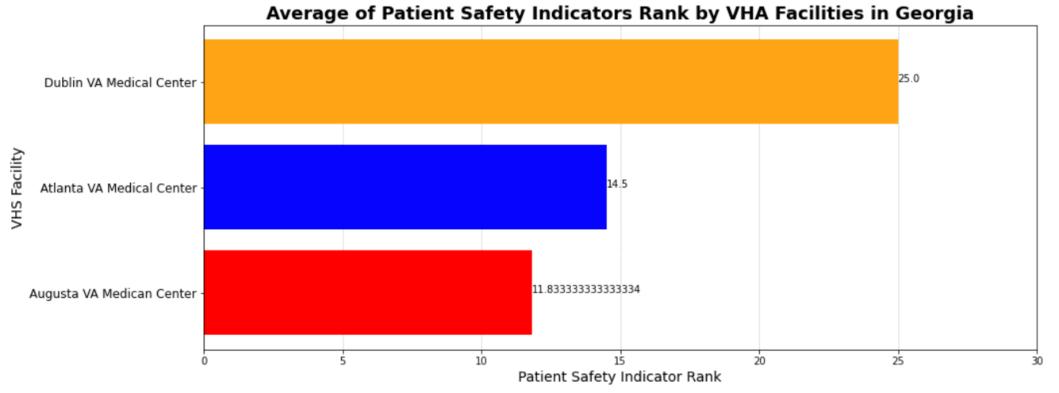
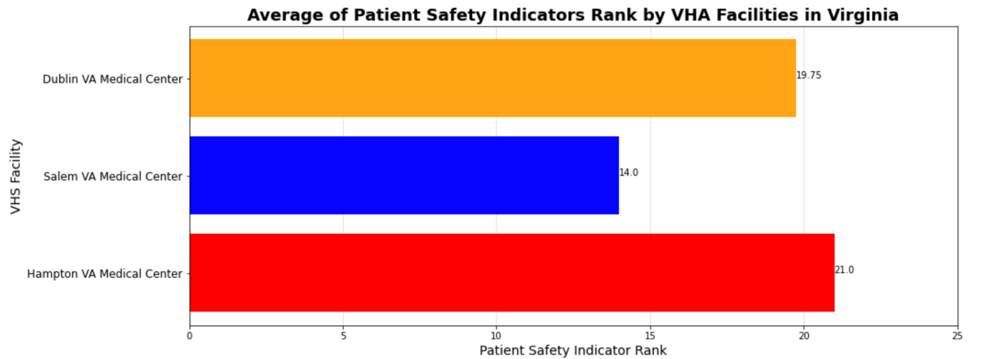
Average of Patient Safety Indicators Rank by Hospitals in Georgia and Virginia
Objective
Compare Patient Safety Indicator Ranks between different measures. Calculate rank for each measure by hospital and the average PSI overall by hospital.
O
Main Pandas and Matploitlab code used
Data-frames, ranks, horizontal bars (barh) and adding labels to each bar applying ax1.
C
Your Title
A good business plan starts with an executive summary of the business goals
AB
Your Title
A
A good business plan starts with an executive summary of the business goals

Slide 5
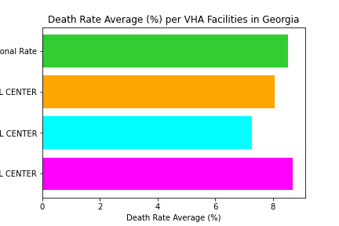
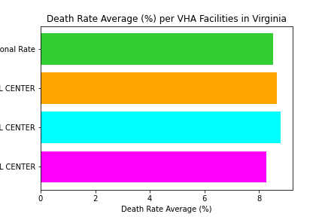
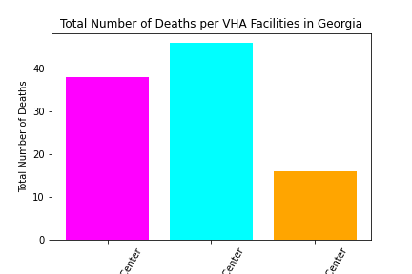
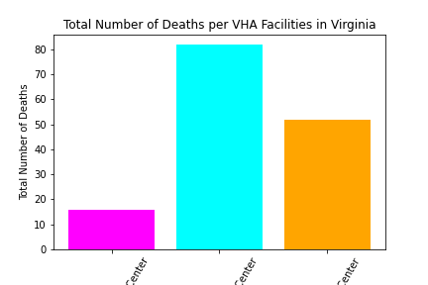
Comparison of Death Rates between VHA Facilities in Georgia and Virginia
Objective
Compare Death Rates between VHA Facilities in Georgia and Virginia. Calculate rates by taking the average of all the rates provided and the sum of the total death counts.
O
Main Pandas and Matploitlab code used
Data-frames, horizontal bars (barh), vertical bars adding labels to each bar applying ax1.
C
Your Title
A good business plan starts with an executive summary of the business goals
AB
Your Title
A
A good business plan starts with an executive summary of the business goals

Slide 6
X-Ray Infographic
WRITE YOUR SUBTITLE HERE
A business plan is a written document that describes in detail how a business, usually a new one, is going to achieve its goals. A business plan is a written document that describes in detail how a business, usually a new one, is going to achieve its goals.
Your Title
Your Title
A good business plan starts with an executive summary of the business goals
A good business plan starts with an executive summary of the business goals
98%
35%

Slide 7
Doctor & Nurse Infographic
WRITE YOUR SUBTITLE HERE
Structure
A good business plan starts with an executive summary of the business goals
Strategies
A good business plan starts with an executive summary of the business goals
Your Title
65%
Your Title
5%

