Slide 1
Introduction to Actor model concurrency/parallelism and demonstration with Akka
Manuj Bhalla
Meetup #1 - Lets talk functional Programming, Scala & Akka
Bangalore-Scala-Akka-Functional-Programming meetup group
23 August 2014

Slide 2
Agenda
Brief historical and current trends in concurrency
What is Actor model ? Need, Definition and concept
Various Implementations of the model
Dive into Akka – few examples and demo samples
Some real use cases
Demo using Java and Scala
Q & A

Slide 3
Moore’s law
Number of transistors on integrated circuits double approximately two years – Carver Mead, 1970
Technically correct but now focus has changed
Scale out instead of scale up
Multi core processors
Parallelism in applications
100 cores on a chip³

Slide 4
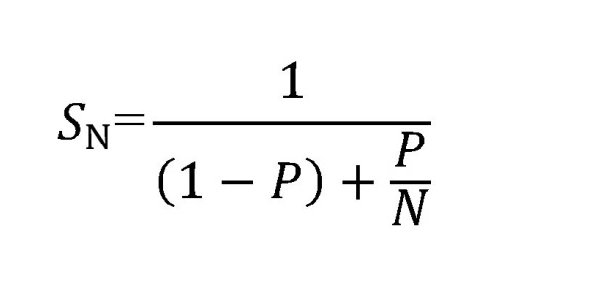
Amdahl Law
S_{N} = Speed up in processing
P = Fraction of job [0,1] which can be parallelized
N = Number of processors / threads

Slide 5
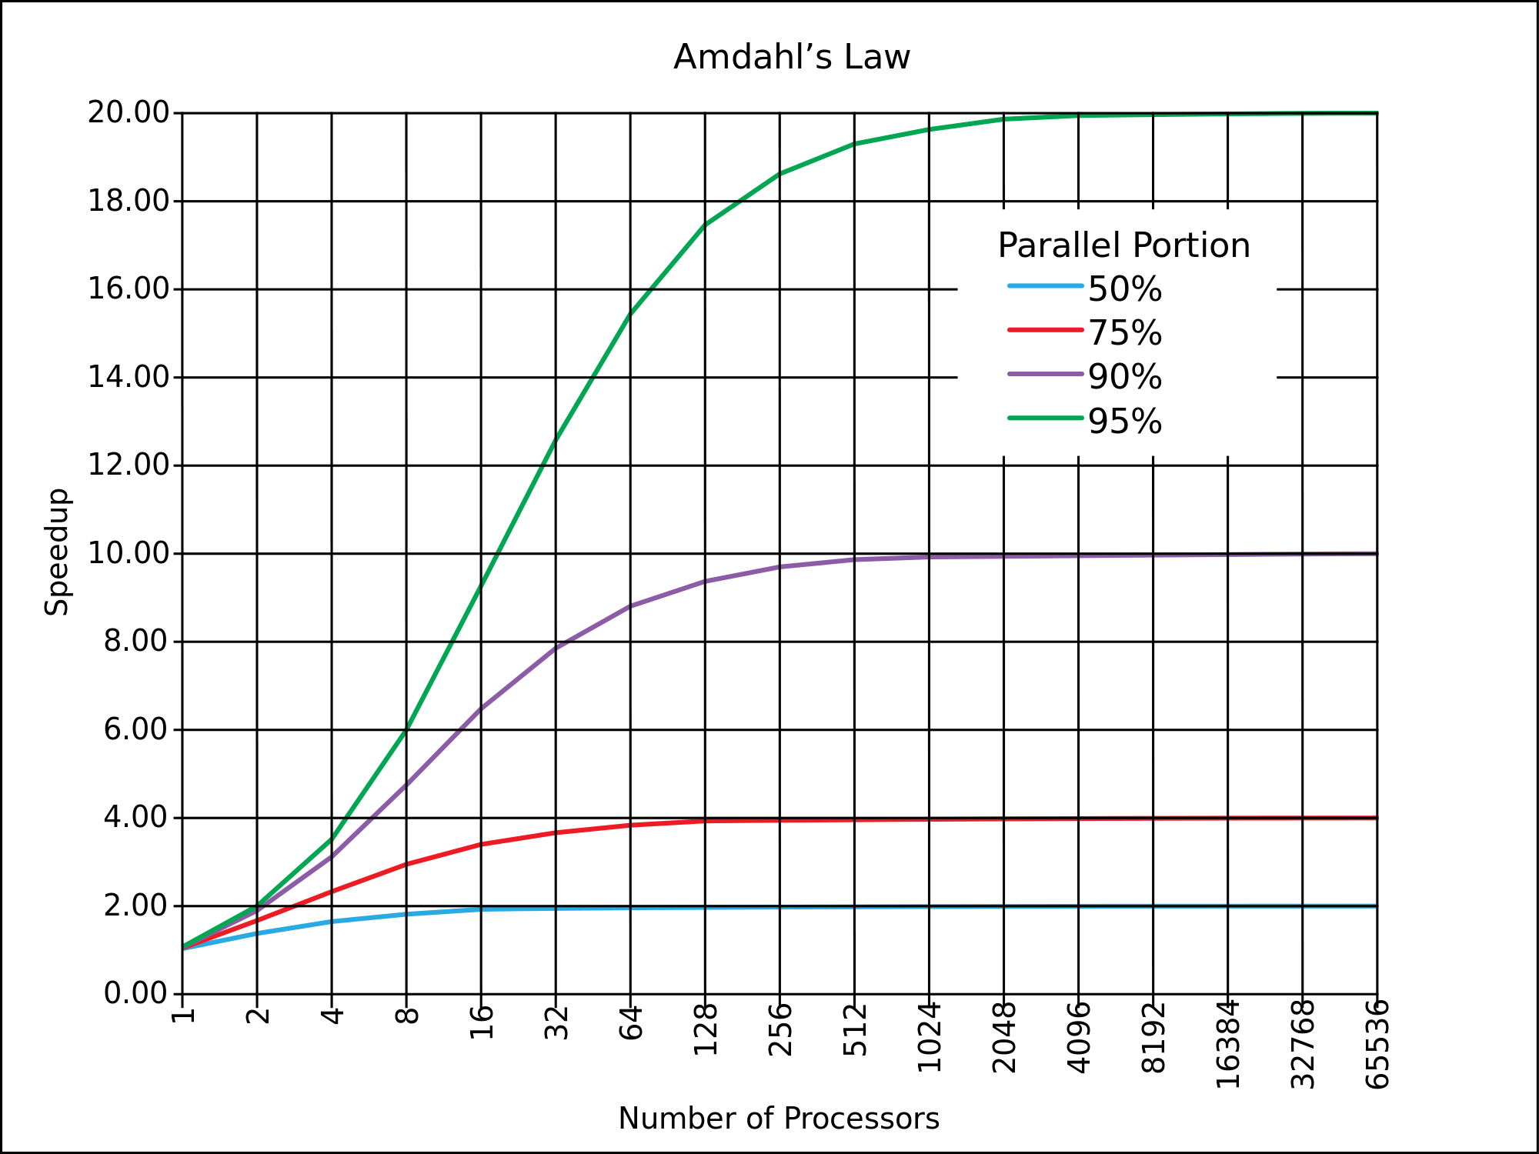

Slide 6
On the application side
Need for an easy to reason and abstract about concurrency model
Concurrency models:
Simple thread usage
Executors framework model
Fork and Join model
Actor model

Slide 7
Simple Thread model
Uses class Thread
Thread represents a unit of execution
Basic building block of concurrency on JVM
Design complex applications with simple Threads is hard
Custom Thread group/pool is hard to write correctly

Slide 8
Executor framework
Since Java 1.5
Abstraction layer over traditional thread model
Decoupling task submission and task execution
Thread lifecycle/memory management managed by framework
Focus on jobs (Runnables) to be run concurrently

Slide 9
Fork Join framework
Since Java 1.7
Implementation of ExecutorService
Good for divide and conquer style of problems
Merge sort of 1 trillion numbers!
Gives developers more abstraction to focus on business logic rather than thread lifecycle details

Slide 10
Concurrency/Parallelism
Concurrency: When at least two threads are making progress. Can include time slicing as a form of virtual parallelism
Parallelism: When at least two threads are executing simultaneously
Both of them are hard because of “shared mutable state”

Slide 11
Manage state
We cannot avoid state
But we have 3 options to manage them:
Shared mutability
Evil !
Isolated mutability
OK !
Pure immutability
Ideal !
Example: age totaller

Slide 12
Manage Synchronization
Explicit synchronization is hard
Can we prevent it ?
Two models in modern concurrency
Software Transactional Memory
Systems to be built using message passing and do not hold any state – Alan Kay (coined the term OOP)
But they do now !
Separation of identity and state
Clojure
Actor model

Slide 13
Actor model - definition
Based on ACM Paper⁴ in 1973 by Hewitt, Bishop and Steiger
A model which defines an entity called an actor
What is an actor ?
Embodies 3 essential elements :
processing
storage
communication
Fundamental unit of computation

Slide 14
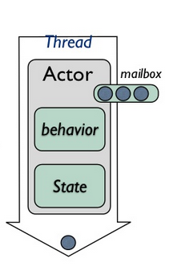
Actor
Various running methods available
Lightweight object
Encapsulates behavior and state
Processes messages from its queue one at a time
Receiver actor need not be running

Slide 15
Actor model – What can an actor do ?
When it receives message it can :
Create more actors
It can send message to other actors for which it has address before
It can change its behavior (for the next and subsequent messages)
State machines
Actor message sending is asynchronous and there is no guarantee of ordering
State of the actor only accessible by passing message
When you ask it
Actor model contract
Many to Many relationships between actor and addresses
Example: Google search – 1 address, millions of actors
Think of actors as humans talking to each other

Slide 16
Earlier implementation
Was implemented by Joe Armstrong in Erlang in used in Ericsson AXD 301 switch
99.9999999 % reliability achieved
Event driven semantics
Reactive programming

Slide 17
Actor model implementations
Many libraries and frameworks available⁵
Some of them include:
Akka (JVM – Java/Scala)
GPars (JVM – Groovy)
F# MailboxProcessor (.NET)
plus many more…

Slide 18
Akka
Founded by Jonas Bonêr⁶
Part of TypeSafe stack
Each actor is referred by and ActorRef
Actor behavior is implemented as a stack
It can become
It can unbecome
Don’t think of actors as abstract objects on which you call methods
Think of them as talking entities
Workflow processing
Let it fail – fault tolerance strategies
1 for 1
1 for all

Slide 19
Some examples

Slide 20
Some real use cases
Event driven transactional systems
API ad networks

Slide 21
Some real use cases
Event driven architecture and workflow applications
Think of it as a DAG graph of actors
Actor encapsulated in a Neo4j node!
Concurrent execution of different stages under a context

Slide 22
Some real use cases
How twitter is scaling
Implemented kestrel – twitter queuing system in Scala⁷ using actor model implementation
Facebook chat using Erlang OTP⁸

Slide 23
Code samples

Slide 24
References
http://en.wikipedia.org/wiki/Moore's_law
http://en.wikipedia.org/wiki/Amdahl's_law
http://www.tilera.com/
http://dl.acm.org/citation.cfm?id=1624804
http://en.wikipedia.org/wiki/Actor_model#Actor_libraries_and_frameworks
http://www.slideshare.net/nartamonov/above-the-clouds-introducing-akka
https://waimingmok.wordpress.com/2009/06/27/how-twitter-is-scaling/
http://www.erlang.org/
http://channel9.msdn.com/Shows/Going+Deep/Hewitt-Meijer-and-Szyperski-The-Actor-Model-everything-you-wanted-to-know-but-were-afraid-to-ask

Slide 25
Q&A

