Slide 1
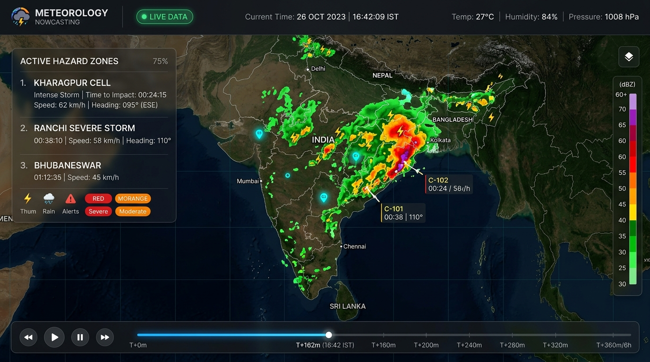
SMART INDIA HACKATHON 2026
Nowcast-GIS
High-Resolution Convective-Scale Weather Prediction & Real-Time GIS Early Warning Engine
Bridging the 0–6 Hour Weather Gap: From Satellite Thermal Detection to Ground-Level Evacuation.
An end-to-end, AI-powered convective nowcasting platform that ingests INSAT-3D thermal IR and Doppler radar to detect storm updrafts 30–45 minutes before rain begins and projects severe storm advection up to 6 hours with real-time GIS countdown clocks.
Team: [Your Team Name] | Problem Statement: Convective-Scale Severe Weather Nowcasting

Slide 2
SLIDE 2 — PROPOSED SOLUTION
The Nowcasting Problem & Our Integrated GIS Solution
WHAT IS THE PROBLEM?
• Severe thunderstorms & lightning claim 2,500+ Indian lives annually.
• Traditional NWP models have 3–6 hour compute latency and miss rapid convective storm births.
• Disaster authorities (NDRF/SDMA) receive zero sub-hour tactical lead time.
HOW IT WORKS (3 SIMPLE STEPS):
1. Ingest & Detect: Monitors INSAT-3D cloud-top cooling rates (ΔT/Δt) to spot storm updrafts 30–45 mins before radar echoes form.
2. Nowcast (0–6 Hours): Dual-engine advection (OpenCV Optical Flow + ConvLSTM) outputs 12 forecast frames at 30-min steps.
3. Warn & Act: Clusters severe echoes (≥50 dBZ) and lightning into active hazard alert zones with automated, ticking countdown clocks.
WHAT MAKES NOWCAST-GIS UNIQUE:
• Pre-Radar Convective Initiation: Identifies storm updrafts 30–45 mins before ground rain via satellite thermal cooling.
• Live Arrival Countdown Clocks: Zone cards calculate exact ticking countdowns (MM:SS) to storm arrival.
• 6-Hour Interactive Timeline: 13 time capsules (T+0 to T+360m) with animated Play/Pause playback.
• Dual-Model Engine: Combines OpenCV Farneback Optical Flow with deep learning ConvLSTM.
• Multi-Hazard Data Fusion: Unified GeoJSON payload merging radar dBZ polygons, CI points & lightning.
• Offline Demo / Replay Mode: Embedded historical replay toggle for venue demos without Wi-Fi.
• WebSocket Real-Time Stream: Notifies clients within 3 seconds of new file ingestion.

Slide 3
SLIDE 3 — TECHNICAL APPROACH
System Architecture & Production Technology Stack
LAYER | TECHNOLOGIES EMPLOYED
GIS Dashboard | HTML5, Tailwind CSS, Vanilla JS, Leaflet.js 1.9, CartoDB Dark
Backend API | Python 3.14, FastAPI, Uvicorn (ASGI), Pydantic v2
Nowcast Models | OpenCV (Farneback Optical Flow), PyTorch (ConvLSTM)
Geospatial Stack | Rasterio 1.5.1, GDAL/Affine, NumPy 2.5, Pillow
CI Detection ML | Scikit-Learn, LightGBM, Joblib (ΔT/Δt + Texture Var)
Real-Time Push | Native WebSockets (/live) with async 3s file-watcher
END-TO-END PIPELINE ARCHITECTURE:
1. Ingestion Layer: Pulls INSAT-3D thermal IR, DWR Doppler radar (0.027° grid), and synthetic lightning proxy data into /engine/data/.
2. Convective Initiation (CI): ML classifier extracts cooling rate and texture variance to output geo-referenced CI detection points.
3. AI Nowcasting Engine: OpenCV Farneback dense optical flow advects radar reflectivity forward into 12 future frames (30m intervals, 6h horizon).
4. Data Readers (readers.py): Extracts GeoJSON contour polygons (Moderate 30-40, Heavy 40-50, Severe ≥50 dBZ) and synthesizes warning zones (HZ-01..06).
5. FastAPI Service (main.py): Exposes /status, /hazards, /forecast, /replay, and WS /live. Verified with 10/10 passing pytest test cases.
6. Full-Screen Dashboard: Full-screen Leaflet dark map centered on India with active storm countdown clocks, bottom timeline scrubber, and offline replay mode.

Slide 4
SLIDE 4 — FEASIBILITY AND VIABILITY
Deployment Viability & Engineering Risk Mitigation
WHY THIS IS FEASIBLE RIGHT NOW:
• Technical Feasibility:
Built on open standards (GeoTIFF, GeoJSON, EPSG:4326). Farneback optical flow executes in < 2 seconds on CPU. 100% operational working prototype.
• Operational Feasibility:
Direct drop-in for NDRF, SDMA, and airport weather offices. No specialized hardware required; runs on standard edge servers and loads on any browser.
• Financial Feasibility:
Zero proprietary software license fees. 100% open-source stack. Negligible deployment cost vs. billions saved in avoided disaster damage.
CHALLENGE | RISK | MITIGATION STRATEGY
Radar beam blockage in hills | Coverage gaps | Fused satellite thermal IR (INSAT) provides continuous top-down coverage.
Non-linear storm dissipation | Advection inaccuracy | ConvLSTM deep model predicts cell decay; CI detector tracks new births.
Unreliable field Wi-Fi | Live demo lag | Embedded Replay Mode loops pre-baked 771-hazard snapshot completely offline.
Large GeoJSON payload | Browser map stutter | Polygon simplification & 4-decimal truncation cuts payload by >50%.

Slide 5
SLIDE 5 — IMPACT AND BENEFITS
Quantifiable Impact & Multi-Sector Beneficiaries
PERFORMANCE METRIC | TRADITIONAL NWP | NOWCAST-GIS PLATFORM
Forecast Update Frequency | Every 3 to 6 hours | Every 5 to 15 minutes
Spatial Resolution | 12 km – 25 km grid | 0.027° (~3 km) localized
Convective Initiation Lead Time | 0 mins (post-rainfall) | 30–45 mins advance detection
Hazard Arrival Precision | District-wide vague alert | Zone-specific countdown (MM:SS)
Client Payload Size | Gigabytes (binary grids) | Lightweight GeoJSON (<500 KB)
TARGET BENEFICIARIES & BROADER IMPACT:
• Disaster Authorities (SDMA / NDRF):
Increases actionable lead time from 0 to 45 mins. Live countdowns enable targeted siren alerts and localized evacuations.
• Aviation & Airports:
Enables tactical terminal airspace rerouting around severe cells (≥40 dBZ) up to 2 hours ahead; prevents lightning ramp hazards.
• Agriculture & Rural Communities:
Provides farmers advance notice for localized squalls and hailstorms; drastically cuts lightning fatalities in open fields.
• Smart Cities & Municipalities:
Preemptively triggers storm pump stations 45 minutes before cloudbursts hit; diverts urban underpass traffic.

Slide 6
SLIDE 6 — RESEARCH AND REFERENCES
Scientific Literature, Technical Standards & Live Prototype
ATMOSPHERIC SCIENCE & DOMAIN REFERENCES:
• India Meteorological Department (IMD): Operational Doppler Weather Radar (DWR) Nowcasting Guidelines & Reflectivity dBZ thresholds.
• ISRO / MOSDAC: INSAT-3D/3DR Meteorological Data Products & Thermal IR Specifications.
• World Meteorological Organization (WMO): WMO Publication No. 1198 — Guidelines for Nowcasting Techniques.
• Farneback, G. (2003): 'Two-Frame Motion Estimation Based on Polynomial Expansion' (Foundational basis for optical flow advection).
• Shi et al. (2015 - NeurIPS): 'Convolutional LSTM Network: A Machine Learning Approach for Precipitation Nowcasting'.
PROJECT VERIFICATION & LIVE PROTOTYPE:
• Test Suite Status: 10/10 automated tests passing (pytest engine/api/test_api.py -v).
• Hazard Coverage: 771 combined active hazards across India grid (200 CI points, 115 lightning strikes, 450 radar polygons, 6 alert zones).
• GitHub Repository: Pull Request #5 open into main: Phase 5-6: backend API + GIS dashboard.
• Live Local Dashboard: http://127.0.0.1:8000/dashboard/ (Full-screen Leaflet map, countdown timers, 6h timeline scrubber).
• SIH 2026 Reference: Problem Statement: Convective-Scale Severe Weather Nowcasting Engine.

