Slide 1







College Event Management System
FSD-2 · EXTERNAL LAB PROJECT
CampusConnect – College Event Portal
Presented by
Shaik Mabhu Subhani
BTech · Full Stack Development-2 (FSD-2) Project
github.com/mabhu438/college_event_management_system
Notes:
Good morning/afternoon. My name is Shaik Mabhu Subhani. My FSD-2 project is the College Event Management System, and the website is called CampusConnect. It is a MERN-style web portal: React with Vite on the front end, Node and Express on the back end, and MongoDB Atlas as the database. The code is on GitHub.

Slide 2



Introduction & Problem Statement
Problems with manual management
Purpose of the project
Manual registration is slow
Paper forms and sheets cause delays and errors
CampusConnect is a centralized web portal for all college events. Admins publish events, and students explore and register in a few clicks.
Hard to track students
No single record of who registered for what
Centralized
Online registration
Seat tracking
Seats are difficult to monitor
Available seats are not visible in real time
Solution: one platform to create events, register students and track seats
Notes:
The purpose of CampusConnect is to give the college one central place for events. Before this, registration was manual with paper forms or spreadsheets. That is slow, easy to get wrong, and makes it hard to know how many students have joined or how many seats are left. CampusConnect solves this by moving everything online.

Slide 3




Objectives & Technologies Used
Objectives
Technologies
Manage college events
Let students explore and register
React.js + Vite
Node.js + Express.js
Frontend user interface
Backend and REST API
Track student registrations
Store information securely
MongoDB Atlas
Postman + VS Code
Cloud database
API testing and coding
Notes:
Our four objectives: manage college events, let students explore and register, track registrations, and store the data securely. For technologies, the frontend uses React.js with Vite. The backend uses Node.js with Express.js to build the REST API. Data is stored in MongoDB Atlas, which is a cloud database. I used VS Code to write the code, Postman to test the APIs, and Google Chrome to test the website.

Slide 4








System Architecture & Modules
Student / Admin
React.js Frontend
Express.js REST API
Node.js Backend
MongoDB Atlas
Users of the portal
UI built with Vite
Routes and requests
Application logic
Cloud database
Main modules
Admin Login
Event Management
Explore Events
Student Registration
Registration Management
Secure admin access
Add, edit, delete events
Browse and search events
Join an event with details
View student records
Notes:
This is the architecture. A student or admin uses the React.js frontend in the browser. The frontend sends requests to the Express.js REST API, which runs on the Node.js backend. The backend reads and writes data in MongoDB Atlas. There are five main modules: Admin Login, Event Management, Explore Events, Student Registration, and Registration Management.

Slide 5
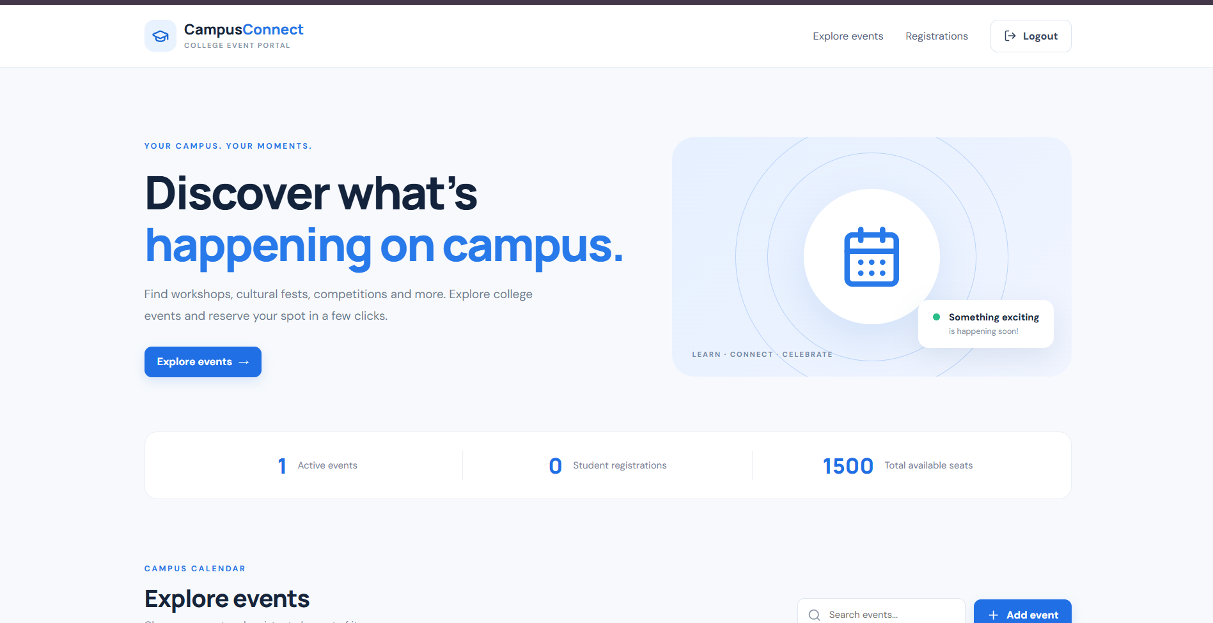



Homepage & Dashboard
Homepage
CampusConnect hero section and tagline
Navigation menu
Explore events, Registrations, Logout
Explore events
Button leads to the event list
Live dashboard
Active events, registrations and seats
1
0
1500
Active events
Registrations
Total seats
Notes:
This is the CampusConnect homepage. The top navigation has Explore events, Registrations and Logout. The big Explore events button takes the student to the event list. Below the banner there is a live dashboard showing the number of active events, student registrations and total available seats. Right now there is 1 active event, 0 registrations and 1500 seats.

Slide 6
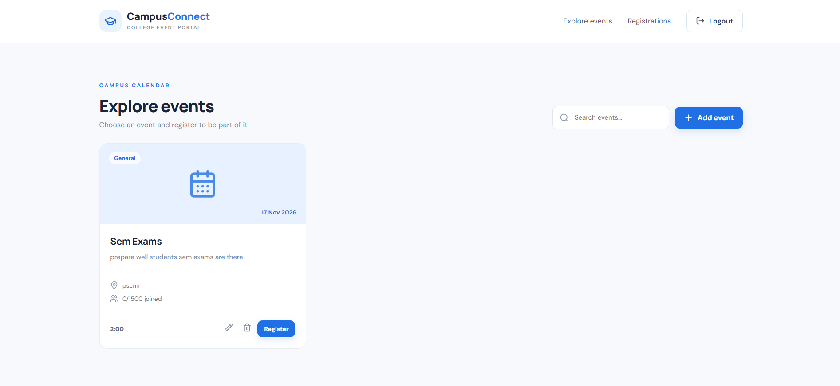




Event Management
Display events as cards
Category, date and time
Description and venue
Search events
Add, edit and delete events
Details shown on every event card
General
17 Nov 2026
2:00
pscmr
0/1500 joined
Student registration option
Notes:
Events are shown as cards. Each card shows the category, date, time, description, venue and how many seats are filled, for example 0 out of 1500. There is a search box to find events. The admin can add a new event and edit or delete existing ones using the pencil and bin icons. Students use the Register button to join an event.

Slide 7
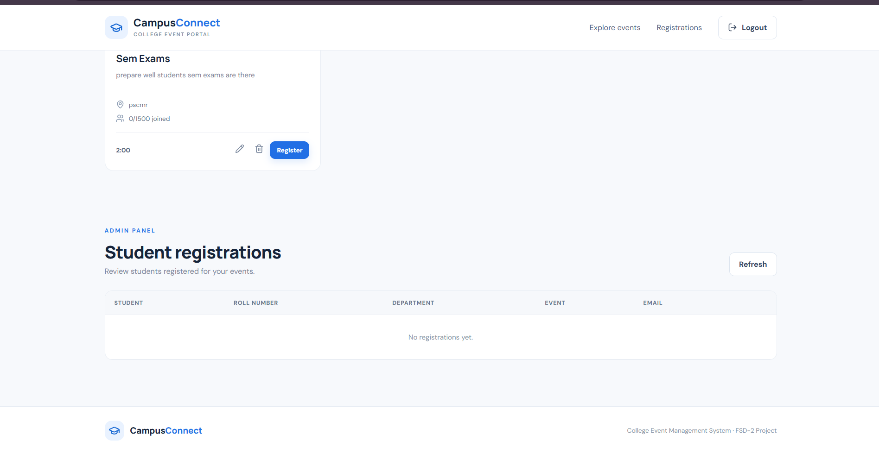
Student Registrations & Database
MongoDB collections
Events
_id
PK
title
category
date / time
venue / seats
1 : N
One event, many registrations
Registrations
_id
PK
eventId
FK
Admin can view these registration records
studentName
Student
Roll Number
Department
Event
Email
rollNumber
department / email
Notes:
When a student registers, the details are stored in MongoDB: student name, roll number, department, the event name and email. The admin can see all of them in the Student registrations table on the website. In the database there are two collections. Events stores each event. Registrations stores each student's registration and links back to an event by its ID, so one event can have many registrations.

Slide 8





Conclusion & Future Enhancements
Conclusion
Future Enhancements
Developed a centralized college event management platform
Student login
Email notifications
Simplifies event creation and student registration
QR code attendance
Digital certificates
Helps administrators manage events and registrations
Event analytics
THANK YOU
Shaik Mabhu Subhani
CampusConnect · FSD-2 Project
github.com/mabhu438/college_event_management_system
Notes:
To conclude: CampusConnect is a centralized platform that makes it easy to create events and register students, and it helps administrators manage both. In future I plan to add student login, email notifications, QR code attendance, digital certificates and event analytics. Thank you. I am happy to answer any questions.

