Slide 1
GROUP 18
MABIRIZI KIZZA AHMED | 16/U/553
SSESSAZI NASSER | 16/U/11763/EVE
KABALI FAHAD MALIK | 16/U/5043/PS
LUBEGA MARK ARNOLD | 16/U/6609/PS

Slide 2
Introduction to Bayesian Classification
The Bayesian Classification represents a supervised learning method as well as a statistical method for classification.
Assumes an underlying probabilistic model and it allows us to capture uncertainty about the model in a principled way by determining probabilities of the outcomes.
It can solve diagnostic and predictive problems.
Notes:
<number>

Slide 3
Probability
Probability is calculating the occurrence of events in a particular sequence, that is, if it is known that something has already happened, what will be the probability that another event happens after that.
To represent it mathematically, If A is the first event(prediction) and B is the observed event, then P(B|A) is our desired probability of calculating probability of event A after occurrence of event B, P(A n B) is probability of the two events occurring together
P(A | B) = P(B | A) *P(A) / P(B)

Slide 4
Naive Bayes classification
It is a classification algorithm based on Bayes’ Theorem with an assumption of independence among predictors(features). In simple terms, a Naive Bayes classifier assumes that the presence of a particular feature in a class is unrelated to the presence of any other feature. For example, a fruit may be considered to be an apple if it is red, round, and about 3 inches in diameter. Even if these features depend on each other or upon the existence of the other features, all of these properties independently contribute to the probability that this fruit is an apple and that is why it is known as ‘Naive’.

Slide 5
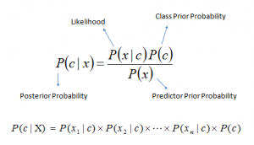
Bayes theorem provides a way of calculating posterior probability P(c|x) from P(c), P(x) and P(x|c). Look at the equation below:
P(c|x) is the posterior probability of class (c, target) given predictor (x, attributes).
P(c) is the prior probability of class.
P(x|c) is the likelihood which is the probability of predictor given class.
P(x) is the prior probability of predictor.

Slide 6
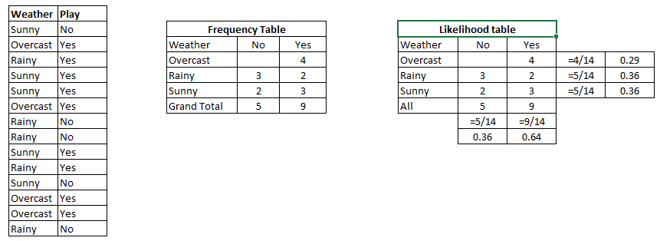
How Naive Bayes classification works?
Let’s understand it using an example. Below I have a training data set of weather and corresponding target variable ‘Play’ (suggesting possibilities of playing). Now, we need to classify whether players will play or not based on weather condition. Let’s follow the below steps to perform it.

Slide 7
Step 1: Convert the data set into a frequency table

Slide 8
Step 2: Create Likelihood table by finding the probabilities like Overcast probability = 0.29 and probability of playing is 0.64.

Slide 9
Step 3: Now, use Naive Bayesian equation to calculate the posterior probability for each class. The class with the highest posterior probability is the outcome of prediction.
Problem: Players will play if weather is sunny. Is this statement is correct?
We can solve it using above discussed method of posterior probability.
P(Yes | Sunny) = P( Sunny | Yes) * P(Yes) / P (Sunny)
Here we have
P (Sunny |Yes) = 3/9 = 0.33
P(Sunny) = 5/14 = 0.36
P( Yes)= 9/14 = 0.64
Now
P (Yes | Sunny) = 0.33 * 0.64 / 0.36 = 0.60, which has higher probability.

Slide 10
Applications of Naive Bayes Classification
Real time Prediction: Naive Bayes is an eager learning classifier and it is sure fast. Thus, it could be used for making predictions in real time.This can be very vital for real time systems.
Multi class Prediction: This algorithm is also well known for multi class prediction feature. Here we can predict the probability of multiple classes of target variable.
Text classification/ Spam Filtering/ Sentiment Analysis: Naive Bayes classifiers mostly used in text classification (due to better result in multi class problems and independence rule) have higher success rate as compared to other algorithms. As a result, it is widely used in Spam filtering (identify spam e-mail) and Sentiment Analysis (in social media analysis, to identify positive and negative customer sentiments)
Recommendation System: Naive Bayes Classifier and Collaborative Filtering together builds a Recommendation System that uses machine learning and data mining techniques to filter unseen information and predict whether a user would like a given resource or not

Slide 11
Application of Naive Bayes Classification
P(A|B) = (P(B|A)*P(A))/P(B)
Predicting spam tweets
P(spam|drugs)
P(A)- tweet is spam(30 in every 100)
P(B)-tweets contains word drugs(10 in every 100),whether spam or not
P(B|A)-tweet contains word drugs given that it is spam,percentage of tweets in spam category that contain word drugs(6 in every 30)

Slide 12
Pros:
The algorithm is easy and fast to train,unlike more complex models like neural networks.
It performs well in multi class prediction,unlike other linear models that are strictly binary classifiers.
When assumption of independence holds, a Naive Bayes classifier performs better compare to other models like logistic regression and you need less training data.
It perform well in case of categorical input variables compared to numerical variable(s). For numerical variable, normal distribution is assumed (bell curve, which is a strong assumption).

Slide 13
Cons:
If a category (in test data set), was not observed in training data set, then model will assign a 0 (zero) probability and will be unable to make a prediction.
Naive Bayes is also known as a bad estimator for small datasets, ie it requires relatively large datasets to make reliable predictions.
Another limitation of Naive Bayes is the assumption of independent and equal predictors. In real life, it is almost impossible that we get a set of predictors which are completely independent.

Slide 14
Naive Bayes in R
The e1071 package contains the naiveBayes function. It allows numeric and factor variables to be used in the naive bayes model. Laplace smoothing allows unrepresented classes to show up. Predictions can be made for the most likely class or for a matrix of all possible classes.
The function naiveBayes is a simple, elegant implementation of the naive bayes algorithm. There are really only a handful of

Slide 15
parameters you should consider.
naiveBayes(formula, data, laplace =0, na.action =na.pass)
> The formula is traditional Y~X1+X2+…+Xn
> The data is typically a dataframe of numeric or factor variables.
> laplace provides a smoothing effect
> na.action lets you determine what to do when you hit a missing value in your dataset.
The only parameters we have reason to change in this instance is the laplace smoothing value. Since the naive bayes algorithm is so simple, we don’t need to spend much time setting up our parameters in the first place.

Slide 16
Predicting with Naive Bayes Classifier
After creating the naive Bayes model object, you can use the universal predict function to create a prediction.
predict(nb_default, test, type="class")
predict will, by default, return the class with the highest probability for that predicted row.
The predict function allows you to specify whether you want the most probable class or if you want to get the probability for every class. Nothing changes with the exception being the type parameter is set to “raw”.

