Slide 1

Capture The Flag
CTF Team:
Marcos Álvares marcos.alvares at gmail
Gustavo Bittencourt gusbit at gmail
Rafael Oliveira ludug3r0 at gmail

Slide 2
CTF - Environment
Linux Ubuntu Server
Build essentials
Interpreters, compilers, debuggers
Most common text editors
ASLR disabled
GCC stack protections disabled
One user per participant

Slide 3
CTF - Challenges
11 challenges
3 difficulty levels
2 categories
  Crackme (5 challenges)
  Vulndev (6 challenges)
“Just hack” mode
Real time score
Individual or Team

Slide 4
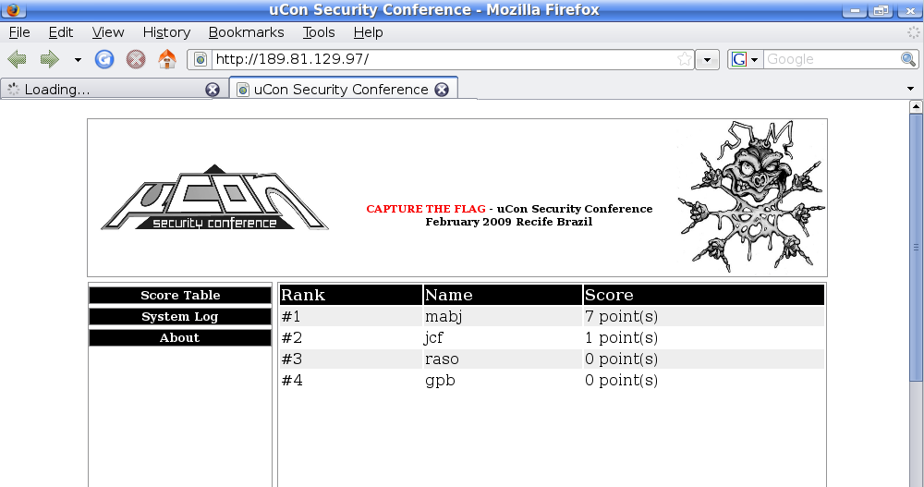
CTF - Interface

Slide 5
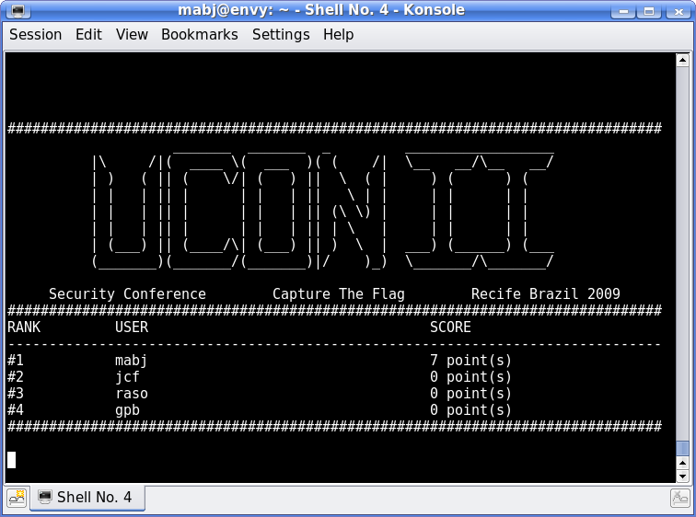
CTF - Old School Interface: ]

Slide 6
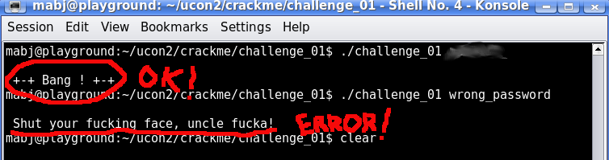
CTF - Main Objectives
Discover the software key
Find and exploit the software vulnerability
And print the “bang” string

Slide 7
CTF - Awards
A Legendary Shellcode Hand Book
A cool uCon t-shirt
A free pass to the next uCon
Fame and Glory !

Slide 8
CTF - Registration
Just two things:
  Name
  Mail address

Slide 9
Any questions ?

