Slide 1



eksport-hajmi-model
View in Power BI
Last data refresh:
12/9/2025 3:29:28 AM UTC
Downloaded at:
12/9/2025 3:55:23 AM UTC

Slide 2
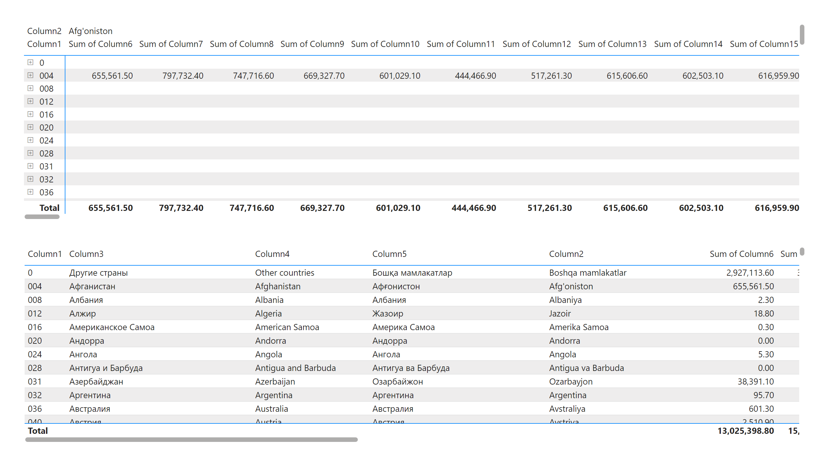
Page 1
Notes:
pivotTable
No alt text provided
tableEx
No alt text provided

