Slide 1
Swarm Demonstration Hardware System: Applied to Maintaining a Wireless Sensor Network
Christiana Chamon
Rachel Dunn
Maria Ciara Lalata
Mable Wan
Sponsor: Dr. Aaron Becker

Slide 2
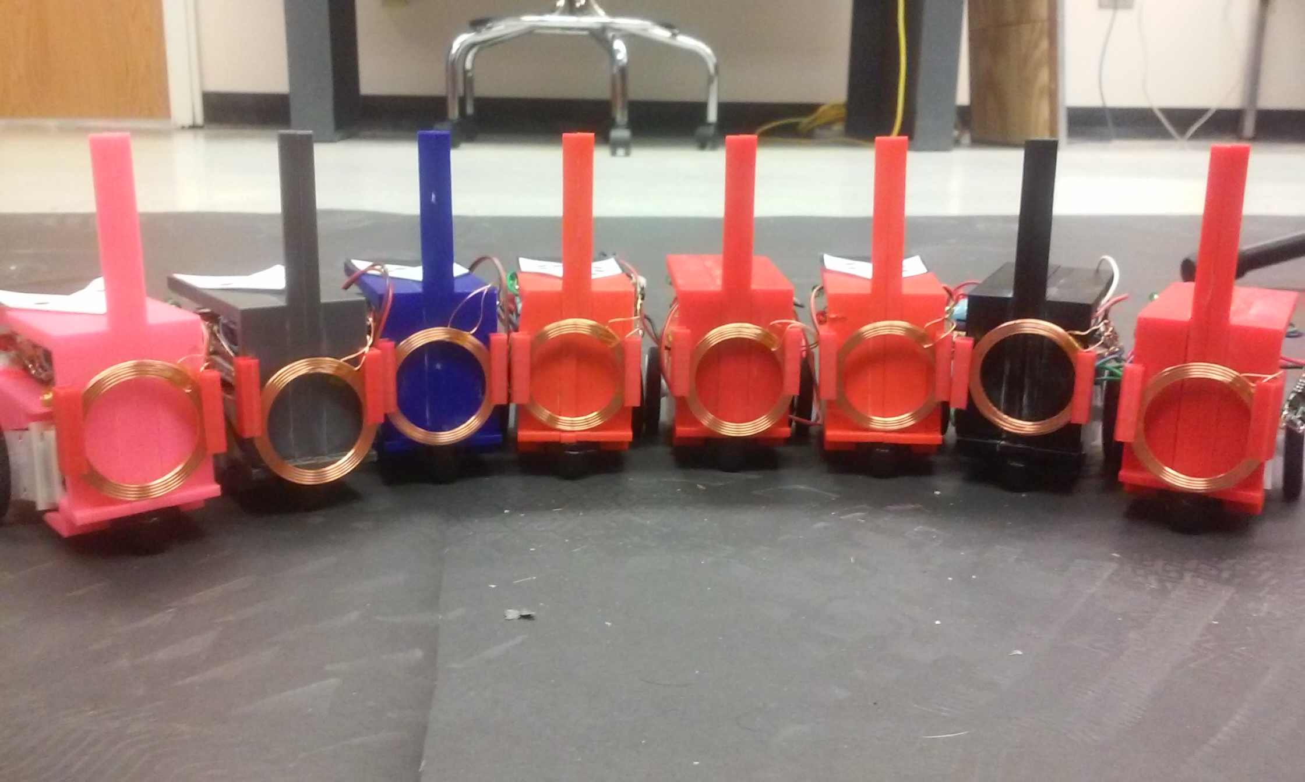
Agenda
The purpose of this project
Problem and background
Methodologies used
Overview diagram of project
Accomplishments
Challenges
Conclusion

Slide 3
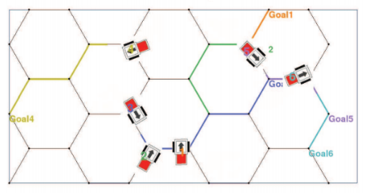
Purpose
This project develops search and control algorithms to enable robots to autonomously locate and then wirelessly charge moving sensors

Slide 4
Problem and Background
No current solutions for:
Cheap, simple, tracking robots
Inductive charging robots
Image processor to identification tags and orientation

Slide 5
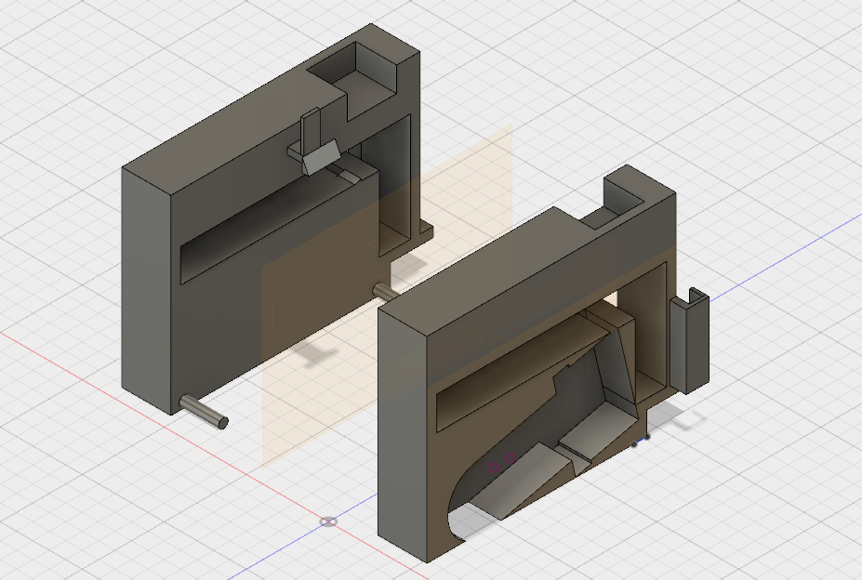
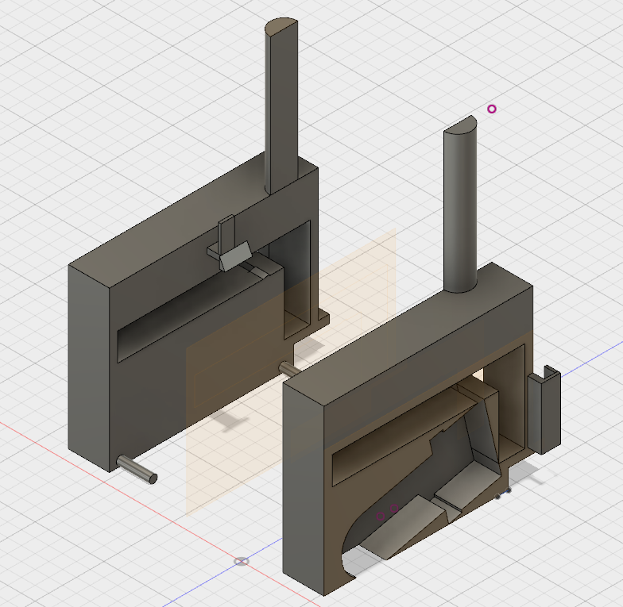
Methodology
Open source robot design
Matlab programming
Image processing
Modular programming

Slide 6
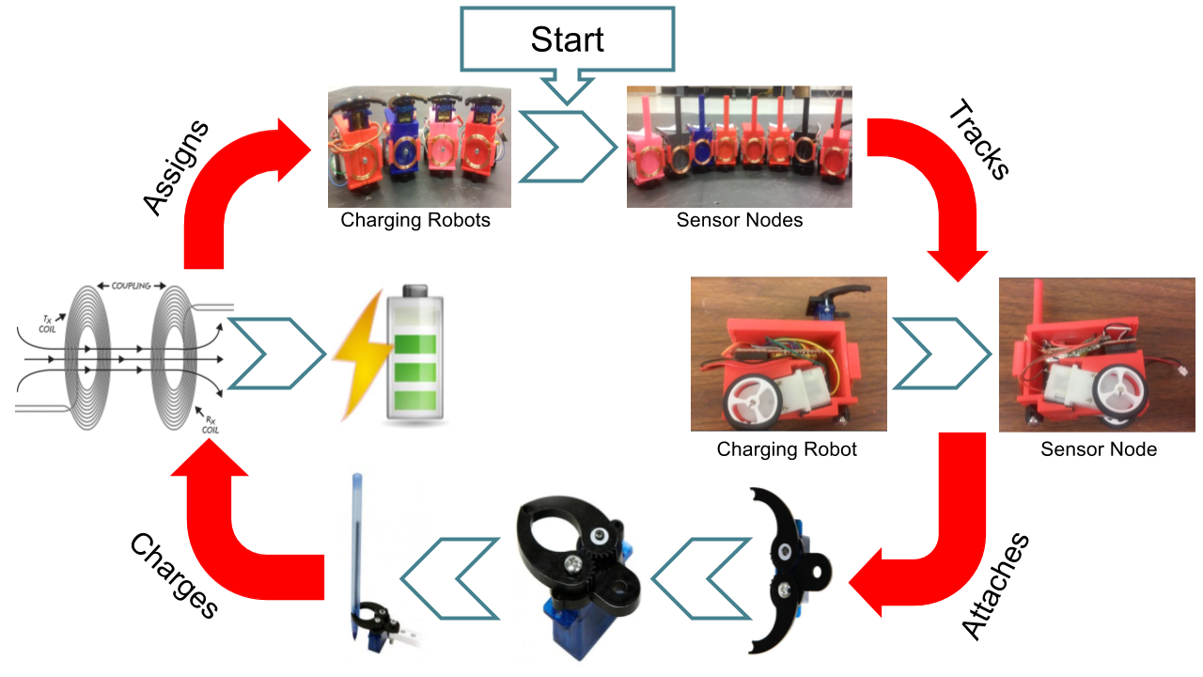
Overview Diagram

Slide 7
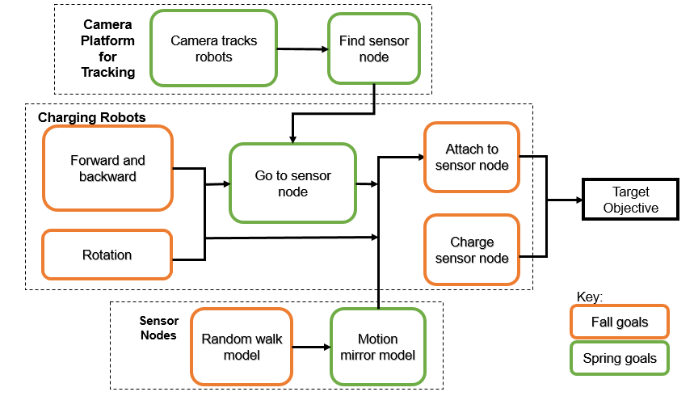
Goal Analysis

Slide 8
Goal Analysis

Slide 9
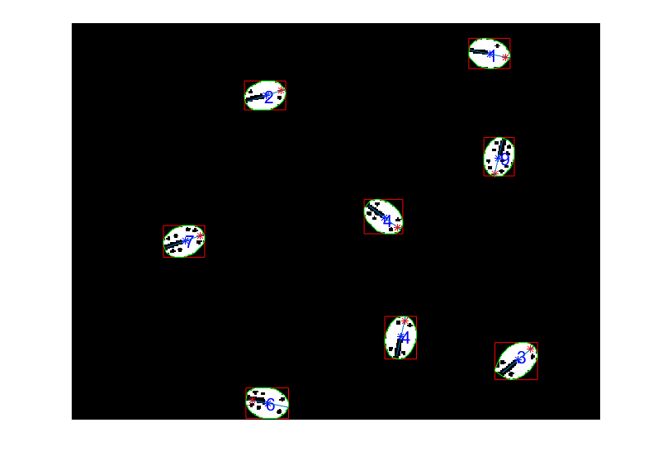
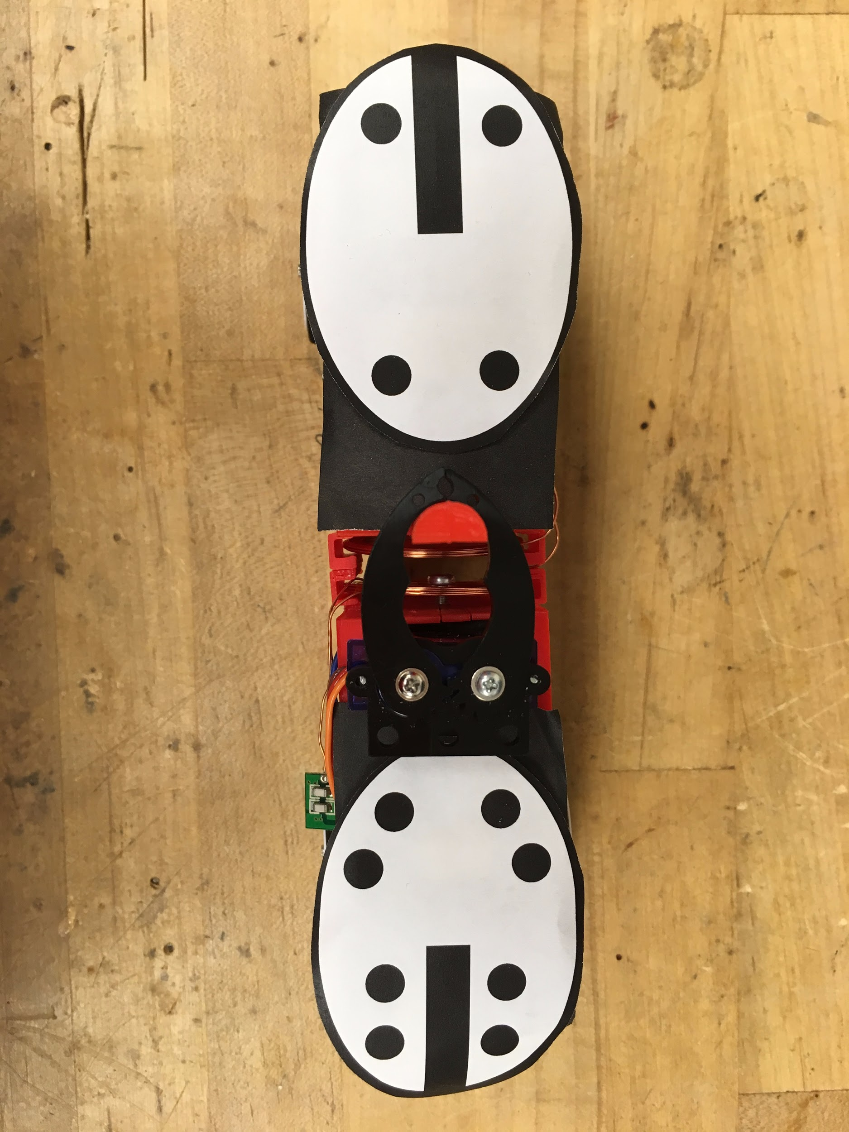
Camera Platform
Camera track robots
Finds sensor nodes

Slide 10
Goal Analysis

Slide 11
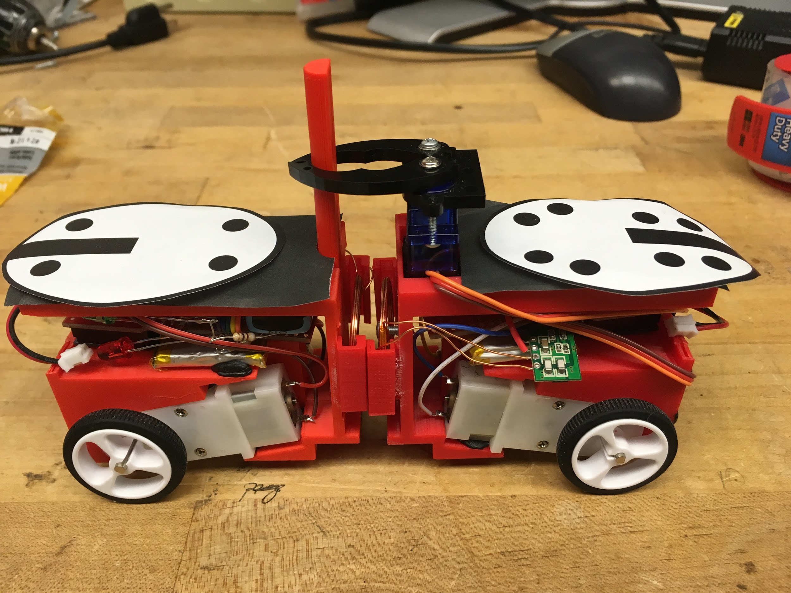
Charging Platform
Forward and Backward
Rotation
Go to sensor node
Attach to sensor node
Charge sensor node

Slide 12
Goal Analysis

Slide 13
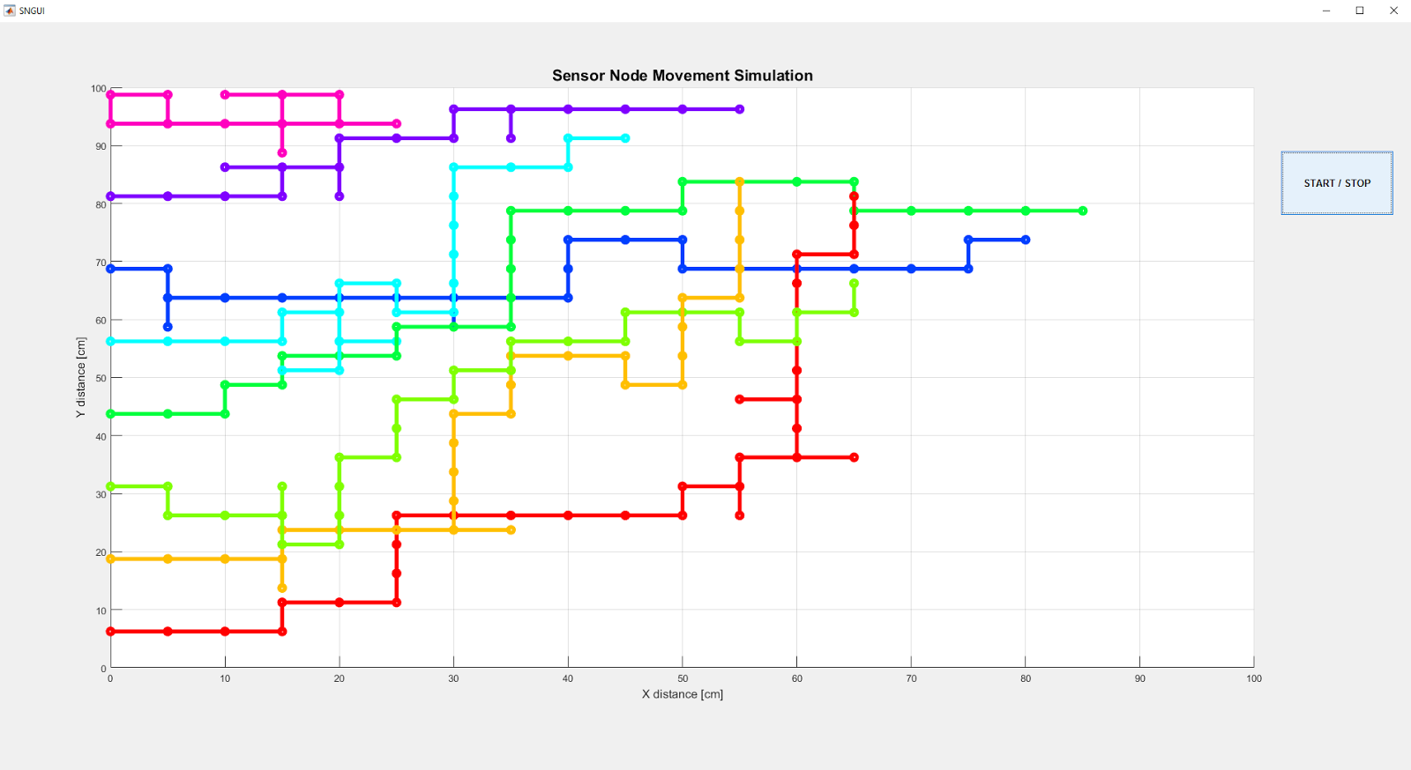

Sensor Node
Random walk model
Motion mirror model

Slide 14
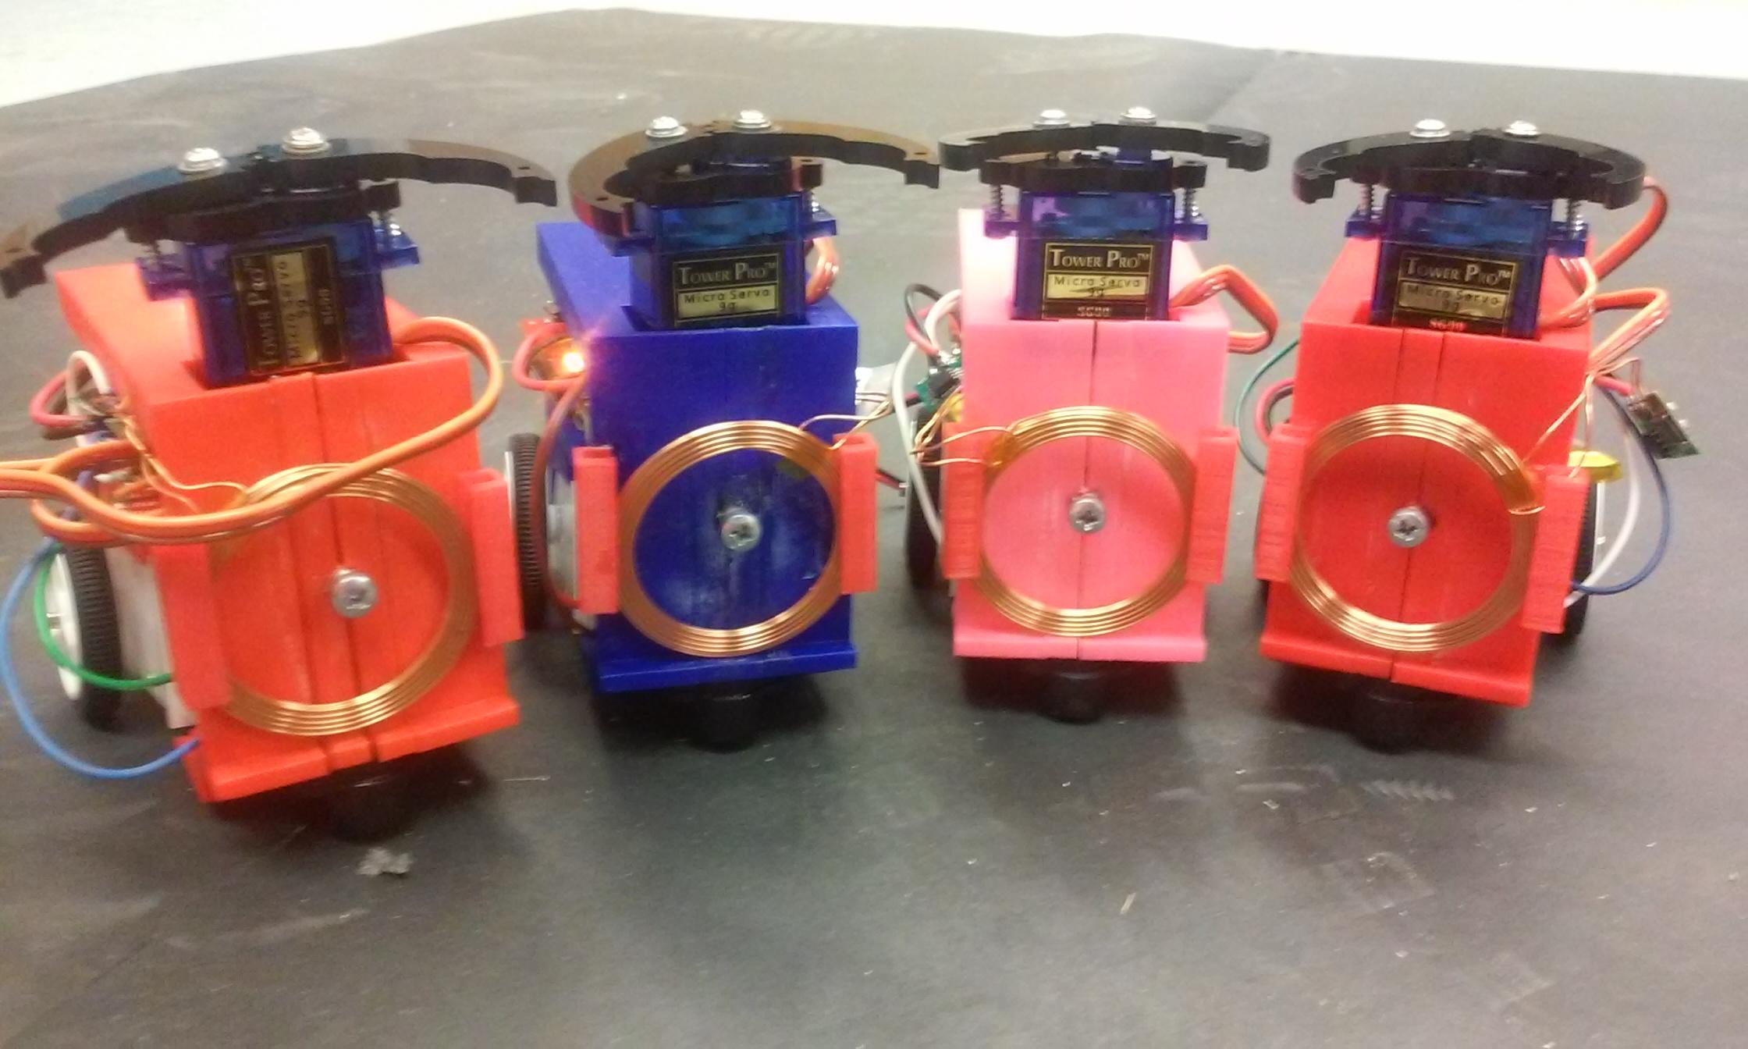
Accomplishments
Assembled Robots
Wireless communication
Tested individual modules
Image processor
Integration – 80%
Video - https://www.youtube.com/watch?v=_dyrbnKCqX0

Slide 15

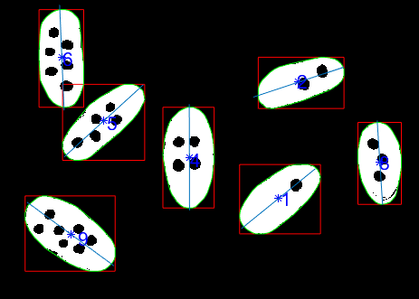
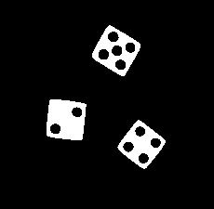

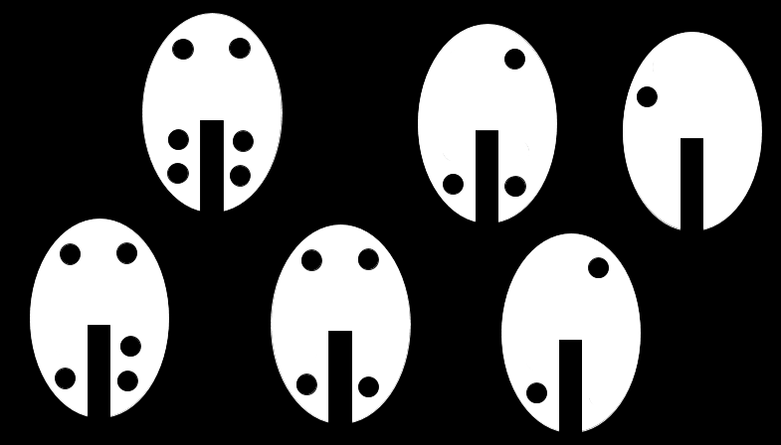
Challenges
Inconsistent Image processor – many iterations
Testing individual modules that were dependent
Project management
Writing original programs
XBee - wireless communication
Image processing identification tags
Simulation -> Physical Testing
Custom shells

Slide 16
Conclusion
Robotic hardware system
Maintain the battery life of sensor nodes
Inspire future engineering students

Slide 17
Thank you

Slide 18
Appendix
Random Walk - https://www.youtube.com/watch?v=0jP0-5w1uqE

