Slide 1
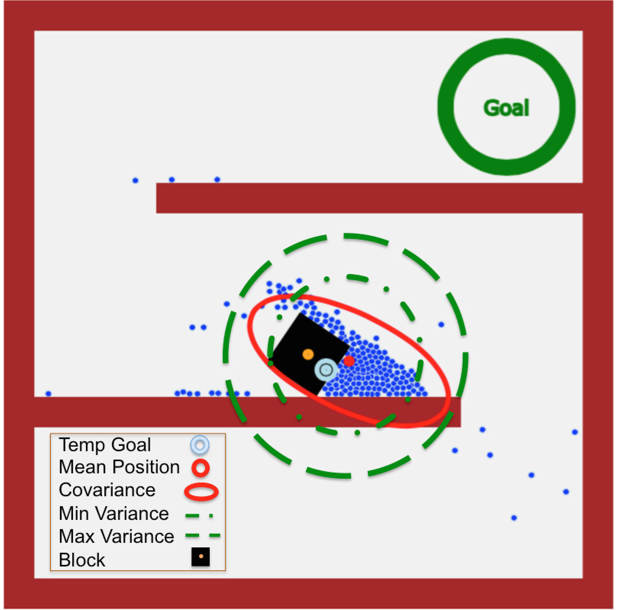
Stochastic Swarm Control with Global Inputs
Shiva Shahrokhi, Aaron T. Becker
University of Houston, TX, USA
Push a block through a maze using a swarm of robots with global inputs
All robots get the same global input and use hybrid hysteresis mean-variance control to reach the goal
We choose local goals to steer the swarm: aggregate behind the block to push the block forward

