Slide 1
Analog IC DESIGN
Lecture 1 Introduction

Slide 2
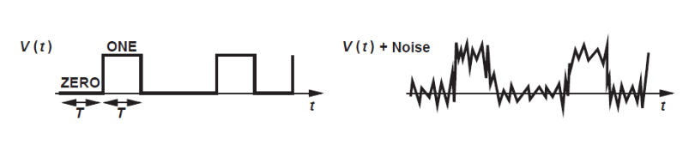
Digital vs Analog
Digital benefits
  Noise immunity
  Easier to store and process
  Easier to automate the design and testing
  Direct benefit of scaling

Slide 3
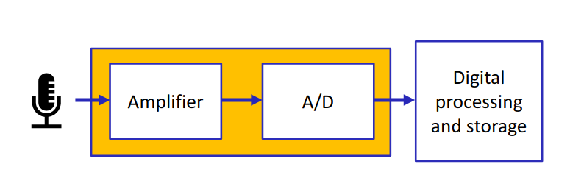
Digital vs Analog
Analog Benefits:
  You need analog interface to sense any physical phenomena and convert it to digital
  At high speed digital design is analog design
  You will always Amplifiers,ADC’ s,DAC’ s and Power Management blocks

Slide 4
Why CMOS?
Consumed negligible static power in the past but not now (due to leakage)
Required very few devices per gate (for example And or not )
Can be scaled down and get higher density and lower power consumption
Lower fabrication cost
For Analog:
  CMOS is used today because market is mainly driven by digital which driven by CMOS
  And we want to integrate analog and digital on the same ship

Slide 5
Analog IC Design Challenges
Device scaling
  Transistors become faster, but the gain declines
Supply voltage scaling
  Will limit the available headroom for the transistor
Complexity
  Continuous increase in transistor count and system complexity
PVT variations
  Tolerate large process,voltage , and temperature variations

Slide 6
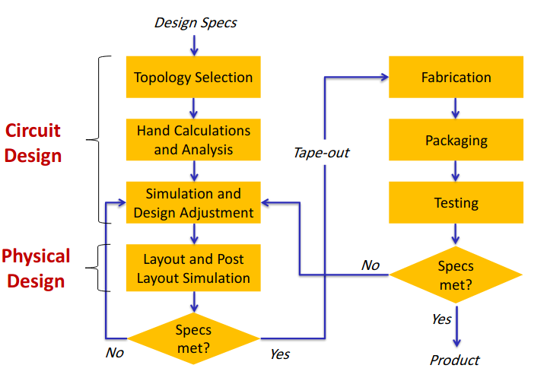
Analog IC Design Flow (Simplified)

