Slide 1
Analog IC Design
Lecture 2 circuits and systems review

Slide 2
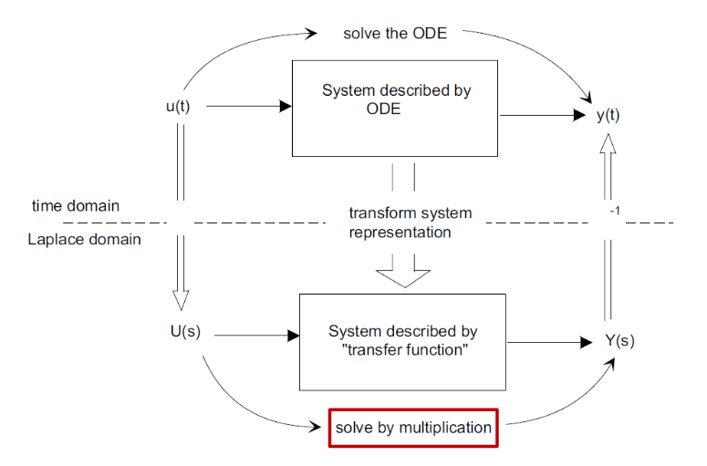
Laplace Transform (LT)
L
L
H(s)

Slide 3
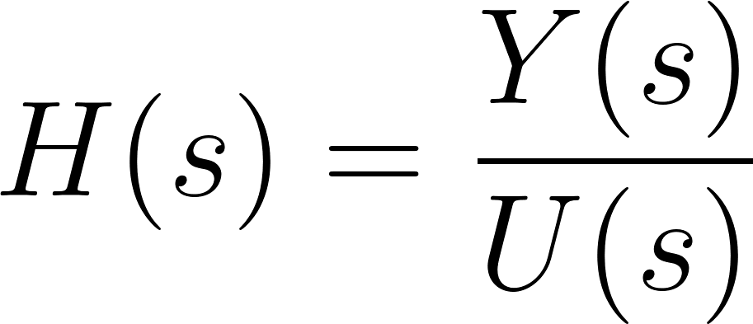
Laplace Transform (LT)
Laplace transform helps you to solve differential equations by multiplication and division
H(s)
U(s)
Y(s)
Y(S)=H(s)U(s)

Slide 4
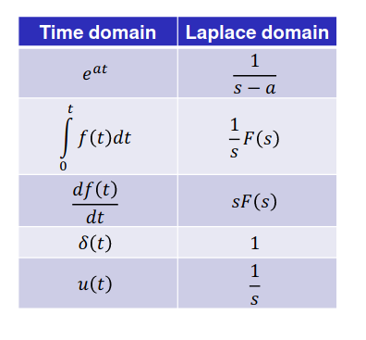
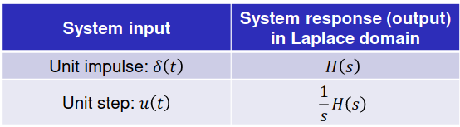
Laplace Transform (LT)

Slide 5

Poles and Zeros
Transfer function
Zeros:roots of the numerator N(s) = 0
Poles: roots of the denominator (characteristic eq.) D(s) =0
For physical systems, poles & zeros are real or complex conjugate
Notes:
  If the system input is impulse in the time domain then the output is the transfer function in laplace domain

Slide 6
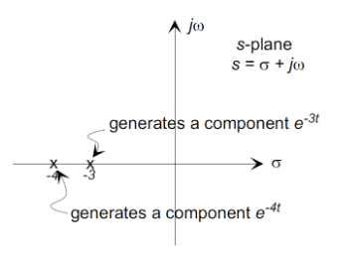
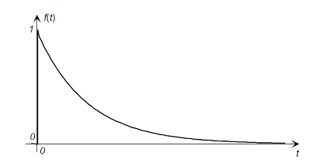
Real and Complex Poles

Slide 7
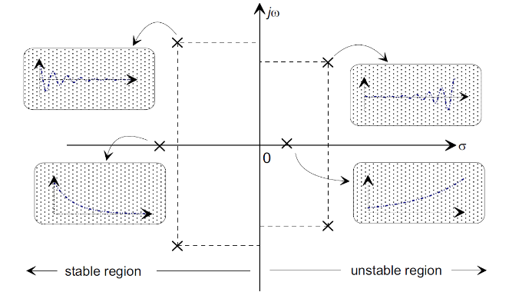
LHP and RHP Poles
Poles in LHP: Decaying exponential (stable system)
Poles in RHP: Growing exponential (unstable system)

Slide 8
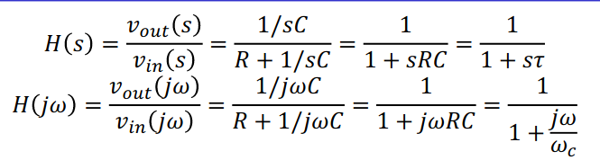
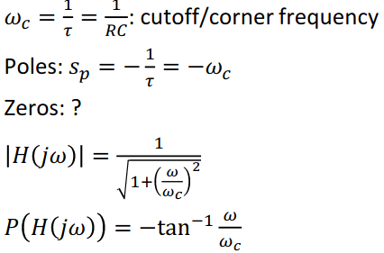
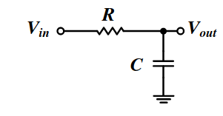
First-Order LPF
𝜏 = 𝑅𝐶: time constant
@ w = infinity

Slide 9
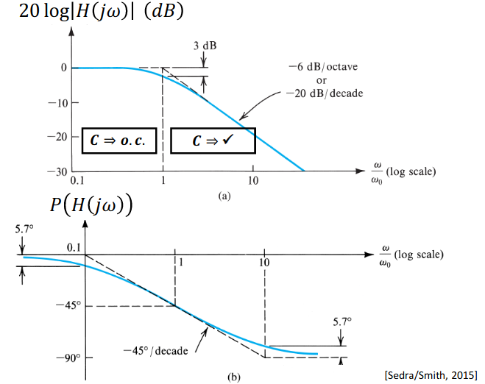
First-Order LPF Bode Plot

Slide 10
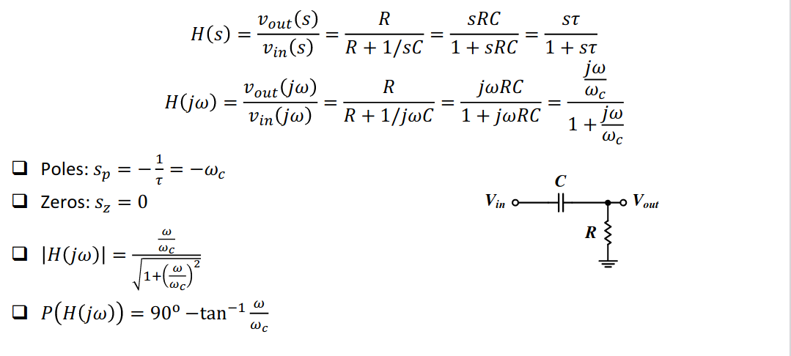
First-Order HPF

Slide 11
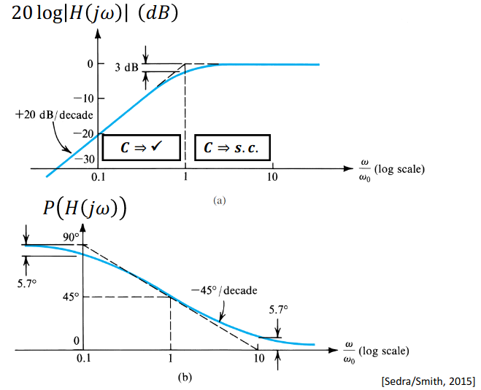
First-Order HPF Bode Plot

Slide 12
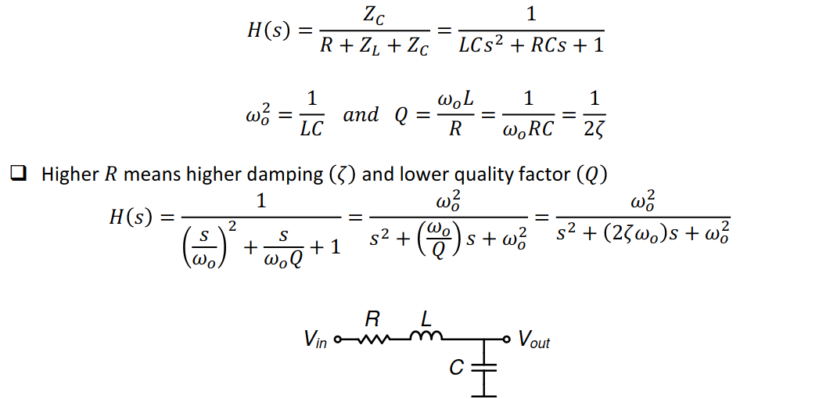
Second-Order System: LC LPF

Slide 13
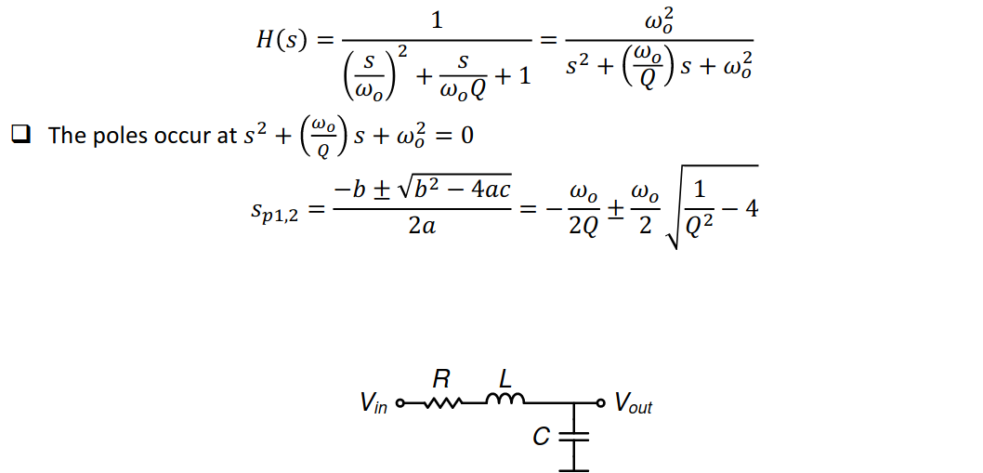
Second-Order Passive LC LPF

Slide 14
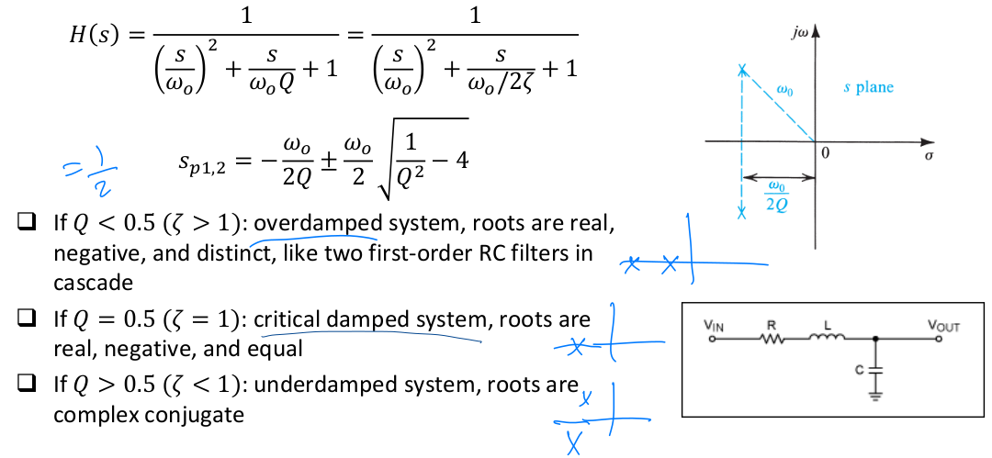
Second-Order System Poles

Slide 15
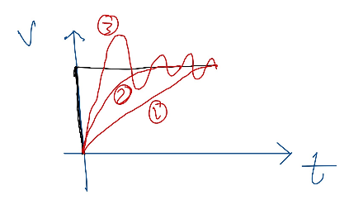

Ringing and Peaking
Q < 0.5 (ζ > 1) over damped system roots are real,
negative, and distinct
Q = 0.5 (ζ = 1):critical damped system, roots are
real, negative, and equal
Q > 0.5 (ζ < 1):under damped system,roots are
complex conjugate
  Problems:
        Increase settling time
        Overshoot and undershooting which is calculated by

Slide 16
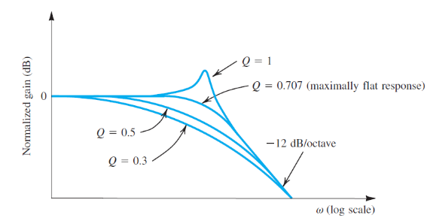
Ringing and Peaking
Ringing at time happens first at Q > 0.5 then peaking at frequency domain at Q > 0.707

