Slide 1
Bandgap Design

Slide 2
Introduction
- One of the essential building blocks of many analog circuits is a voltage reference, which should exhibit little dependence on supply and process parameters and a well-defined dependence on temperature.
- Temperature dependence: -
1- Positive temperature coefficient (+ve TC): Proportional to absolute temperature (PTAT).
2- Negative temperature coefficient (-ve TC): Complementary to absolute temperature (CTAT).
3- Temperature independent (Zero-TC): ZTAT = PTAT + CTAT.
- If we achieve a temperature independent reference it will also be process independent.
- Applications: Voltage regulators, ADCs and DACs, Biasing of amplifiers, Common-mode (CM) level of fully-differential circuits, ...etc.

Slide 3
Band-gap Reference
- A reference voltage is generated by adding two voltages that have temperature coefficients of opposite sign with suitable multiplication constants.
- For example, for two voltages v1 and v2 that vary in opposite directions with temperature, choose a1 and a2 such that: -
a1(dv1/dT) + a2(dv2/dT) = 0
obtaining a reference voltage, VREF = a1.v1 + a2.v2 with zero TC.
- We must now identify two voltages that have positive and negative TCs. Among various device parameters in semiconductor technologies, the characteristics of bipolar transistors have proven the most reproducible and well-defined quantities that can provide positive and negative TCs.

Slide 4
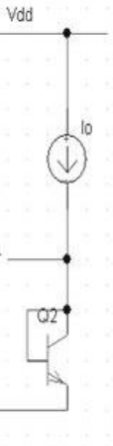

CTAT Voltage
- The base-emitter voltage of bipolar transistors or, more generally, the forward voltage of a pn-junction diode exhibits a negative TC.
❑ It can be shown that Vbe = const. − b1 T → CTAT
▪ Is is a strong function of temperature.
▪ b1 from simulations: Usually b1 ≈ 1.5 − 2 mV/K.

Slide 5
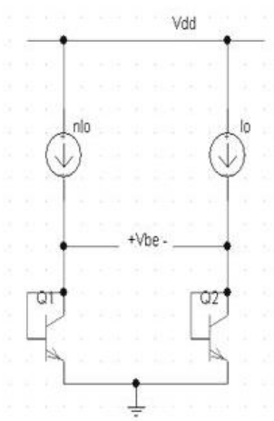
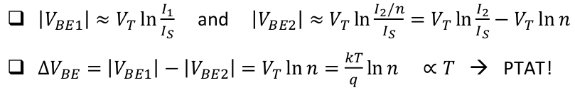
PTAT Voltage
- If two bipolar transistors operate at unequal current densities, then the difference between their base-emitter voltages is directly proportional to the absolute temperature.

Slide 6
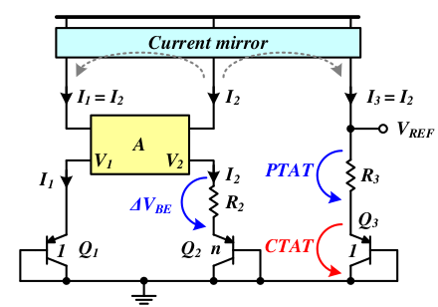
Basic Band-gap Reference
- Adding a PTAT and CTAT in one circuit will produce a ZTAT voltage reference as shown in figure:
- The A-block is a circuit that makes V1 = V2 .
- The current mirror copies I2 to I1 and I3 .

Slide 7
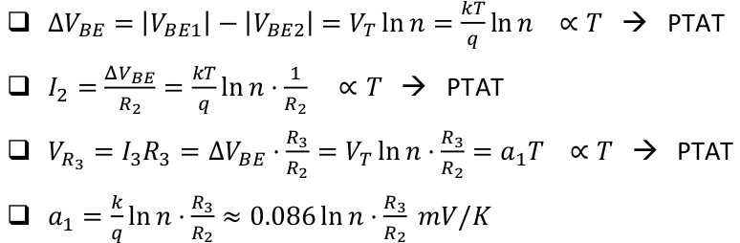
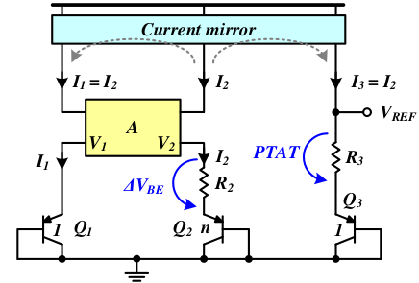
The PTAT Component

Slide 8
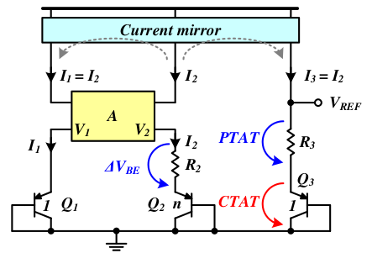
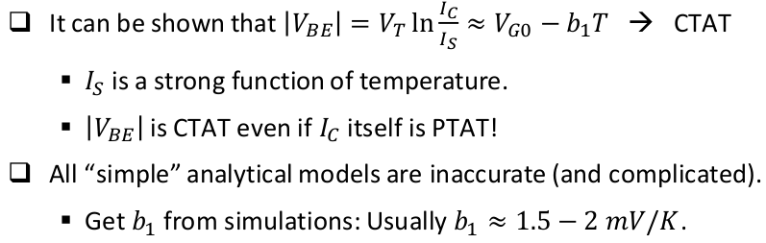
The CTAT Component

Slide 9
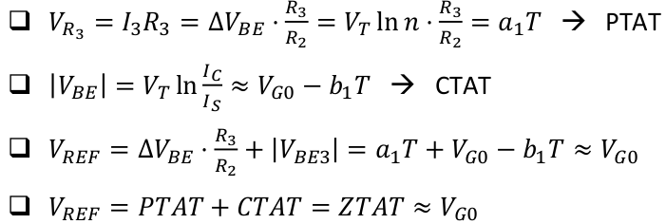
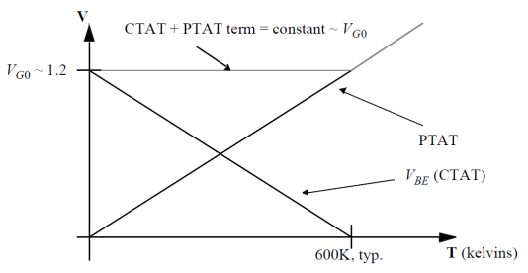
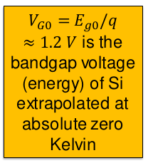
The ZTAT Reference Voltage

Slide 10
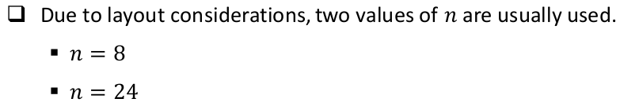
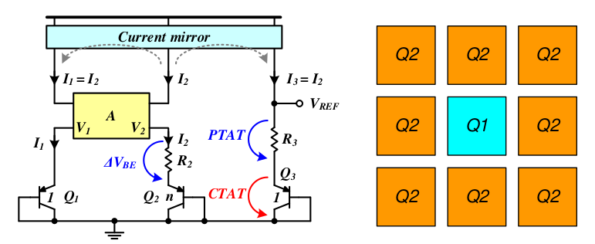
The number of BJT's used

Slide 11
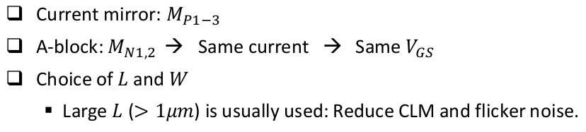
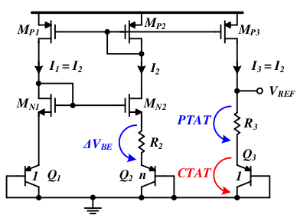
Band-gap Reference Topologies 1- Current mirror based

Slide 12
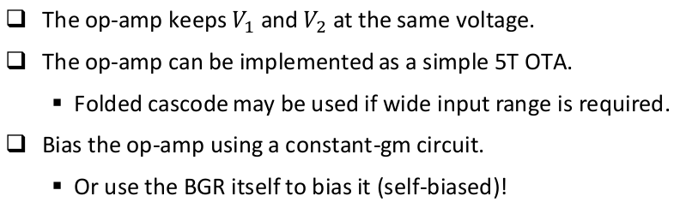
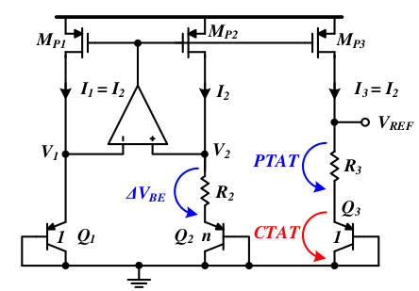
Band-gap Reference Topologies 2- Op-amp based

Slide 13
The start-up Problem
- In the circuit of bandgap, if all of the transistors carry zero current when the supply is
turned on, they may remain off indefinitely because the loop can support a zero current in both
branches. So it is needed to inject current in the bandgap core for proper operation of
the circuit. Start-up circuit does this job. This circuit also turns off when steady state is reached.

Slide 14
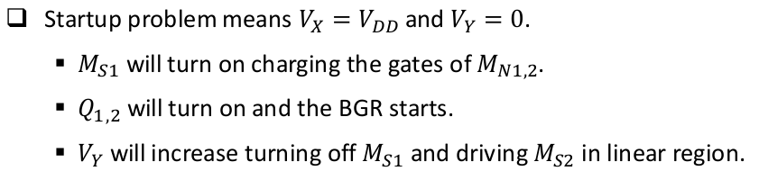
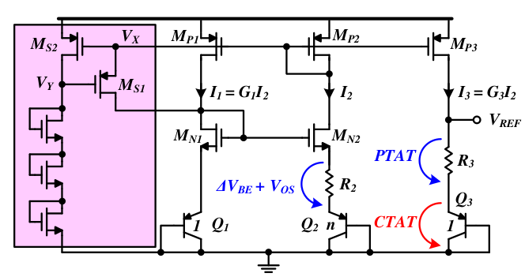
Operation of start-up circuit

Slide 15
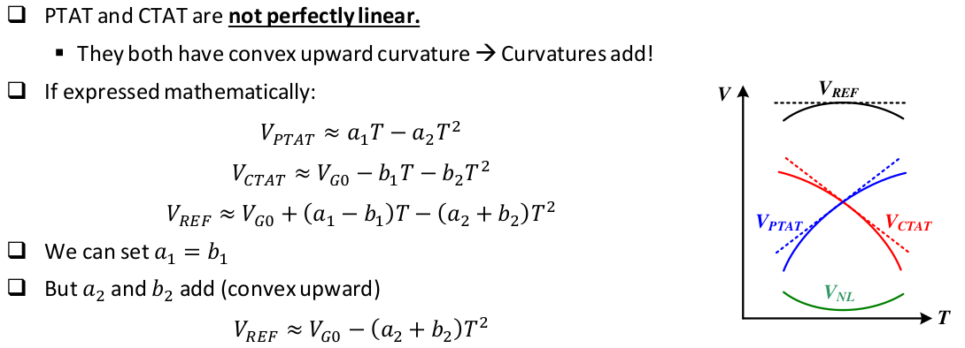
Band-gap Curvature

Slide 16
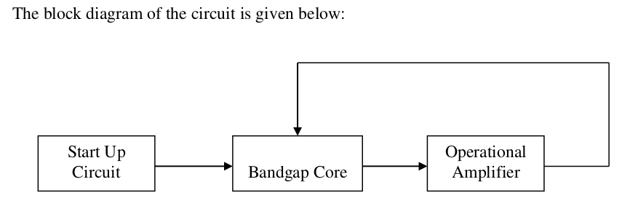
Proposed Band-gap Design

Slide 17
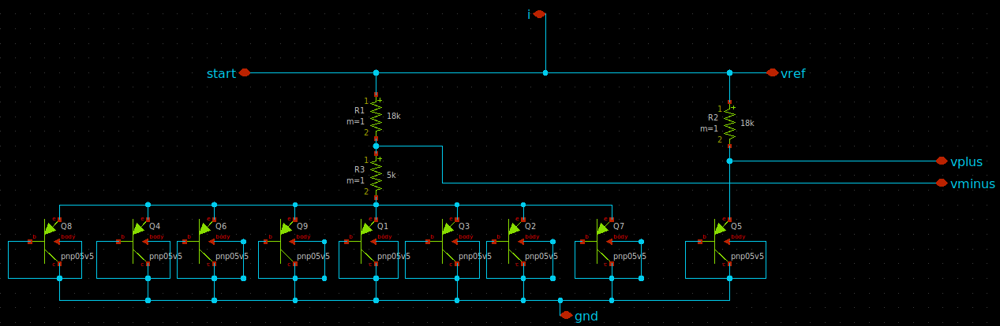
Proposed Band-gap Design
1.1- Band-gap core schematic

Slide 18
Proposed Band-gap Design
1.2- Band-gap core analysis
- VR2 = I2 × R2
= ((VBE2 − VBE1) / R3 ) x R2
= VT ln(n) × (R2 / R3)
= VT ln(8) × (R2/R3)
Where: [n = 8 for our circuit] and VT=KT/q.
- VR2 is a positive TC which is 1.94 mV/°C for the BJT’s used in this circuit.
- Vout =Vref= VR2 + VBE2, thus output voltage is actually summation of a positive TC and
a negative TC voltage. By choosing the proper value of resistors, output reference voltage is
made constant with respect to temperatures (Zero TC).

Slide 19
Proposed Band-gap Design
1.2- Band-gap core analysis
Vref = a1 VR2 + a2 VBE = const. => dVref/dT = a1 dVR2/dT + a2 dVBE/dT = 0
So a1(85uv/k) - a2(1.6mv/k) = 0
Since CTAT slope is greater than PTAT slope we will make a2=1 and vary a1 to make PTAT slope increasing to reach CTAT slope:
So a1=1.6m/85u => a1=19 = (R2/R1)*ln(8)
Let I=30uA then R1=VTln(8)/I = 2k ohm and R2= a1R1/ln(8) = 18k

Slide 20
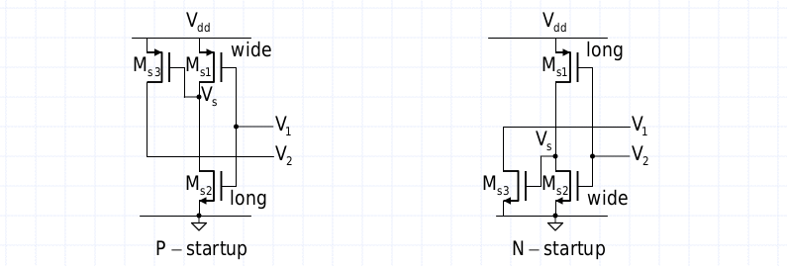
Proposed Band-gap Design
2.1 - Start-up Circuit schemes

Slide 21
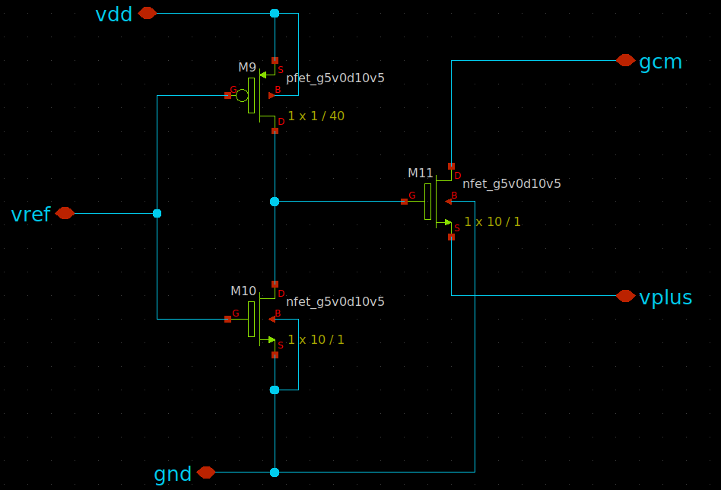
Proposed Band-gap Design
2.2- Start-up Circuit schematic

Slide 22
Proposed Band-gap Design
2.3- Start-up Circuit operation
- At first Vref = 0 but M9 will be ON so there is current will flow in M9 and also in M10 so M11
will turn ON and it will pull down the voltage at current mirror gate down from Vdd and v+ of
the op-amp will increase (so Vref no longer be zero) and when it reaches a value close to vdd
then M11,M10,M9 will be OFF and at this moment the role of start-up circuit will be ended.

Slide 23
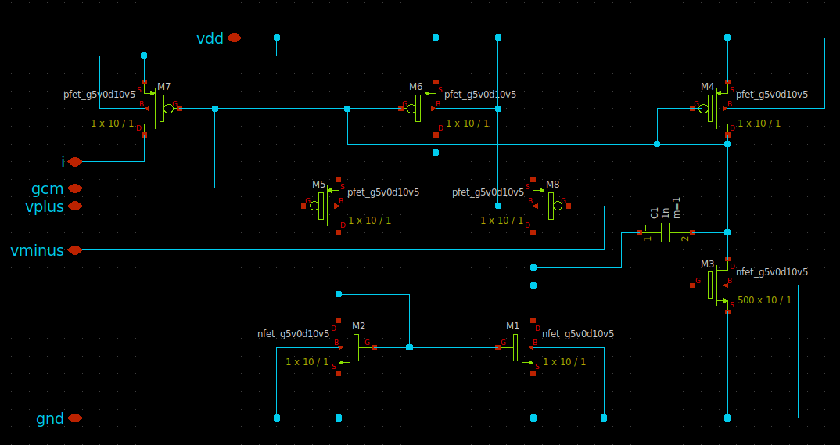
Proposed Band-gap Design
3.1- OTA schematic

Slide 24
Proposed Band-gap Design
3.2- OTA Properties
- Ideally our operational amplifier should have infinite gain for proper function of bandgap core. So for proper function of bandgap core we need to increase the gain of the circuit. That’s why a two stage operational amplifier has been used.
- But in a two stage amplifier, there is more than one pole which tries to make the circuit unstable. To make sure that the circuit is stable, stability analysis of the op amp has to be done.
- Another important aspect of OPAMP design is to produce a current which is insensitive to variation of VDD (supply voltage), this is accomplished by driving the operational amplifier with its own output current(self-biased), this makes the output current of operational amplifier almost constant with respect to voltage.

Slide 25
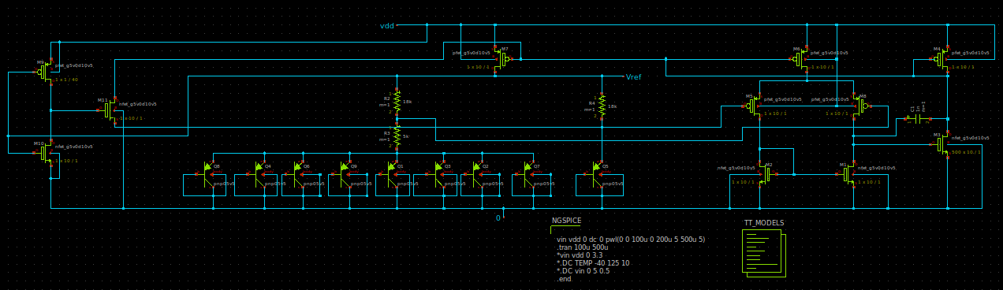
Proposed Band-gap Design Complete circuit

Slide 26
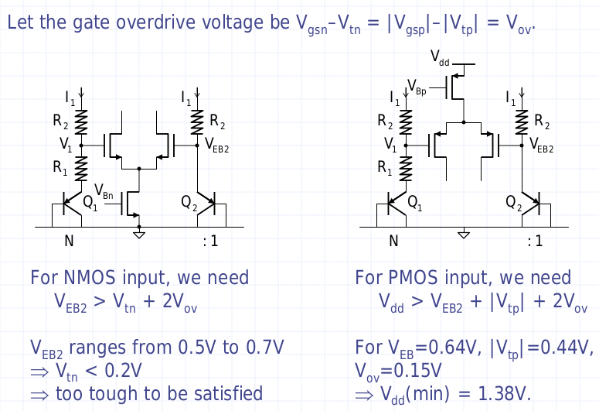
Choosing input stage of OTA

Slide 27
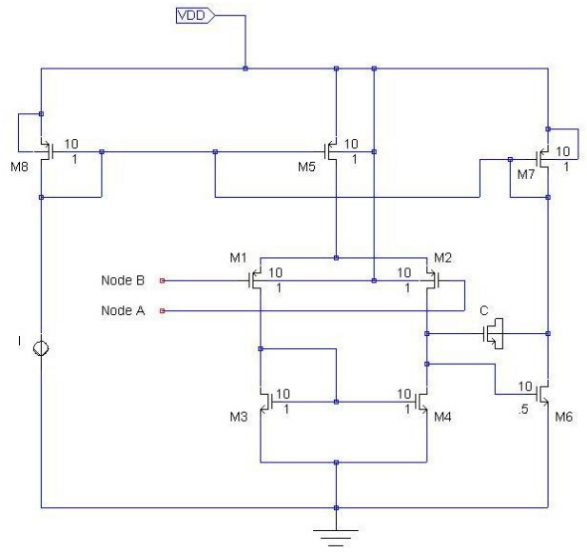
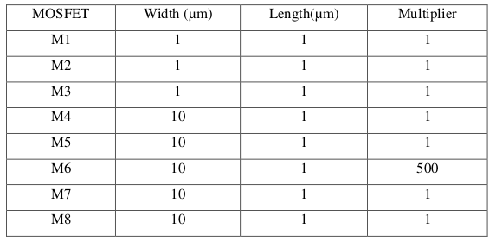
Analysis of the Op-amp

Slide 28
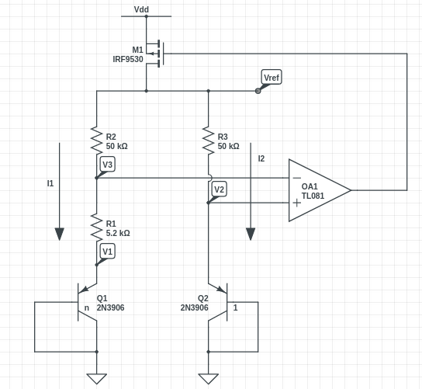
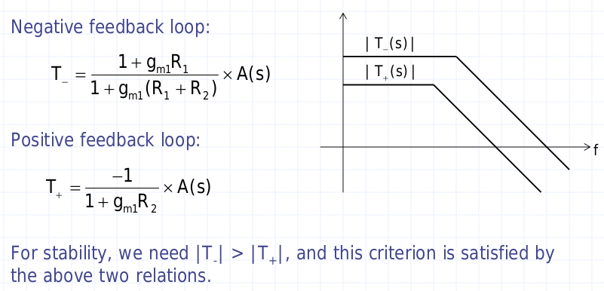
Stability of Bandgap

Slide 29
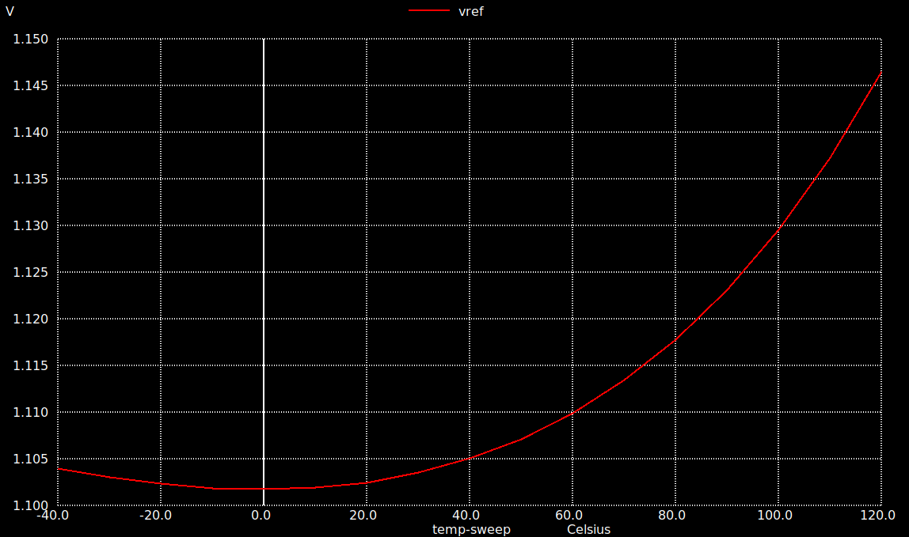
Simulation of Bandgap 3.3v 1- DC sweep vs Temperature
- Vdd = 3.3v and the temperature was swept from –40 to 120 c

Slide 30
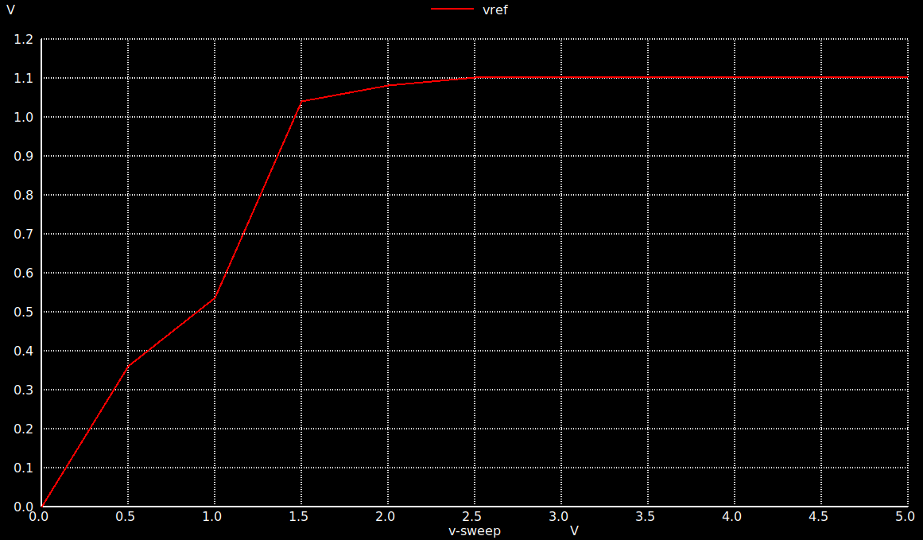
Simulation of Bandgap 3.3v 2- DC sweep vs Supply voltage
- VDD was swept from 0 to 5v

Slide 31
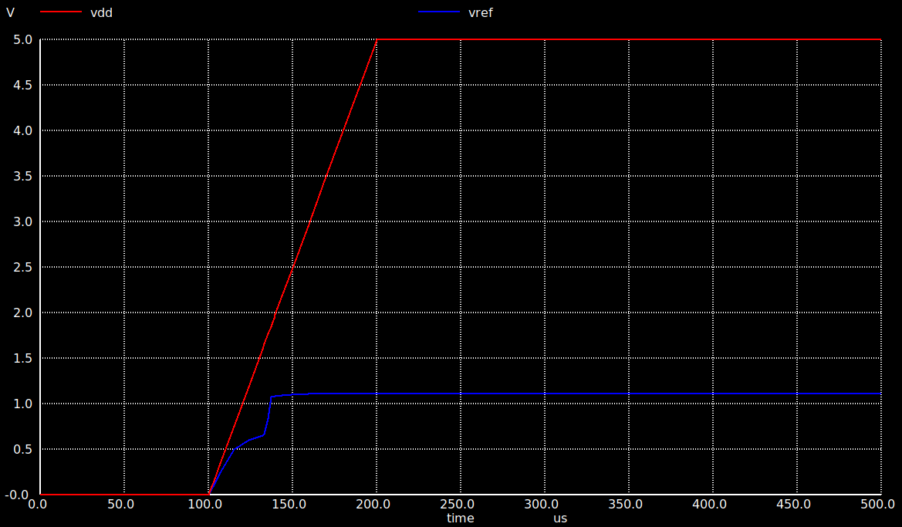
Simulation of Bandgap 3.3v 3- Transient Analysis
- A step voltage from 0 to 5v volt used with 100 us rise time

Slide 32
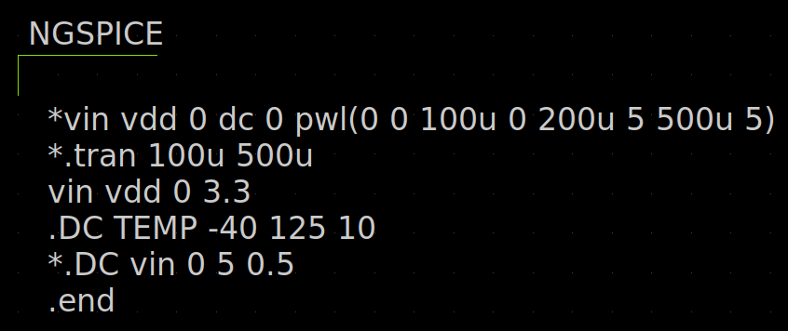
SPICE Netlist

Slide 33
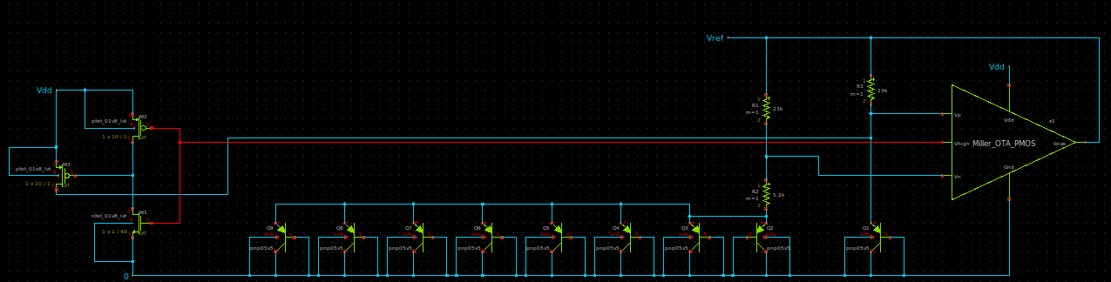
Design of BGR using 1.8v supply

Slide 34
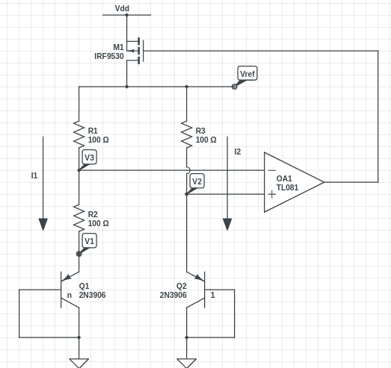
Analysis of BGR circuit
I2 = Io exp(v2/vt) , I1 = n * Io exp(v1/vt)
So v1-v2 = vt ln(I1/nI2)
I1=I2
v3 = I1*R2 + v1 = v2
Vref = I1 * R1 + v3 and Vref = I2* R3 + v2
I1=I2=(v2-v1)/R2 so I1=vt/r2 ln(n)
Vref = vt*(R3/R2)*ln(n) + v2 = 1.2v
Vref = -------PTAT--------- + CTAT = 1.2v
Using I1=I2= 10 µA , n=8
From above equation R2=5.2kΩ
R3=R1=50kΩ

Slide 35
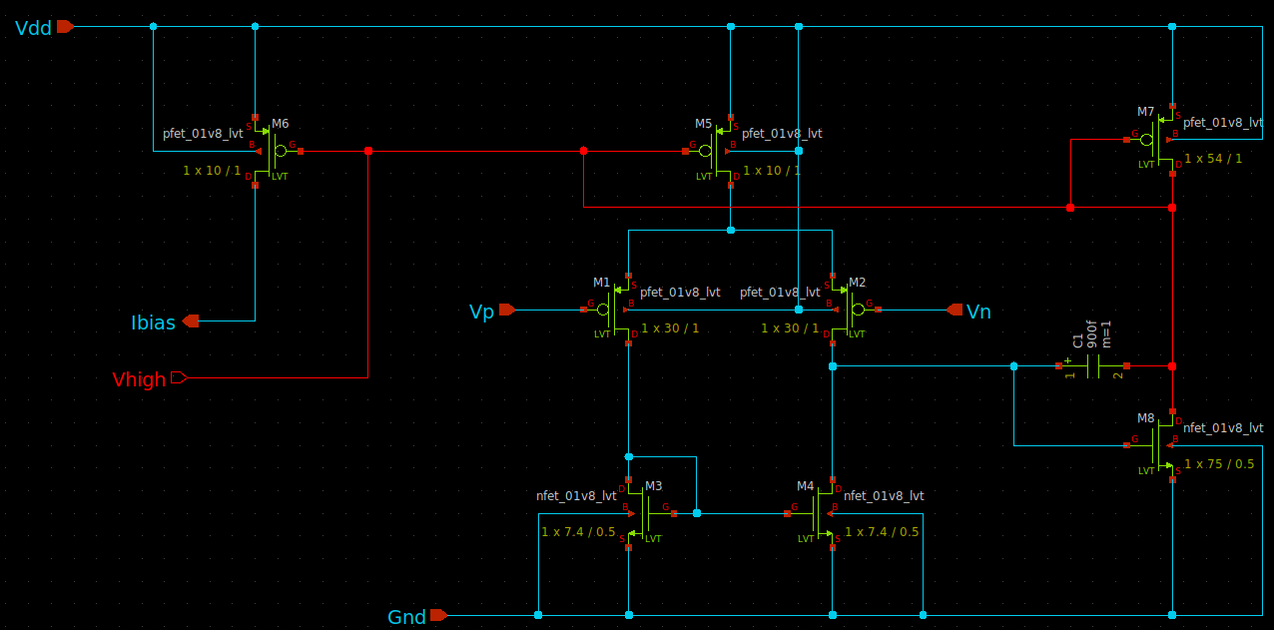
OTA schematic

Slide 36
Analysis of OTA
- Two stage miller OTA used with the following specs:-
DC gain = 60 dB , GBW = 30 MHZ , Phase margin >= 60 deg , ICMR = 0.8v : 1.6v
Slew rate = 20v / microsec , C load = 2pf , Vdd = 1.8v
- Miller cap Cc >= 0.22 to achieve PM >= 60 deg so Cc = 800fF
- from Slew rate equation : SR = I5 / Cc we get I5 = 20 microAmp
- from GBW eauation: GBW = gm1 / 2πCc we get gm1 then (W/L) of m1,m2
- from ICMR+ equation : we get (W/L) of m3,m4
- from ICMR- eqatution : we get (W/L) of m5,m6
- from phase margin condition : we get (W/L) of m8
-from current mirror relation between m5,m7 we get (W/L) of m7

Slide 37
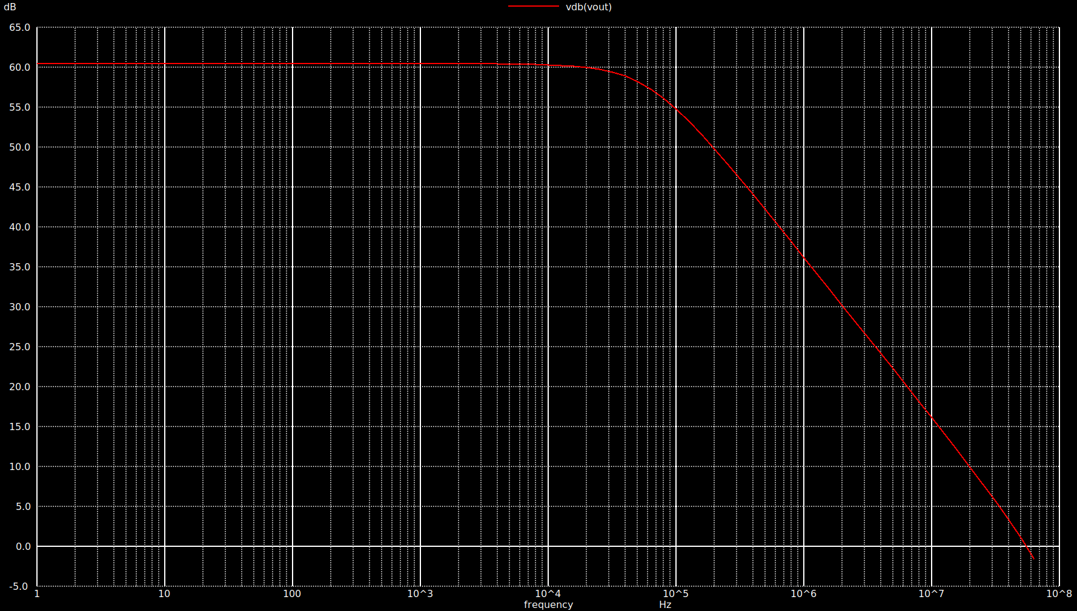
OTA simulation 1- AC analysis
Gain > 60 db , GBW = 60 MHZ , PM = 97 deg

Slide 38
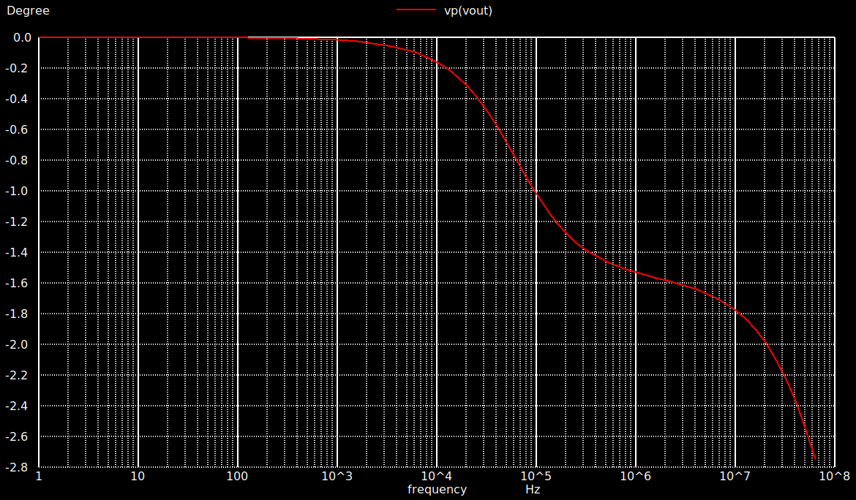
OTA Simulation: 1- AC Analysis

Slide 39
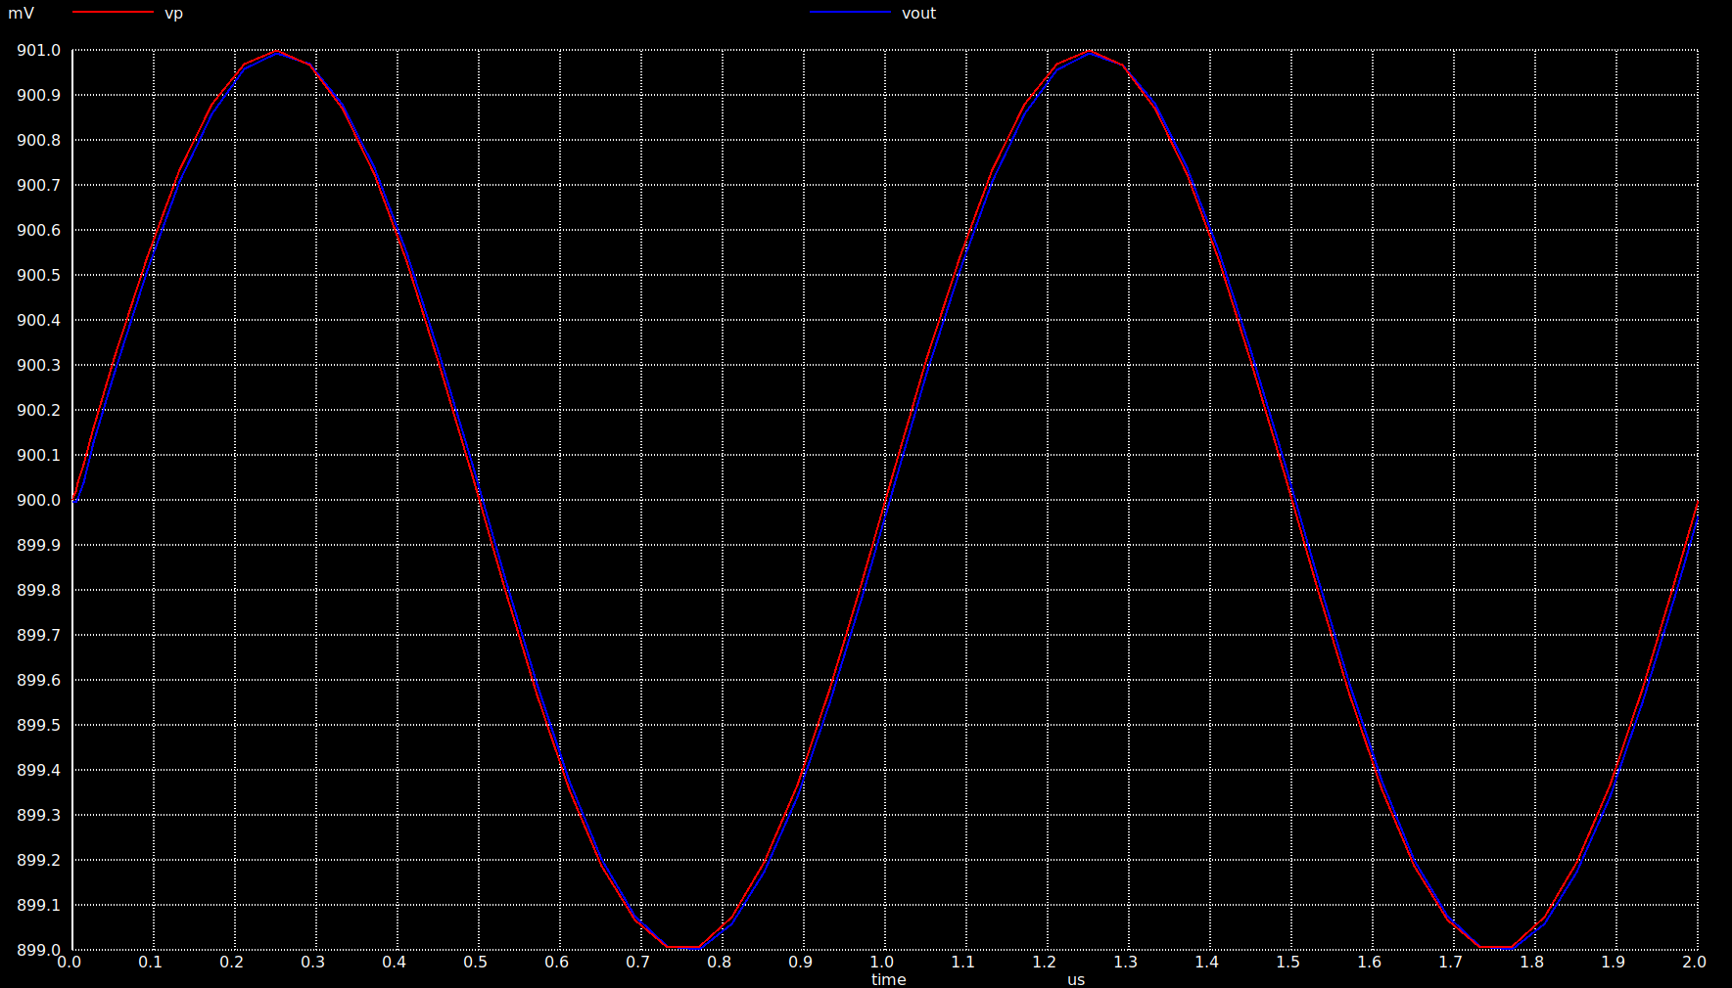
OTA Simulation 2- Transient Analysis
- I put the OTA in a feedback as a buffer and run transient simulation with input 1mv AC and
0.9v DC and the output is equal to the input as seen below:

Slide 40
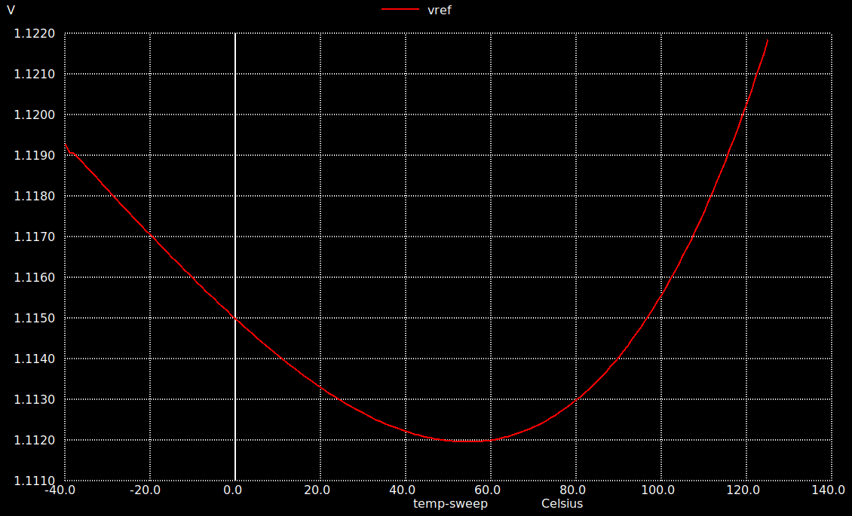
Simulation of Bandgap 1.8v 1- DC sweep vs Temperature
Using Vdd=1.8v and the temperature was swept from –40 to 125 deg and output is 1.11

Slide 41
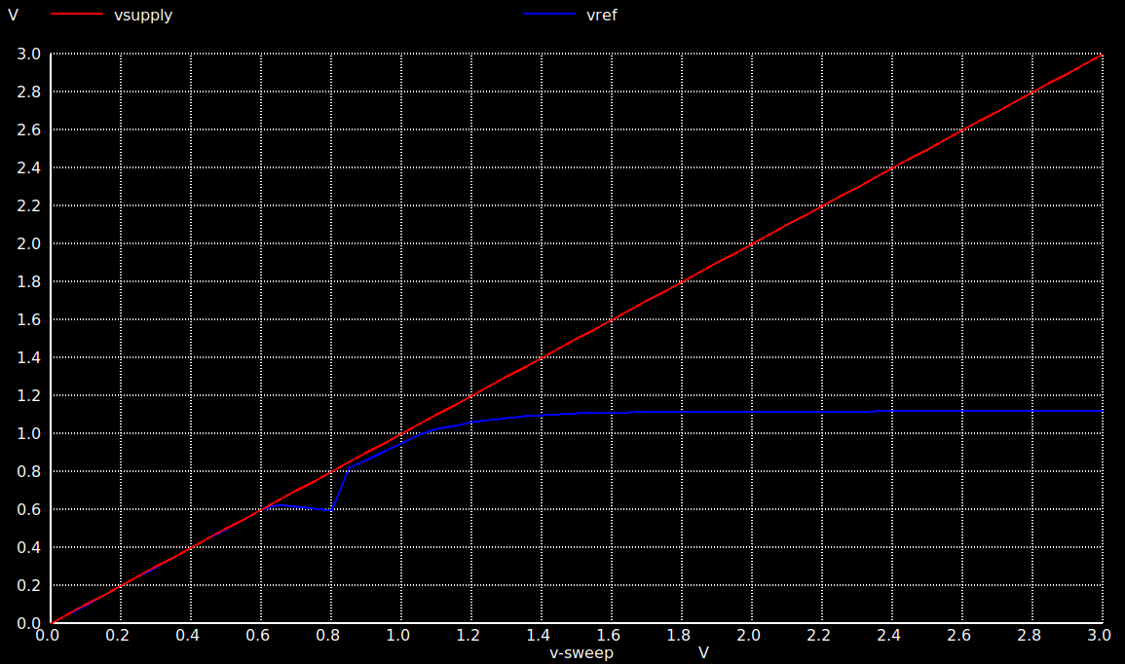
Simulation of Bandgap 1.8v 2- DC sweep vs Supply voltage
- VDD was swept from 0 to 3v and the output is 1.1v

Slide 42
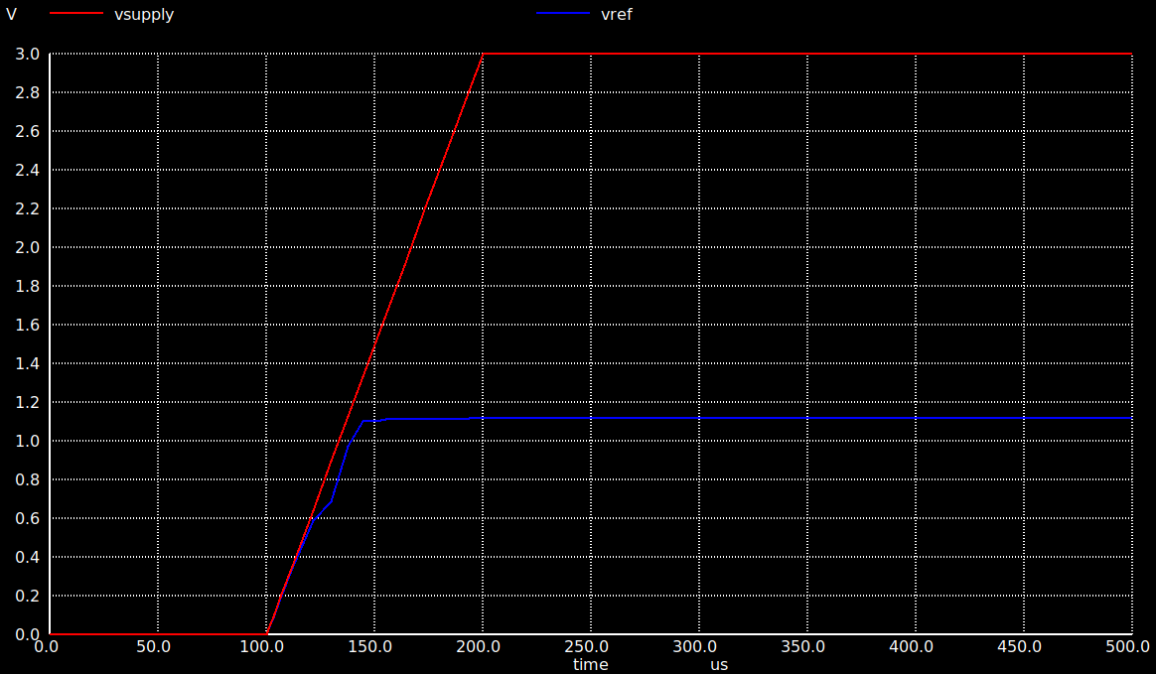
Simulation of Bandgap 1.8v 3- Transient Analysis
- A step voltage from 0 to 3v volt used with 100 us rise time and the output is 1.1v

Slide 43
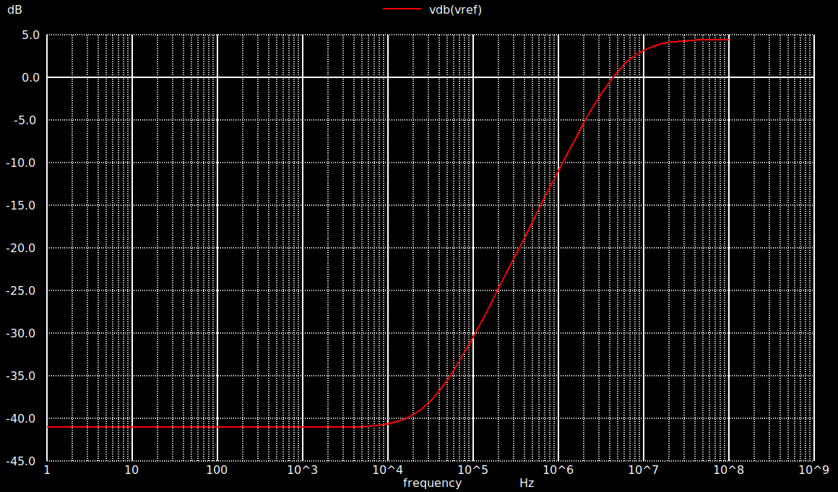
Simulation of Bandgap 1.8v 4- PSRR Analysis
- PSRR = -40 dB from 1Hz to 16 KHZ

Slide 44
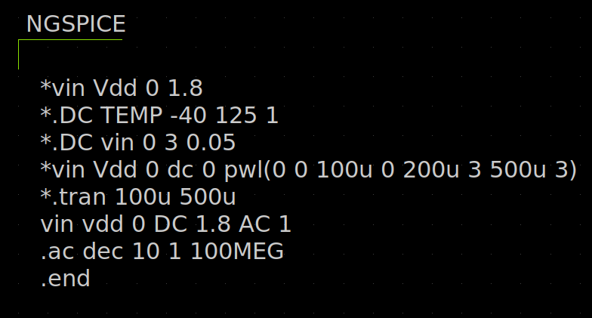
SPICE Netlist

Slide 45
References
1- https://www.youtube.com/watch?v=wJz6claEGa0list=PLK2eyR1C9gjp5tk5j7eTYU_Th4IL_H83T
2- https://www.researchgate.net/publication/275341924_Design_of_a_Simple_CMOS_Bandgap_Reference
3- https://drive.google.com/drive/folders/1OWcbg8f48_ilr8jptdFEA3nbNeQyD0Hi
4- https://www.youtube.com/watch?v=F2fCmRKGoCY&list=PLK2eyR1C9gjoBp61ZDvz6Zdd_6Hu7vZTz

