Slide 1
OTA Report

Slide 2
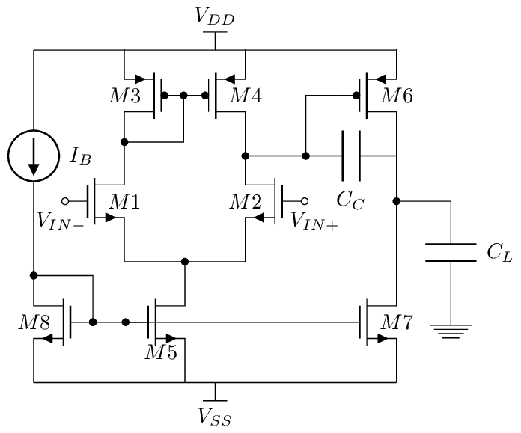
OTA Design
I designed Miller OTA.
- Required Specs: -
1- DC gain >= 60 dB
2- GBW >= 30 MHz
3- PM > 60 deg
4- Slew rate = 20v / 1 usec
5- ICMR(+) = 1.6v , ICMR(-) = 0.8v
6- Power < 1mW

Slide 3
OTA Design steps
I used VDD=1.8v ,Cl=2pf and skywater130nm technology
1- To have phase margin >=60 , Cc should be >=0.22 Cl so Cc>=440 fF
2- From slew rate equation we got the Current value , I = SR*Cc so I >= 8.8 uA
3- From GBW equation we got gm1,2 = GBW*2*pi*Cc then W/L)1,2
4- From ICMR+ equation we got W/L)3,4 and from ICMR- equation we got W/L)5,8
ICMR+ <= VDD-Vsg3+Vth1
ICMR- >= Vgs1+Vov5
5- For PM>=60 gm6 >= 10*gm1 then from W/L)6 / W/L)4 = gm6/gm4 we got W/L)6
6- From equation: W/L)6 / W/L)4 = I6 / I4 we got I6
7- Finally from equation: W/L)7 / W/L)5 = I7 / I5 we got W/L)7

Slide 4
OTA Calculated parameters
Parameter | Value
Iref | 20uA
W/L)1,2 | 25u/0.5u
W/L)3,4 | 7u/0.5u
W/L)5,8 | 12u/1u
W/L)6 | 90u/0.5u
W/L)7 | 75u/1u
Cc | 2pf

Slide 5
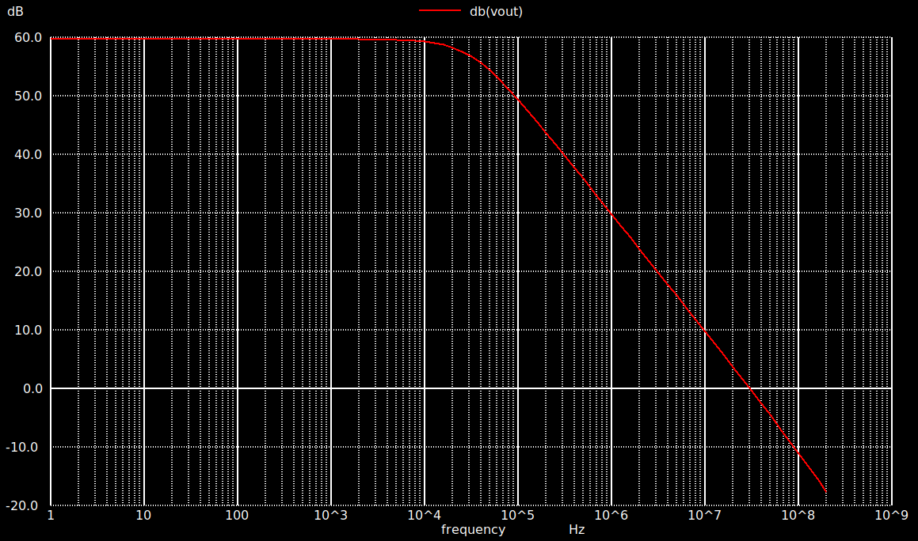
OTA Simulations
1. DC analysis to check the DC operating point and ensure that all transistors are in sat.
2. AC analysis: - a) Differential gain

Slide 6
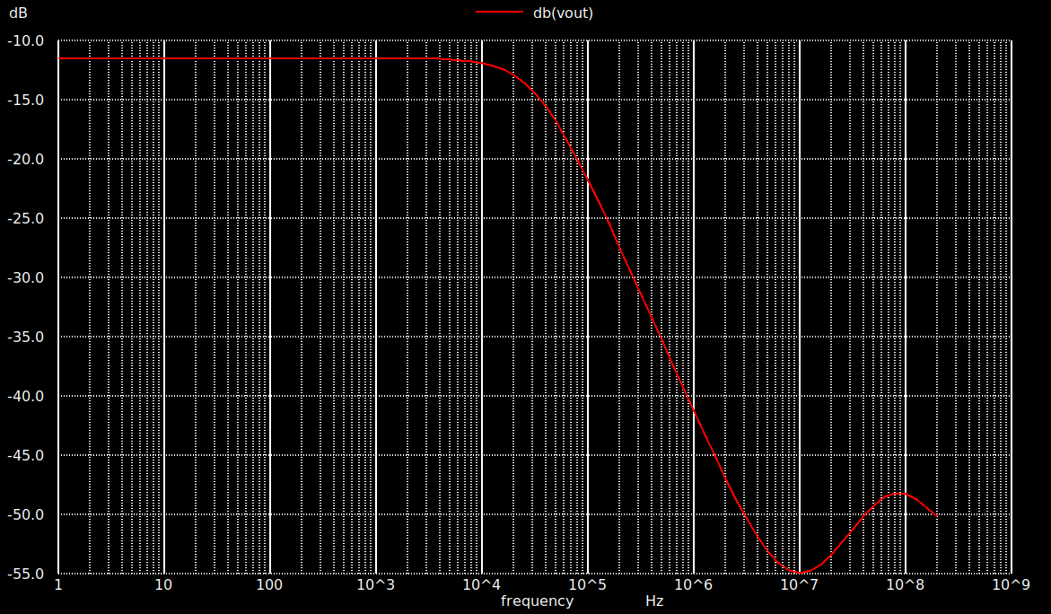
OTA Simulations
2- AC analysis b) Common mode gain

Slide 7
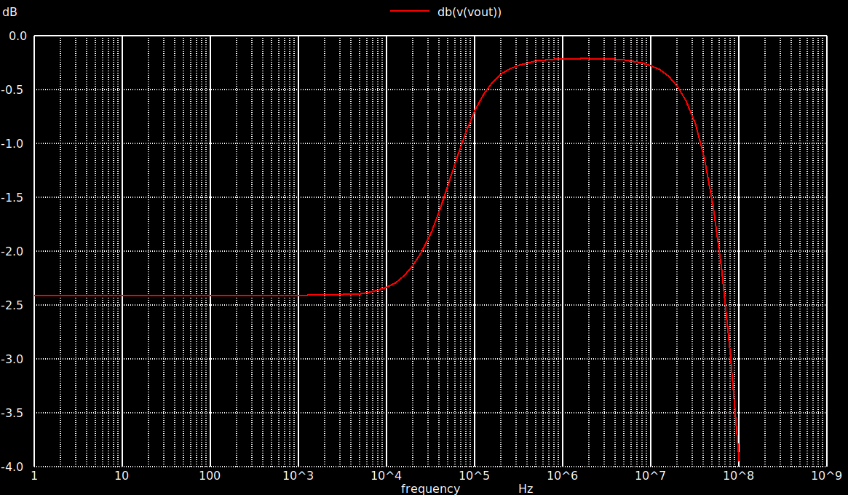
OTA SIMULATIONS
2- AC analysis c) PSRR

Slide 8
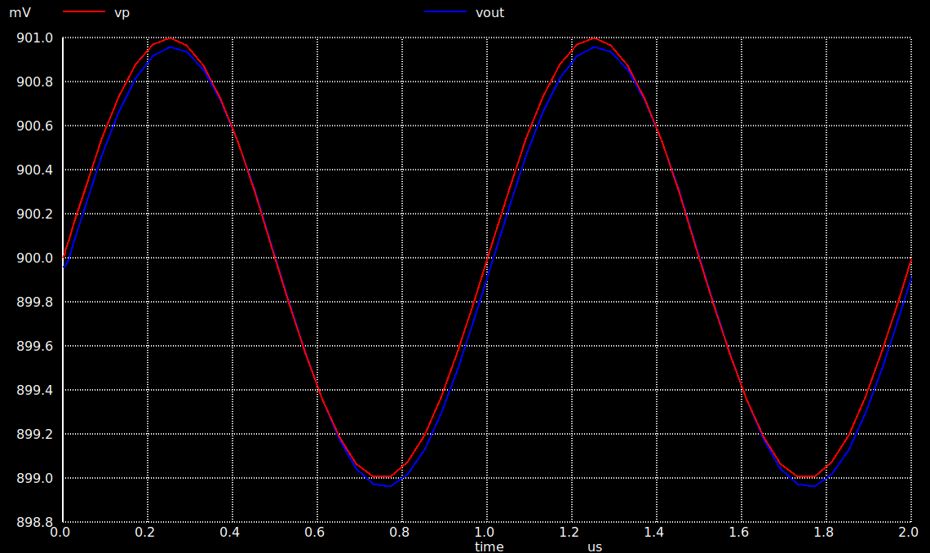
OTA simulations
3- Transient analysis (The OTA as buffer)

Slide 9
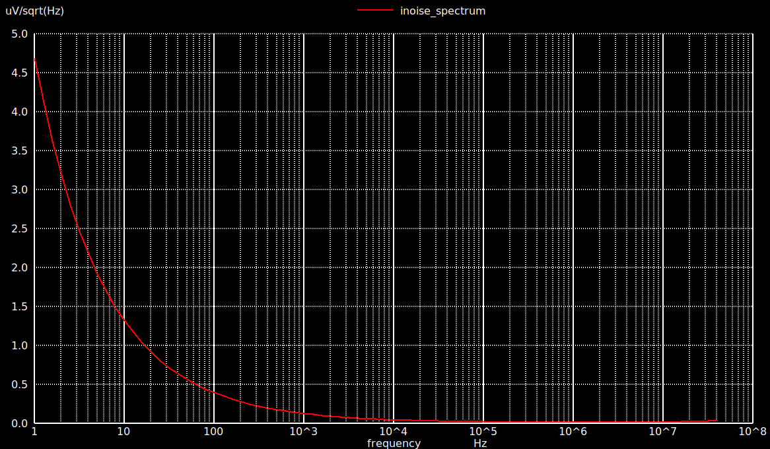
OTA simulations
4- Noise analysis (Input referred noise)

Slide 10
OTA achieved specs
spec | value
Av | 60 dB
Acm | -11.5 dB
CMRR | 71.5 dB
PSRR | 57 dB
GBW | 30MHz
PM | 52 deg
Power | 318 uW

