Slide 1

THEMIS
Themis turns a legal request into a matter, an analysis, and a record.
And it catches the question nobody asked.
FOUNDER
Brian Harris, sole founder. 17 years in-house counsel: founding GC/CCO at Settle, founding CLO/CCO at Manifest, product and regulatory counsel leadership at Affirm. M.S. Computer Science, Georgia Tech, with AI research in document classification and redaction. J.D.
BUILT FOR
Legal teams of one to three at U.S. technology and fintech companies, with no legal ops function and no procurement process for new tools.
Working prototype. Raising a $1.5M pre-seed to hire the first engineer.
Notes:
Cover art: output/deck/assets/bright-editorial/cover-flashlight-bw.png. OPEN ITEM FOR BRIAN: if you built the working prototype yourself, add four words saying so to the Founder block. The reviewing VC called this 'the most persuasive fact available to a sole founder' and it is currently missing. The subhead carries both the mechanism (matter, analysis, record) and the differentiator (the unasked question) deliberately. An earlier draft carried only the differentiator and failed the repeat-back test: a capability is not a company.

Slide 2
THE PROBLEM
02 / 06
In-house lawyers lose the week
before they ever reach the legal question.
The problem isn’t that nothing is saved. It’s that the reasoning behind past decisions isn’t.
~20%
THE REAL GAP
Lawyers already have a Drive folder, a DMS, a precedent bank and Slack search. Things are saved.
What is not saved is the reasoning: why a past decision went the way it did.
of a general counsel’s week goes to drafting. About two-thirds goes to meetings and committee work; the rest to staying current and holding context.
OUR READ
“half-baked”
how one general counsel described the requests that arrive over Slack, email, tickets and drop-bys, missing purpose, permissions and timing.
Many of those meetings exist because the reasoning behind a decision made months earlier is not retrievable, so the room re-derives it live, every time.
Four in-house counsel interviews, August 2026. Participants described by role only. The time estimate is one general counsel’s own account, not a survey. “Our read” is our inference from those conversations, not a finding.
Notes:
Sources: four exploratory interviews in output/research/raw/interviews/in-house-counsel/. The ~20% figure is ONE interviewee's self-reported estimate (roughly two-thirds of the week in meetings and investment-committee work, ~20% drafting). It is labelled as an n=1 estimate on the slide because an earlier draft re-attributed the other 80% to context-rebuilding, which the source does not support. Do not restate it as a survey result. OPEN ITEM FOR BRIAN: the quoted word 'half-baked' is drawn from an AI meeting summary, not a verified transcript, and the interviews README forbids publishing participant quotations without approval. Get that approval before this deck is sent, and ask for two or three more usable sentences while you are asking. OPEN ITEM FOR BRIAN: 'Our read' is an inference stacked on one estimate. Ask the next four in-house lawyers one question - how much of your recurring meeting load is re-deriving reasoning from decisions already made? Three of four saying 'most' turns this line from a read into a finding.

Slide 3
THE SOLUTION
03 / 06
Seventeen years of malformed requests,
encoded into how Themis reads an intake.
Themis orders its questions by how much each would change the recommendation, most decision-changing first.
FOUR RECURRING SHAPES OF THE MISSED QUESTION
WHY NOBODY WRITES IT DOWN
Recording the reasoning afterwards feels like homework on a decision already made, and it has no natural home. Themis captures it during the work, not after.
01
Missing purpose
02
Bundled uses
The request names an activity but not the purpose the data or capability will serve.
The request bundles two different uses as one, when each has a different answer.
THE TEST WE ARE COMMITTING TO
By December 15, 2026, report the share of pilot matters that end in a recorded decision without the lawyer being asked to write one.
03
Missing timing
04
Assumed permission
The request omits the timing that controls the analysis: a renewal, a launch date.
The request assumes an existing permission or consent already covers a new use.
Target: 70%
WHO ELSE IS HERE
Claude, ChatGPT, Harvey, Legora, CoCounsel and GC AI all produce a first pass. Onit, SimpleLegal and Brightflag manage spend for larger departments. A lean team’s real alternative is a Drive folder and a Claude Project.
The matter on slide 05 shows shapes 02, 03 and 04 inside a single request.
The four shapes are drawn from the founder’s in-house practice and are already encoded in the product’s intake agent. Depth is the ordering by decision impact and the accumulation across matters, not the four examples.
Notes:
The four patterns correspond to fields the shipped intake agent already extracts (backend/app/blank_vault_template/00_System/agents/intake-agent.md): business objective, requested timing, product change, participants, reported facts, missing facts, assumptions needed to continue - with questions ordered by expected effect on the recommendation. OPEN ITEM FOR BRIAN, AND THE REVIEWING VC'S SHARPEST NOTE: each pattern needs one real sanitised instance from Settle, Manifest or Affirm beside it. His words: 'A pattern without an instance is a category; a pattern with an instance is a secret.' If you can only produce two real instances, ship TWO patterns with two instances rather than four patterns with none. Also supply the denominator - roughly how many requests across the three companies these are drawn from. OPEN ITEM FOR BRIAN: be ready to say why the target is 70% and not 50%. There is no basis for the number yet. The cross-reference to slide 4 is deliberate: it is currently the only instance of the taxonomy shown anywhere in the deck, and the matter it points to is fictional. Real instances replace it.

Slide 4
THE CONTEXT
04 / 06
A Claude Project is a folder someone remembers to curate.
Themis assembles the same stack, on every request, whether anyone remembers to or not.
Each recorded decision becomes context for the next matter, which sharpens the next first pass, which produces the next record.
THE TAX
ASSEMBLED ON EVERY REQUEST, IN THIS ORDER
Every new question pays a setup cost: the company, what it sells, how money and data move, which regulators matter, what was already decided.
Identity and agent standards
Soul.md · Agents.md
THE STACK
The lawyer
user.md
Every request assembles the same context stack, automatically, before any analysis starts. The company profile is never optional.
The company
company.md
THE VAULT
Durable observations
memory.md
It reads from standing folders: playbooks, a living company-knowledge file, and every prior matter, in plain Markdown the lawyer can open and edit.
This matter and its prior decisions
03_Matters/
The document open right now
active file
DECISION MAINTENANCE
↓
A standing watch system does decision maintenance: when the law underneath a recorded decision moves, the decision resurfaces. The alternative is that nobody notices it went stale.
The first pass
This describes the shipped mechanism, not a measured result. Claude and ChatGPT both offer persistent memory and projects; the claim here is about who assembles the context, in what order, and whether it can be skipped.
Notes:
Verified in the codebase before this slide was written. backend/app/agents/context.py sets USER_CONTEXT_FILES = [user.md, company.md, memory.md] and always includes company.md (selected = not negative || filename == 'company.md'). Soul.md is read from 00_System/Soul.md. PRD section 11.5 defines the assembly order rendered in the diagram: Soul.md, Agents.md, agent definition, user.md, company.md, the relevant part of memory.md, matter root and request, key matter records, active file. Standing vault folders: 01_Playbooks (product-review.md, decision-review.md), 02_Company_Knowledge (product-and-funds-flow.md), 03_Matters. The Research Agent draws on matter, company, playbook and prior-decision context before any external search. Decision maintenance is one of three watch purposes in backend/app/models/awareness.py: awareness, company_impact, decision_maintenance. DELIBERATE OMISSIONS, both flagged by the reviewing VC. (1) An earlier draft opened 'Every blank Claude or ChatGPT tab starts from zero.' That headline is a strawman - both products have memory and Projects, the footnote conceded it three sentences later, and a partner who uses Projects daily would read it as uninformed. The argument is who assembles the context and whether it can be skipped, not whether the competitor has any. (2) An earlier draft claimed Themis knows 'which body of law is in play, before the lawyer types the first word.' False: the applicable law is derived from the request. It was cut because it would die in a live demo. This slide is the deck's answer to the standing objection - why the first pass beats the Claude tab already open. It is a mechanism answer to a quality question and it does not close the objection. Only the head-to-head test does.

Slide 5
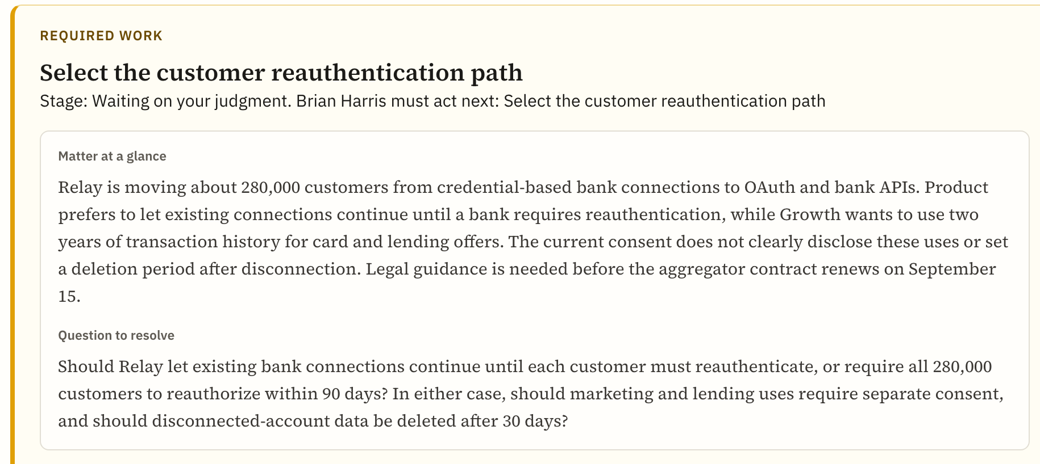
WHERE WE ARE
05 / 06
Two legal leaders have agreed to try it.
Both commitments are verbal and unpriced. Here is the plan to firm them up, and the product on one matter.
WORKED EXAMPLE · FICTIONAL MATTER, SEEDED IN THE PROTOTYPE
Head of legal, data company
Product asked one question. It was two.
Committed to pilot at release and is scoping AI budget. Verbal and unpriced.
Deputy GC, consumer fintech
Agreed to be a design partner. Verbal and unpriced. Team size still to be confirmed against the customer profile.
THE PLAN TO FIRM THEM UP
Prototype walkthrough with each contact by October 15, 2026. Start date agreed by November 1, 2026.
A company moving 280,000 customers off shared bank credentials onto OAuth. Themis split the continuity question from the monetization question, and surfaced the consent and deletion questions the business had not asked.
Fictional company and volume, seeded in the prototype to demonstrate product behaviour. Not a customer, and not a validated legal conclusion.
Notes:
Screenshot: output/deck/screenshots/matter-relay.png, cropped to the required-work card. Seeded fictional data in vault/03_Matters/relay-open-banking/. OPEN ITEM FOR BRIAN, FLAGGED HARD BY THE REVIEWING VC: the two dates on this slide are now live liabilities. Today is early September. If you pitch in November with no walkthrough held, the slide convicts you. Send both emails this week, hold the walkthroughs, then replace 'the plan' with what actually happened. Silence from a contact is also a result you need. OPEN ITEM FOR BRIAN: confirm the fintech legal team size. A Deputy GC implies a GC above them and therefore a layered department - which does not match the one-to-three-lawyer profile on slide 1. Either the profile widens or that pilot is unrepresentative, and you need to know which before you are asked. The three open questions are deliberately NOT repeated in text - they are legible in the screenshot itself.

Slide 6
WHY NOW AND MARKET
06 / 06
Models just got good enough to produce a usable
legal first pass. That capability is also the risk.
If the value lives only in the model, the next release captures it. The record is what keeps it with the lawyer.
+87%
~$82M
~$245M
growth in U.S. in-house counsel, 2008 to 2024, against +23% for law firm lawyers and +38% for government lawyers.
17,003 U.S. legal departments under $1B revenue, at $4,800 a year. First seats alone, bottom up.
the same departments at an average of three seats, before the 5,235 departments above $1B. A model, not a forecast.
WHAT THE INCUMBENTS REQUIRE
HOW WE LAND AND EXPAND
Harvey, per one buyer’s account of their own quote: a five-seat minimum on a twelve-month term. GC AI sells a self-serve single seat at $500 a month.
We land one lawyer at $400 a month, monthly, no term. That same department at three seats is $14,400 a year, against a single-seat product.
Raising $1.5M pre-seed
Counsel growth: ACC analysis of BLS data. Department counts: secondary estimate from a buildlegaltech.com analysis citing Dun & Bradstreet/NetWise and U.S. Census Economic Survey. Expansion figure models mature adoption and is not a forecast. Harvey terms are one anonymous buyer’s account, not a published or verified rate. The beachhead segment is not independently sized.
Notes:
Growth figures: ACC 2025 analysis of BLS OEWS data - in-house counsel 78,000 (2008) to 145,000 (2024), +87%, versus +23% law firm and +38% government. Department counts (22,238 total; 17,003 under $1B; 5,235 above) are a SECONDARY estimate and must be re-derived from a primary source before diligence. DELIBERATE OMISSION: an earlier draft cited Harvey at $425 per seat. It was cut. Quoting a named competitor's per-seat price from a single anonymous post is both indefensible and self-defeating - $425 against our $400 makes us look six percent cheaper rather than structurally different. The seat minimum and the annual term are the real difference; the price is not. CORRECTED CLAIM: an earlier draft said Harvey and GC AI both run department-level sales. That is false as to GC AI, whose published Individual plan is $500/month, monthly or yearly, one seat, self-serve by card without a demo, with a 14-day trial. The single-lawyer segment is already served. Price is not our wedge and the deck no longer claims it is. THE QUESTION THIS DECK STILL CANNOT ANSWER, per the reviewing VC: is the first pass actually better? Nobody has tested it. His proposed experiment, which costs one afternoon: take ten real intake requests, run each through Themis and through raw Claude, strip the labels, have two of the four interviewees grade them, and count how often Themis surfaced a materially decision-changing question the general model missed. If it is seven of ten, that number belongs on slide 3 and is worth more than every other line in the deck.

