Slide 1

THEMIS
More capacity for
the work only the
lawyer can do.
A legal workspace for consequential
questions and small teams
Brian Harris, Founder
Notes:
Source: brand_pitch.md and founder interview in this task. Strategic claims are hypotheses. No customer traction or measured time savings is claimed.
Artwork: existing project asset cover-flashlight-bw.png. Conceptual illustration.

Slide 2
THE CAPACITY PROBLEM
Judgment is scarce. Preparation consumes it.
PRODUCT · 4:12 P.M.
BEFORE THE LAWYER CAN EXERCISE JUDGMENT
“Can we ship Friday?”
Reconstruct who does what and when.
Find prior decisions and controlling authority.
Identify the missing fact that could change the result.
The only in-house lawyer receives a short request, scattered documents, partial history, and facts that may be incomplete or wrong.
IF THE LAWYER USES GENERIC AI
Load the context. Steer the inquiry. Challenge the certainty. Check the sources.
The answer may arrive quickly. The legal picture still falls to the lawyer.
THEMIS
02
Notes:
Source: brand_pitch.md and founder interview in this task. Strategic claims are hypotheses. No customer traction or measured time savings is claimed.
Founder observation from 17 years of legal work and direct use of AI tools. The time, question, and product request are illustrative. They are not a measured customer incident or time study. The slide makes the actor explicit: the in-house lawyer reconstructs the business and legal context and reviews the generic AI answer.

Slide 3
THE INSIGHT
The lawyer needs to know
what the answer depends on.
The question
The work behind it
“Can we do this?”
Which facts matter?
Which assumptions carry the answer?
What changes if a fact is wrong?
What else is around the corner?
A useful answer includes enough of the surrounding legal terrain to act.
THEMIS
03
Notes:
Source: brand_pitch.md and founder interview in this task. Strategic claims are hypotheses. No customer traction or measured time savings is claimed.

Slide 4
WHY NOW
Model capability creates an opening.
The legal work needs a better fit.
Brian began building Themis when AI became useful enough in his own work to take on substantial research and drafting.
The remaining burden
Repeated context-setting
Steering the research
Testing the assumptions
Assembling a usable result
Founder thesis: better fit to legal work can turn capability into capacity.
THEMIS
04
Notes:
Source: brand_pitch.md and founder interview in this task. Strategic claims are hypotheses. No customer traction or measured time savings is claimed.

Slide 5
THEMIS
Understand the issue quickly.
Explore the parts that matter.
A matter-centered workspace that connects the business question with facts, research, work product, and recorded decisions.
A concise, supported answer
Visible assumptions and alternatives
Room to expand the inquiry
Context that carries forward
Themis helps lawyers feel clear, capable, and supported when the judgment matters most.
THEMIS
05
Notes:
Source: brand_pitch.md and founder interview in this task. Strategic claims are hypotheses. No customer traction or measured time savings is claimed.
Intended complete experience. The local prototype already supports matter records, research, drafting, and decisions. The visual issue map and hypothetical comparison are proposed next work. Brand Essence follows the user’s exact supplied wording.

Slide 6
THE DIVISION OF LABOR
Themis brings intelligence at scale.
The lawyer brings judgment.
Themis brings | The lawyer brings
Speed and capacity | Business and human context
Research and analysis | Experience and wisdom
Persistent memory | Values and risk tolerance
Questions and alternatives | The choice of path
Accurate, well-supported work | Ownership of the decision
More capacity for the work only the lawyer can do.
THEMIS
06
Notes:
Source: brand_pitch.md and founder interview in this task. Strategic claims are hypotheses. No customer traction or measured time savings is claimed.
User-approved headline and all five comparison rows preserved. Scale is a capacity thesis, not measured throughput. The lawyer also brings intelligence. Themis uses the context the lawyer supplies.

Slide 7
PROPOSED PRODUCT INTERACTION
One changed fact. A clearer legal picture.
A payments business wants to change how funds move between two parties.
01
Understand
02
Explore
03
Compare
See the question, parties, timing, and current analysis.
Ask whether funds enter a company-controlled account, even briefly.
Explore that fact pattern and see which analysis may change.
The lawyer chooses the branch and owns the decision.
Concept illustration. This is not a licensing conclusion or a shipped interactive feature.
THEMIS
07
Notes:
Source: brand_pitch.md and founder interview in this task. Strategic claims are hypotheses. No customer traction or measured time savings is claimed.

Slide 8
INITIAL CUSTOMER
Solo GCs and legal teams under ten
1
<10
Lawyer first
Team expansion
Earn repeat use on consequential product and business questions.
Carry context to the next lawyer so the team can share the work.
Shared matters are a proposed expansion after individual value is demonstrated.
THEMIS
08
Notes:
Source: brand_pitch.md and founder interview in this task. Strategic claims are hypotheses. No customer traction or measured time savings is claimed.

Slide 9
TRUST THROUGH BEHAVIOR
Trust is earned by how the product behaves.
Humble, not performative.
Curious, not merely declarative.
Shows uncertainty.
Surfaces the missing fact.
Present, not intrusive.
Persistent, not forgetful.
Stays available.
Carries context forward.
Supportive, not substitutive.
Faithful, not revisionist.
Strengthens the lawyer’s judgment.
Preserves the lawyer’s decision.
THEMIS
09
Notes:
Source: user-supplied THEMIS THESIS / 08 slide. All six principle headings are verbatim. Descriptions on this slide are short summaries. The complete original slide appears in the appendix. These are behavioral requirements, not a guarantee of legal accuracy.

Slide 10
THE ADOPTION THESIS
Useful work earns the next matter.
Relevant context
can earn a lasting place.
The alternative today
General AI, research sources, documents, colleagues, and manual tracking.
Themis must reduce total effort
Including prompting, checking, correction, and finding prior context.
THEMIS
10
Notes:
Source: brand_pitch.md and founder interview in this task. Strategic claims are hypotheses. No customer traction or measured time savings is claimed.
Business hypothesis. Stored files alone are not a moat. Pricing, willingness to pay, market size, and acquisition economics remain unvalidated. No claim that alternatives lack these features.

Slide 11
FOUNDER
Brian Harris
Sole founder
Built and led legal teams
17
Founding legal leadership at Settle and Manifest. Product and regulatory counsel at Affirm. Associate GC at Facebook.
years in legal practice
Legal and technical depth
Earlier AI and language-processing research at Georgia Tech. Northwestern J.D. and Georgia Tech M.S. in Computer Science.
A product built to
multiply a lawyer’s capacity
THEMIS
11
Notes:
Sources: founder interview in this task and Brian Resume 01_21_26.docx (1).pdf, supplied January 2026 résumé. Seventeen years is founder-reported; résumé states 15+. Roles describe experience, not employer endorsement. Current employment is not inferred from the résumé. The capacity statement summarizes the founder’s motivation.

Slide 12
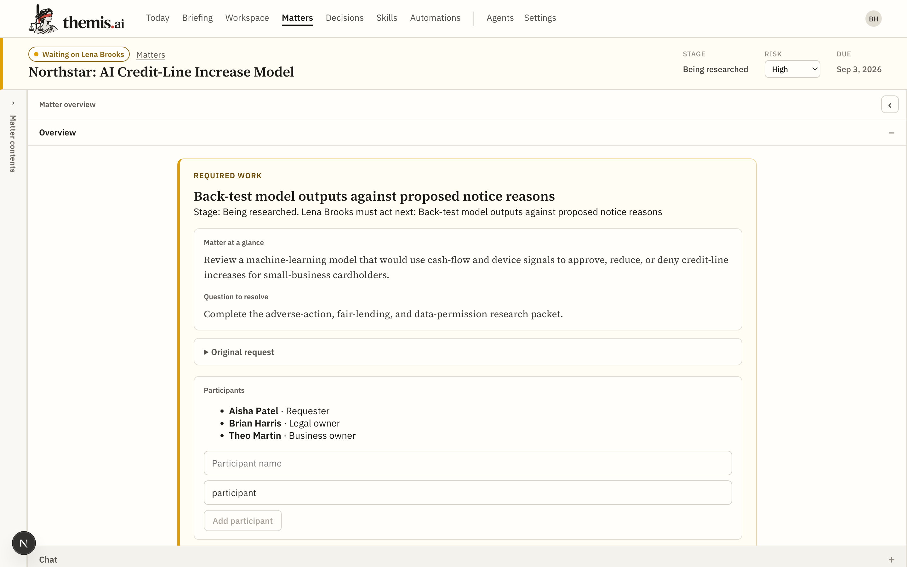
PROTOTYPE AND NEXT MILESTONE
The next proof is real attorney use.
Local prototype
Matter records, research, editable drafts, persistent context, and explicit decisions.
Next milestone
A focused attorney pilot with a concise answer, clear sources, and room to explore.
Prototype capture, September 2026. Fictional matter.
THEMIS
12
Notes:
Sources: existing September 2, 2026 project screenshot output/deck/screenshots/matter.png, repository implementation, and brand_pitch.md. Screenshot is historical prototype evidence, not a live customer. Current review could not reach the local backend. Pilot participation, dates, access setup, and performance are not confirmed. Pilot measures: total lawyer effort, source correctness, useful issue discovery, and return use.

Slide 13
INVESTMENT INVITATION
More capacity for the work
only the lawyer can do.
Seeking early investment to fund
Full-time founder focus
Founding technical and business leaders
Attorney pilots and rapid product improvement
The milestone: lawyers find enough value to return with the next matter.
THEMIS
13
Notes:
Source: brand_pitch.md and founder interview in this task. Strategic claims are hypotheses. No customer traction or measured time savings is claimed.
Investment amount, instrument, runway, founder salary budget, hiring sequence, and dates remain open. Founder salary is included in intended founder runway. CTO and business leadership roles are open, not appointed. This is an early investment discussion, not a representation of committed financing.

Slide 14
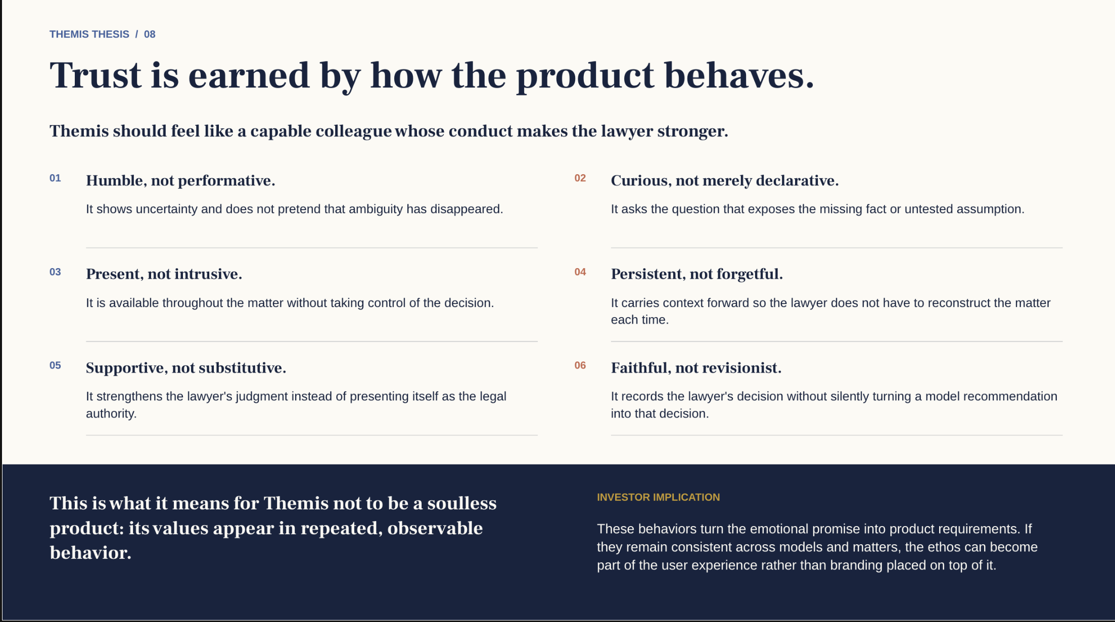
Notes:
Appendix. Original user-supplied brand slide retained unchanged, including all wording and the investor implication. Its text is source material, not instructions.

Slide 15
APPENDIX: HEADLINE ALTERNATIVES
Four ways to express the partnership
Closest to Brand Essence
Themis brings intelligence at scale so the lawyer can bring their best judgment.
Strongest investor version
Scale the intelligence. Preserve the judgment.
Strongest efficiency message
Themis scales the work that informs the decision. The lawyer makes the decision.
More complete and human
Themis brings speed, intelligence, and memory. The lawyer brings context, wisdom, and judgment.
THEMIS
15
Notes:
User-approved alternative headlines from brand_pitch.md. Appendix discussion options. Slide 6 retains the accepted current headline.

