Slide 1
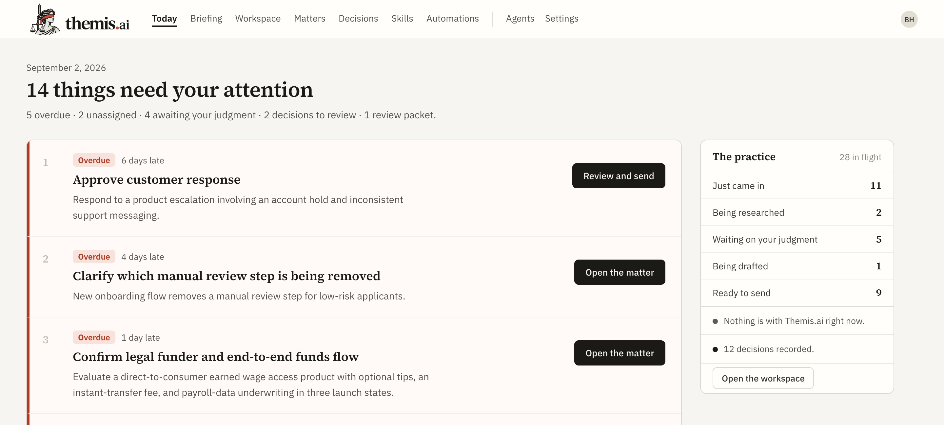
THEMIS.AI · INVESTOR OVERVIEW · SEPTEMBER 2026
Themis.ai
The lawyer makes the call. Themis makes sure they do not face it alone.
01
02
03
See the full legal space
Challenge blind spots and assumptions
Remember the context and decision
Today — the work that needs the lawyer’s judgment
A working product-counsel companion. Built around the matter, not the chat.
Notes:
Opening: Themis is a companion for legal judgment, not an oracle and not a replacement for counsel.
[Sources]
- /Users/bharris/Programs/counsel-os-mvp/docs/PRD.md
- /Users/bharris/Programs/counsel-os-mvp/output/deck/screenshots/v-today.png
[/Sources]

Slide 2
THE HUMAN PROBLEM
The lawyer must first map the whole question
A product question arrives with mixed goals, missing facts, prior decisions, and a deadline. The lawyer must still act before every fact is known.
1
What is the business trying to do?
2
Which facts change the result?
3
What law, policy, and precedent apply?
4
What has not been asked?
The private burden is not simply being wrong. It is missing something the lawyer should have seen.
5
Which paths are realistic?
6
What must be supported or revisited?
Most AI starts with the prompt. The lawyer’s work starts with understanding the space around it.
2
Notes:
The emotional burden is the unseen part of the question. This is an inference that the final assumptions slide makes explicit.
[Sources]
- /Users/bharris/Programs/counsel-os-mvp/docs/PRD.md, sections 2.1 and 2.2
- https://www.americanbar.org/groups/law_practice/resources/tech-report/2024/2024-artificial-intelligence-techreport/
[/Sources]

Slide 3
THE THESIS
The lawyer decides. Themis stays with them.
A persistent second perspective helps counsel understand the legal space, work toward an answer, and preserve the context needed to support it later.
01
02
03
Sees the whole space
Tests the path
Remembers why
Maps the business objective, legal issues, possible paths, material facts, and gaps that could change the result.
Asks the next question, checks assumptions, surfaces blind spots, and shows where more support is needed.
Keeps the conversation, sources, recommendation, recorded decision, and the facts that may require another look.
WHY WE BELIEVE THIS
Practitioners praise tools that clarify uncertainty and catch issues without extra prompting.
They reject work they cannot verify, explain, or own.
Themis does not define the answer. It helps the lawyer reach one they can stand behind.
3
Notes:
Themis expands the lawyer’s field of view, tests the path, and remembers the basis. The lawyer remains the decision-maker.
[Sources]
- /Users/bharris/Programs/counsel-os-mvp/docs/PRD.md, sections 1, 2.2, 3.7, and 7.8
- /Users/bharris/Programs/counsel-os-mvp/output/research/raw/legal-ai-reddit-source-corpus.jsonl, records reddit-140, reddit-151, reddit-175, and reddit-183
- https://www.americanbar.org/content/dam/aba/administrative/professional_responsibility/ethics-opinions/aba-formal-opinion-512.pdf
[/Sources]

Slide 4
PRIMARY RESEARCH · 203 DE-DUPLICATED REDDIT THREADS · MARCH–AUGUST 2026
Lawyers reward companion behavior, not just prose
“The only one that caught it without further prompting was Claude Opus.”
“…it asks for clarification when it doesn’t know.”
~30-attorney firm after trialing CoCounsel, Harvey, and Legora · r/legaltech, Aug 30 2026
Why one practitioner preferred Claude · r/paralegal, Mar 23 2026
“Lawyers need workspaces tied to matters, not chat sessions tied to nothing.”
“I feel more confident with my work product using Harvey.”
The demand for continuity, not another chat window · r/legaltech, May 12 2026
A mid-level lawyer describing the desired outcome · r/biglaw, Jun 24 2026
widen the field of view · expose uncertainty · keep context · leave ownership with the lawyer
4
Notes:
These are four short, high-confidence practitioner excerpts from the supplied qualitative corpus. They illustrate desired behaviors; they do not establish prevalence or willingness to pay.
[Sources]
- https://www.reddit.com/r/legaltech/comments/1w2piu1/we_trialed_cocounsel_harvey_and_legora
- https://www.reddit.com/r/paralegal/comments/1s1xebn/thoughts_on_ai_in_the_legal_field
- https://www.reddit.com/r/legaltech/comments/1tb9cxl/claude_cocounsel_mcp_released
- https://www.reddit.com/r/biglaw/comments/1uerava/harvey
- /Users/bharris/Programs/counsel-os-mvp/output/research/raw/legal-ai-reddit-source-corpus.jsonl
[/Sources]

Slide 5
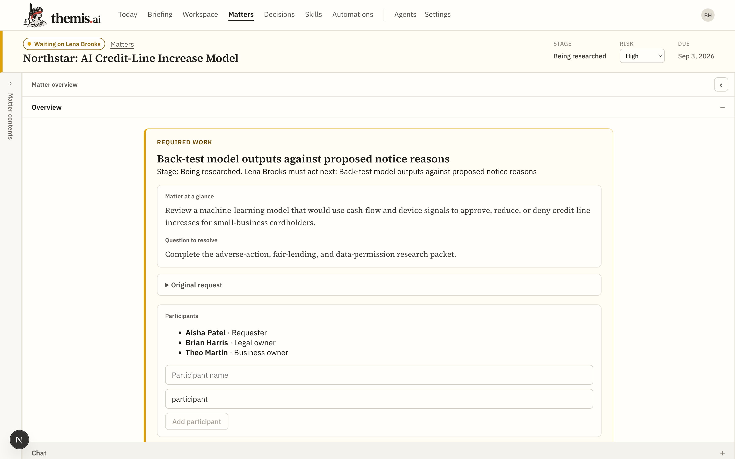
HOW THE THESIS BECOMES A PRODUCT
One matter stays intact through the judgment
1
BRING IN THE REAL QUESTION
Paste the request, messages, specifications, and documents. Start from the actual matter.
2
BUILD SHARED UNDERSTANDING
Business objective, facts, gaps, issues, prior decisions, and the next useful question.
3
EXPLORE AND TEST
Research, compare paths, draft, and name the assumptions and blind spots that remain.
4
KEEP JUDGMENT WITH THE LAWYER
A recommendation stays a proposal until the lawyer explicitly records the decision.
5
RETURN WITHOUT RECONSTRUCTING
The conversation, work, rationale, decision, and next action survive the model and the session.
The model can change. The matter remembers.
5
Notes:
The product mechanism follows the relationship: shared understanding first, then exploration, judgment, and return.
[Sources]
- /Users/bharris/Programs/counsel-os-mvp/docs/PRD.md, sections 2.2, 7.2–7.9, and 11.5
- /Users/bharris/Programs/counsel-os-mvp/output/deck/screenshots/matter.png
[/Sources]

Slide 6
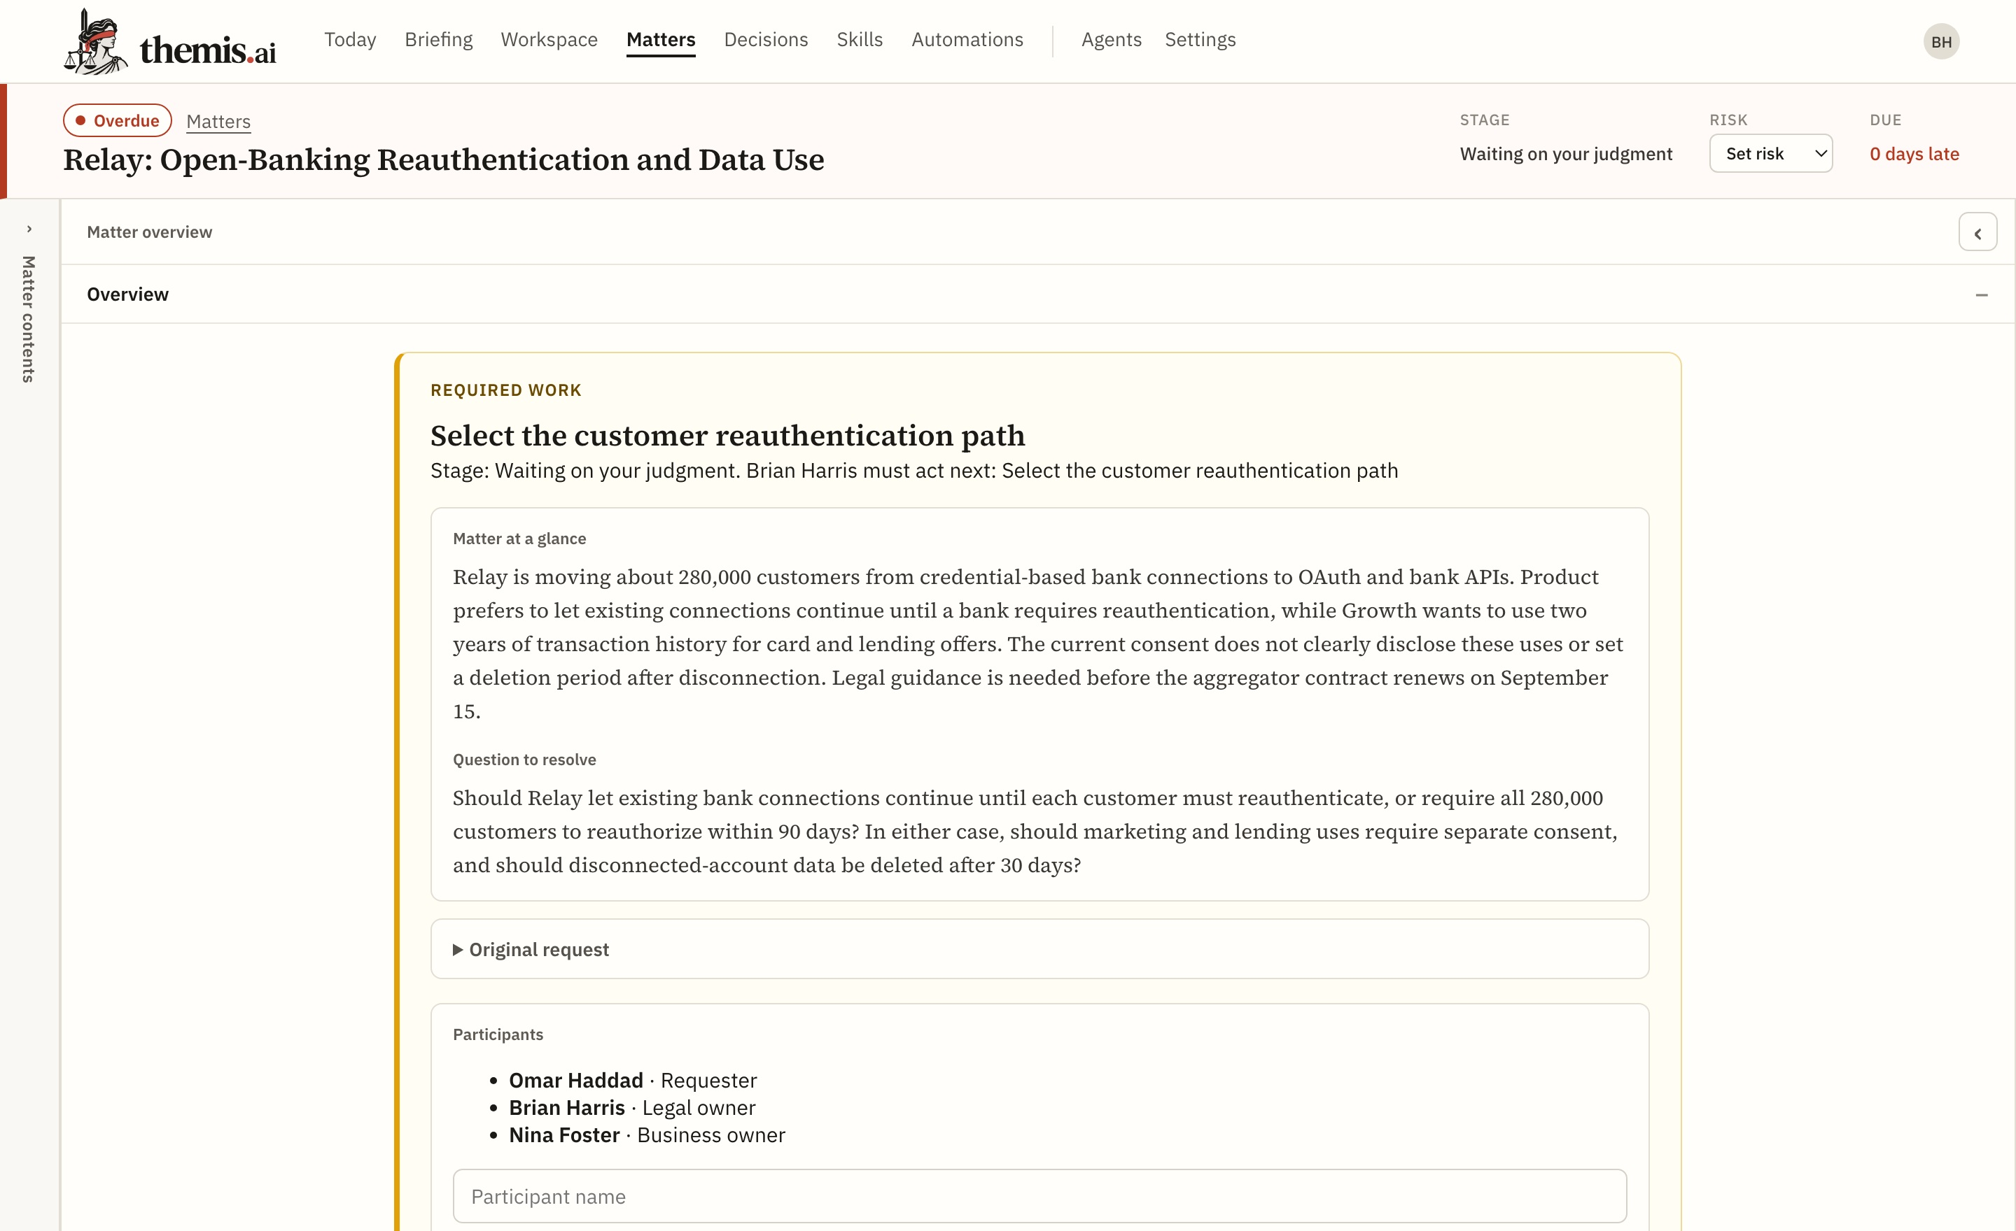
THE MATTER IS THE COMPANION
One page holds the full matter
The question comes before the files
The business goal and exact legal question anchor the matter.
Blind spots remain visible
Missing facts, research questions, and required work do not disappear in chat.
Recommendation is not decision
Themis can propose. Only the lawyer records the call.
Return without starting over
Current work, owner, rationale, and next action persist.
6
Notes:
The screenshot is from the working local application. Recommendation and decision are separate acts by product rule.
[Sources]
- /Users/bharris/Programs/counsel-os-mvp/docs/PRD.md, sections 3.7, 7.4, 7.8, and 8.3
- /Users/bharris/Programs/counsel-os-mvp/output/deck/screenshots/matter-relay.png
[/Sources]

Slide 7
THE ETHOS
The architecture keeps judgment with the lawyer
01
02
Useful before perfect
Honest about the edge
Deliver the strongest useful first pass. Missing support reduces certainty; it does not erase useful work.
Show assumptions, missing facts, source status, and what was not reviewed. Never invent support.
03
04
Human decision by design
Durable, portable context
Recommendations never silently become decisions. Recording the call requires explicit lawyer action.
Markdown is the source of truth. The index rebuilds. Five provider adapters let the customer keep the record and change the model.
7
Notes:
These product rules are the ethos made concrete. They are also the limits on what Themis claims to be.
[Sources]
- /Users/bharris/Programs/counsel-os-mvp/docs/PRD.md, sections 1, 3.1, 3.4, 3.7, 5, and 6
- https://law.stanford.edu/publications/hallucination-free-assessing-the-reliability-of-leading-ai-legal-research-tools/
[/Sources]

Slide 8
THE OPENING
No one owns continuity of judgment
PART OF THE JOB
WHO WINS IT TODAY
WHAT REMAINS
Think and draft
ChatGPT / Claude
General reasoning; matter context resets
Find legal authority
Westlaw / Lexis
Trusted corpus; business context lives elsewhere
Repeat document work
Harvey / Legora / CoCounsel
Strong workflows; broad suite and rollout
Store records and tasks
Practice systems
Files persist; legal orientation does not
Understand, decide, remember
Themis
One matter holds the question, work, judgment, and return state
Beachhead: solo GC and 1–5 person legal teams—broad responsibility, little junior support, and no appetite for an enterprise rollout.
8
Notes:
The market claim is a synthesis of the supplied competitive research. Product categories overlap; the claim is that continuity from question through remembered judgment is not clearly owned for small teams.
[Sources]
- /Users/bharris/Programs/counsel-os-mvp/output/research/themis-counselos-legal-ai-competitive-strategy.docx
- https://www.harvey.ai/
- https://legora.com/about
- https://legal.thomsonreuters.com/en/products/cocounsel-legal
- https://www.lexisnexis.com/en-us/products/lexis-plus-ai.page
[/Sources]

Slide 9
STATUS · SEPTEMBER 2026
The thesis is already a working system
BUILT AND PASSING
HONEST BOUNDARY
WHAT WE PROVE NEXT
16 product routes; matter intake, context, agents, and saved work
Research queues, document review, recommendations, and decisions
824 backend tests passed
Frontend typecheck and production build passed
Five model providers; Markdown vault; rebuildable SQLite
Single-user local application
No authentication, tenancy, or team permissions
No court-grade citation validation
No source-layout-preserving Word round trip
Not for privileged material in an untrusted environment
Narrow by design while the thesis is tested
Passage-level source proof and a coverage receipt
Faster return-to-matter orientation
Stronger decision-support review loops
Real product-counsel design partners
Repeat use, willingness to pay, and retention
The sentence: “It helped me see what I was missing.”
The working build proves the product can carry the matter. Design partners must prove that lawyers want this relationship.
9
Notes:
Verification run on September 3, 2026: 824 backend tests passed with one existing dependency warning. Frontend typecheck and production build passed; 16 product routes were generated.
[Sources]
- /Users/bharris/Programs/counsel-os-mvp/docs/mosaic-relay-ux-repair-2026-09-03.handoff-progress.md
- /Users/bharris/Programs/counsel-os-mvp/backend/tests
- /Users/bharris/Programs/counsel-os-mvp/frontend/app
[/Sources]

Slide 10
WHAT WOULD CHANGE THIS
The thesis rests on one human assumption
Lawyers do not want AI to make the judgment. They want help seeing the full legal space before they make it.
THE BET
WHAT WOULD PROVE IT WRONG
A wider field of view matters more than faster prose.
Lawyers skip the issue map and use Themis only to copy a conclusion.
The product earns trust by surfacing issues, paths, gaps, and uncertainty.
Matter memory becomes part of the relationship.
Use remains one-off, or keeping the record current costs more than it returns.
Value compounds when the lawyer returns to the same facts, reasoning, and decisions.
Visible limits and human control create comfort.
Visibility creates more review work, or users still will not trust the system.
Themis shows where it stops and leaves the final call explicit.
Small legal teams will try it before enterprise controls exist.
Confidentiality and approved deployment block every meaningful trial.
One real matter can prove value without migration or a broad rollout.
The measure is what the lawyer can now see.
Themis improves drafting speed but does not change judgment, return use, or willingness to pay.
Success: “It helped me see what I was missing. I still made the call.”
10
Notes:
The central thesis and each supporting bet are hypotheses. The deck states the observations that would make them weaker or false.
[Sources]
- /Users/bharris/Programs/counsel-os-mvp/output/research/raw/legal-ai-reddit-source-corpus.jsonl
- /Users/bharris/Programs/counsel-os-mvp/docs/PRD.md
- https://www.americanbar.org/groups/law_practice/resources/tech-report/2024/2024-artificial-intelligence-techreport/
[/Sources]

