Slide 1
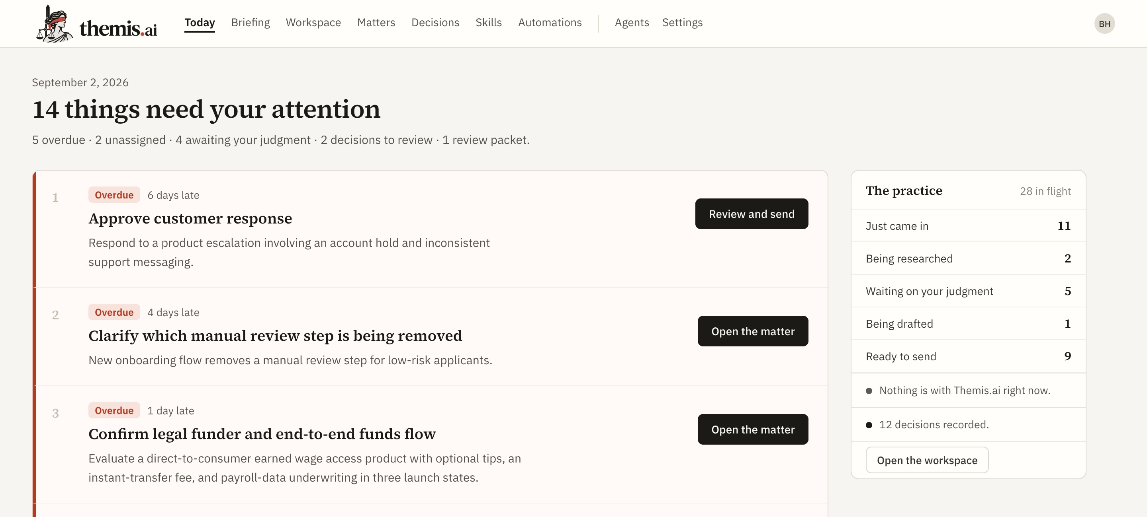
PRODUCT COUNSEL WORKSPACE · INVESTOR OVERVIEW · SEPTEMBER 2026
Themis.ai
The matter operating layer between general AI, legal authority, Word, and the decision that actually gets recorded.
203
665
5
Reddit threads of
primary buyer research
backend tests passing
on a working system
model providers —
the lawyer keeps theirs
Today — the ranked briefing the lawyer opens on
A single-user working MVP. Not a mockup, not a production legal system.
Notes:
Themis.ai is a product-counsel workspace. The thesis: the model is a component, not the product. The durable unit of value is the matter.

Slide 2
THE PROBLEM
Legal work starts in ambiguity. The setup is the tax.
A request reaches product counsel as a Slack thread, a spec, a screenshot, and a deadline. Before any judgment is applied, the lawyer performs the same reconstruction — every time, by hand.
1
Work out what the business is actually trying to do
2
Separate the material facts from the missing ones
3
Find the prior decision and playbook that already govern this
4
Decide what research is even necessary
Every one of these happens before the lawyer does the one thing only the lawyer can do.
5
Draft the response, then track what was decided
6
Revisit it when the law, the product, or the facts move
Existing tools store documents, manage tasks, or answer isolated questions. None of them organises the path from intake to decision the way a product lawyer actually thinks about the work.
2
Notes:
Source: docs/PRD.md section 2.1. This is the cognitive-load thesis the whole product is built around.

Slide 3
PRIMARY RESEARCH · 203 DE-DUPLICATED REDDIT THREADS · MARCH–AUGUST 2026
The buyers are already saying what is missing
“We had access to each system for ~3 weeks… The only one that caught it without further prompting was Claude Opus.”
“For 5 Harvey seats (minimum), 12 months lock-in, I was told it was USD $425/seat/month.”
~30-attorney firm, after trialing CoCounsel, Harvey and Legora — then building its own tool instead. r/legaltech, Aug 30 2026
A 3-attorney legal department separately rejected roughly $30,000/year of the same product. r/legaltech, Jul 20 2026
“Each member just creates a Claude chat and uploads the contract, the playbook, and any additional context needed.”
“I missed that AI had hallucinated an entire statutory provision.”
The context tax, paid again on every single matter. r/legaltech, Apr 22 2026
A reviewer cite-checked an AI memo and still missed it. Proof is the product, not prose. r/biglaw, Jun 6 2026
r/legaltech 75 · r/biglaw 39 · r/Lawyertalk 30 · r/LawFirm 23 · every claim carries a URL, a date and a confidence grade
3
Notes:
Corpus: output/research/raw/legal-ai-reddit-source-corpus.jsonl. Records are graded high/medium/low confidence; all four quotes above are high-confidence firsthand reports.

Slide 4
THE STRUCTURE OF THE MARKET
Legal AI is not one market. Buyers assemble a stack.
BUYER JOB
WHO WINS IT TODAY
WHY
Think, draft, explain
ChatGPT / Claude
General reasoning, fast writing, low entry cost
Find legal authority
Westlaw / Lexis
Known corpus, links to authority, the citator habit
Repeatable document work
Harvey / Legora / CoCounsel
Review tables, document scale, Word and DMS
Apply a firm's own method
An internal build
Exact playbooks, precedent, connectors, control
Remember and move the matter
No clear owner for small teams
Practice systems store records. None create a foothold or a next action.
Most buying disappointment comes from expecting one product to do all five jobs. The fifth is the opening.
4
Notes:
This table is the core strategic finding of the competitive brief. Themis does not compete for jobs 1-4; it makes them add up.

Slide 5
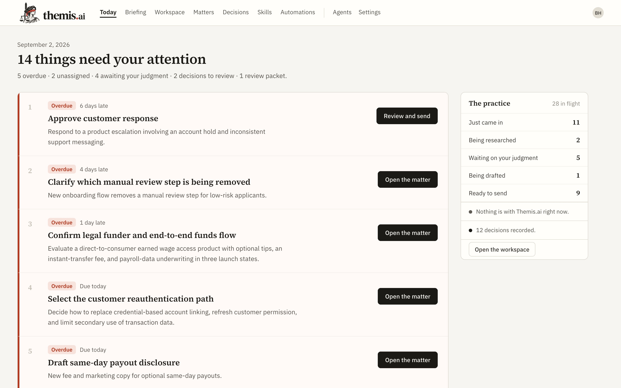
WHAT THEMIS DOES
One matter, from a pasted request to a recorded decision
1
INTAKE ONCE
Paste a Slack thread, an email or a redline note. Drop the files. Keep your own model.
2
ORIENT AUTOMATICALLY
Business objective, material facts, missing facts, issues, the prior decisions that already govern it, and one next action.
3
DO THE FIRST WORK
Targeted research or document review, queued per matter, saved into the matter as an editable record.
4
PROVE IT
Agent output stays visibly agent output — labelled, dashed, source status shown — until a human accepts it. Passage-level proof is the next build.
5
HAND IT OFF
A review-ready draft, a recorded decision with a named decider and a revisit date, and a next action that survives the model.
The lawyer never reconstructs the matter to ask the next question.
5
Notes:
The subway analogy: Themis carries the lawyer from the unstructured start to the stop near the destination. The lawyer walks the last mile.

Slide 6
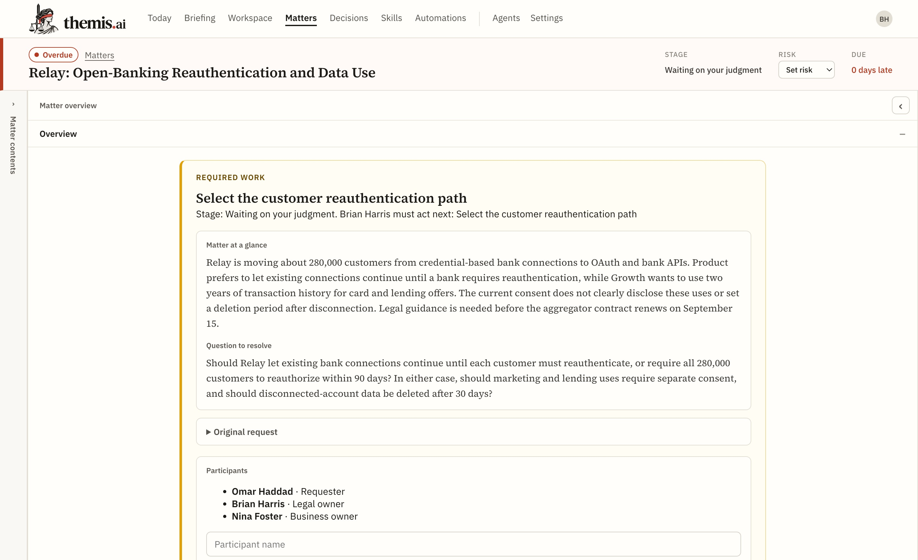
THE MATTER IS THE PRODUCT
Everything needed to act, on one page
The question, in plain language
Not a file tree. The business objective and the exact question to resolve sit above everything else.
Who must act next, by name
Ownership and lateness are first-class. “Waiting on Brian Harris” is a state the system computes, not a status someone remembered to set.
Judgment and work product are separate acts
Record decision and Finalize draft are two explicit buttons. Neither happens because an agent wrote something.
The customer owns the records
Every matter is plain Markdown on disk. SQLite is a disposable index that rebuilds. There is no database to be locked out of.
6
Notes:
Screenshot is the live application against the sample vault, September 2 2026.

Slide 7
WHAT THEMIS IS
The second lawyer in the room
In-house counsel is structurally alone. There is no partner down the hall, no one to say “have you thought about this?” — and every blind spot is theirs alone. Themis is not there to hand down the answer. It is there to make sure the lawyer sees the whole question before they give theirs.
01
02
03
Sees the space with you
Says where it stops
Remembers why
Maps the business objective, the live issues, the realistic paths, and the few facts that actually move the outcome. It widens what the lawyer has considered rather than replacing their consideration.
Names what it assumed, what it could not determine, and what it never read. A colleague who admits the edge of their knowledge is worth more than one who is never unsure — and lawyers already say so.
Holds the conversation, the reasoning, the recorded decision and its date. A year later it can say what was decided, on what basis, and what has changed underneath it since.
WHY WE BELIEVE THIS
30% of 203 threads are lawyers asking other lawyers what is normal — improvising the colleague they do not have.
“…it asks for clarification when it doesn’t know.” The best-rated tool in the corpus wins on colleague behaviour, not on answer quality.
The lawyer still gives the answer. Themis makes sure it is given with the whole question in view — and remembers why, when somebody asks a year from now.
7
Notes:
The purpose is to uncover blind spots, not to define the ultimate answer. This is the positioning slide — the mechanism that delivers it is on slide 5, and the record that survives the conversation is bet 03 on slide 8.

Slide 8
WHY THIS HOLDS
Four architectural bets, each one a reason not to churn
01
02
Model-neutral by construction
Markdown is the source of truth
Five provider adapters ship today, with per-agent model and reasoning-effort selection. The buyer keeps Claude, ChatGPT or an approved internal endpoint. Model quality moves too fast to be anyone's moat — so we refuse to make it ours.
Every matter, decision, agent, tool, workflow and schedule is a readable file on disk. SQLite is a rebuildable index. There is no lock-in to defend, which is exactly why a lawyer will trust it with the record.
03
04
Recommendation and decision are separate objects
The intelligence is editable text
Competitors keep this distinction in a chat transcript. Themis keeps it in the schema, in the type system and on the screen. It is the difference between a tool and a system of record.
Agents, tools, company context and playbooks are Markdown the lawyer can read and change — configurable enough to beat an internal build, and far cheaper to maintain than one.
8
Notes:
A Themis feature is funded only if it removes repeated setup, reduces review work, proves coverage, or moves the matter to a decision.

Slide 9
WHERE TO START
Highest setup tax, lowest rollout cost
BEACHHEAD
Constant ambiguous intake, no junior support, company-specific history to carry, and no appetite for an enterprise rollout. Can test on one real matter without migrating anything.
Solo GC and 1–5 person product / legal teams
Highest fit
ADJACENT
Need repeatable document work and matter continuity, but reject seat minimums and broad suites.
5–30 lawyer boutiques and specialty firms
High, if the workflow is narrow
LATER
Must beat an internal build on configuration, DMS handoff and maintenance — the segment that most often builds its own.
30–100 lawyers with a technology lead
Conditional
NOT NOW
Purchases turn on SSO, permissions, DMS, governance and support. None of that is built, and none of it is needed to prove the wedge.
150+ lawyer enterprise and BigLaw
Low for this product
Not a replacement for Westlaw or Lexis. Themis brings lawyer-checked authority into the matter; it never claims a proprietary corpus or a citator.
9
Notes:
Segmentation is a strategic inference from the corpus plus the product thesis. Reddit shows an unmet workflow pattern; it does not prove market size or willingness to pay.

Slide 10
STATUS · SEPTEMBER 2026
A working system, deliberately narrow
BUILT AND PASSING
DELIBERATELY NOT BUILT
WHAT WE PROVE NEXT
Next.js + FastAPI application, 16 product surfaces
665 backend tests green; typecheck and production build clean
Markdown vault as source of truth, rebuildable SQLite index
Five model providers with per-agent selection
Research queues, decision register, staleness checks, scheduler
Document review with native DOCX and PDF export
Auth, SSO, tenancy, team permissions
Source-layout-preserving Word round trip
Citator integration and court-grade cite validation
Embeddings, queues, cloud deployment
Multi-agent voting and reviewer vetoes
Each excluded on purpose. None is needed to prove the wedge.
Exact source passages plus a document coverage receipt
Automatic matter dossier and next action on return
Structured multi-document review with exceptions
Review-ready Word handoff that keeps the support trail
Lawyer-checked Westlaw / Lexis authority attached to a proposition
Design partners doing real product-counsel work
Themis.ai runs today as a single-user local web application. It has no authentication, tenancy or enterprise authorization, and is not for privileged material in an untrusted environment. That is the honest boundary of the current build.
10
Notes:
Verification: cd backend && pytest; cd frontend && npm run typecheck && npm run build. Status per current.md and docs/MVP_CLOSURE_AUDIT.md.

Slide 11
WHAT WOULD CHANGE THIS
The assumptions this rests on
The product's own discipline, applied to its deck. Each of these is load-bearing. Each names what would prove it wrong.
THE ASSUMPTION
WHAT WOULD PROVE IT WRONG
Lawyers want a colleague, not an oracle.
Design partners who skip the edge map and want only the conclusion.
Every valued use in the corpus is companion-shaped — issue spotting, first pass, “where to start.” None is “give me the answer.”
Matter memory becomes real switching cost.
Teams that never revisit a decision, or that let the register go stale because keeping it current costs more than it returns.
The compounding bet: the register is worth more every month and cannot be imported by a competitor.
The small-team wedge is reachable before enterprise controls.
Prospects blocking on confidentiality and approved deployment before they will try it. The corpus already shows this risk live.
No SSO, tenancy, DMS or ethical walls are needed to prove value on one real matter.
Model neutrality stays an advantage.
One model plus harness becoming decisively better at legal work — at which point neutrality is a liability, not a virtue.
Model quality moves too fast to be anyone's moat, so we decline to make it ours.
The evidence base supports what we claim from it.
It establishes an unmet workflow pattern. It does not establish market size, willingness to pay, or that these posters are buyers.
203 de-duplicated, self-selected Reddit threads, March–August 2026, graded by confidence.
11
Notes:
Put this slide in front of an investor deliberately. Naming the falsifiers is the same discipline the product applies to a legal answer, and it is the fastest way to show what Themis actually believes.

