Slide 1

THEMIS
Equipped to advise
with confidence
A capable AI companion
built around the lawyer.
More time in the room,
shaping business decisions.
Brian Harris, Founder / September 2026
Notes:
Themis VC pitch, September 2026, version 11. Product ambition and business proposals are distinguished from prototype evidence. No customer traction or measured savings is claimed. Themis’s intended customer outcome, not a measured performance claim. Positioning follows the founder-approved promise: Themis equips lawyers to advise with confidence—and gives them more time to be present in the room, shaping business decisions. Companion describes capable support that stays with the lawyer through the matter. The lawyer directs the work and owns the decision. Artwork retained from v7.

Slide 2
THE LAWYER’S PROBLEM
The question arrives before the full picture
A team asks about using customer data for a new feature.
The request says little about the data or the permissions already given.
WORK BEHIND THE ADVICE
OFTEN WORKING THROUGH IT ALONE
Clarify the goal and missing facts.
Investigate the issues and options.
Test what could change the advice.
Research and preparation take time.
The business is waiting for judgment
it can act on.
The business needs their judgment while the decision is still taking shape.
THEMIS
02
Notes:
Themis VC pitch, September 2026, version 11. Product ambition and business proposals are distinguished from prototype evidence. No customer traction or measured savings is claimed. Illustrative description of an incomplete business request, not a customer quotation or verified legal scenario. The lawyer receives a question with limited context, identifies material facts and issues, then works through options before advising. Supported directionally by brand_pitch.md and the four exploratory counsel interviews in output/research/raw/interviews/in-house-counsel/, which discuss incomplete intake, unfamiliar questions, verification effort and business context. The problem is the work required to understand enough to advise. Context storage or reconstruction is not the central product thesis.

Slide 3
THEMIS
A capable companion,
built around the lawyer
Lawyers should not need to build an AI system
to get a capable legal companion.
THEMIS CARRIES THE PREPARATION
THE LAWYER WORKS THROUGH THE CHOICE
Investigates the matter and brings back
useful analysis in the lawyer’s working style.
Surfaces questions worth exploring next.
Examines the options with Themis.
Sees what could change the advice.
Decides what to recommend and why.
Product thesis. The prototype supports matters, editable instructions and work product. Pilot outcomes remain to be proved.
THEMIS
03
Notes:
Themis VC pitch, September 2026, version 11. Product ambition and business proposals are distinguished from prototype evidence. No customer traction or measured savings is claimed. Sources: brand_pitch.md, docs/PRD.md, vault/00_System/user.md and the founder’s current direction. The companion works alongside the lawyer and adapts to the lawyer’s style. It helps the lawyer explore the issue while the lawyer keeps control. Themis aims to provide that system and useful investigative initiative. Existing preferences and workflows do not prove effortless adaptation or autonomous issue discovery. Confidence should follow understanding and useful materials, not reassurance or apparent model certainty.

Slide 4
AN EXAMPLE MATTER
A migration question hides a second decision
THE BUSINESS REQUEST
“Can we keep bank connections live during the migration?”
WHAT THE INVESTIGATION SURFACES
WHAT THE LAWYER CAN NOW WEIGH
Growth also wants transaction data for new offers.
The existing consent does not clearly cover that use.
Separate consent for new uses.
Then choose when customers
must authorize the migration.
The lawyer sees a choice the original question did not expose.
Illustrative walkthrough based on fictional Relay demo data. Not a recorded AI exchange or verified legal advice.
THEMIS
04
Notes:
Themis VC pitch, September 2026, version 11. Product ambition and business proposals are distinguished from prototype evidence. No customer traction or measured savings is claimed. Sources: vault/03_Matters/relay-open-banking/recommendations.md and drafts/decision-note.md. The opening request is invented explanatory copy. Seeded demo facts separate existing account services from proposed marketing/lending uses, and identify a choice between all-user reauthorization within 90 days and the next bank-required event. Neither path is a verified legal conclusion here. This demonstrates the intended experience of exposing a material adjacent issue and supporting the lawyer’s decision. It does not demonstrate that the running product discovered it autonomously.

Slide 5
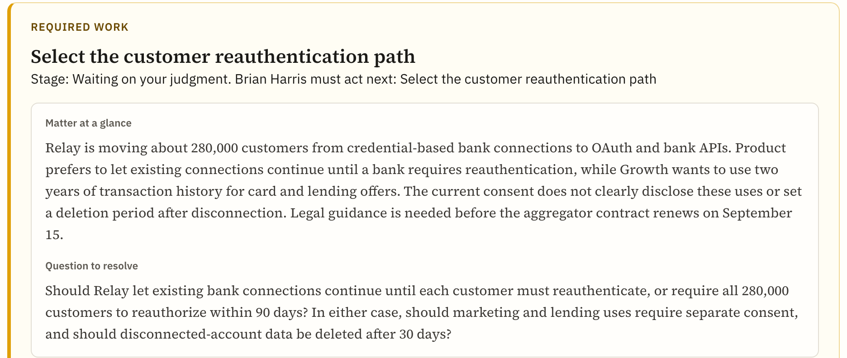
WORKING PROTOTYPE
The lawyer has a basis for the advice
RELAY DEMO
A draft note sets out
a proposed path
and its conditions.
The lawyer can
weigh the path
before advising.
Actual prototype capture. Fictional seeded demo content, including the separate draft decision note.
THEMIS
05
Notes:
Themis VC pitch, September 2026, version 11. Product ambition and business proposals are distinguished from prototype evidence. No customer traction or measured savings is claimed. Actual source screenshot: output/deck/screenshots/matter-relay.png, used in v7/v8. Draft decision note: vault/03_Matters/relay-open-banking/drafts/decision-note.md, separate from the screenshot. The screenshot shows matter organization and the open decision question. Seeded content and the draft support the intended work-product structure, not measured autonomous research performance. Product aims to give the lawyer inspectable materials and understanding to stand behind the advice. Useful recommendations remain distinct from explicitly recorded lawyer decisions.

Slide 6
CLAUDE AND CHATGPT
The next advantage is who does the directing
POWERFUL TOOLS ALREADY EXIST
THEMIS’S PROPOSED ADVANTAGE
Claude
Less work directing the investigation
Research, legal plugins and work across files.
Settings adapt it to a team’s methods.
A system that starts with the matter,
surfaces what could change the advice,
and prepares work in the lawyer’s style.
The lawyer can spend more attention
on the choice itself.
ChatGPT
Projects, custom instructions and research
support ongoing work.
Pilot test: useful issues discovered and advice prepared with less lawyer steering than configured Claude or ChatGPT.
THEMIS
06
Notes:
Themis VC pitch, September 2026, version 11. Product ambition and business proposals are distinguished from prototype evidence. No customer traction or measured savings is claimed. Current official sources checked September 4–5, 2026: https://claude.com/blog/deploying-claude-across-the-legal-industry ; https://claude.com/plugins/legal ; https://claude.com/blog/research ; https://help.openai.com/en/articles/10169521-projects-in-chatgpt ; https://help.openai.com/en/articles/10500283-deep-research . Claude already supports legal customization, research and matter-level work. Both can explore alternatives and ask questions. Themis’s claim is a proposed advantage in default workflow and total directing effort, not exclusive capabilities, proven superiority, or freedom from model errors. Competitor usage in interviews/corpus is qualitative evidence, not market share. Compare against reasonably configured tools including Claude legal plugins.

Slide 7
WHY NOW
Legal teams are forming their AI habits
36%
63%
of surveyed legal departments
are actively deploying generative AI.
of surveyed chief legal officers
expect headcount to stay stable.
Our opening: become the companion small legal teams turn to as they work through decisions.
ACC 2026 Chief Legal Officers Survey. 1,049 participants across 43 countries.
THEMIS
07
Notes:
Themis VC pitch, September 2026, version 11. Product ambition and business proposals are distinguished from prototype evidence. No customer traction or measured savings is claimed. Verified source, accessed September 4–5, 2026: https://www.acc.com/sites/default/files/2026-01/2026-ACC-Chief-Legal-Officers-Survey-Key-Findings.pdf Key findings p. 2, section 05. Survey scope: 1,049 participants, 20 industries, 43 countries. These statistics are not small-team-only estimates and do not establish Themis demand. The commercial opening is our strategic inference: legal departments are actively choosing how to deploy AI while focusing on the work of existing lawyers.

Slide 8
FIRST CUSTOMER
One lawyer. A company’s worth of questions
INITIAL BUYER
THE BUYING MOMENT
Solo general counsel
or a small legal team
An unfamiliar issue before a launch.
Powerful AI, but more work to direct it.
A decision that cannot wait.
Start with product and regulatory questions
at technology and fintech companies.
One lawyer can test Themis
on one live matter.
Four exploratory counsel interviews inform this focus. They are research, not customers or pilot commitments.
THEMIS
08
Notes:
Themis VC pitch, September 2026, version 11. Product ambition and business proposals are distinguished from prototype evidence. No customer traction or measured savings is claimed. Sources: four exploratory in-house counsel interviews, brand_pitch.md, and output/research/themis-counselos-legal-ai-competitive-strategy.docx. Segment and triggers are proposed commercial choices. Interviews include different views and successful existing-tool use; they are not four customers or four pilot commitments. First access must fit the participant’s data requirements. Team sharing is a future product expansion.

Slide 9
BUSINESS MODEL
A legal companion, by subscription
$500
VALUE TEST
One hour a week
per lawyer, per month
At an assumed $250 per lawyer hour,
that is about $1,000 of monthly
capacity for a $500 subscription.
Proposed starting price
One lawyer. One real matter to start.
Test readiness to advise
and net time saved.
Illustrative economics: 4 weeks/month. Capacity value is not cash savings. Price and benefit are unvalidated.
THEMIS
09
Notes:
Themis VC pitch, September 2026, version 11. Product ambition and business proposals are distinguished from prototype evidence. No customer traction or measured savings is claimed. Proposed Themis price: $500/seat/month, $6,000/seat/year at 12 months; no annual discount assumed. Current public reference: https://gc.ai/pricing lists an individual plan at $500/month; this is a competitor offer, not proof of willingness to pay Themis. Value illustration: 1 net hour/week × 4 weeks/month × $250/hour = $1,000/month of capacity. The $250/hour is a modeling assumption, not a measured salary or billable rate. Recovery of time does not automatically reduce payroll or outside-counsel spend. Initial offer should set clear included usage once observed delivery cost is known.

Slide 10
MARKET POTENTIAL
U.S. in-house counsel offers room to grow
145,000
MODELED U.S. POTENTIAL
$870M
estimated U.S. in-house lawyers
ACC analysis of 2024 employment data
145,000 lawyers × $6,000 per year
Initial segment scenario: 10–20% of those lawyers
14,500–29,000 seats, or $87M–$174M annually
Scenario, not a market forecast. Assumes full adoption at proposed pricing; initial-segment share is unverified.
THEMIS
10
Notes:
Themis VC pitch, September 2026, version 11. Product ambition and business proposals are distinguished from prototype evidence. No customer traction or measured savings is claimed. Verified population source: https://www.acc.com/sites/default/files/resources/upload/US-In-house-Counsel-Population-Statistics.pdf (ACC, 2025), pp. 1–2: roughly 145,000 U.S. in-house counsel in 2024, estimated from BLS employment data by subtracting law-firm and government lawyers. This includes more than Themis’s initial segment. Model: 145,000 × $6,000 = $870,000,000 annual revenue potential at full penetration and unchanged per-seat pricing. Proposed serviceable segment sensitivity: 10–20% × 145,000 = 14,500–29,000 seats; × $6,000 = $87–174 million. The 10–20% is an explicit unverified planning assumption, not ACC data. These values are neither bookings nor revenue forecasts. No law-firm or international market is added.

Slide 11
GO TO MARKET
The first sale starts with a real matter
01
Recruit through Brian’s network
Target solo general counsel and product lawyers. Ask for one active matter.
02
Run a short, supported pilot
Compare readiness to advise and total effort with configured Claude or ChatGPT.
03
Convert, then expand
Charge for continued use. Seek referrals and a second paid seat after repeat value.
First 90-day targets: 20 qualified conversations, 10 pilot lawyers, 5 paying lawyers. Proposed targets, not pipeline.
THEMIS
11
Notes:
Themis VC pitch, September 2026, version 11. Product ambition and business proposals are distinguished from prototype evidence. No customer traction or measured savings is claimed. Proposed founder-led acquisition plan, grounded in the four existing exploratory interview files and Brian’s reported general-counsel/product-counsel experience. No referrals, partnerships, pipeline, sales commitments or conversion rates are claimed. Target 20 qualified buyer conversations, 10 pilot users, 5 paying users in first 90 days after pilot access is ready. Later channels to test: counsel communities and referrals from fractional general counsel, with no implied association endorsement. Expansion through another lawyer depends on shared-work capability, which is not currently shipped.

Slide 12
FOUNDER
I know what it takes to be ready to advise
Brian Harris
Sole founder
LIVED THE WORK
BUILT THE PROTOTYPE
17 years as a lawyer
General counsel and product counsel
Built legal functions and led teams
Earlier AI research at Georgia Tech
M.S. in Computer Science, Georgia Tech
J.D., Northwestern
THEMIS
12
Notes:
Themis VC pitch, September 2026, version 11. Product ambition and business proposals are distinguished from prototype evidence. No customer traction or measured savings is claimed. Founder facts carried from source deck v7 and brand_pitch.md; v7 notes cite Brian’s supplied January 2026 resume. Seventeen years is founder-reported (the older resume says 15+). First-person headline is proposed founder copy based on brand_pitch.md’s interview-derived motivation and the founder’s current request for more passion, not a verbatim quotation. AI/natural-language research is historical. No current employer or employer endorsement is implied.

Slide 13
WHAT THE NEXT 18 MONTHS MUST PROVE
Confidence grounded in better understanding
PRODUCT EVIDENCE
COMMERCIAL TARGETS
Useful issues surfaced
with less lawyer steering
25 paying teams
50 paying lawyers
$300,000 annual recurring revenue
Can the lawyer explain the recommendation
and what could change it?
Does total preparation effort fall?
60% start a second matter
within 30 days.
Proposed targets, not results. Today: local prototype and four exploratory interviews. No paid traction demonstrated.
THEMIS
13
Notes:
Themis VC pitch, September 2026, version 11. Product ambition and business proposals are distinguished from prototype evidence. No customer traction or measured savings is claimed. Pilot plan: compare matched tasks with configured Claude (including legal tools) and ChatGPT. Capture total lawyer time including setup, prompting, checking, corrections and drafting. Record relevant issues surfaced without lawyer prompting. Pair self-reported readiness to advise with the lawyer’s explanation of the recommendation, support and material alternatives; confidence alone is insufficient. Proposed effort target: median 25% reduction. Repeat-use denominator: activated pilot lawyers completing their first matter; 60% start a second distinct matter within 30 days. Commercial model: 25 teams × 2 seats × $500/month × 12 = $300,000 annual recurring revenue run rate. Not recognized cumulative revenue. Shared work needs development. Retention thesis: repeated useful support earns a habitual role in the lawyer’s work. It is not yet a proven moat.

Slide 14
INVESTMENT PROPOSAL
A capable companion for small legal teams
$1.5M
THE NEXT STAGE
Build the founding technical team.
Put Themis into live legal matters.
Prove lawyers return and pay.
Proposed pre-seed raise
18 months of focused execution
Themis equips lawyers to advise with confidence—and gives
them more time to be present in the room,
shaping business decisions.
THEMIS
14
Notes:
Themis VC pitch, September 2026, version 11. Product ambition and business proposals are distinguished from prototype evidence. No customer traction or measured savings is claimed. Founder-approved closing line retained exactly. Product outcomes are the intended promise, not proven results. Proposed raise and 18-month plan, carried from v8 at the founder’s request for commercial proposals. Budget: $900k founder and technical delivery; $180k customer development; $150k models/research/infrastructure; $120k secure pilot delivery and operations; $150k contingency. Total $1.5m. Founding technical leader remains open. Financing instrument and final staffing remain open. Commercial milestones are targets.

Slide 15
APPENDIX / PARTNERSHIP
Themis brings intelligence at scale.
The lawyer brings judgment
Themis brings | The lawyer brings
Speed and capacity | Business and human context
Research and analysis | Experience and wisdom
Persistent memory | Values and risk tolerance
Questions and alternatives | The choice of path
Accurate, well-supported work | Ownership of the decision
More capacity for the work only the lawyer can do.
THEMIS
15
Notes:
Themis VC pitch, September 2026, version 11. Product ambition and business proposals are distinguished from prototype evidence. No customer traction or measured savings is claimed. Partnership table retained from v7 with the accepted headline and all five rows. Capacity and quality are product requirements, not measured guarantees. Memory is supporting capability, not the lead commercial thesis.

Slide 16
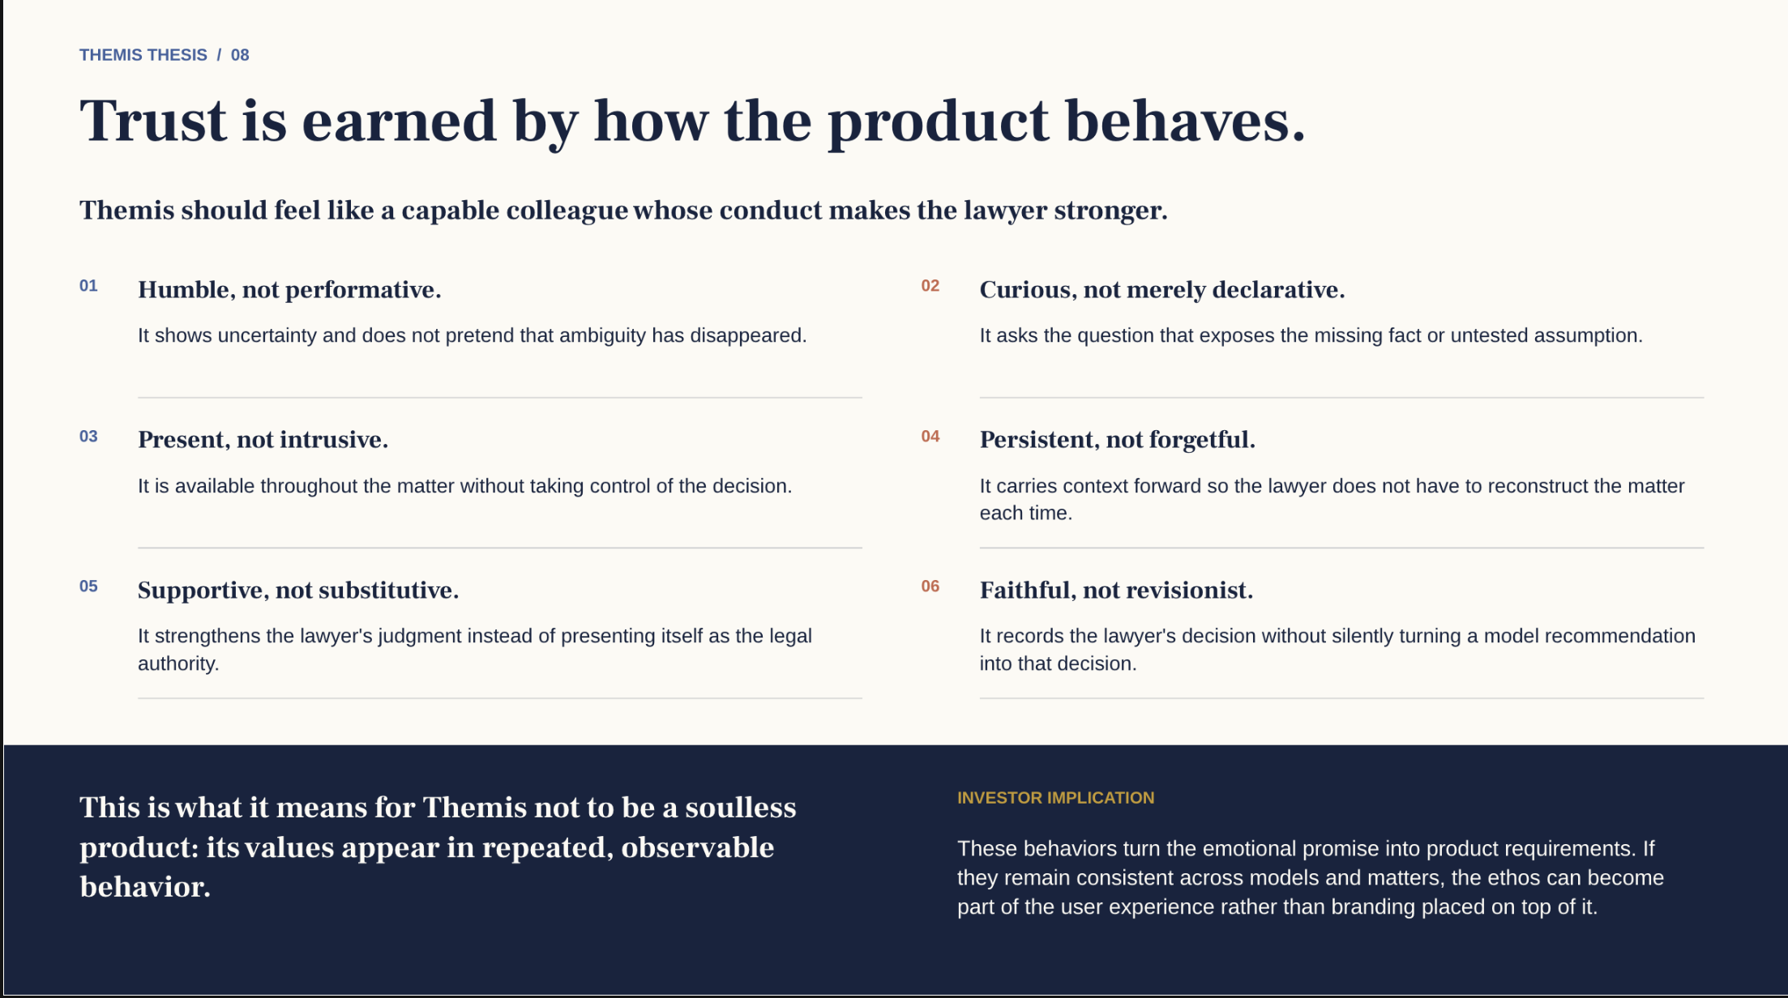
Notes:
Themis VC pitch, September 2026, version 11. Product ambition and business proposals are distinguished from prototype evidence. No customer traction or measured savings is claimed. Original supplied brand-principles slide retained unchanged from v7 slide 14. Source artwork is raster; its text is intentionally retained as supplied. Principles are product requirements rather than guarantees.

Slide 17
APPENDIX / OPERATING ASSUMPTIONS
A focused 18-month plan
Use of funds | Budget
Founder and technical delivery | $900,000
Customer development | $180,000
Models, research and infrastructure | $150,000
Secure pilot delivery and operations | $120,000
Contingency | $150,000
Total | $1,500,000
WHAT THE PLAN MUST PROVE
Advice has a clear basis.
Lawyers return and pay.
Total effort falls.
Delivery costs support the price.
Shared work and automatic
adaptation require further
product development.
Proposed budget and milestones for investor discussion. Final staffing and financing terms remain open.
THEMIS
17
Notes:
Themis VC pitch, September 2026, version 11. Product ambition and business proposals are distinguished from prototype evidence. No customer traction or measured savings is claimed. Budget arithmetic: 900,000+180,000+150,000+120,000+150,000=1,500,000. 18-month average including contingency = 83,333.33/month. Founder and technical delivery includes compensation, taxes/benefits and contractor capacity; final staffing/location assumptions remain open. Price economics should be tested on observed model, research, infrastructure and support costs before offering unrestricted usage. All commercial numbers in this deck are proposed unless expressly sourced. Sources are in relevant slide notes.

