Slide 1

THEMIS
The AI companion
for in-house counsel
Equipped to advise with confidence.
More time to be present in the room,
shaping business decisions.
Brian Harris, Founder / September 2026
Notes:
Themis is a capable AI companion and a system already adapted to lawyers. The intended outcome is confidence earned through understanding the issue and choices, with more time for business judgment. These are intended benefits, not measured outcomes. Founder-approved statement: Themis equips lawyers to advise with confidence—and gives them more time to be present in the room, shaping business decisions. Existing Themis cover artwork: output/deck/assets/bright-editorial/cover-flashlight-bw.png.

Slide 2
PROBLEM
The business needs advice.
The lawyer has to investigate first
THE REQUEST
THE WORK BEHIND THE ADVICE
A product team wants to
reuse customer data.
Find the facts that change the analysis.
Research unfamiliar issues.
Work through the available choices.
Prepare advice the business can use.
The question leaves out the purpose,
permissions and timing.
While the lawyer prepares, business decisions keep moving.
THEMIS
02
Notes:
Illustrative business request, not a customer quote or legal conclusion. Founder experience and four exploratory interviews in output/research/raw/interviews/in-house-counsel/ inform the problem: incomplete intake, research and verification effort, unfamiliar questions and the need to understand the surrounding answer space. The product north star in AGENTS.md and brand_pitch.md is to reduce cognitive load and equip the lawyer for the decision. Context storage is a supporting capability, not the problem statement.

Slide 3
SOLUTION
Confidence comes from
understanding the choices
Themis prepares the matter.
The lawyer explores the answer space.
A SYSTEM ALREADY ADAPTED TO LAWYERS
A BASIS FOR THE LAWYER’S JUDGMENT
Research and editable drafts.
Material assumptions made visible.
Useful questions to explore next.
Work through the options together.
See what could change the advice.
Decide what to recommend and why.
Product thesis. The lawyer directs the inquiry and owns the decision.
THEMIS
03
Notes:
Source: brand_pitch.md and founder-approved positioning in this conversation. Answer space means the plausible options, supporting evidence, assumptions and facts that can change the recommendation. Themis should conduct useful preparation and expose issues without requiring the lawyer to design an AI system. The proposed distinction is the default experience and effort required, not an exclusive ability to reason or ask questions. Prototype supports matters, instructions and editable work product; reliable unprompted discovery and automatic adaptation remain outcomes to validate. Confidence follows a basis for advice, not model certainty.

Slide 4
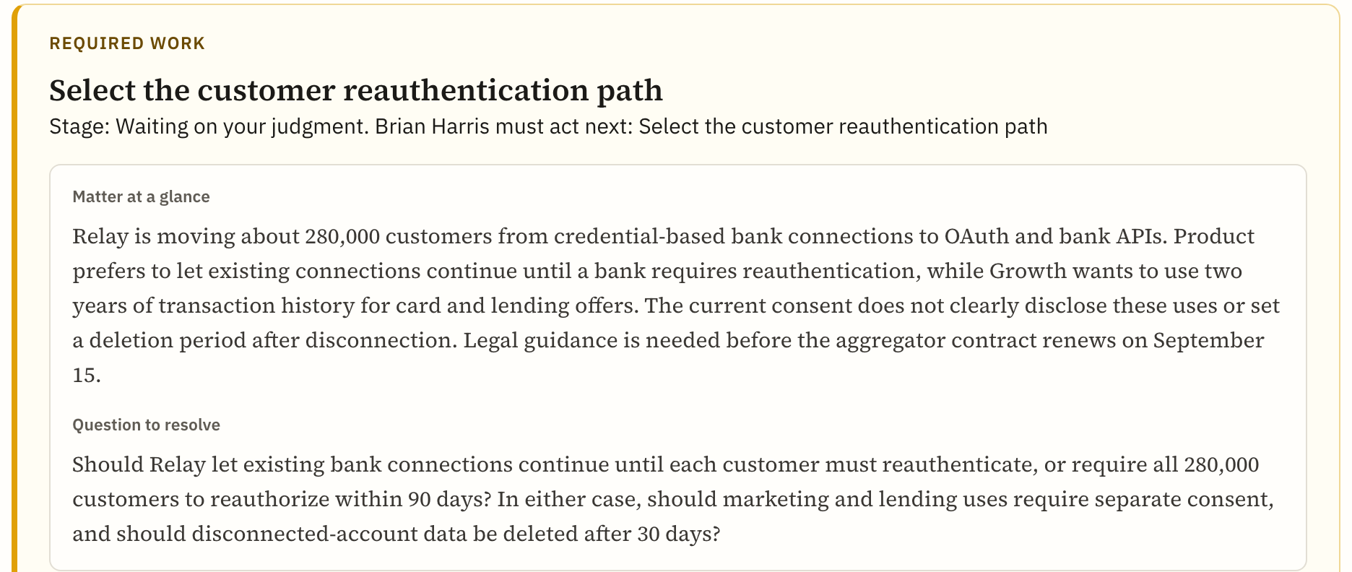
PRODUCT IN PRACTICE
A migration request hides
a separate data-use decision
ILLUSTRATIVE MATTER
Keep bank connections live
during a migration.
The investigation also surfaces
a plan to use transaction data
for new offers.
The lawyer can now weigh
the permissions for each use.
The matter brings the open choices into view.
Actual prototype capture with fictional seeded content. Illustrates the intended experience, not proven AI discovery.
THEMIS
04
Notes:
Screenshot: output/deck/screenshots/matter-relay.png. Fictional Relay data: vault/03_Matters/relay-open-banking/recommendations.md and drafts/decision-note.md. The seed differentiates continued account connectivity from proposed use for card/lending offers, and sets up alternative customer reauthorization timing. This is an illustration of a useful issue map and decision preparation, not a recorded AI exchange or validated legal advice. Screenshot crop preserves the matter summary and question to resolve. It does not establish that Themis discovered the issues autonomously.

Slide 5
FOUNDER
Built by a GC who has
built legal teams
Brian Harris
SETTLE AND MANIFEST
Built legal and compliance functions
from inception.
Sole founder
AFFIRM AND FACEBOOK PORTAL
17 years
Advised product teams through
launches and regulatory questions.
practicing law, including general
counsel and product counsel roles
AI research at Georgia Tech.
M.S. Computer Science. J.D. Northwestern.
THEMIS
05
Notes:
Sources: founder-supplied Brian Resume 01_21_26.docx (1).pdf and brand_pitch.md. Settle: Founding General Counsel, Chief Compliance Officer and Secretary (2021–2024). Manifest: Founding Chief Legal Officer and Chief Compliance Officer (resume dated January 2026). Affirm: product/regulatory counsel leadership (2016–2020), grew that team from three to eight attorneys. Facebook: Associate General Counsel, Portal (2020–2021). Georgia Tech Research Scientist I (2004–2006), AI/NLP document classification and automated redaction research. M.S. CS Georgia Tech, J.D. Northwestern. Seventeen years is current founder-reported experience; resume says 15+. Employer names describe experience, not customer relationships or endorsement. Do not infer current employment from an older Present entry. Brian is the sole founder. A founding technical leader is a planned hire, not an existing team member.

Slide 6
DIFFERENTIATION
Built around how a small-team
lawyer reaches a decision
THE TOOLS ALREADY AVAILABLE
THEMIS’S PROPOSED ADVANTAGE
Claude and ChatGPT
A prepared matter.
Visible choices.
Less work directing AI.
Flexible research, drafting and custom workflows.
Harvey, Legora, CoCounsel, GC AI
Optimize for the lawyer’s readiness
to advise, measured against the
tools they already use.
Legal research, work product and workflow tools.
THEMIS
06
Notes:
Sources checked September 2026: https://claude.com/plugins/legal ; https://help.openai.com/en/articles/10169521-projects-in-chatgpt ; https://www.harvey.ai/platform/agents ; https://legora.com/ ; https://legal.thomsonreuters.com/en/products/cocounsel-legal ; https://gc.ai/pricing. These platforms overlap materially with the Themis thesis. Claude has a legal plugin configured to organizational playbooks. Harvey markets judgment, legal agents, preferences and review-ready work. GC AI directly serves in-house lawyers and sells individual seats. Do not claim competitors only produce answers, cannot explore, lack lawyer workflows, or cannot adapt. Themis’s proposed advantage combines a narrow buyer, matter preparation, visible decision alternatives and lower steering effort. It is a product/market thesis, not demonstrated superiority or an established moat. Earn repeat use through useful work; reusable practice-specific instructions and evaluation cases could improve that experience over time. No cross-customer data network effect is assumed. Pilot comparison should use reasonably configured Claude/ChatGPT and the specialist tool the lawyer currently uses.

Slide 7
WHY NOW
Legal teams are choosing
how AI will fit their work
36%
63%
of surveyed legal departments
are actively deploying generative AI.
of surveyed chief legal officers
expect headcount to stay stable.
The opportunity is more capacity from the lawyers already in the room.
ACC 2026 Chief Legal Officers Survey. 1,049 participants across 43 countries.
THEMIS
07
Notes:
Source: https://www.acc.com/sites/default/files/2026-01/2026-ACC-Chief-Legal-Officers-Survey-Key-Findings.pdf , page 2, finding 05. Survey covers 1,049 participants, 20 industries and 43 countries. The estimates are not restricted to small teams or the United States. Commercial interpretation: departments are adopting AI while expecting stable legal headcount, making the way AI supports existing lawyers a timely buying choice. This does not establish that the market is unserved, that competitors have not solved parts of the problem, or that Themis has proven demand.

Slide 8
INITIAL CUSTOMER AND DISTRIBUTION
The first legal hire
is our first buyer
Solo GCs and small product legal teams
at technology and fintech companies.
A CLEAR REASON TO TRY
A DIRECT ROUTE TO ADOPTION
Frequent launches. Limited research support.
Already using Claude or ChatGPT.
A live matter that needs deeper exploration.
Brian’s counsel network brings the first pilot.
Useful work earns the next matter.
Paid use earns a referral or another seat.
First 90-day targets after pilot access: 20 qualified conversations, 10 pilot lawyers, 5 paying lawyers.
THEMIS
08
Notes:
Sources: founder experience and four exploratory counsel interviews in output/research/raw/interviews/in-house-counsel/. Initial segment, buying trigger and channel are business choices, not measured market shares. First legal hires and product counsel on lean technology/fintech teams have broad questions, limited specialist support and a founder-reachable professional network. No channel partnership, referral, signed pilot or pipeline count is claimed. Proposed 90-day targets: 20 qualified conversations, 10 pilot lawyers and five paying lawyers, beginning when pilot access is ready. Later expansion into other industries and shared team matters depends on observed value and further product development.

Slide 9
BUSINESS MODEL
A legal companion
one lawyer can buy
$400
A SMALL THRESHOLD FOR USEFUL CAPACITY
24 minutes
a week
per lawyer, per month
Proposed price. Start with one seat.
Monthly billing. No annual commitment.
No setup fee.
At an assumed $250 per lawyer hour,
that time equals the monthly price.
Illustration uses four weeks/month. Capacity is not cash savings. Pricing and an 80% gross margin target need validation.
THEMIS
09
Notes:
Approved Lean Canvas v4 pricing: $400/seat/month, billed monthly, one seat or more, no required annual commitment or setup fee. At 12 months of continued use, revenue per seat is $4,800. Capacity illustration: $400 ÷ $250/hour = 1.6 hours/month = 96 minutes/month ÷ four weeks = 24 minutes/week. The $250/hour is a modeling assumption, not a measured cost rate. Time recovery is not cash savings or proven ROI. Gross margin target 80% requires direct delivery costs at or below $80/paid seat/month, including applicable model, research, hosting and support costs. Usage allowance must be tested; unlimited usage is not promised. Public comparison: GC AI Individual $500/month (https://gc.ai/pricing). Repository reddit-163 reports Harvey $425/seat/month with five seats and a 12-month term (https://www.reddit.com/r/legaltech/comments/1v1q70k/help_me_understand_what_harvey_has_that_claude/), implying $25,500/year for that quote. This is a single anonymous reported quote, not a payment or universal price. Themis must win on useful work as well as initial commitment.

Slide 10
SIZE OF THE PRIZE
A $696M annual U.S.
in-house subscription opportunity
145,000
$4,800
estimated U.S. in-house lawyers
annual revenue per lawyer
at the proposed monthly price
21,000 paying lawyers would generate about $100M a year.
Full-market model, not a forecast. 21,000 seats is about 14.5% of the U.S. estimate. The starting segment is smaller.
THEMIS
10
Notes:
Population source: ACC 2025 analysis of 2024 BLS employment data, https://www.acc.com/sites/default/files/resources/upload/US-In-house-Counsel-Population-Statistics.pdf , pp. 1–2. ACC estimates about 145,000 U.S. in-house lawyers by subtracting law firm and government lawyers from total employed lawyers. Revenue model: 145,000 × $400/month × 12 = $696,000,000/year at full adoption with constant pricing. 21,000 × $4,800 = $100,800,000/year, approximately $100m; 21,000/145,000 = 14.48%. This is a scale illustration, not a forecast, goal with a defined deadline, established serviceable obtainable market, or assertion that acquiring 14.5% is easy. The initially reachable subset of solo/small technology and fintech legal teams is not independently sized, so no arbitrary percentage is presented as measured demand. Expansion from the initial segment to broader in-house counsel requires product and distribution work. No international, law-firm, outside-counsel spend or labor savings is added to subscription market size.

Slide 11
EVIDENCE AND NEXT MILESTONE
The prototype is built.
Repeat paid use is the next proof
TODAY
PROPOSED 18-MONTH TARGETS
Working local prototype
50 paying lawyers
$240,000 annual recurring revenue
Matters, research and editable work product.
Four exploratory counsel interviews.
60% return with a second matter.
25% less total preparation effort.
A clear basis for the lawyer’s advice.
No paid traction demonstrated.
Targets, not results. Compare total effort and useful issues surfaced against the lawyer’s configured usual tools.
THEMIS
11
Notes:
Current stage carried from v11 and brand_pitch.md: working local prototype and four exploratory interviews. No actual paying customer or verified paid traction evidence was supplied. Prototype screenshot is seeded fiction, not live customer usage. Targets carried from prior deck, recalculated at approved $400 pricing: 50 × $400 × 12 = $240,000 recurring annual run rate. This is not cumulative recognized revenue. Repeat-use target: 60% of activated pilot lawyers who complete a first matter start a second distinct matter within 30 days. Effort target: median 25% reduction on matched tasks versus configured usual tools, including setup, prompting, source checking, corrections and drafting. Pair readiness with an explanation of the recommendation, material alternatives and what would change it. Targets prove initial paid usefulness, not Series A readiness or repeatable venture-scale distribution. Unit-cost target and customer acquisition evidence remain necessary.

Slide 12
INVESTMENT PROPOSAL
Put a capable companion
beside the in-house lawyer
$1.5M
WHAT THE CAPITAL ENABLES
A founding technical team.
Live use with working lawyers.
Evidence that lawyers return and pay.
Proposed pre-seed raise
18 months of focused execution
Themis equips lawyers to advise with confidence—and gives them more time to be present in the room, shaping business decisions.
THEMIS
12
Notes:
Proposed $1.5m pre-seed raise and 18-month period carried from prior deck, not a committed round or finalized term sheet. Capital supports founder focus, founding technical delivery, customer development and pilot delivery. Technical leadership remains an open role. Financing instrument, final compensation and hiring sequence remain open. Appendix budget totals $1.5m, including contingency. Closing line is the exact founder-approved positioning and an intended product outcome. No proven time saving or investment return is implied.

Slide 13
APPENDIX / COMPETITIVE DETAIL
The alternatives already do useful legal work
Alternative | Current strengths | Themis must earn the switch
Claude / ChatGPT | Research, drafting, custom instructions and workflows. Claude has a legal plugin. | Less effort directing the matter with useful questions surfaced.
Harvey / Legora | Legal agents, research, document review and work adapted to customer methods. | A compelling daily experience for small in-house teams.
CoCounsel / GC AI | Legal work product and research. GC AI directly serves in-house counsel. | Better preparation for advice on the buyer’s actual matters.
Positioning comparison, not a controlled benchmark. Feature overlap is substantial.
THEMIS
13
Notes:
Official sources: gc: https://gc.ai/pricing ; harvey: https://www.harvey.ai/platform/agents ; legora: https://legora.com/ ; claude: https://claude.com/plugins/legal ; gpt: https://help.openai.com/en/articles/10169521-projects-in-chatgpt ; tr: https://legal.thomsonreuters.com/en/products/cocounsel-legal. Checked September 2026. Harvey already emphasizes judgment and adaptation to customer playbooks/preferences. Legora markets legal research, agents and in-house use. CoCounsel combines legal work assistance with research offerings; access varies by plan. GC AI provides in-house skills, Word editing, connectors and individual seats. Claude’s legal plugin is designed for in-house workflows and requires playbook configuration. ChatGPT supports continuing project context and custom instructions. This slide intentionally avoids unsupported feature exclusivity or claims that other models refuse exploration. Themis must show value against the actual alternative each pilot lawyer uses.

Slide 14
APPENDIX / MARKET AND PRICING
A seat model with a low entry commitment
Scope or benchmark | Basis | Annual amount
Full U.S. in-house model | 145,000 seats × $4,800 | $696M
Scale illustration | 21,000 seats × $4,800 | $100.8M
One Themis seat, proposed | 12 monthly payments of $400 | $4,800
Harvey buyer-reported quote | 5 seats × $425 × 12-month term | $25,500
Small tech and fintech teams first. Broader in-house use follows demonstrated value.
ACC population estimate. Themis pricing is proposed. Harvey is one anonymous quote, not a standard rate or verified payment.
THEMIS
14
Notes:
ACC population source https://www.acc.com/sites/default/files/resources/upload/US-In-house-Counsel-Population-Statistics.pdf. Themis proposal: $400 monthly, no annual term. The $4,800 row annualizes continued use rather than imposing an annual purchase. Reported Harvey terms: https://www.reddit.com/r/legaltech/comments/1v1q70k/help_me_understand_what_harvey_has_that_claude/ ; source reddit-163 in output/research/raw/legal-ai-reddit-source-corpus.jsonl, live quote verified. Single quote cannot establish universal contract minimums. GC AI public Individual price is $500/month, https://gc.ai/pricing. Other repository report reddit-117 contains a lower Harvey tier near $399, as well as $1,200 and $2,400 scopes, and secondhand Legora pricing around $400/month: https://www.reddit.com/r/legaltech/comments/1qvwswa/pricing_harvey_v_claude_v_legora_v_cocounsel_from/ . These are inconsistent scopes and anonymous reports, not comparable vendor rate cards. Legora does not publish a standard seat rate on its homepage and has announced usage-based Agent Pro pricing; no verified all-in rate assumed. Initial segment size is still to be established. Market counts and annualized prices are a scenario, not revenue forecasts or demand estimates.

Slide 15
APPENDIX / USE OF FUNDS
An 18-month plan to establish paid use
Use of funds | Proposed budget
Founder and technical delivery | $900,000
Customer development | $180,000
Models, research and infrastructure | $150,000
Secure pilot delivery and operations | $120,000
Contingency | $150,000
Total | $1,500,000
THE FUNDING TEST
Lawyers use it on live matters.
They return and pay.
Preparation effort falls.
Delivery costs support the price.
Hiring sequence and
financing terms remain open.
THEMIS
15
Notes:
Proposed budget carried from v11: $900,000 + $180,000 + $150,000 + $120,000 + $150,000 = $1,500,000. Average 18-month envelope including contingency is $83,333/month. Founder and technical delivery includes compensation, taxes/benefits and contractor capacity, with exact staffing assumptions still open. It is a proposed financing and learning plan, not approved spend or a committed raise. At $400/month, 50 paid seats yield $20,000 monthly recurring revenue ($240,000 annualized), materially below this average spending envelope. The round funds validation and further company development, not a modeled break-even point. Team sharing and automatic adaptation need further work.

Slide 16
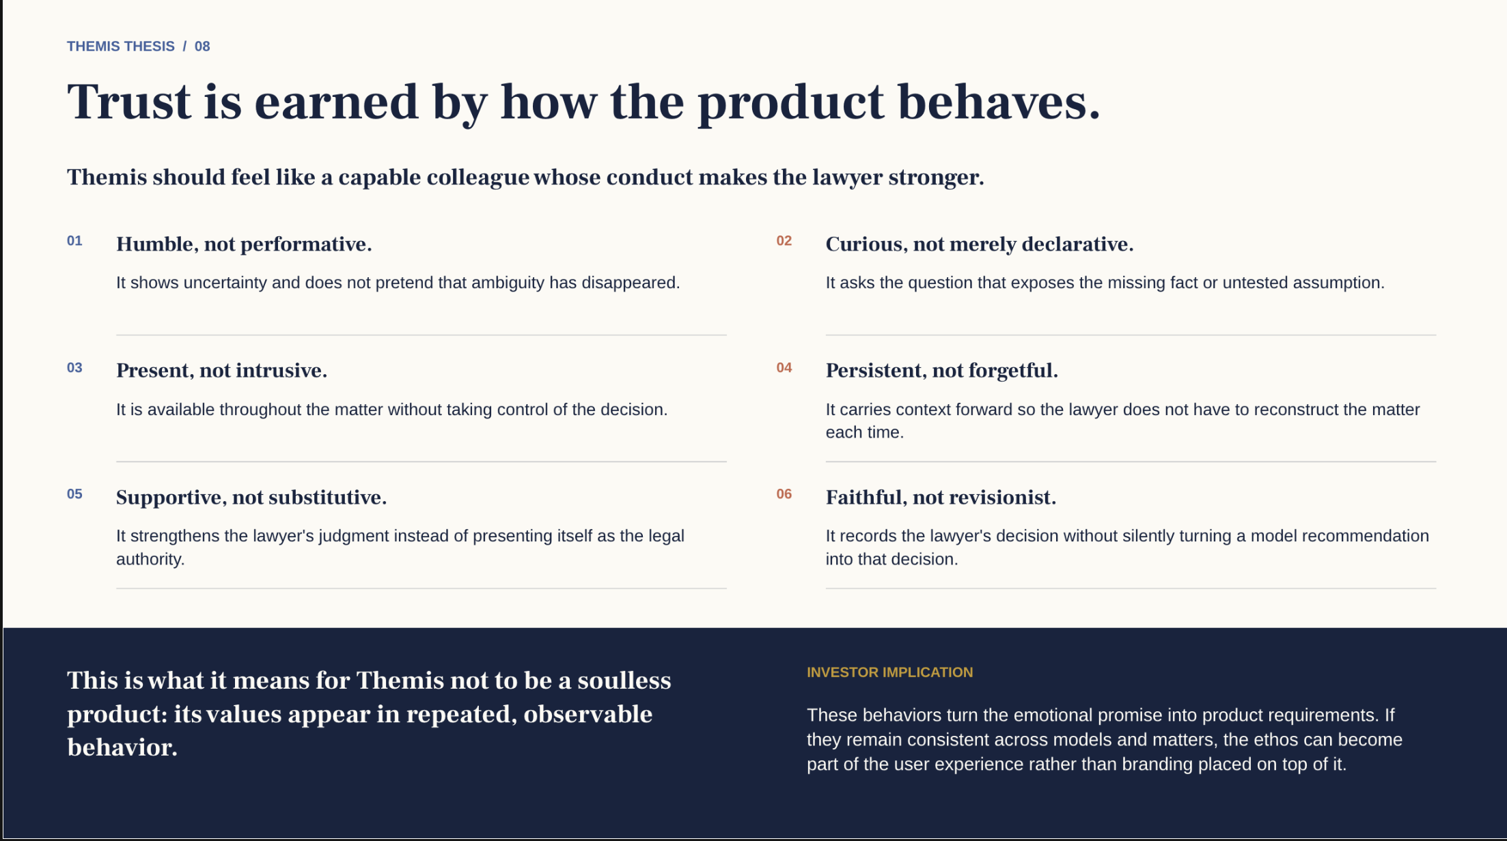
Notes:
Supplied Themis brand-principles source retained unchanged from the earlier deck. Text is part of the original raster artwork. Humble, curious, present, persistent, supportive and faithful describe intended product behavior, not outcome guarantees. Persistent context supports the product but is not the lead commercial thesis.

