Slide 1

THEMIS
Your judgment.
With more time
to use it.
AI that takes on the slow work
behind legal advice.
Built around the lawyer.
Brian Harris, Founder / September 2026
Notes:
Themis VC pitch, September 2026, version 8. Product ambition and business proposals are distinguished from prototype evidence. No customer traction or measured savings is claimed. Proposed positioning reflects the founder’s latest direction: remove slow preparation work and adapt to the lawyer’s working style. This is an intended benefit, not a measured performance claim. Existing conceptual flashlight artwork retained from v7.

Slide 2
THE PROBLEM
The company needs a decision.
Preparation consumes the lawyer’s day
THE REQUEST
WORK BEFORE THE ADVICE
“Can we ship Friday?”
Search for the relevant rules.
Read and compare the sources.
Pull facts from the documents.
Prepare a usable first draft.
A new product. An unclear data use.
A deadline that will not move.
That work is necessary. The business value comes from what the lawyer does with it.
THEMIS
02
Notes:
Themis VC pitch, September 2026, version 8. Product ambition and business proposals are distinguished from prototype evidence. No customer traction or measured savings is claimed. Founder observation, supported directionally by four exploratory in-house counsel interviews in output/research/raw/interviews/in-house-counsel/. The launch request is illustrative. The argument concerns lawyer time spent on preparation; it does not claim research is inherently valueless. See also Thomson Reuters 2025 State of the Corporate Law Department Report, pp. 4–10: https://www.acc.com/sites/default/files/2025-06/2025-State-of-the-Corporate-Law-Department-Report.pdf

Slide 3
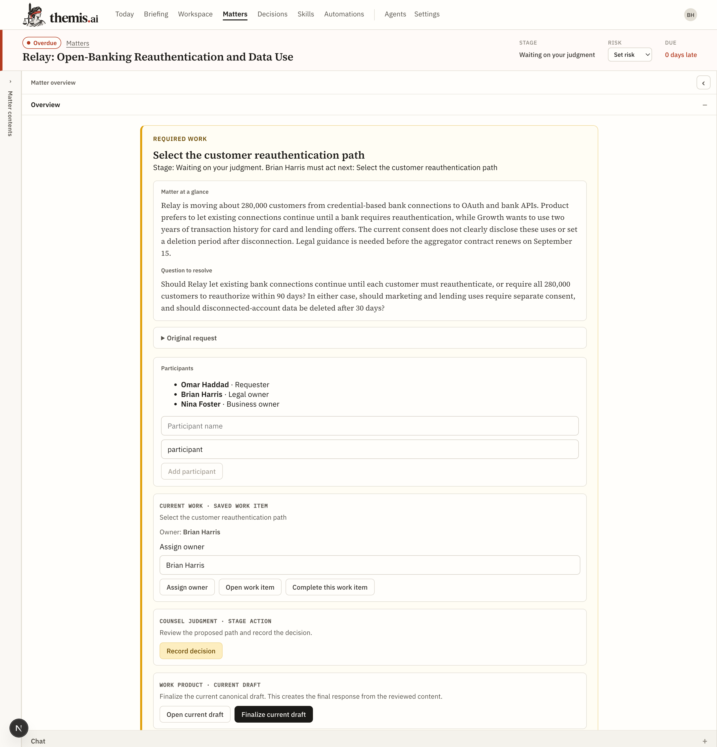
WORKING PROTOTYPE
A business question becomes
a concrete decision
RELAY DEMO MATTER
A bank-data migration.
An unclear consent.
When should customers
give permission again?
Themis puts the
question in front
of the lawyer.
Actual prototype capture, September 2026. Fictional demo data.
THEMIS
03
Notes:
Themis VC pitch, September 2026, version 8. Product ambition and business proposals are distinguished from prototype evidence. No customer traction or measured savings is claimed. Source: output/deck/screenshots/matter-relay.png, also used in the project’s prior deck assets. Cropped to the required-work and matter-summary area for readability. This is a historical prototype screenshot containing seeded fictional demo data, not an external customer or a fresh product execution. The screenshot supports the existence of the workspace and decision orientation, not autonomous production of the displayed content.

Slide 4
THE USEFUL HANDOFF
A draft the lawyer can judge and use
RELAY / DRAFT DECISION NOTE
THE LAWYER’S CALL
Proposed path
Require everyone
to reauthorize
within 90 days?
Continue existing disclosed uses during the migration.
Seek permission for new marketing or lending uses separately.
Conditions to resolve
Or wait until each bank
requires it? Weigh the
business cost and risk.
Set the migration period. Approve the consent copy.
Confirm deletion and contract terms.
Abridged seeded demo content. Proposed advice remains separate from a recorded decision.
THEMIS
04
Notes:
Themis VC pitch, September 2026, version 8. Product ambition and business proposals are distinguished from prototype evidence. No customer traction or measured savings is claimed. Source: vault/03_Matters/relay-open-banking/drafts/decision-note.md and recommendations.md, read for this revision. Text is an abridgment of fictional seeded demo content, not a new legal conclusion, verified authority or output produced during this session. The 90-day choice is a scenario parameter, not a claim about a legal deadline. Demonstrates the intended editable handoff and the distinction between a proposal and the lawyer’s decision.

Slide 5
THE PRODUCT THESIS
Themis works the way you work
A strong junior associate learns
how the partner wants the work done.
YOUR INSTRUCTIONS
THEMIS ADAPTS
“Start with the answer. Show the sources.
Give me a short note for the product team.”
Your preferred depth and format.
Your working methods.
Your business priorities.
Design thesis. Editable preferences and agent instructions exist in the prototype; effortless adaptation is the pilot goal.
THEMIS
05
Notes:
Themis VC pitch, September 2026, version 8. Product ambition and business proposals are distinguished from prototype evidence. No customer traction or measured savings is claimed. Source: founder’s current instructions, brand_pitch.md, docs/PRD.md §3.5 and vault/00_System/user.md. Existing prototype supports editable user preferences, agent instructions and workflows. Do not imply automatic learning of individual style has been validated or fully shipped. The example instruction is illustrative. This positioning replaces repeated context reconstruction as the primary value proposition.

Slide 6
WHY NOW
Legal teams are deciding how AI will work
36%
63%
of surveyed legal departments
are actively deploying generative AI.
of surveyed chief legal officers
expect headcount to stay stable.
Our opening: help a small legal team do more useful work with the people it already has.
ACC 2026 Chief Legal Officers Survey. 1,049 participants across 43 countries.
THEMIS
06
Notes:
Themis VC pitch, September 2026, version 8. Product ambition and business proposals are distinguished from prototype evidence. No customer traction or measured savings is claimed. Verified source, accessed September 4–5, 2026: https://www.acc.com/sites/default/files/2026-01/2026-ACC-Chief-Legal-Officers-Survey-Key-Findings.pdf Key findings p. 2, section 05. Survey scope: 1,049 participants, 20 industries, 43 countries. These statistics are not small-team-only estimates and do not establish Themis demand. The commercial opening is our strategic inference: legal departments are actively choosing how to deploy AI while focusing on the work of existing lawyers.

Slide 7
FIRST CUSTOMER
One lawyer. A company’s worth of questions
INITIAL BUYER
THE BUYING MOMENT
Solo general counsel
or a 1–5 lawyer team
A launch adds unfamiliar legal work.
The team has no junior support.
The backlog grows before headcount does.
Start with product and regulatory questions
at technology and fintech companies.
One lawyer can test Themis
on one live matter.
Proposed initial segment. Interview signals support the need; paid demand remains to be tested.
THEMIS
07
Notes:
Themis VC pitch, September 2026, version 8. Product ambition and business proposals are distinguished from prototype evidence. No customer traction or measured savings is claimed. Sources: four exploratory in-house counsel interviews, brand_pitch.md, and output/research/themis-counselos-legal-ai-competitive-strategy.docx. Segment and triggers are proposed commercial choices. Interviews include different views and successful existing-tool use; they are not four customers or four pilot commitments. First access must fit the participant’s data requirements. Team sharing is a future product expansion.

Slide 8
WHERE WE COMPETE
The opening is the whole job, done your way
THEMIS’S INTENDED ADVANTAGE
GENERAL AI
Delegate a product question through research and a usable draft, with fewer instructions.
Flexible thinking and drafting
LEGAL PLATFORMS
Start with one product lawyer. Fit the investigation and work product to that lawyer’s methods.
Harvey, Legora, GC AI
Win on total lawyer effort, including instructions, source checks, corrections, and the final draft.
THEMIS
08
Notes:
Themis VC pitch, September 2026, version 8. Product ambition and business proposals are distinguished from prototype evidence. No customer traction or measured savings is claimed. Verified competitor sources accessed September 4–5, 2026: https://www.harvey.ai/platform/agents ; https://legora.com/ ; https://gc.ai/pricing. Harvey markets agents, customization and legal workflows; Legora serves in-house teams and supports research/drafting; GC AI directly targets in-house teams with skills, Word, connectors and individual access. The slide asserts a Themis focus, not exclusive capabilities or proven superiority. Local corpus: output/research/themis-counselos-legal-ai-competitive-strategy.docx, 203 reported de-duplicated Reddit threads, qualitative and not representative. Broad competitor claims in that older report were not adopted without current support.

Slide 9
BUSINESS MODEL
Sell capacity back to the legal team
$500
VALUE TEST
One hour a week
per lawyer, per month
At an assumed $250 per lawyer hour,
that is about $1,000 of monthly
capacity for a $500 subscription.
Proposed starting price
One seat to start. Expand with use.
Measure time saved after checking
and correcting the work.
Illustrative economics: 4 weeks/month. Capacity value is not cash savings. Price and benefit are unvalidated.
THEMIS
09
Notes:
Themis VC pitch, September 2026, version 8. Product ambition and business proposals are distinguished from prototype evidence. No customer traction or measured savings is claimed. Proposed Themis price: $500/seat/month, $6,000/seat/year at 12 months; no annual discount assumed. Current public reference: https://gc.ai/pricing lists an individual plan at $500/month; this is a competitor offer, not proof of willingness to pay Themis. Value illustration: 1 net hour/week × 4 weeks/month × $250/hour = $1,000/month of capacity. The $250/hour is a modeling assumption, not a measured salary or billable rate. Recovery of time does not automatically reduce payroll or outside-counsel spend. Initial offer should set clear included usage once observed delivery cost is known.

Slide 10
MARKET POTENTIAL
A focused entry into a $870M annual opportunity
145,000
MODELED U.S. POTENTIAL
$870M
estimated U.S. in-house lawyers
ACC analysis of 2024 employment data
145,000 lawyers × $6,000 per year
Initial segment scenario: 10–20% of those lawyers
14,500–29,000 seats, or $87M–$174M annually
Scenario, not a market forecast. Assumes full adoption at proposed pricing; initial-segment share is unverified.
THEMIS
10
Notes:
Themis VC pitch, September 2026, version 8. Product ambition and business proposals are distinguished from prototype evidence. No customer traction or measured savings is claimed. Verified population source: https://www.acc.com/sites/default/files/resources/upload/US-In-house-Counsel-Population-Statistics.pdf (ACC, 2025), pp. 1–2: roughly 145,000 U.S. in-house counsel in 2024, estimated from BLS employment data by subtracting law-firm and government lawyers. This includes more than Themis’s initial segment. Model: 145,000 × $6,000 = $870,000,000 annual revenue potential at full penetration and unchanged per-seat pricing. Proposed serviceable segment sensitivity: 10–20% × 145,000 = 14,500–29,000 seats; × $6,000 = $87–174 million. The 10–20% is an explicit unverified planning assumption, not ACC data. These values are neither bookings nor revenue forecasts. No law-firm or international market is added.

Slide 11
GO TO MARKET
The first sale starts with a real matter
01
Recruit through Brian’s network
Target solo general counsel and product lawyers. Ask for one active matter.
02
Run a short, supported pilot
Use the lawyer’s preferred format. Compare total effort with their usual tools.
03
Convert, then expand
Charge for continued use. Seek referrals and a second paid seat after repeat value.
First 90-day targets: 20 qualified conversations, 10 pilot lawyers, 5 paying lawyers. Proposed targets, not pipeline.
THEMIS
11
Notes:
Themis VC pitch, September 2026, version 8. Product ambition and business proposals are distinguished from prototype evidence. No customer traction or measured savings is claimed. Proposed founder-led acquisition plan, grounded in the four existing exploratory interview files and Brian’s reported general-counsel/product-counsel experience. No referrals, partnerships, pipeline, sales commitments or conversion rates are claimed. Target 20 qualified buyer conversations, 10 pilot users, 5 paying users in first 90 days after pilot access is ready. Later channels to test: counsel communities and referrals from fractional general counsel, with no implied association endorsement. Expansion through another lawyer depends on shared-work capability, which is not currently shipped.

Slide 12
FOUNDER
I wanted to multiply what one lawyer can do
Brian Harris
Sole founder
LIVED THE WORK
BUILT THE PROTOTYPE
17 years as a lawyer
General counsel and product counsel
Built legal functions and led teams
Earlier AI research at Georgia Tech
M.S. in Computer Science, Georgia Tech
J.D., Northwestern
THEMIS
12
Notes:
Themis VC pitch, September 2026, version 8. Product ambition and business proposals are distinguished from prototype evidence. No customer traction or measured savings is claimed. Founder facts carried from source deck v7 and brand_pitch.md; v7 notes cite Brian’s supplied January 2026 resume. Seventeen years is founder-reported (the older resume says 15+). First-person headline is proposed founder copy based on brand_pitch.md’s interview-derived motivation and the founder’s current request for more passion, not a verbatim quotation. AI/natural-language research is historical. No current employer or employer endorsement is implied.

Slide 13
THE NEXT PROOF
Useful work earns the next matter
FOUNDATION TODAY
18-MONTH TARGETS
Working local prototype
Four exploratory counsel interviews
Editable research and draft workflows
25 paying teams
50 paying lawyers
$300,000 annual recurring revenue
Each completed matter should make Themis more useful.
Apply the lawyer’s corrections to how the next job gets done.
Targets: 60% start a second matter within 30 days; 25% less total lawyer effort on matched tasks. Not measured results.
THEMIS
13
Notes:
Themis VC pitch, September 2026, version 8. Product ambition and business proposals are distinguished from prototype evidence. No customer traction or measured savings is claimed. Foundation: current repository and v7, four interview files, existing prototype captures. No paying users or live customer retention demonstrated in reviewed sources. Proposed 18-month targets: 25 paying organizations, average 2 paid seats = 50 seats, each $500/month × 12 = $300,000 annual recurring revenue run rate, not recognized cumulative revenue. Repeat-use target: 60% of activated pilot lawyers start a second distinct matter within 30 days of completing their first. Effort target: median 25% reduction against matched usual-tool tasks, including prompting, verification, correction and final assembly. Sustained personalization and workflow fit are proposed retention mechanisms; automated learning is not claimed as existing.

Slide 14
INVESTMENT PROPOSAL
More capacity for the lawyers
building the business
$1.5M
CAPITAL TURNS THE PROTOTYPE INTO
A dependable product for real work
A founding technical team
A path to paying customers
Proposed pre-seed raise
18 months of focused execution
Themis takes on the preparation.
The lawyer has more room to lead.
THEMIS
14
Notes:
Themis VC pitch, September 2026, version 8. Product ambition and business proposals are distinguished from prototype evidence. No customer traction or measured savings is claimed. Proposed fundraising plan created for this revision at the user’s request. Not a committed round, approved budget, appointed team or fixed financing term. 18-month illustrative allocation: $900k founder and technical delivery; $180k customer development; $150k models/research/infrastructure; $120k secure pilot delivery and operations; $150k contingency. Sum $1.5m; average including reserve about $83.3k/month. Founding technical leader is open. Customer development can begin with the founder and fractional support. Financing instrument and final budget remain to be set. Milestones on slide 13 are proposed, not promised.

Slide 15
APPENDIX / PARTNERSHIP
Themis brings intelligence at scale.
The lawyer brings judgment
Themis brings | The lawyer brings
Speed and capacity | Business and human context
Research and analysis | Experience and wisdom
Persistent memory | Values and risk tolerance
Questions and alternatives | The choice of path
Accurate, well-supported work | Ownership of the decision
More capacity for the work only the lawyer can do.
THEMIS
15
Notes:
Themis VC pitch, September 2026, version 8. Product ambition and business proposals are distinguished from prototype evidence. No customer traction or measured savings is claimed. Partnership table retained from v7 with the accepted headline and all five rows. Capacity and quality are product requirements, not measured guarantees. Memory is supporting capability, not the lead commercial thesis.

Slide 16
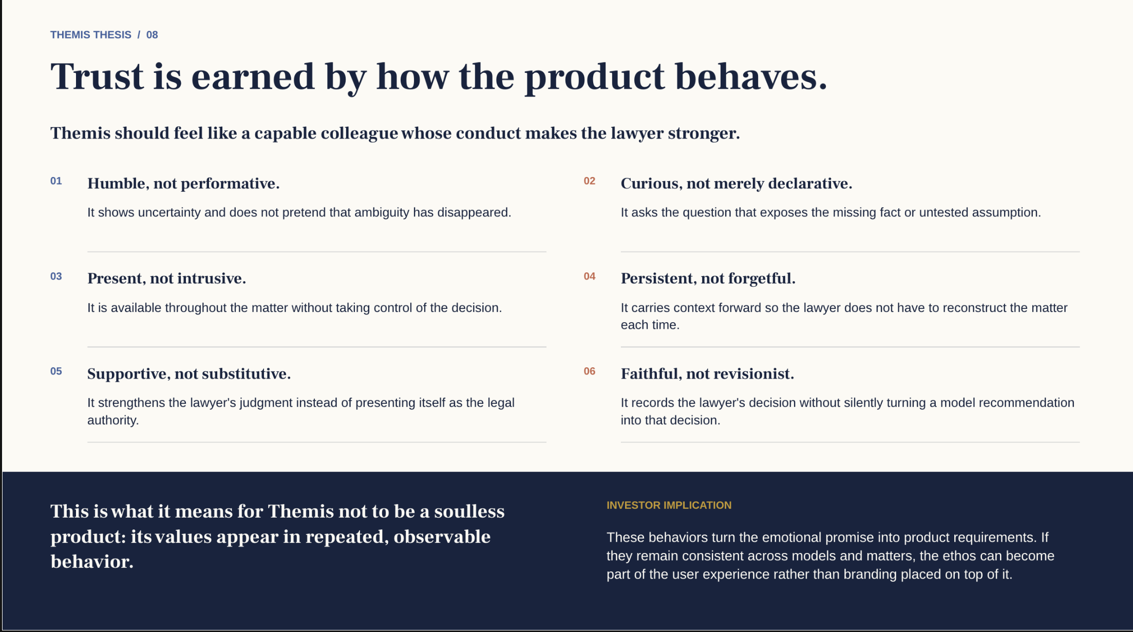
Notes:
Themis VC pitch, September 2026, version 8. Product ambition and business proposals are distinguished from prototype evidence. No customer traction or measured savings is claimed. Original supplied brand-principles slide retained unchanged from v7 slide 14. Source artwork is raster; its text is intentionally retained as supplied. Principles are product requirements rather than guarantees.

Slide 17
APPENDIX / OPERATING ASSUMPTIONS
A focused 18-month plan
Use of funds | Budget
Founder and technical delivery | $900,000
Customer development | $180,000
Models, research and infrastructure | $150,000
Secure pilot delivery and operations | $120,000
Contingency | $150,000
Total | $1,500,000
WHAT THE PLAN MUST PROVE
Lawyers return.
They pay for continued use.
Total effort falls.
Delivery costs support the price.
Shared work and automatic
adaptation require further
product development.
Proposed budget and milestones for investor discussion. Final staffing and financing terms remain open.
THEMIS
17
Notes:
Themis VC pitch, September 2026, version 8. Product ambition and business proposals are distinguished from prototype evidence. No customer traction or measured savings is claimed. Budget arithmetic: 900,000+180,000+150,000+120,000+150,000=1,500,000. 18-month average including contingency = 83,333.33/month. Founder and technical delivery includes compensation, taxes/benefits and contractor capacity; final staffing/location assumptions remain open. Price economics should be tested on observed model, research, infrastructure and support costs before offering unrestricted usage. All commercial numbers in this deck are proposed unless expressly sourced. Sources are in relevant slide notes.

