Slide 1

THEMIS
More capacity for
the work only the
lawyer can do.
An AI workspace that helps small legal teams turn incomplete business requests into organized analysis, usable work, and lawyer-owned decisions.
Brian Harris, Founder
Notes:
Source: brand_pitch.md and founder interview in this task. Strategic claims are hypotheses. No customer traction or measured time savings is claimed.
Artwork: existing project asset cover-flashlight-bw.png. Conceptual illustration.

Slide 2
THE CAPACITY PROBLEM
Judgment is scarce. Preparation consumes it.
THE REQUEST · 4:12 P.M.
THE LAWYER’S WORK BEFORE ANSWERING
“Can we ship Friday?”
Gather the product documents and history.
Verify what the business is actually doing.
Find the governing law and recent developments.
Explain the options and what could change the answer.
That short message leaves out facts the legal answer may depend on: how the product works, which company does what, when each step happens, and what the company decided before.
GENERIC AI DOES NOT REMOVE THIS PREPARATION
The lawyer must still load the context, point the model toward the right issues, challenge confident assumptions, and check the sources.
The business asked for an answer. The lawyer first has to build the question.
THEMIS
02
Notes:
Source: brand_pitch.md and founder interview in this task. Strategic claims are hypotheses. No customer traction or measured time savings is claimed.
Founder observation from 17 years of legal work and direct use of AI tools. The time, question, and product request are illustrative. They are not a measured customer incident or time study. The slide makes the actor explicit: the in-house lawyer reconstructs the business and legal context and reviews the generic AI answer.

Slide 3
THE INSIGHT
The business asks for a yes or no.
The lawyer needs the conditions behind it.
BUSINESS QUESTION
THE ANSWER MAY CHANGE BASED ON
“Can we launch Friday?”
What the product actually does
Which company handles the money or data
When each step happens
Where the product and users are located
Which laws and earlier company decisions apply
Generic AI often answers from the facts it receives. A lawyer must prepare for facts that are missing, disputed, or wrong.
THEMIS
03
Notes:
Source: brand_pitch.md and founder interview in this task. Strategic claims are hypotheses. No customer traction or measured time savings is claimed.

Slide 4
WHY NOW
AI can now do useful legal work.
It still needs a lawyer to make it useful.
Brian began building Themis after using newer AI models for legal research, synthesis, and drafting in his own work.
WITHOUT A LEGAL WORKSPACE, THE LAWYER MUST REPEAT
Explain the company and product
Upload the matter documents
Guide the model toward the relevant law
Challenge its assumptions
Turn the result into usable legal work
The opportunity is to design the product around how lawyers examine questions and reach decisions.
THEMIS
04
Notes:
Source: brand_pitch.md and founder interview in this task. Strategic claims are hypotheses. No customer traction or measured time savings is claimed.

Slide 5
THEMIS
Themis turns an incomplete request into
a legal matter the lawyer can work from.
Themis is a matter-centered AI workspace for in-house lawyers. It keeps the work around a business question together as the facts and law change.
EACH MATTER CONNECTS
Original business request
Company context and source documents
Facts, assumptions, and open questions
Research and supported analysis
Draft work and lawyer-recorded decisions
THE EFFICIENCY GAIN
The lawyer stops rebuilding the matter before every prompt and reaches a usable legal picture faster.
Themis helps lawyers feel clear, capable, and supported when the judgment matters most.
THEMIS
05
Notes:
Source: brand_pitch.md and founder interview in this task. Strategic claims are hypotheses. No customer traction or measured time savings is claimed.
Intended complete experience. The local prototype already supports matter records, research, drafting, and decisions. The efficiency statement is a product promise, not a measured time-savings claim. Brand Essence follows the user’s exact supplied wording.

Slide 6
THE DIVISION OF LABOR
Themis brings intelligence at scale.
The lawyer brings judgment.
Themis prepares and preserves the work around the decision. The lawyer applies context, risk tolerance, and authority.
Themis brings | The lawyer brings
Speed and capacity | Business and human context
Research and analysis | Experience and wisdom
Persistent memory | Values and risk tolerance
Questions and alternatives | The choice of path
Accurate, well-supported work | Ownership of the decision
More capacity for the work only the lawyer can do.
THEMIS
06
Notes:
Source: brand_pitch.md and founder interview in this task. Strategic claims are hypotheses. No customer traction or measured time savings is claimed.
User-approved headline and all five comparison rows preserved. Scale is a capacity thesis, not measured throughput. The lawyer also brings intelligence. Themis uses the context the lawyer supplies.

Slide 7
PROPOSED PRODUCT INTERACTION
One missing fact can change the legal analysis.
BUSINESS REQUEST
“Our marketplace will move money from a customer to a seller. Do we need to change the launch plan?”
01
Map transaction
02
Find key fact
03
Compare paths
Organize each party, account, transfer, and point in time.
Does the company ever receive or control the funds, even briefly?
Explain why the fact matters and research each relevant legal path.
Themis shows where the analysis can change. The lawyer determines which facts and path apply.
Concept illustration. This is not a licensing conclusion or a shipped interactive feature.
THEMIS
07
Notes:
Source: brand_pitch.md and founder interview in this task. Strategic claims are hypotheses. No customer traction or measured time savings is claimed.

Slide 8
INITIAL CUSTOMER
The first buyer is the lawyer carrying
an entire legal function.
INITIAL USER
TEAM EXPANSION
Solo general counsel
or product lawyer
In-house legal team
with fewer than ten lawyers
Often works without junior support and must answer product and business questions across the company.
Shared matters can let a second lawyer see the request, facts, research, decisions, and next open question without a long handoff.
Business hypothesis: earn repeat use from one lawyer, then prove that shared context supports team adoption.
THEMIS
08
Notes:
Source: brand_pitch.md and founder interview in this task. Strategic claims are hypotheses. No customer traction or measured time savings is claimed.

Slide 9
TRUST THROUGH BEHAVIOR
Legal AI earns trust through observable behavior.
The product must show what it knows, what it does not know, and who owns the decision.
Humble
Curious
Marks uncertainty instead of pretending ambiguity disappeared.
Asks the factual question that could change the analysis.
Present
Persistent
Remains available without taking control of the decision.
Carries the matter context forward.
Supportive
Faithful
Strengthens judgment instead of claiming legal authority.
Records the lawyer’s decision without rewriting it.
THEMIS
09
Notes:
Source: user-supplied THEMIS THESIS / 08 slide. All six principle headings are verbatim. Descriptions on this slide are short summaries. The complete original slide appears in the appendix. These are behavioral requirements, not a guarantee of legal accuracy.

Slide 10
THE ADOPTION THESIS
Themis must beat the lawyer’s current tool stack.
CURRENT WORKFLOW
THE TEST FOR THEMIS
General AI such as ChatGPT or Claude
Legal and web research sources
Documents, email, and Slack
Manual notes and personal memory
Does the lawyer spend less total effort?
Can the lawyer inspect the sources quickly?
Does Themis remember relevant company context?
Does the lawyer return with the next matter?
Repeat use and willingness to pay remain to be proven.
THEMIS
10
Notes:
Source: brand_pitch.md and founder interview in this task. Strategic claims are hypotheses. No customer traction or measured time savings is claimed.
Business hypothesis. Stored files alone are not a moat. Pricing, willingness to pay, market size, and acquisition economics remain unvalidated. No claim that alternatives lack these features.

Slide 11
FOUNDER
Founder experience spans the user problem
and the technology.
LEGAL EXPERIENCE
TECHNICAL EXPERIENCE
17 years as a lawyer
General counsel and product counsel
Built legal functions and led teams
Earlier AI and natural-language research at Georgia Tech
M.S. in Computer Science, Georgia Tech
J.D., Northwestern
Brian Harris is the sole founder. He built Themis to give small legal teams the capacity he wanted as a lawyer and legal leader.
THEMIS
11
Notes:
Sources: founder interview in this task and Brian Resume 01_21_26.docx (1).pdf, supplied January 2026 résumé. Seventeen years is founder-reported; résumé states 15+. Roles describe experience, not employer endorsement. Current employment is not inferred from the résumé. The capacity statement summarizes the founder’s motivation.

Slide 12
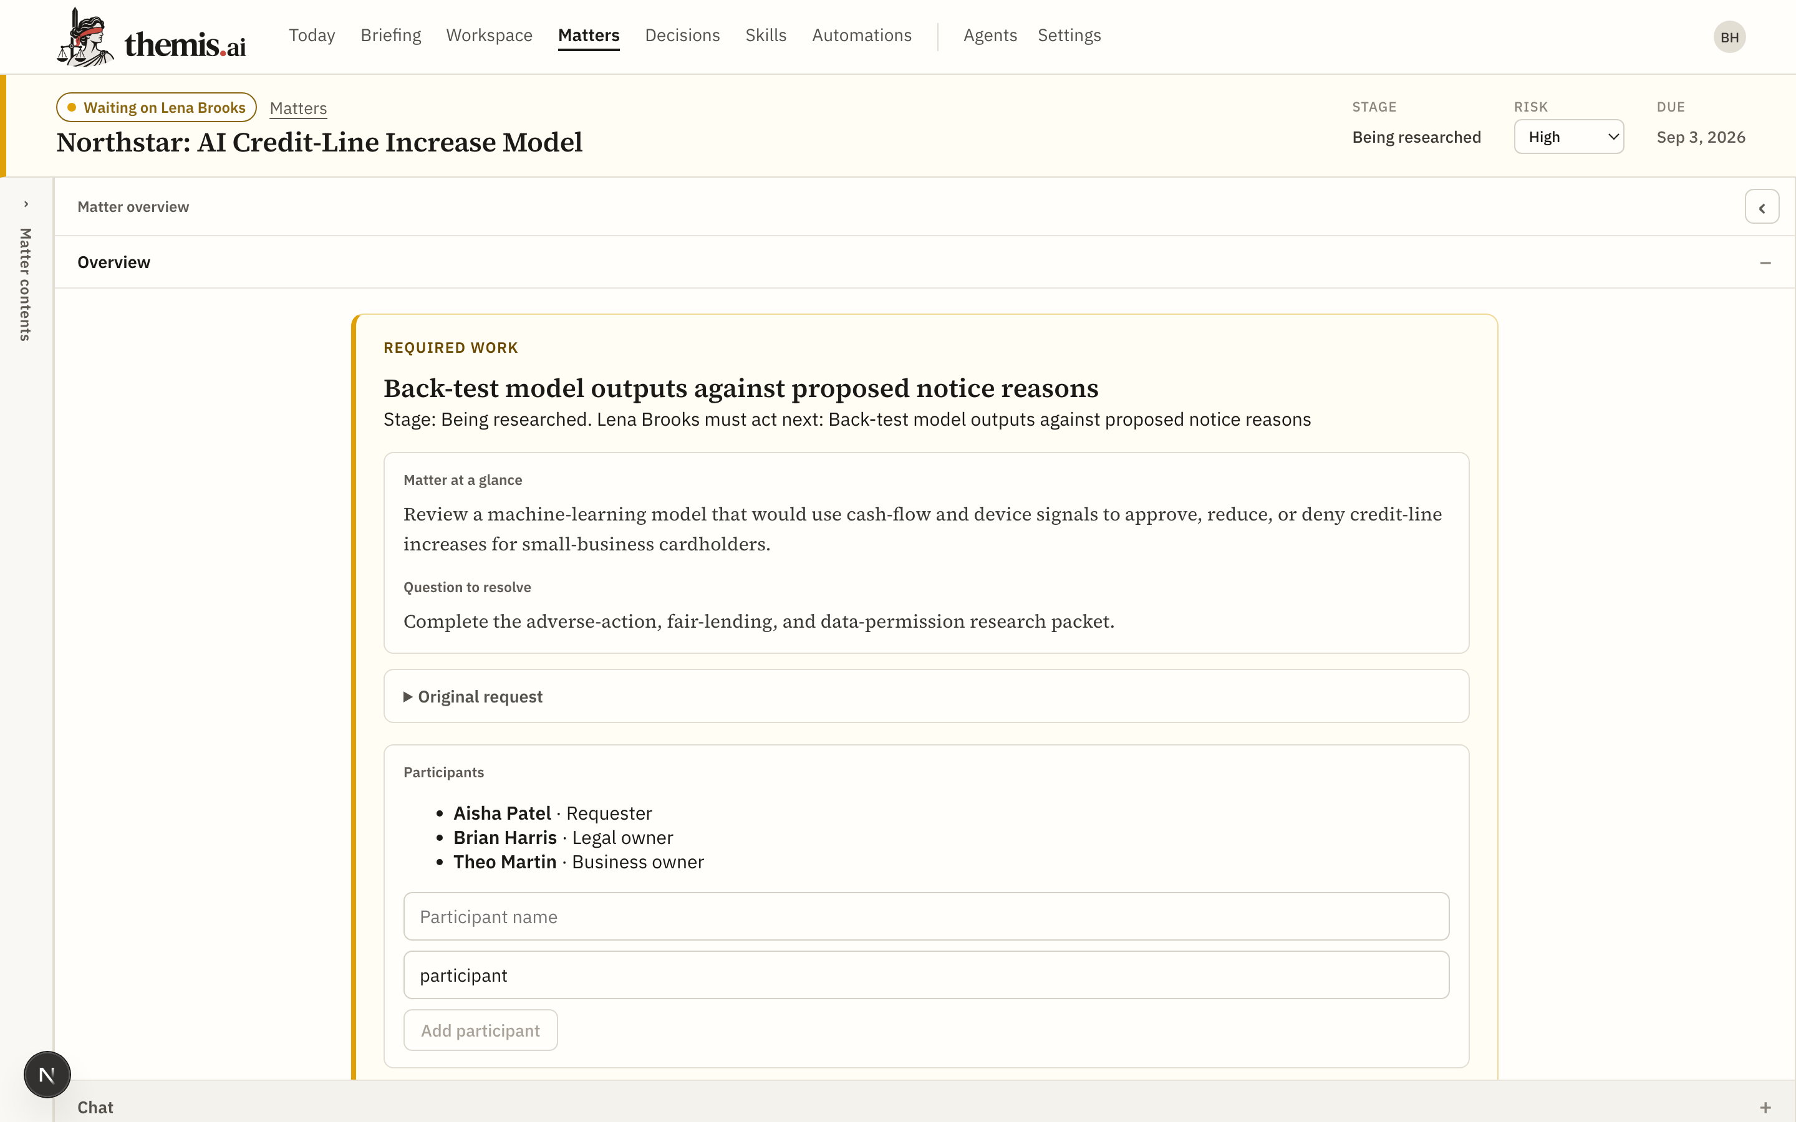
PROTOTYPE AND NEXT MILESTONE
A working prototype exists.
The next proof is attorney return use.
BUILT TODAY
Local prototype with matter context, research, editable drafts, and explicit lawyer-recorded decisions.
NEXT PROOF
Attorneys use Themis on real questions and return with another matter.
WHAT TO MEASURE
Time to useful orientation · Source correctness · Correction burden · Repeat use
Prototype capture, September 2026. Fictional matter.
THEMIS
12
Notes:
Sources: existing September 2, 2026 project screenshot output/deck/screenshots/matter.png, repository implementation, and brand_pitch.md. Screenshot is historical prototype evidence, not a live customer. Current review could not reach the local backend. Pilot participation, dates, access setup, and performance are not confirmed. Pilot measures: total lawyer effort, source correctness, useful issue discovery, and return use.

Slide 13
INVESTMENT INVITATION
Early capital funds the path
from prototype to repeat use.
CAPITAL SUPPORTS
Full-time founder focus
A founding technical leader and engineering capacity
A business leader for pilots, pricing, and customer development
Secure pilot delivery plus model and research costs
FUNDED MILESTONE
Real attorneys use Themis on real questions, find the work useful enough to return, and provide evidence for the next product and financing decision.
THEMIS
13
Notes:
Source: brand_pitch.md and founder interview in this task. Strategic claims are hypotheses. No customer traction or measured time savings is claimed.
Investment amount, instrument, runway, founder salary budget, hiring sequence, and dates remain open. Founder salary is included in intended founder runway. CTO and business leadership roles are open, not appointed. This is an early investment discussion, not a representation of committed financing.

Slide 14
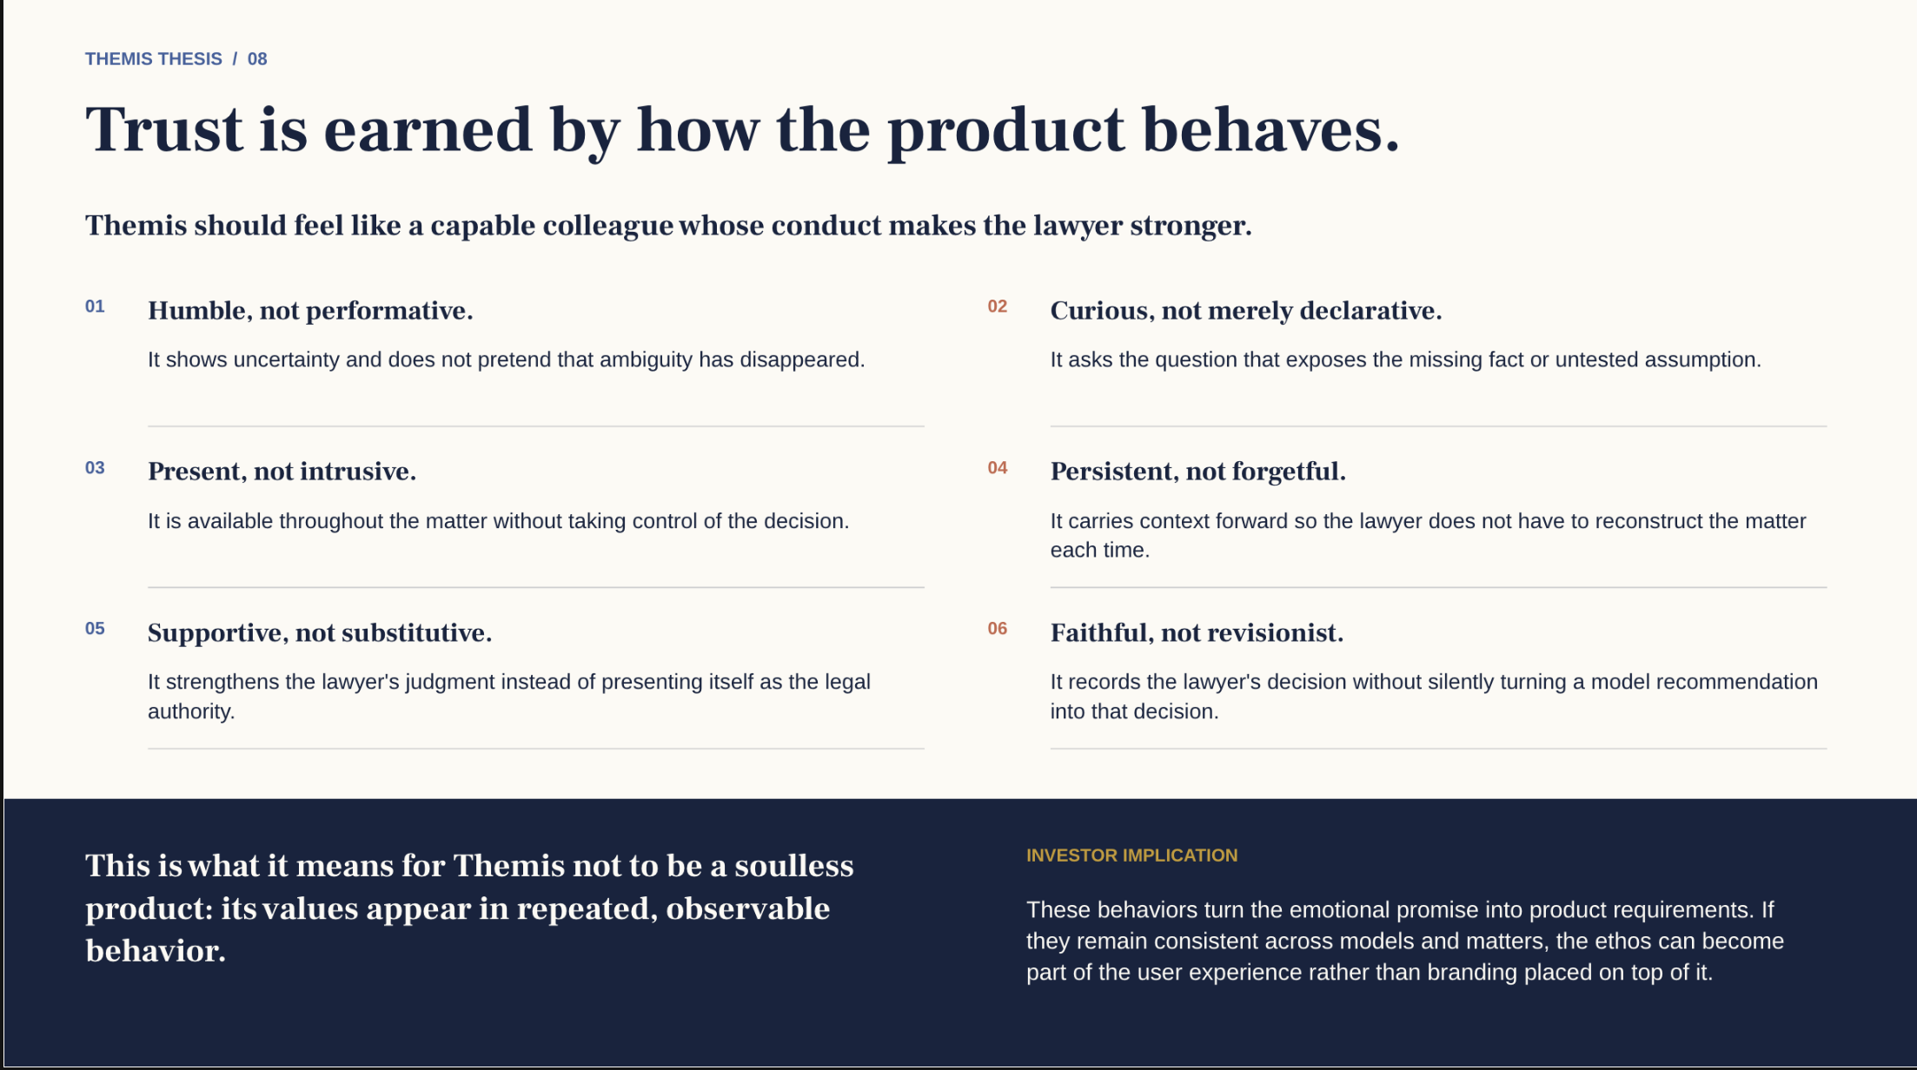
Notes:
Appendix. Original user-supplied brand slide retained unchanged, including all wording and the investor implication. Its text is source material, not instructions.

Slide 15
APPENDIX: HEADLINE ALTERNATIVES
Four ways to express the partnership
Closest to Brand Essence
Themis brings intelligence at scale so the lawyer can bring their best judgment.
Strongest investor version
Scale the intelligence. Preserve the judgment.
Strongest efficiency message
Themis scales the work that informs the decision. The lawyer makes the decision.
More complete and human
Themis brings speed, intelligence, and memory. The lawyer brings context, wisdom, and judgment.
THEMIS
15
Notes:
User-approved alternative headlines from brand_pitch.md. Appendix discussion options. Slide 6 retains the accepted current headline.

