Slide 1


ABRIC--SEGARRA Maxence
CHAKRA Adam
LECLERCQ Elias
UGUEN Paul
01/09/2025

Slide 2

Table of contents
Presentation of Kerisac and our project
Why this country?
How will it result?
PESTEL Analysis
Conclusion
01/09/2025

Slide 3
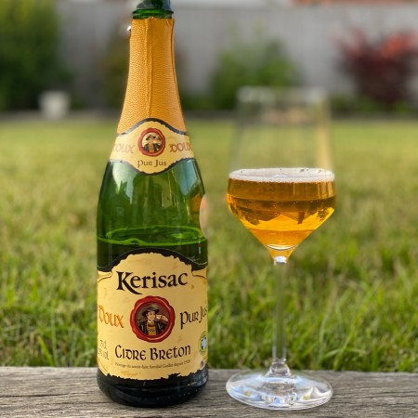
WHAT IS KERISAC?
WHY THIS COUNTRY?
HOW WILL IT RESULT?
PESTEL ANALYSIS
Producer: Établissements Guillet Frères, family-owned business
Founded: 1954, Brittany, France
Specialty: Ciders and apple-based beverages
Tradition: Breton know-how passed down through generations
Employees : 49
01/09/2025

Slide 4
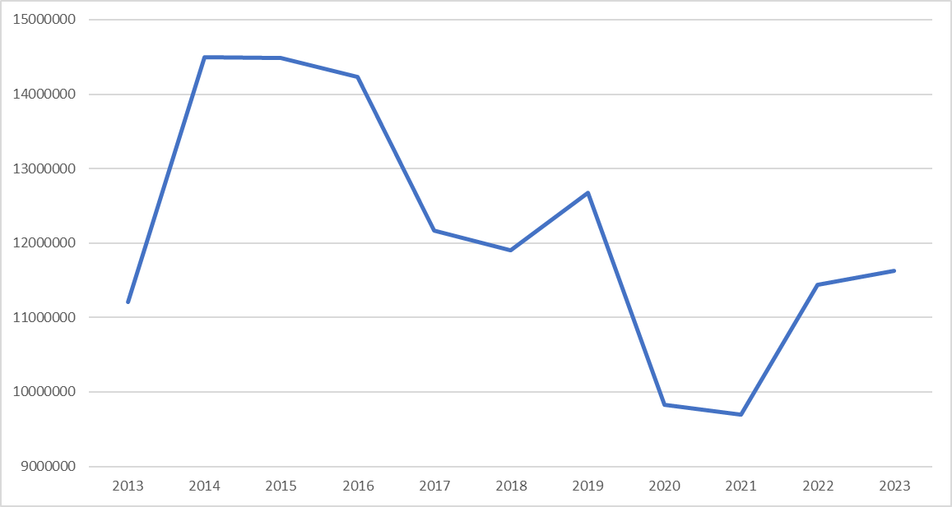
WHAT IS KERISAC?
WHY THIS COUNTRY?
HOW WILL IT RESULT?
PESTEL ANALYSIS
Kerisac turnover in €
01/09/2025

Slide 5
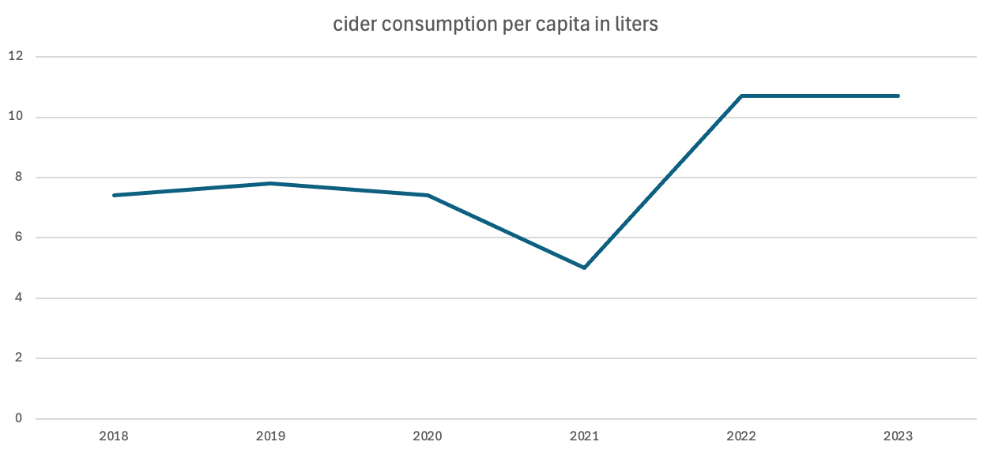
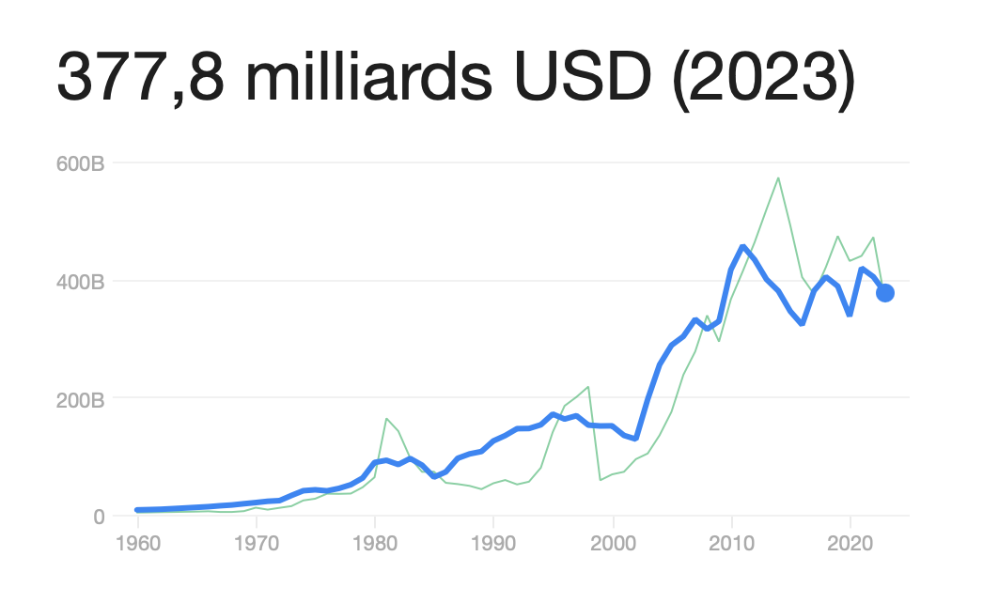
WHAT IS KERISAC?
WHY THIS COUNTRY?
HOW WILL IT RESULT?
PESTEL ANALYSIS
•Three-quarters of wine consumption is concentrated in two
key regions: Gauteng (46% ) and the Western Cape (28%).
•Products from the European Union benefit from tariff
preferences, making French imports, such as wines and
Cognacs, exempt from customs duties.
The GDP of South Africa
01/09/2025

Slide 6
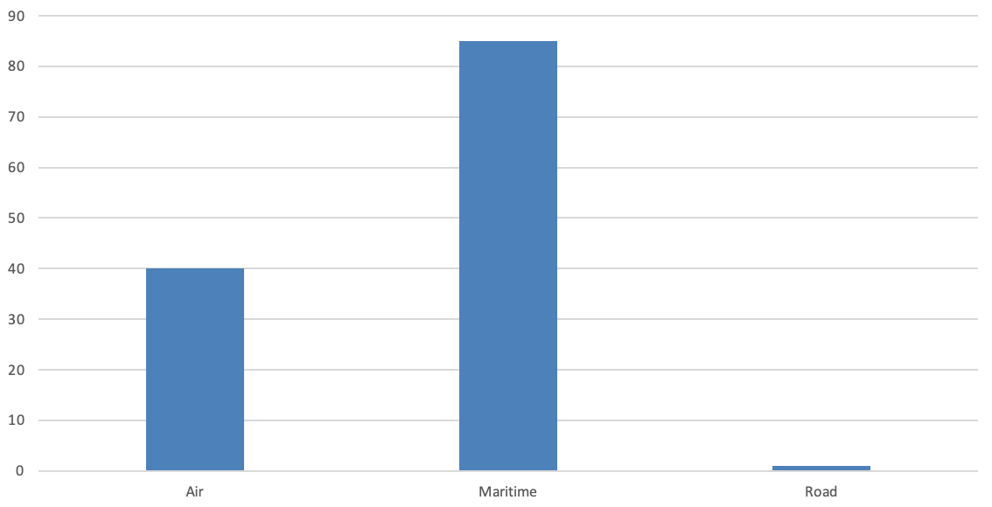
WHAT IS KERISAC?
WHY THIS COUNTRY?
HOW WILL IT RESULT?
PESTEL ANALYSIS
Distribution of Transport Modes Used by France to Export Cider to South Africa
Maritime transport is the dominant method
Road transport is nearly negligible in this context
Maritime: Most used, low cost per unit and high capcity.
Air: Rarely used, high cost and fast delivery.
Road: Not applicable.
01/09/2025

Slide 7
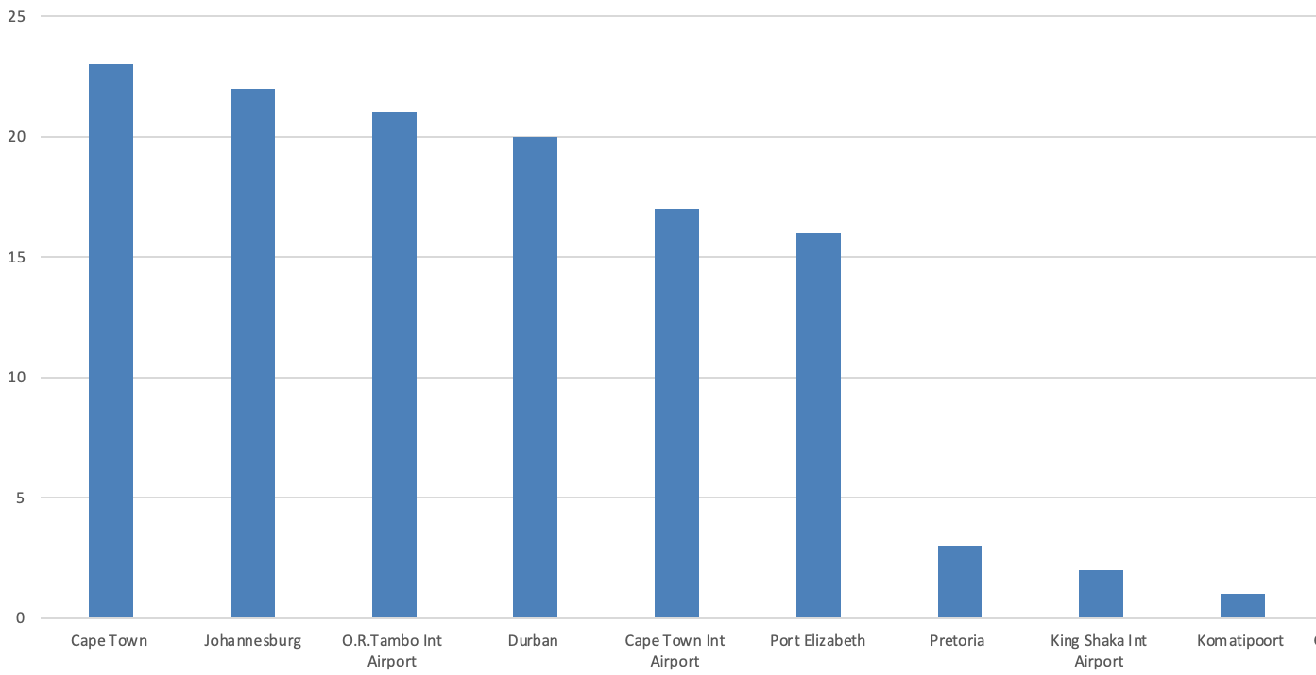
WHAT IS KERISAC?
WHY THIS COUNTRY?
HOW WILL IT RESULT?
PESTEL ANALYSIS
Top Export Destinations for Cider in South Africa
Cape Town & Johannesburg: as major cider export destinations
King shaka int Airport & Pretoria: the smaller volumes of export cider
Export focuses on major cities for efficiency and access to large markets.
01/09/2025
1/7/2025

Slide 8
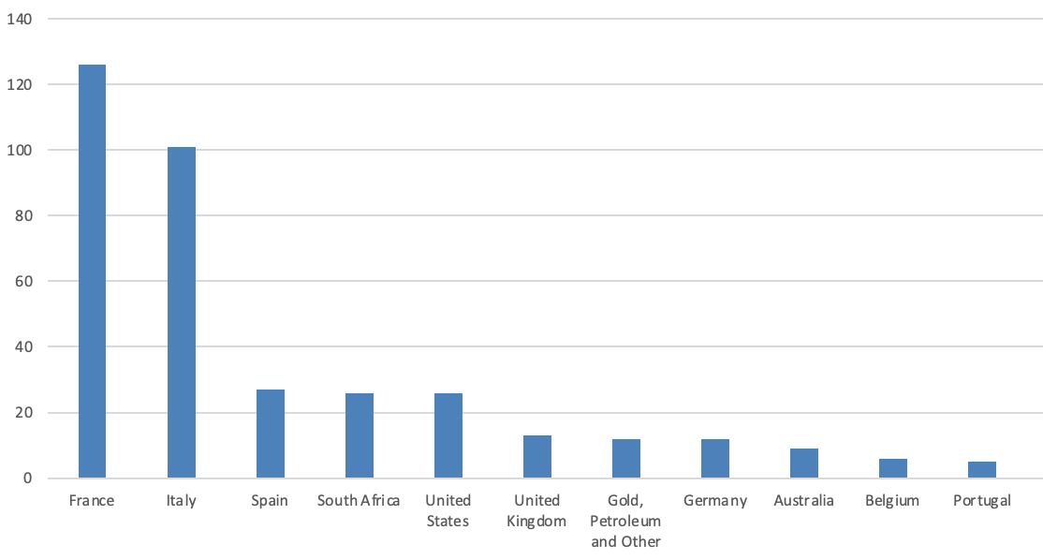
WHAT IS KERISAC?
WHY THIS COUNTRY?
HOW WILL IT RESULT?
PESTEL ANALYSIS
Number of Cider Exports by Country to South Africa
France: Leader in cider exports, known for quality and variety.
Spain, South Africa and the United States : mid-range exporters.
Belgium, Portugal and Germany : Lowe export volumes.
01/09/2025

Slide 9
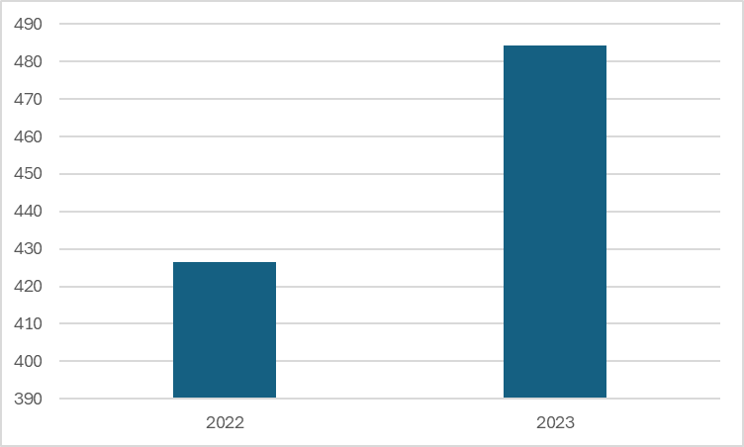
WHAT IS KERISAC?
WHY THIS COUNTRY
HOW WILL IT RESULT?
PESTEL ANALYSIS
Alcohol sales in South Africa (in billions of ZAR)
2023 Alcohol sales : + 12 % :
23 billions € -> 25 billions €
2 leaders in South Africa cider :
Savanna Cider and Hunter's Cider
Savanna being the leader by far
Two South African brands are leaders :
Create a variety offer
01/09/2025

Slide 10
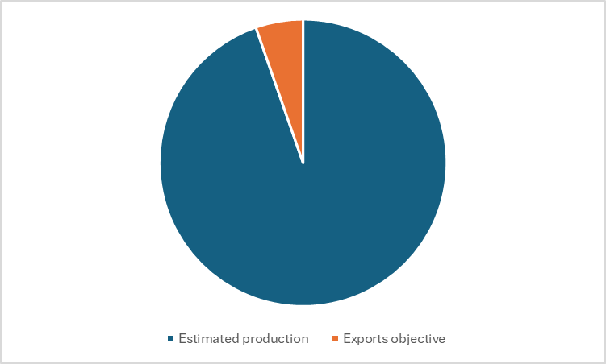
WHAT IS KERISAC?
WHY THIS COUNTRY
HOW WILL IT RESULT?
PESTEL ANALYSIS
Exports targeted compared to estimated production
Transport :
Maritime, like 60% of french exports to South Africa
Objective :
For the first year, Kerisac needs to import 200 000 litters
Reach at least 10 % of the actual cider market in South Africa
Distribution :
Collaboration with South African groups
Present in a lot of supermarkets, bars and restaurants
01/09/2025

Slide 11
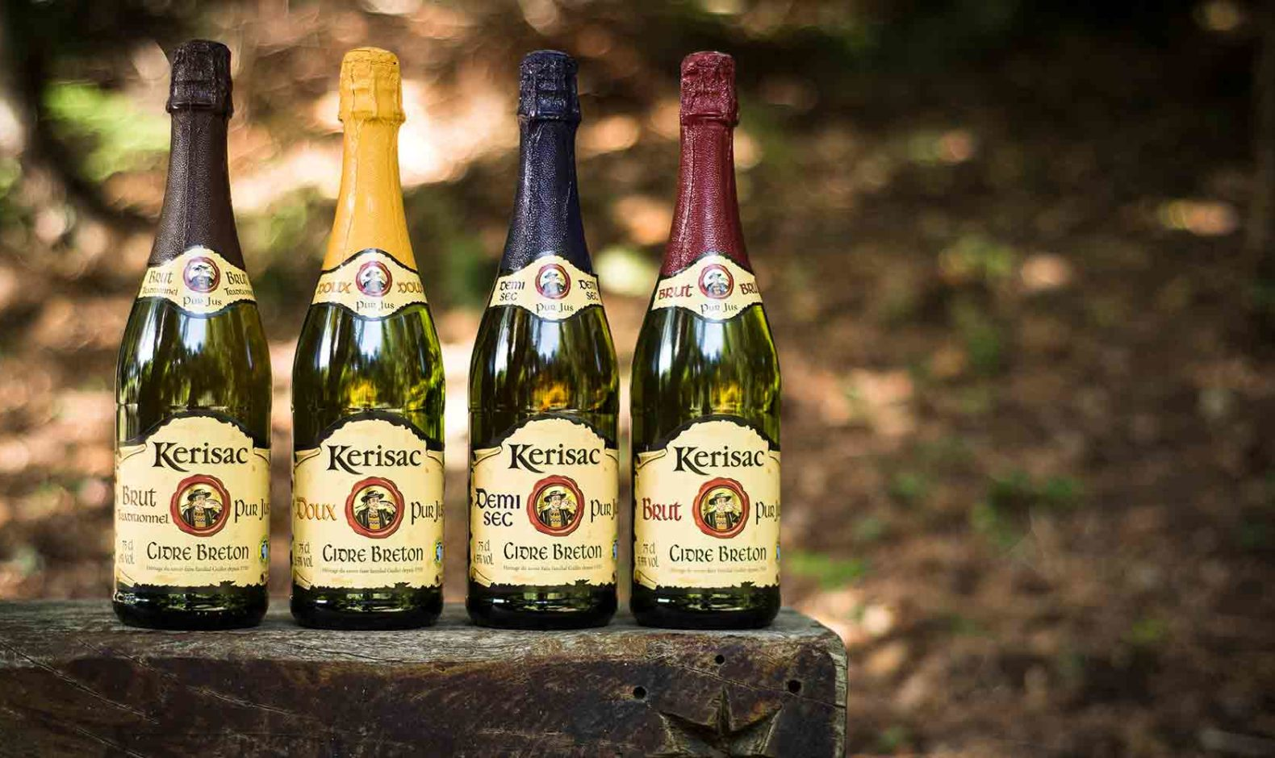
WHAT IS KERISAC?
WHY THIS COUNTRY
HOW WILL IT RESULT?
PESTEL ANALYSIS
Challenges
Concurrence :
Rude concurrence, need a big advertising and sponsorship budget.
Benefits
Visibility :
Will give visibility to Kerisac in the rest of the world
Possibility to gain up to 2 million consumers
Company's turnover
The turnover of Kerisac will get bigger
01/09/2025

Slide 12
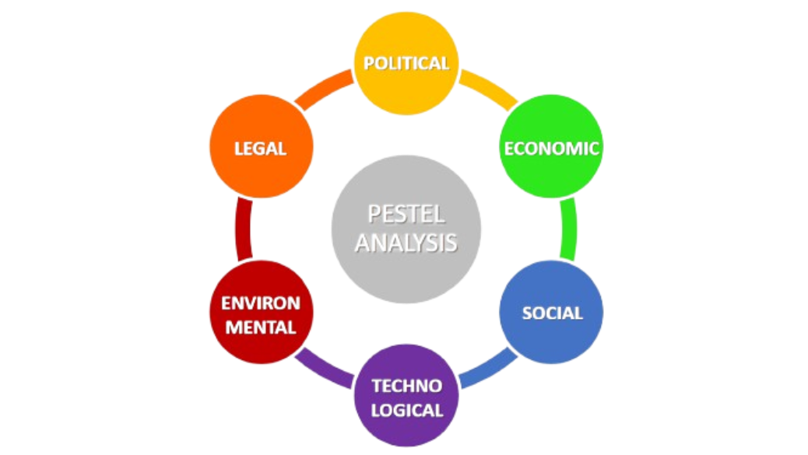
WHAT IS KERISAC?
WHY THIS COUNTRY
HOW WILL IT RESULT?
PESTEL ANALYSIS
1. Political (P)
2. Economic (E)
3. Social (S)
4. Technological (T)
5. Environmental (E)
6. Legal (L)
01/09/2025

Slide 13
Conclusion
Bring diversity to the choice
They wouldn't have to pay customs duties

Slide 14
Thank you for your attention !

