Slide 1


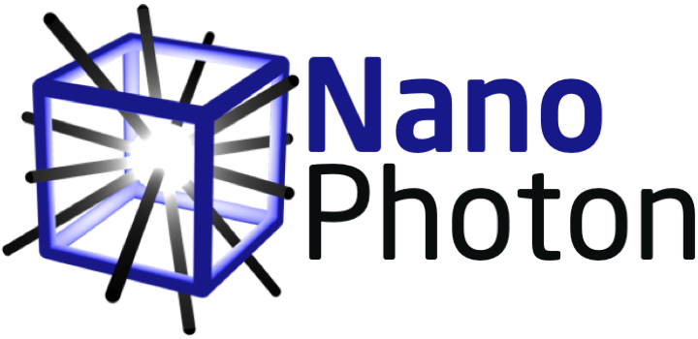
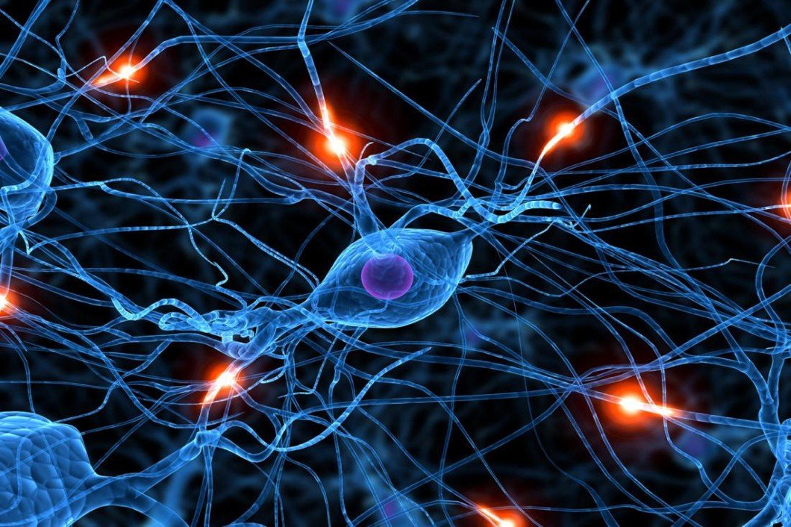
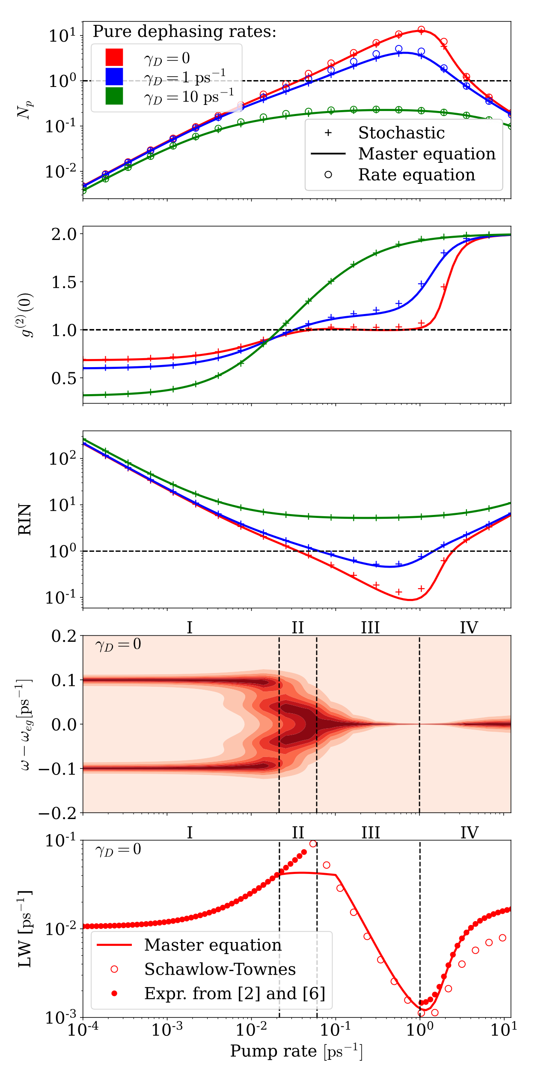
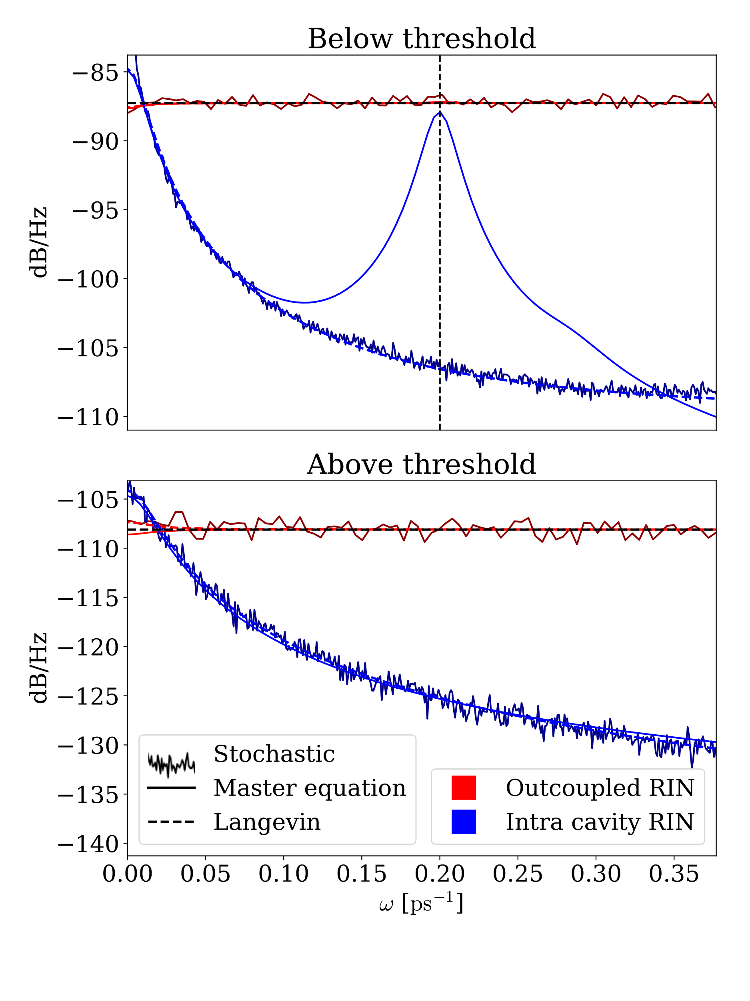
Wasserstein Generative Adversarial Network
Matias Bundgaard-Nielsen^{1,2}, Emil Vosmar Denning^{1,2,3}, and Jesper Mørk^{1,2}
¹Department of Electrical and Photonics Engineering, Technical University of Denmark, Building 343, 2800 Kongens Lyngby, Denmark
²NanoPhoton-Center for Nanophotonics, Technical University of Denmark, Building 343, 2800 Kongens Lyngby, Denmark
³Nichtlineare Optik und Quantenelektronik, Institut für Theoretische Physik, Technische Universität Berlin , Berlin, Germany
Motivation
The single-emitter laser is an interesting playground for studying cavity quantum electrodynamics in the transition from vacuum Rabi oscillations and anti-bunching to coherent emission [1-4]. Nanolasers may also play an important practical role as light-sources for on-chip optical links. In this context, a detailed understanding of the noise properties is very important since the lasers work in a regime where quantum noise cannot be neglected. Here, we calculate the intracavity as well as out-coupled intensity noise and show that partition noise dominates in the latter case. We compare the results obtained by first-principles quantum master equations to those obtained by stochastic simulations of rate equations and show that the latter is able to predict the intensity noise properties with surprisingly good accuracy, despite neglecting coherent effects such as Rabi oscillations.
Computational methods
Laser transition
Master equation [2]: Full quantum mechanical description of the emitter-cavity system using Jaynes-Cummings model. Losses are modeled as Lindblad terms and include: cavity out-coupling, pure dephasing, background radiation, and pumping (inverse loss).
Stochastic simulation of rate equation [5]: The laser system is represented by stochastic Poisson processes representing the different events that may happen (stimulated emission and absorption, spontaneous emission, pumping, and photon loss), which all involve integer changes of the cavity population and the emitter excitation. In practice, we use Gillespie’s first-reaction method.
Relative Intensity Noise (RIN)
For the Intracavity RIN, Rabi oscillations manifests themselves below threshold in the master equation, but not in the stochastic approach. This is a shortcoming of the stochastic approach, as it does not account for the dynamical material polarization.
For the out-coupled RIN, Rabi oscillations are not observed, as partition noise dominates.
Above threshold, the two approaches agree, showing that the noise is due to the discrete-particle nature of emitter and photons.
Conclusion
Despite the stochastic approach being based on a rate equation, it is surprisingly accurate for predicting intensity noise, even in the regime of Rabi oscillations. This shows that many properties of the single-emitter laser can be explained by considering only the discrete nature of photons and emitter excitation. The out-coupled RIN is dominated by shot noise and characteristics of the intracavity RIN are washed out
For zero pure dephasing, four regimes are identified:
Regime I - Below threshold: Strong emitter-photon correlation leads to Rabi-oscillations.
Regime II - Transition to lasing: Multiple Rabi peaks appearing and collapsing to single peak
Regime III – Lasing: Narrowing linewidth following Schawlow-Townes and Poissonian light statistics
Regime IV - Quenching: Decoherence from pumping leads to quenching and lasing turn-off giving thermal statistics and low intensity.
References
[1] Löffler, M., Meyer, G. M., & Walther, H. (1997. Phys. Rev. A, 55(5), 3923–3930
[2] Gies, et. Al., Reitzenstein, S. (2017) Physical Review A, 96(2)
[3] Del Valle, E., & Laussy, F. P. (2011) Physical Review A, 84(4)
[4] Nomura, M., Kumagai, N., Iwamoto, S., Ota, Y., & Arakawa, Y. (2010) Nature Physics, 6(4), 279–283.
[5] Mork, J., & Lippi, G. L. (2018) Applied Physics Letters, 112(14), 1–6.
[6] Poshakinskiy, A. V., & Poddubny, A. N. (2014). Journal of Experimental and Theoretical Physics, 118(2), 205–216.
compute.dtu.dk

