Slide 1


Overview of C
Computer Science Department
Comp 133

Slide 2
Motivation
//C program for area of circle Comment
#include <stdio.h> // standard header file (contains printf and scanf )
#define PI 3.141
int main()
{
//we use define for creating constant
// int, float , and return (reserved words)
float r, a; // r, a are variables
printf(“Please enter the radius: "); //standard identifier scanf("%f", &r); //standard identifier
a = PI * r * r; // = , *,{, } special symbols printf("%f\n", a); // standard identifier return 0;
}

Slide 3
Preprocessor directives
#include
gives a program access to a library
<stdio.h>
standard header file
contains information about standard input and output functions such as scanf and printf

Slide 4
Preprocessor directives
#include <stdio.h>
notify the preprocessor that some names used in the program are found in <stdio.h>
#define
using only data values that never change should be given names

Slide 5
Preprocessor directives
Constant macro
– a name that is replaced by a particular constant value
EX:
#define PI 3.141593
constant macro constant value
#define MAX_LENGTH 100

Slide 6
Comment
Two types:
One-line comment //
Multiple-line comment /* */
Examples:
// This is a one-line comment
/* Hello, this is
multiple-line comment*/

Slide 7
Variable declarations and data types
Variable: a name associated with a memory cell whose value can change.
Examples:
sum , x ,y , result,…..

Slide 8
Variable declarations and data types
A variable must consist only of letters, digits, and underscores.
A variable cannot begin with a digit.
A C reserved word cannot be used as a user variable.
A variable defined in a C standard library should not be
redefined.
Reserved Words : A word that has special meaning in C
for example: int, float, double, char , return
,…etc

Slide 9
Variable declarations and data types
Syntax Display for Declarations:
Syntax：
int variable_list;
float variable_list;
double variable_list;
char variable_list;
Examples：
int count, large;
float ans; or float ans=4.2;
double x, y, z; or double x=1.2,y=3.6,z=8.9;
char first_initial;

Slide 10
Variable declarations and data types
Data types:
int (16 bit)
float (32 bit)
double (64 bit)
a real number has an integral part and a fractional part that are separated by a decimal point

Slide 11
Variable declarations and data types
Data types:
char (8 bit)
represent an individual character value
include a letter, a digit, a special symbol
– ex. ‘A’ ‘z’ ‘2’ ‘9’ ‘ * ’ ‘ : ’ ‘ ” ’ ‘ ‘

Slide 12
Variable declarations and data types
Invalid variables names
Invalid identifier | Reason Invalid
1Letter | begins with a digit
double | reserved word
int | reserved word
TWO*FOUR | character * not allowed
joe’s | character ’ not allowed

Slide 13
To remove the ambiguity
Reserved Words | Standard Identifiers | User-Define Identifiers
int | printf | KMS_PER_MILE
void | scanf | miles
float |  | kms
double |  | sum
return |  | sum
NOTE:
Sum, sum, SUM are viewed by the compiler as different identifiers

Slide 14
Placeholders in format strings
Placeholder | Variable Type | Function Use
%c | char | printf / scanf
%d | int | printf / scanf
%f | float | printf / scanf
%f | double | printf
%lf | double | scanf

Slide 15
Placeholders in format strings
int sum ;
float a, r ; double num;
let sum=2
a=3.2 , r=5,2 num= 76.2232
printf (“The area is %f”, a);
scanf(“ %f ”,&r);
printf (“the result is %d”, sum);
scanf (“%lf”,& num);
printf (“the number is %f”, num)

Slide 16
Arithmetic expressions.
Arithmetic Operator | Meaning | Examples
+ | addition | 5 + 2 is 7
- | subtraction | 5 - 2 is 3
* | multiplication | 5 * 2 is 10
/ | division | 5 / 2 is 2
% | Remainder or Mod | 5 % 2 is 1

Slide 17
Arithmetic expressions.
Results of / and % operations
2 / 15 = 0
16 / 3 = 5
4 / 0 undefined
2 % 5 = 2
5 % 4 = 1
15 % 0 undefined
int / int = int 12/3= 4 , 9/8=1
int/float =float , float/int=float float/float=float 9/8.0=1.125000
9.0/8=1.125000
9.0/8.0=1.125000

Slide 18
Arithmetic expressions.
Example:
double k,m; k= 9/6; m=9/6.0;
printf("k=%f \nm= %f", k,m);
Output:
k=1.000000 m=1.500000

Slide 19
Arithmetic expressions.
Precedence Rules:
()
* / %
▪ + -

Slide 20
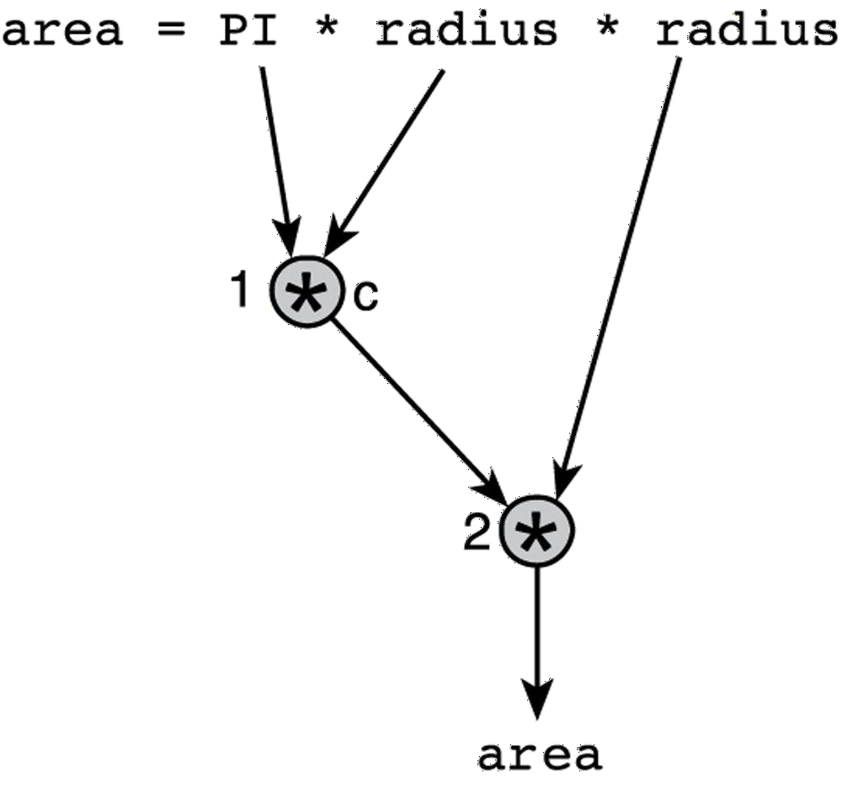
Arithmetic expressions.
Example 1 : Evaluate area = PI * radius * radius

Slide 21
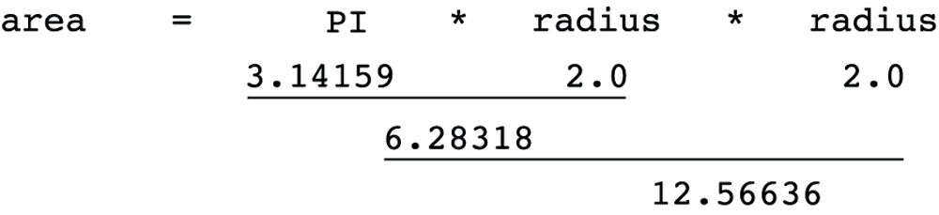
Arithmetic expressions.
Example 1 : Evaluate area = PI * radius * radius Let PI= 3.14159 , radius=2.0

Slide 22
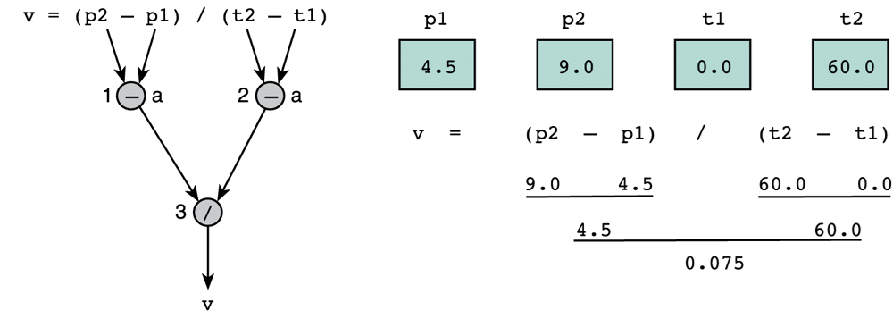
Arithmetic expressions.
p2-p1
Example 1 : Evaluate
v =
t2-t1
let P1=4.5 ,P2=9.0, t1=0.0, t2=60.0

Slide 23
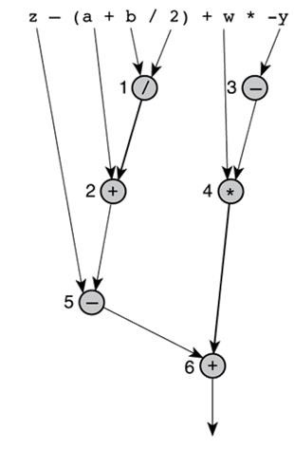
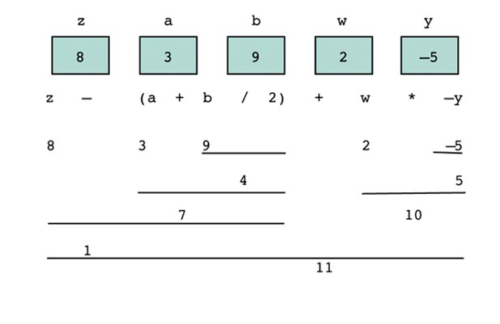
Arithmetic expressions.
Example 1 : Evaluate z - (a + b / 2) + w * - y

Slide 24
Arithmetic expressions.
Mathematical Formula as C Expression
Mathematical Formula | C Expression
b²-4ac | b * b - 4 * a * c
a + b - c | a + b - c
a+b c+d | (a + b) / (c + d)
1 1+x² | 1 / (1 + x * x)
a x -(b + c) | a * -( b + c)

Slide 25
Arithmetic expressions.
Example:
Write a complete C program that prompts the user to enter the radius of
a circle and displays the circumference. Circumference=2 πr
#include <stdio.h> #define PI 3.14159 int main(void)
{
double radius, circum;
printf("Please enter radius of circle> ");
scanf("%lf", &radius); circum = 2 * PI * radius;
printf("The circumference is %.2f.\n", circum);
return 0;
}

Slide 26
Formatting output
int x= 4678, y=3 , z=19
1. printf (“%d %d %d”, x,y,z)
Output
4678▓▓3▓▓ 19
2. printf (“%7d %5d %6d”, x,y,z)
Output
▓ ▓ ▓ 4678▓▓ ▓ ▓ ▓ ▓ 3 ▓▓ ▓ ▓ ▓ ▓ 19

Slide 27
Formatting output
float x=56.2757 y=2.3849 z=114.2 ;
printf (“%8.3f%-7.2f%7.4f”,x,y,z);
▓ ▓ 56.276 2.38 ▓ ▓ ▓114.2000
double a= 38.56, b= 201.117; printf("Is it%6.1f%9.4f", a, b);
Is▓ it ▓ ▓ 38.6 ▓ 201.1170
float x=333.256; printf("%0.2f",x);
333.26

Slide 28
Formatting output (Practice)
Value | Format | Displayed Output |  | Value | Format | Displayed Output
234 | %4d | ▓234 |  | -234 | %4d | -234
234 | %5d | ▓▓234 |  | -234 | %5d | ▓-234
234 | %6d | ▓▓▓234 |  | -234 | %6d | ▓▓-234
234 | %1d | 234 |  | -234 | %2d | -234

Slide 29
Formatting output (Practice)
Value | Format | Displayed Output | Value | Format | Displayed Output
3.14159 | %5.2f | ▓3.14 | 3.14159 | %4.2f | 3.14
3.14159 | %3.2f | 3.14 | 3.14159 | %5.1f | ▓▓ 3.1
3.14159 | %5.3f | 3.142 | 3.14159 | %8.5f | ▓3.14159
.1234 | %4.2f | 0.12 | -.006 | %4.2f | -0.01
-.006 | %8.3f | ▓▓ -0.006 | -.006 | %8.5f | -0.00600
-.006 | %.3f | -0.006 | -3.14159 | %.4f | -3.1416

Slide 30
Extra Exercises
1. Which of the following identifiers are (a) C reserved words, (b) standard identifiers, (c) conventionally used as constant macro names, (d) other valid identifiers, and (e) invalid identifiers?
void | MAX_ENTRIES | double | time | G | Sue's
return | printf | xyz123 | part#2 | "char" | #insert
this_is_a_long_one
2. Do a step-by-step evaluation of the expressions that follow if the value of
celsius is 38.1 and salary is 38450.00 .
1.8 * Celsius + 32.0
(salary - 5000.00) * 0.20 + 1425.00

Slide 31
Extra Exercises
1. Which of the following identifiers are (a) C reserved words, (b) standard identifiers, (c) conventionally used as constant macro names, (d) other valid identifiers, and (e) invalid identifiers?
void | MAX_ENTRIES | double | time | G | Sue's
return | printf | xyz123 | part#2 | "char" | #insert
this_is_a_long_one
2. Do a step-by-step evaluation of the expressions that follow if the value of
celsius is 38.1 and salary is 38450.00 .
1.8 * Celsius + 32.0
(salary - 5000.00) * 0.20 + 1425.00

Slide 32
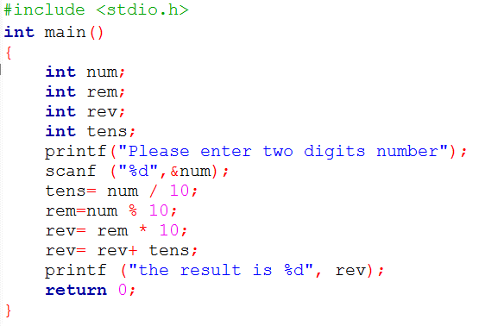
Example
Write a program to reverse any two digits number? (check slide 15, Algorithm lecture )

Slide 33
Common programming errors
Syntax Errors
is a mistake in the syntax.
Ex:
missing semicolon
undeclared variable
last comment is not closed because of blank in */ close-comment sequence

Slide 34
Common programming errors
Logic Errors
– an error caused by following an incorrect algorithm.
Ex:
sum = x-y (minus instead of plus)

Slide 35
Common programming errors
Run-Time Errors
– an attempt to perform an invalid operation, detected during program execution.
Ex:
result= x / 0 (undefined)

Slide 36
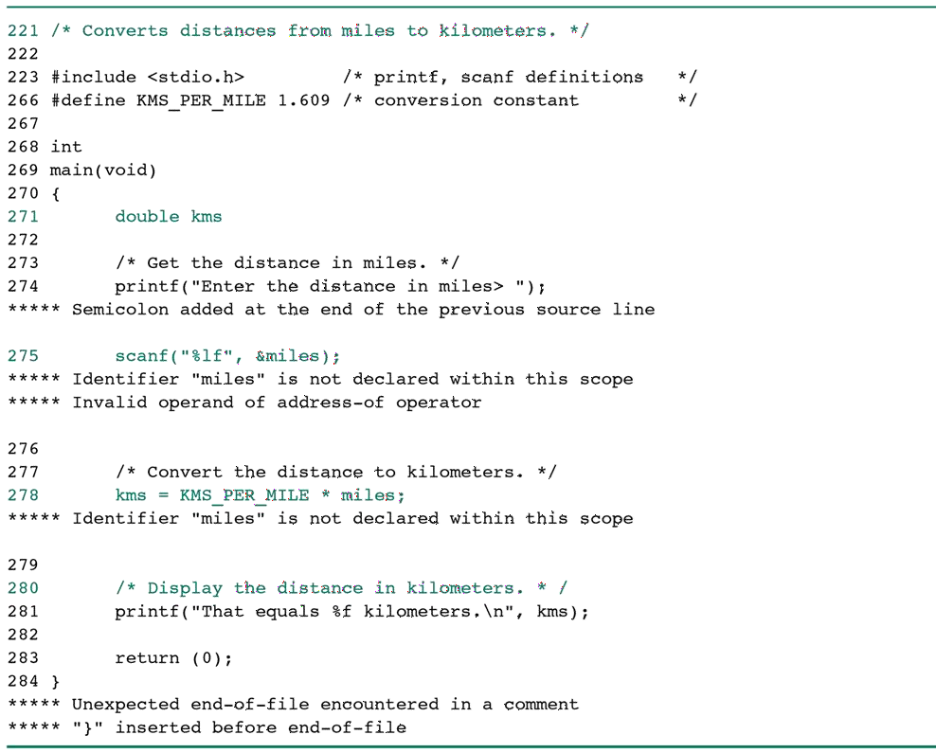
Common programming errors (Practice)
A Program with a syntax errors

Slide 37
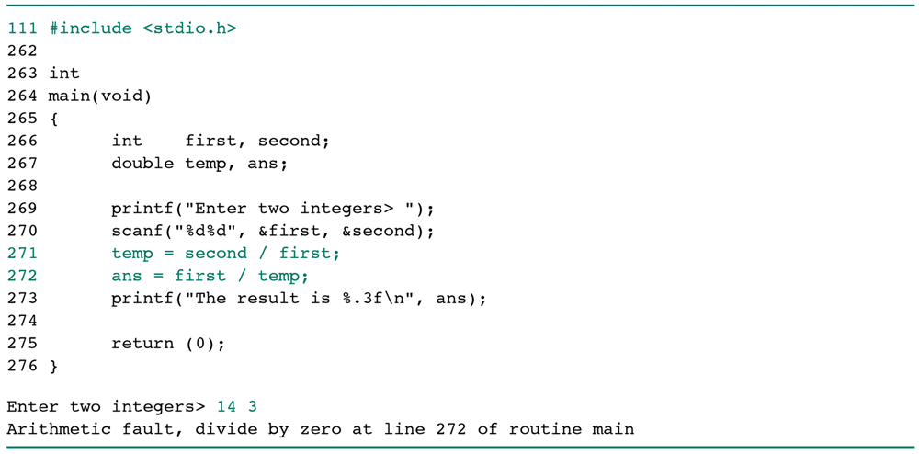
Common programming errors (Practice)
A Program with a run-time error

Slide 38
Type conversion through casts
type cast
– converting an expression to a different type by writing the desired type in parentheses in front of the expression
Example 1:
n = (int)(9 * 0.5); The value of n is 4

Slide 39


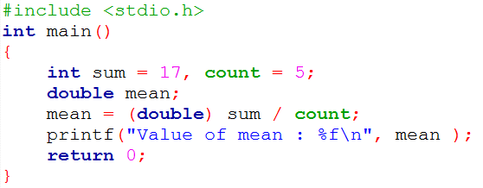
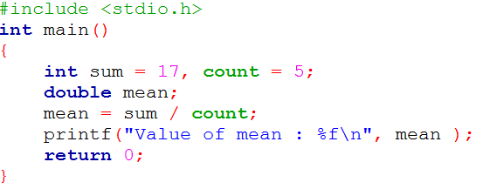
Type conversion through casts
Without Cast
integer division would cause the loss of the fractional part of the mean
Using Cast
Value of mean : 3.400000 Value of mean : 3.000000
Find more examples: http://www.tutorialspoint.com/cprogramming/c_type_casting.htm

Slide 40
Escape sequences
Escape Sequence causes the program to escape from the normal interpretation of a string, so that the next character is recognized as having a special meaning. The back slash “\” character is called the “Escape Character”.
The escape sequence includes the following:
\n => new line
\t => tab
\r => carriage return
\” => double quotations
\\ => back slash etc.

Slide 41
Extra Exercises
What will be the output of the printf statement printf("hello\ryou");
Evaluate the following formulas:
7 - 15 / 4
6 * 5 / 10
2 - 4 * 3 + 26 / 2
Find the value of x after applying the casting
x= (double) (r/t) | , | r=10, t=3
x= (double) r/t | , | r=10, t=3
x= r/(double)t | , | r=10, t=3

Slide 42

Question?
“Success is the sum of small efforts, repeated day in and day out.”
Robert Collier

Slide 43
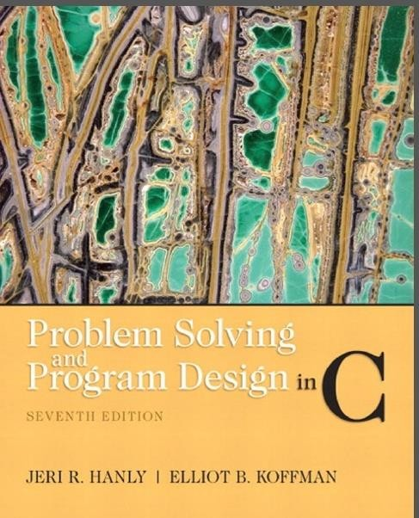
Reference: Problem Solving & Program Design in C

