Slide 1


Pointers & Modular Programming
Computer Science Department
Comp 133

Slide 2
pointer
Pointer or pointer variable: A memory cell that stores the address of a data
item.
The declaration:
float *p; // identifies p as a pointer variable of type “pointer to float .”
// This means that we can store the memory address of a type
// float variable in p .

Slide 3
pointer
Pointer Type Declaration:
SYNTAX: | type | * variable ;
EXAMPLE: | float | *p;
The value of the pointer variable p is a memory address

Slide 4
Example (1)
int y = 5; int *yPtr; yPtr = &y;
//yPtr gets address of y
yPtr “points to” y
y
yptr
y
yPtr
5
500000 600000
600000 5
Address of y is value of yptr

Slide 5
Example (2)
int i = 5; int *ptr; ptr = &i;
printf("*ptr = %d\n", *ptr);
/* declare a pointer variable */
/* store address-of i to ptr */
/* refer to referee of ptr */
output
*ptr = 5

Slide 6




Example (3):
What actually ptr is?
ptr is a variable storing an address
ptr is NOT storing the actual value of i
Address of i= 0022FF18 Address of ptr=0022FF1C
int i = 5; int *ptr; ptr = &i;
printf("i = %d\n", i); printf("*ptr = %d\n", *ptr); printf("ptr = %p\n", ptr); printf("address of i = %p\n", &i);
ptr address of i
i
5
Output:
i = 5
*ptr = 5
value of ptr =
address of i
in memory
printf("address of ptr = %p\n", &ptr); ^{ptr =0022FF18}
address of i = 0022FF18
Karakra

Slide 7
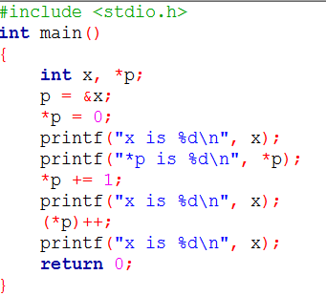
Example (4)
Output:
x is 0
*p is 0
x is 1
x is 2

Slide 8
Example (5)
Trace the execution of the following fragment
int m = 10, n = 5; int *mp, *np;
mp = &m; np = &n;
*mp = *mp + *np;
*np = *mp – *np;
printf("%d %d\n%d %d\n", m, *mp, n, *np);
Output:
15 15
10 10

Slide 9


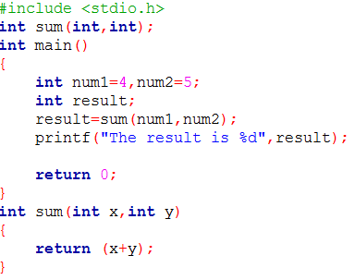
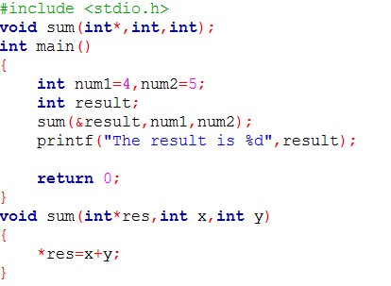
Examples

Slide 10
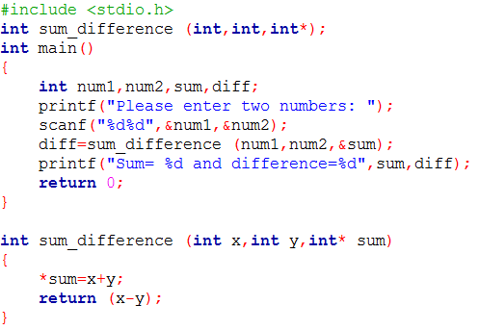
Example (6)
Write function to find the sum and the difference between two numbers.

Slide 11
Example (7)
Write a function to :
Find the number of digits in a given number
Sum of digits
Reverse a number
Example:
Please enter a number: 123 number of digits = 3
sum of digits=6
reverse=321
Code

Slide 12
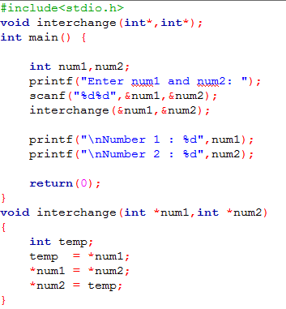
Example (8)
Exchanges the values of the two integer variables

Slide 13
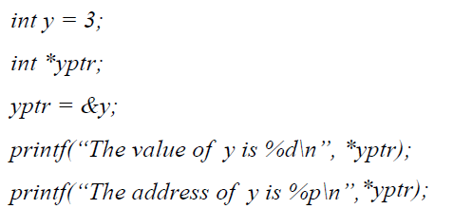
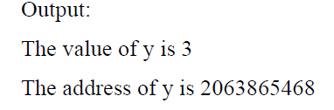
Example (9)
Identify and correct the errors in the following code fragment, given the correct output (%p is used to print a pointer):

Slide 14
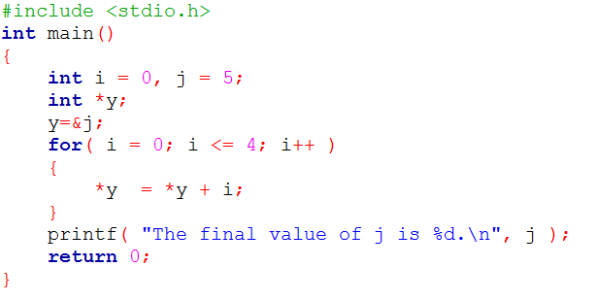
Example (10): Output
The final value of j is 15.

Slide 15
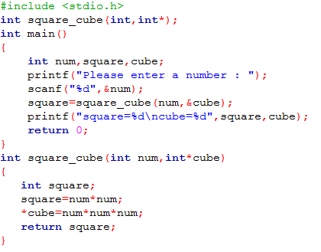
Example (11)
C program to find square and cube of given number
Please enter a number : 2
square=4
cube=8

Slide 16
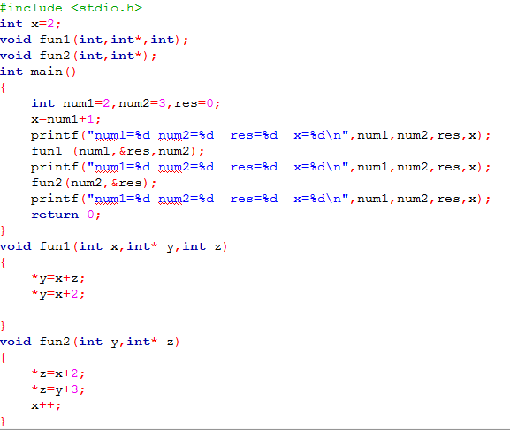
Example (12)
code
Output:
num1=2 num2=3 res=0 x=3 num1=2 num2=3 res=4 x=3 num1=2 num2=3 res=6 x=4

Slide 17

Question?
“Success is the sum of small efforts, repeated day in and day out.”
Robert Collier

Slide 18
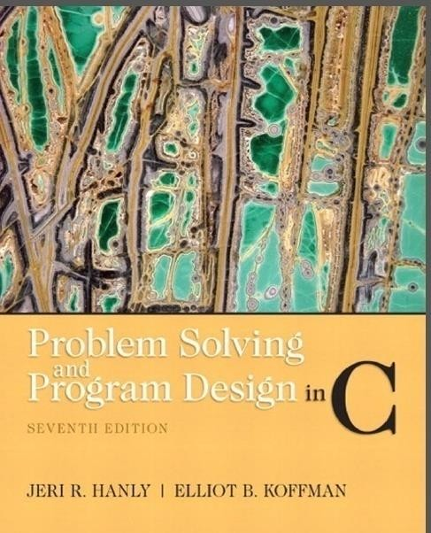
References:
Problem Solving & Program Design in C (main reference)
http://www.programmingsimplified.com/c-program-print-stars-pyramid

