Slide 1


Recursion
Computer Science Department
Comp 31

Slide 2
Introduction to Recursion
A recursive function is one that calls itself.
f1
void message()
{
printf("This is a recursive function.\n“);
message();
}

Slide 3
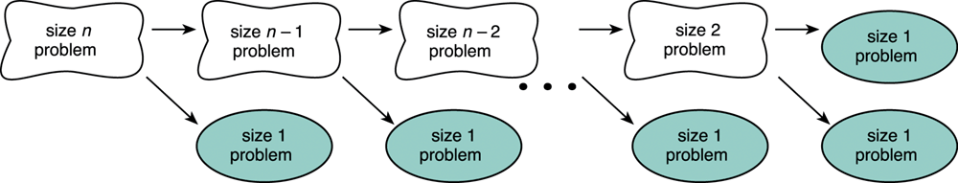
Splitting a Problem into Smaller Problems
Assume that the problem of size 1 can be solved easily (i.e., the simple case).
We can recursively split the problem into a problem of size 1 and another problem of size n-1.

Slide 4

Splitting a Problem into Smaller
Let f(x)=f(x -1)+3 , f(0)=4 , find f(7)
f(7) = f(7-1)+3 → f(7)=f(6)+3
f(7)=22+2=25
f(6) = f(6-1)+3 → f(6)=f(5)+3
f(6)=19+3=22
f(5) = f(5-1)+3 → f(5)=f(4)+3
f(5)=16+3=19
f(4) = f(4-1)+3 → f(4)=f(3)+3
f(4)=13+3=16
f(3) = f(3-1)+3 → f(3)=f(2)+3
f(3)=10+3=13
f(2) = f(2-1)+3 → f(2)=f(1)+3
f(2)=7+3=10
Base case
f(1) = f(1-1)+3 → f(1)=f(0)+3
f(1)=4+3=7
f(0)=4

Slide 5
Recursive Problem
The function below displays the string "This is a recursive function.\n", and then calls itself.
void message()
{
printf("This is a recursive function.\n“); message();
}

Slide 6
Recursive Problem
The function is like an infinite loop because there is no code to stop it from repeating.
Like a loop, a recursive function must have some algorithm to control the number of times it repeats.

Slide 7
Recursion
Like a loop, a recursive function must have some algorithm to control the number of times it repeats. Shown below is a modification of the message function. It passes an integer argument, which holds the number of times the function is to call itself.
void message(int times)
{
if (times > 0)
{
printf("This is a recursive function.\n“);
message(times - 1);
}
}

Slide 8
Recursion
The function contains an if/else
statement that controls the repetition.
As long as the times argument is greater than zero, it will display the message and call itself again. Each time it calls itself, it passes times - 1 as the argument.

Slide 9
Recursive Function
Let f(x)=f(x -1)+3 , f(0)=4 , find f(7)
int f(int x)
{
if (x == 0)
return 4; //base case
else
return f(x-1)+3;
}
Recursive function terminates when a base case is met.

Slide 10
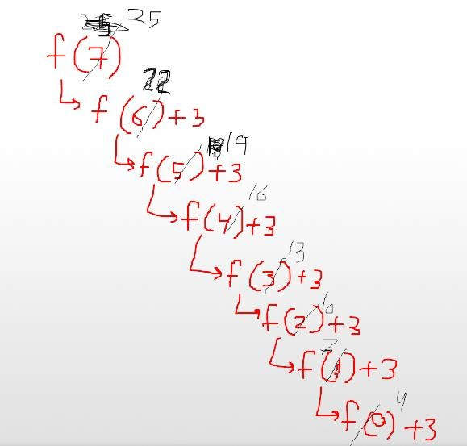
Trace of f(x)=f(x -1)+3

Slide 11
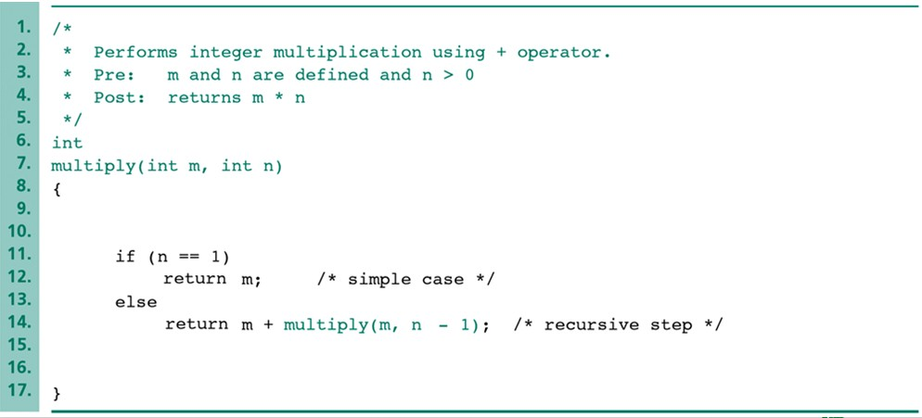
Recursive Function multiply
We can implement the multiplication by addition.
The simple case is “m*1=m.”
The recursive step uses the following equation: “m*n = m+m*(n-1).”

Slide 12
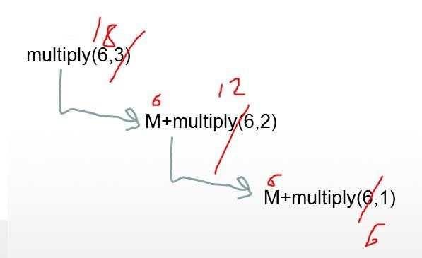
Trace of Function multiply(6,3)
.

Slide 13
Recursive Function Factorial
In mathematics, the notation n! represents the factorial of the number n. The factorial of a number is defined as:
n! = 1 * 2 * 3 * ... * n 1
if n > 0 if n = 0

Slide 14
Recursive Function Factorial
Another way of defining the factorial of a number, using recursion, is:
Factorial(n) =
n * Factorial(n - 1)
1
if n > 0 if n = 0
The following C function implements the recursive definition shown above:
int factorial(int num)
{
if (num == 0)
return 1;
else
return num * factorial(num - 1);
}

Slide 15
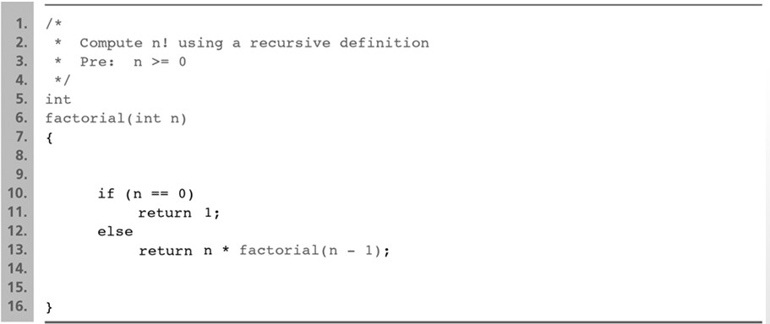
Recursive Function Factorial

Slide 16
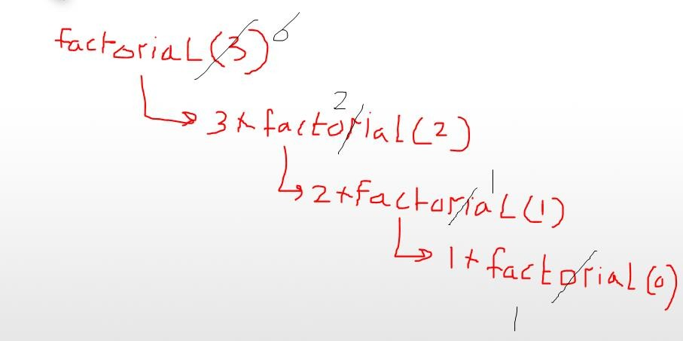
Trace of fact = factorial(3);

Slide 17
Tracing recursive methods
Consider the following method:
int mystery(int x, int y) { if (x < y)
return x;
else
return mystery(x - y, y);
}
For each call below, indicate what value is returned:
mystery(6, 13)
mystery(14, 10)
mystery(37, 10)
mystery(8, 2)
mystery(50, 7)
6
4
7
0
1

Slide 18
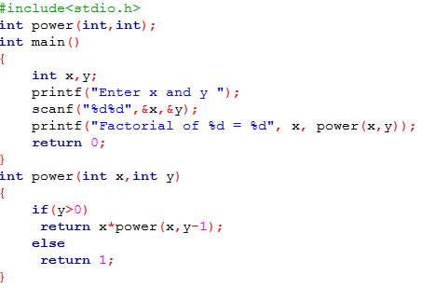
Recursive Function Power

Slide 19
Recursive Function fibonacci
the Fibonacci sequence 1, 1, 2,3, 5, 8, 13, 21, 34,………….
a_{n:} 1, 1, 2, 3, 5, 8, 13, 21, 34,………….
n: 1, 2, 3, 4, 5, 6, 7, 8 , 9,………….
a₁ =1 , a₂ =1 , a₃ = a₁ + a₂ =2 , a_{n}
^{= a}n-1
^{+ a}n-2

Slide 20
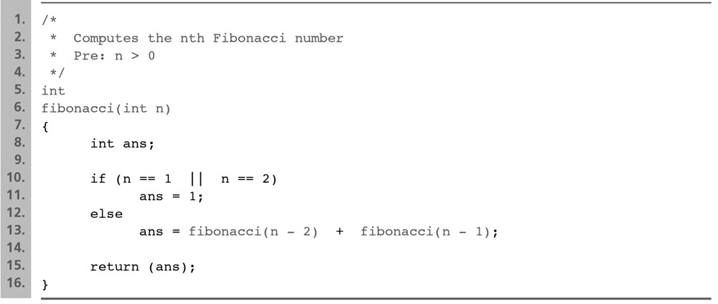
Recursive Function fibonacci
the Fibonacci sequence 1, 1, 2,3, 5, 8, 13, 21, 34,………….

Slide 21

Trace fibonacci

Slide 22
Recall:
What is the output of the following statements.
Try each statement separately.
#include <stdio.h> int main()
{
char s[10]="hello"; char *v;
v=s;
printf("%s",v);// hello printf("%s",&v[1]);//ello
printf("%s",&v[2]);//llo
printf("%c",*v);//h
printf("%c",*(v+1));//e
printf("%c",*s);//h
printf("%c",*(s+1));//e return 0;
}
// s=&s[0]

Slide 23


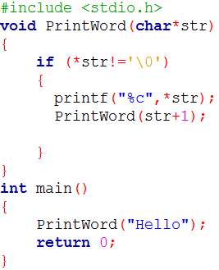
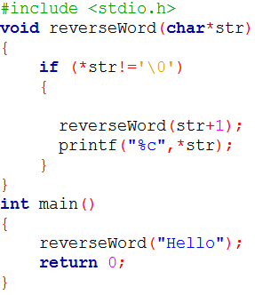
Print Hello
Reverse Word
Print Word

Slide 24
Trace Print Hello

Slide 25

Question?
“Success is the sum of small efforts, repeated day in and day out.”
Robert Collier

Slide 26
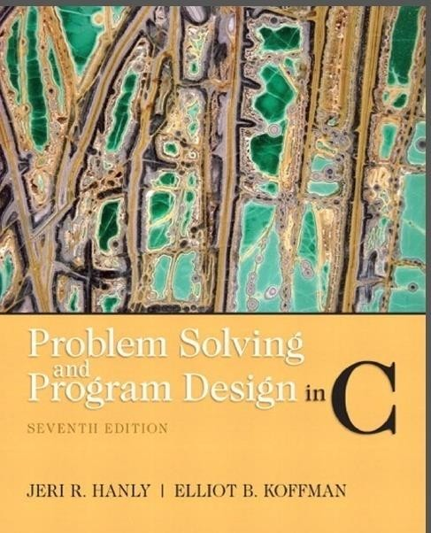
References:
Problem Solving & Program Design in C (main reference)

