Slide 1
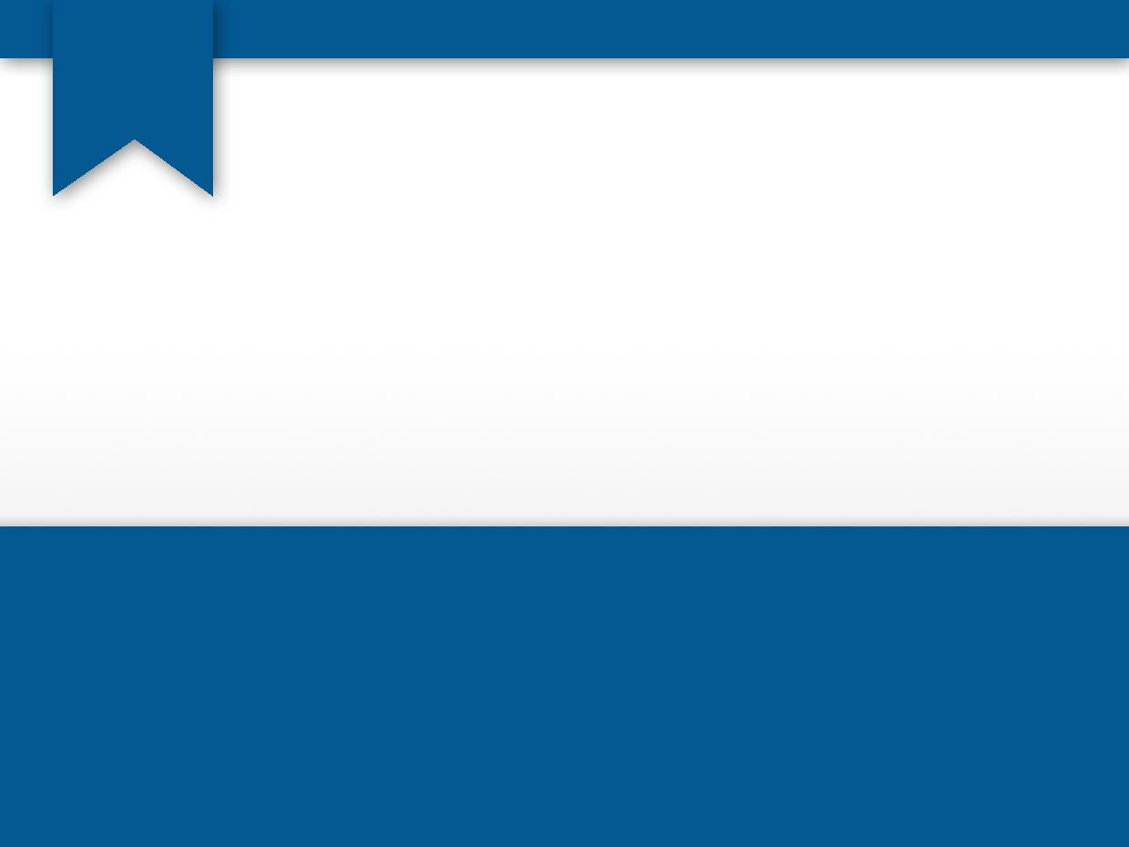

Selection Structures: if and switch Statements
Computer Science Department
Comp 133

Slide 2
Control Structure
Three kinds of control structures
Sequence structure
Programs executed sequentially by default
Statements executed in order
Selection structures
If
if…else
switch
Repetition structures
While
do…while
– for

Slide 3
Control Structure
Before,
let us study: 1. Relational and equality operators
2. Logical Operators

Slide 4
Relational and equality operators
Four different forms:
Variable relational-operator Variable
Variable relational-operator Constant
Variable equality-operator
Variable equality-operator
Variable Constant
Note:
You can use an expression instead of the variable or constant

Slide 5
Relational and equality operators
Operator | Meaning | Type
< | less than | relational
> | greater than | relational
<= | less than or equal to | relational
>= | greater than or equal to | relational
== | equal to | equality
!= | not equal to | equality

Slide 6
Logical Operators
Three types of logical operators:
Operator | Meaning
&& | and
|| | or
! | not

Slide 7
Operator Precedence
Operator | Precedence
function calls | highest
! + - & (unary operators)
* / %
+ -
< <= >= >
== !=
&&
||
= | lowest

Slide 8
Example
double x=3.0 , y=4.0, z=2.0; int flag=0;
What is the value after applying the following expression:
! flag
x + y / z <= 3.5
! flag || (y + z >= x - z )
!(flag || (y + z >= x - z ))
→ !0 is 1 (true)
→ 5.0 <= 3.5 is 0 (false)
→ 1 || 1 is 1 (true)
→ !(0 || 1) is 0 (false)

Slide 9
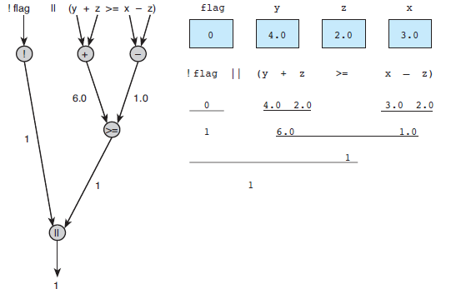
Example
Evaluation for !flag II (y + z >= x - z)

Slide 10
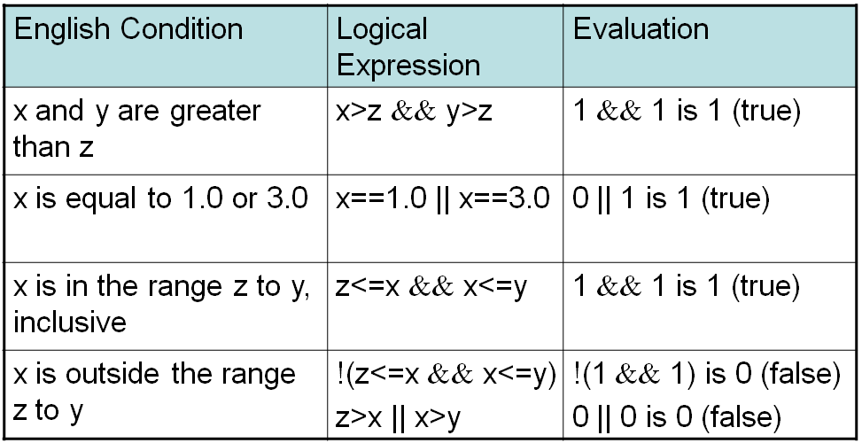
Example: How to convert an English condition into a logical expression
double x = 3.0 , y = 4.0 , z = 2.0 .

Slide 11
Example: Comparing Characters
Expression | Value
‘9’ >= ‘0’ | 1(true)
‘a’ < ‘e’ | 1(true)
‘B’ <= ‘A’ | 0(false)
‘Z’ == ‘z’ | 0(false)
‘a’ <= ‘A’ | system dependent (false for ASCII )
‘a’ <= ch && ch <= ‘z’ | 1(true) if ch is a lowercase letter

Slide 12
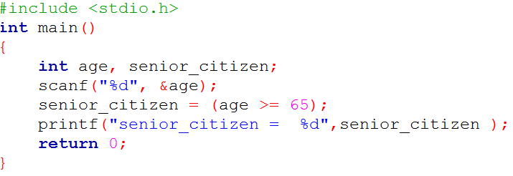
Logical Assignment
Example:

Slide 13
If Statement
If statement with one alternative
if (x!=0)
product = product * x;
If statement with two alternatives
if (rest_heart_rate >56)
printf(“Your heart is in execellent health!\n”); else
printf(“Keep up your exercise program!\n”);

Slide 14
if Statements with Compound Statements
if (condition)
{
true task
}
else
{
false task
}

Slide 15
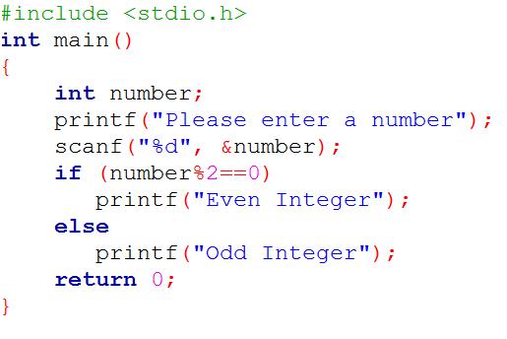
Examples
Write a complete c program to find weather a given integer is odd or even.

Slide 16
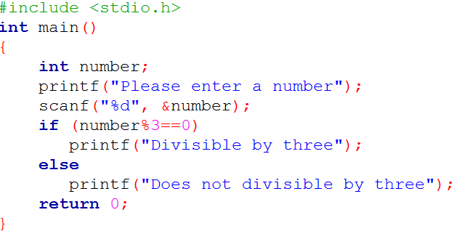
Examples
Write a complete c program to find weather a given integer is divisible by three.

Slide 17
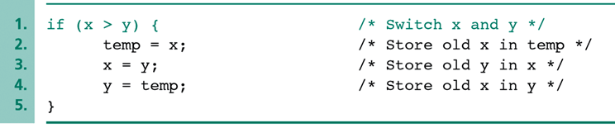
Switch X and Y example

Slide 18
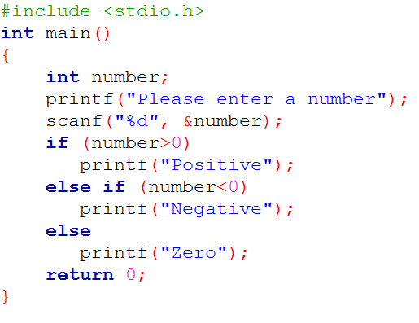
Multiple-Alternative Decisions

Slide 19


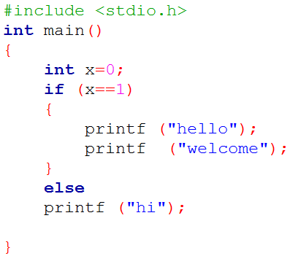
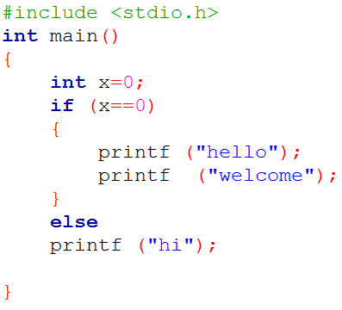
Example (if-else)

Slide 20


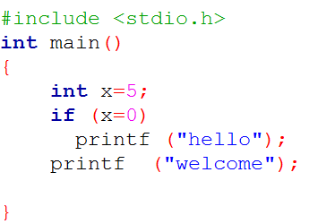
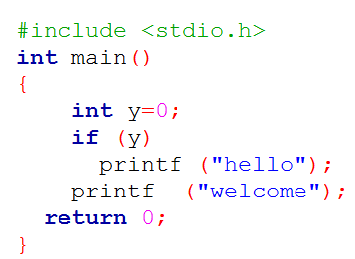


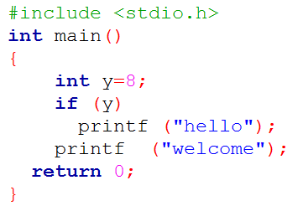
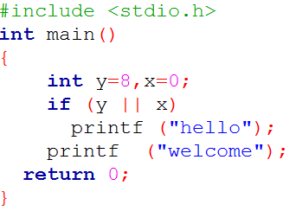
Example

Slide 21

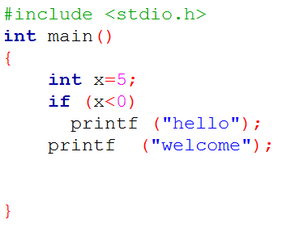

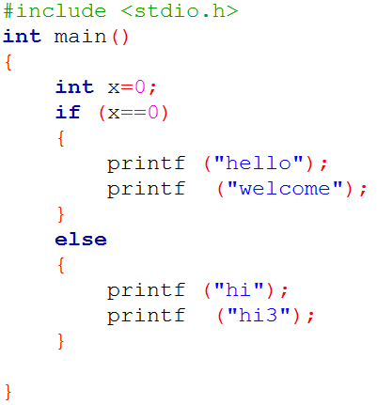

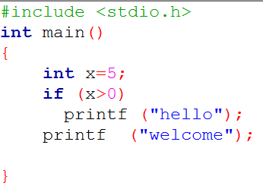
Example ( if, if-else)

Slide 22
Let us review the concepts:
1. If grade has the value of 60 , what will the following code display?
If (grade >= 60 ) printf ("Passed");
nothing.
60
Passed
printf("Passed“);

Slide 23

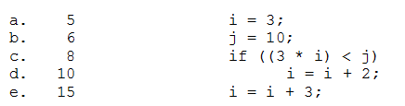

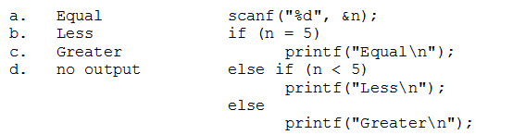
Extra Exercises
2. What will be the value of i after the C statements at the right have been executed?
3. What is displayed by the C statements at the right if the value input is 3?

Slide 24
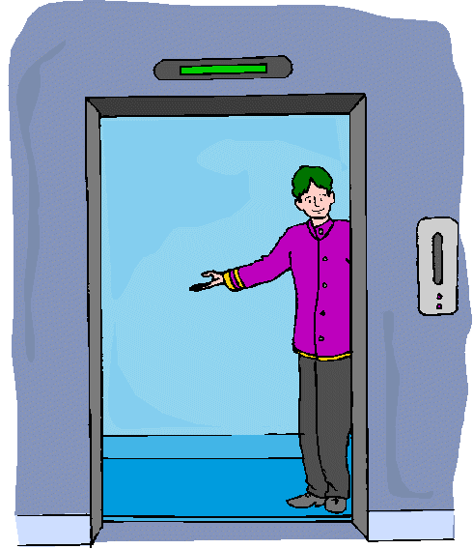

The switch Statement
The switch statement selection is based on the value of a single variable or of a simple expression.
Expression may be of type int or char, but not of type double or string.
The multiple selection mechanism in C is the switch statement.

Slide 25
The switch Statement
Before,
let us Recall: 1. Multiple Selection with if
2. Multiple Selection with if-else

Slide 26
Multiple Selection with if
if (day == 0 ) {
printf ("Sunday") ;
}
if (day == 1 ) {
printf ("Monday") ;
}
if (day == 2) {
printf ("Tuesday") ;
}
if (day == 3) {
printf ("Wednesday") ;
}
if (day == 4) {
printf ("Thursday") ;
}
if (day == 5) {
printf ("Friday") ;
}
if (day == 6) {
printf ("Saturday") ;
}
if ((day < 0) || (day > 6)) { printf("Error - invalid day.\n")
;
}

Slide 27
Multiple Selection with if-else
if (day == 0 ) {
printf ("Sunday") ;
} else if (day == 1 ) {
printf ("Monday") ;
} else if (day == 2) { printf ("Tuesday") ;
} else if (day == 3) {
printf ("Wednesday") ;
} else if (day == 4) { printf ("Thursday") ;
} else if (day == 5) {
printf ("Friday") ;
} else if (day = 6) { printf ("Saturday") ;
} else {
printf (“Error - invalid day.\n”) ;
}
This if-else structure is more efficient than the corresponding if structure. Why?

Slide 28
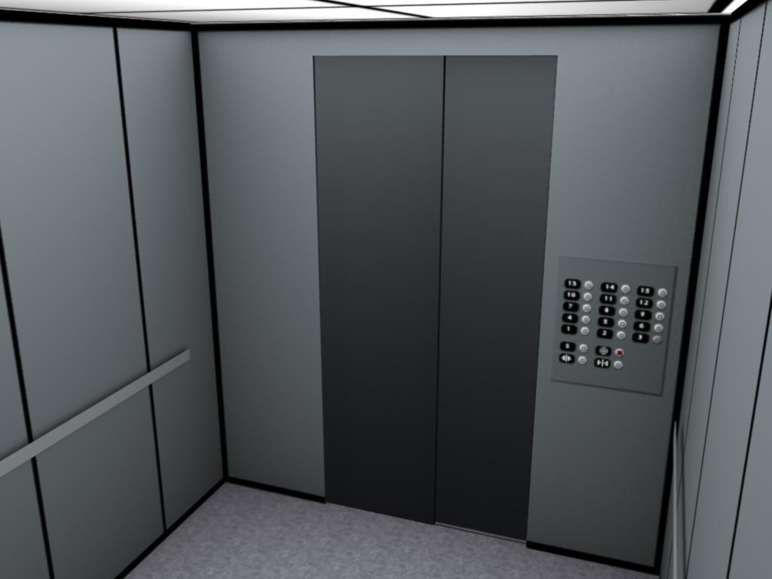
The switch Multiple-Selection Structure
switch ( integer expression )
{
case constant₁ : statement(s) break ;
case constant₂ : statement(s) break ;
. . .
default: :
statement(s)
break ;
}

Slide 29
switch Statement Details
The last statement of each case in the switch should almost always be a break.
The break causes program control to jump to the closing brace of the switch structure.
Without the break, the code flows into the next case. This is almost never what you want.
A switch statement will compile without a default case, but always consider using one.

Slide 30
The switch Multiple-Selection Structure
switch ( day )
{
case 0: printf ("Sunday\n") ; break ;
case 1: printf ("Monday\n") ;
break ;
case 2: printf ("Tuesday\n") ; break ;
case 3: printf ("Wednesday\n") ; break ;
case 4: printf ("Thursday\n") ;
break ;
case 5: printf (“Friday\n”) ; break ;
case 6: printf ("Saturday\n") ; break ;
default: printf ("Error -- invalid day.\n") ; break ;
}

Slide 31
Why Use a switch Statement?
A nested if-else structure is just as efficient as a switch statement.
However, a switch statement may be easier to read.
Also, it is easier to add new cases to a switch statement than to a nested if-else structure.

Slide 32


Common Programming Errors
if( 0 <= x <= 4)
printf(“Condition is true\n” );
Instead, use
if( 0 <= x && x <= 4)
The following always prints the same thing: if ( x = 10 )
printf( “ x is 10\n” );

Slide 33
Common Programming Errors
If (x = 10)
printf(" x is 10');
" instead of '
If (x = 10)
printf(" x is 10")
semicolon
If (x = 10)
printf(" x is 10'
printf(" x is 10 ");

Slide 34
Example (Creating Menus)
switch( choice )
{
case 1: printf( “Do edit\n” );
break;
case 2: printf( “Do delete\n” ); break;
case 3: printf( “Done\n” );
break;
default: printf( “Invalid choice!\n” ); break;
}

Slide 35
Example (More Practice)
Write a C program which takes the 3 sides of a triangle, and print whether the triangle is an equilateral, isosceles or scalene triangle. Your program should include at least one function called triangle_type, this function takes the sides of the triangle and return 1 if the triangle is equilateral, 2 if the triangle is scalene and 3 for isosceles triangle.
NOTE:
Your triangle should be satisfied these conditions | side 1 + side 2 | > side 3
 | side 1 + side 3 | > side 2
 | side 2 + side 3 | > side 1
Try these sides:
3 | 4 | 5
1 | 1 | 1 | Code
3 | 3 | 1

Slide 36
Example (More Practice)
Write a C program which display color name based on first character of color (small or capital letters).
Note: Your program should work with the following colors: white , red and green
Code

Slide 37

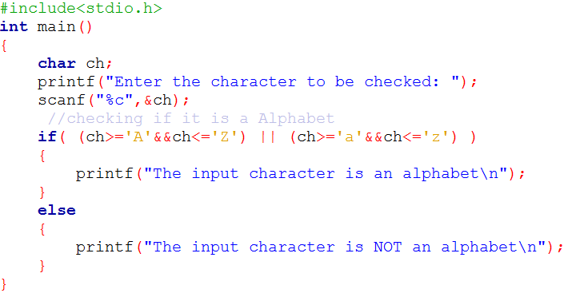
Example (More Practice)
Write a C program which takes a character as input from the user. Check whether
the character is an alphabet or not.

Slide 38
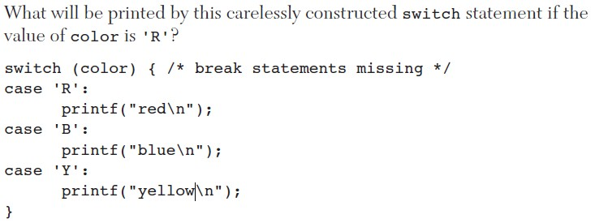
Example (More Practice)

Slide 39
Extra Exercises
Write a program that takes three numbers as input from the user and finds out
whether one of the three numbers is the arithmetic mean of the other two.
For example: Input: 7,15,11
Output: 11 is the mean of 7 and 15
Code

Slide 40
Extra Exercises
Write a program that takes a positive integer in the range 1 to 365 (which corresponds to the day of the year) as input and outputs the day of the week. Assume that day 1 is Sunday. Make use of the switch statement.
For example: Input: 16
Output: Monday
Code

Slide 41
Extra Exercises
The marks obtained by a student in 5 different subjects are input through the
keyboard
The student gets a division as per the following rules: Percentage above or equal to 60 - First division Percentage between 50 and 59 - Second division Percentage between 40 and 49 - Third division Percentage less than 40 – Fail.
Write a program to calculate the division obtained by the student.
Example (output screen) Enter marks in five subjects 34 26 35 35 70
Third division
Code

Slide 42


Question?
“Success is the sum of small efforts, repeated day in and day out.”
Robert Collier

Slide 43
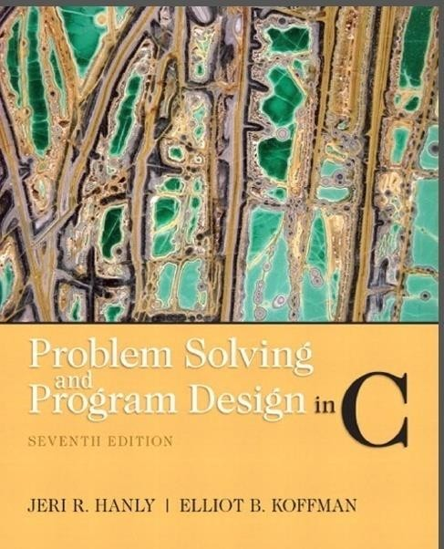
References:
Problem Solving & Program Design in C (main reference)

