Slide 1


Strings
Computer Science Department Comp 131

Slide 2
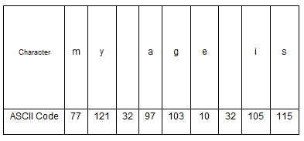
Strings
A string is a sequence of characters (Array of characters).
Strings are stored in memory as ASCII codes

Slide 3
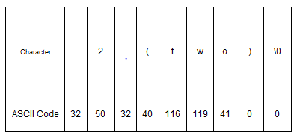
Strings
The last character is the null character having ASCII value zero (character '\0' that marks the end of a string in C)

Slide 4
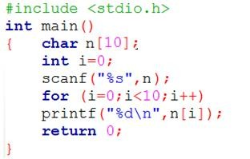
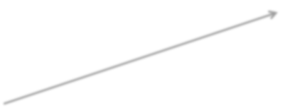

Strings: Examples
hello
Output:
104
101
108
108
111
0
2
0
0
0
0 1 2 3 4 5 6 7 8 9
h | e | l | l | 0 | \0

Slide 5
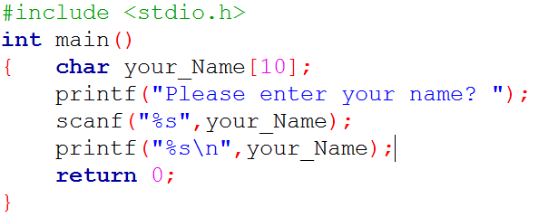
Strings: Examples
0 1 2 3 4 5 6 7 8 9
A | h | m | a | d | \0
\0: null character, determines the end of the string

Slide 6
Strings: Examples
char your_Name[10]="Ahmad";
0 1 2 3 4 5 6 7 8 9
your_Name
char your_Name[ ]="Ahmad";
0 1 2 3 4 5
your_Name
char your_Name[10]={'a','h','m','a','d'};
your_Name[5]='\0';
0 1 2 3 4 5 6 7 8 9
your_Name
A | h | m | a | d | \0 | ? | ? | ? | ?
A | h | m | a | d | \0
A | h | m | a | d | \0 | ? | ? | ? | ?

Slide 7
Strings: Common Errors
char my_char='A'; // correct
my_char
A
char my_char="A"; // error
char my_char [4]="A"; // correct
0 1 2 3
my_char
A | \0

Slide 8
Strings: Array of strings
char week_days[7][13]={"Monday","Tuesday","Wednesday",...}
2 3 4 5 6 7 8 9 10 11 12
0 1
0
1
2
3
4
5
6
M | o | n | d | a | y | \0 | ? | ? | ? | ? | ? | ?
T | u | e | s | d | a | y | \0 | ? | ? | ? | ? | ?
W | e | d | n | e | s | d | a | y | \0 | ? | ? | ?
.
.
.

Slide 9
Strings: Example
Write a program to read the names of 5 students and also their
grades (three grades for each students ),and save them.
Names[5][10] Grades[5][3]
Y | a | m | e | n | \0
A | h | m | A | d | \0
K | h | a | l | e | d | \0
M | o | h | a | m | m | a | d | \0
S | a | n | d | y | \0
99 | 98 | 100
80 | 90 | 50
70 | 78 | 60
88 | 90 | 70
70 | 90 | 92
Code

Slide 10
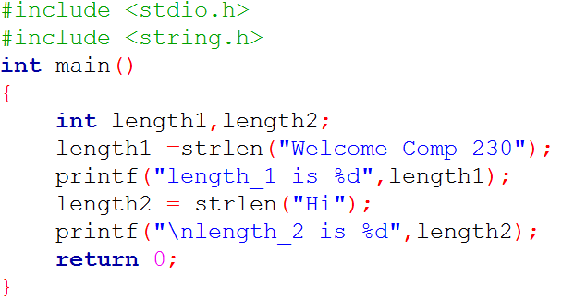
Strings Functions
include string.h library header file in the program
Length (number of characters in the string). strlen() function
Syntax n=strlen(string);
strlen()
Returns the number of characters in s , not counting the terminating null.
size_t strlen(const char *str)
length_1 is 16
length_2 is 2

Slide 11
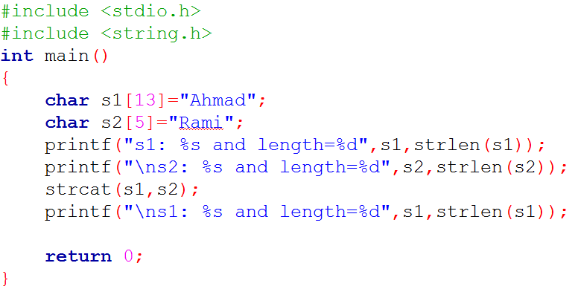
Strings Functions
include string.h library header file in the program
Joins 2 strings together strcat() function
Syntax strcat(string1,string2) ;
s1: Ahmad and length=5
s2: Rami and length=4
s1: AhmadRami and length=9

Slide 12
Strings Functions
include string.h library header file in the program
Joins 2 strings together (Appends source to the end of dest) char s1[13]="Ahmad";
char s2[5]="Rami";
strcat(s1,s2);
0 1 2 3 4 5 6 7 8 9 10 11 12
0 1 2 3 4
A | h | m | a | d | \0
R | a | m | i | \0
s1
s2
0 1 2 3 4 5 6 7 8 9 10 11 12
s1
A | h | m | a | d | R | a | m | i | \0

Slide 13
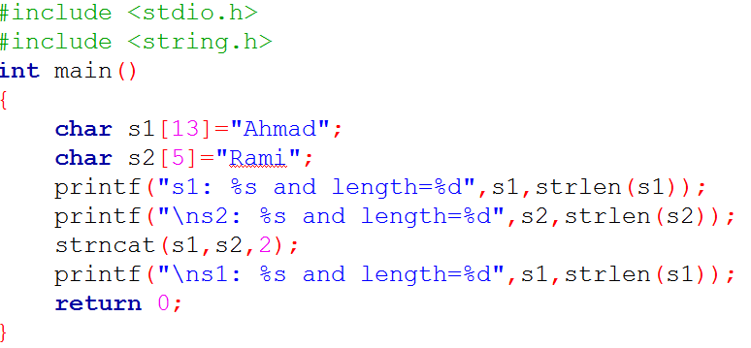
Strings Functions
include string.h library header file in the program
Joins 2 strings together ( add a n characters from s2 to s1 plus a null character ) strncat() function
Syntax strncat(string1,string2,n) ;
s1: Ahmad and length=5
s2: Rami and length=4
s1: AhmadRa and length=7

Slide 14

Strings Functions
include string.h library header file in the program
Joins 2 strings together ( add a n characters from s2 to s1 plus a null character ) char s1[13]="Ahmad";
char s2[5]="Rami";
strncat(s1,s2,2);
0 1 2 3 4 5 6 7 8 9 10 11 12
0 1 2 3 4
A | h | m | a | d | \0
R | a | m | i | \0
s1
s2
Adding Null Character
0 1 2 3 4 5 6 7 8 9 10 11 12
s1
A | h | m | a | d | R | a | \0

Slide 15
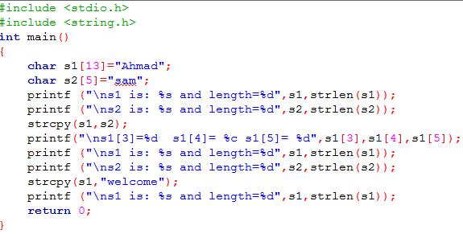
Strings Functions
include string.h library header file in the program
Assigns the contents of string2 to string1 strcpy () function
Syntax strcpy(string1,string2);
s1 is: Ahmad and length=5 s2 is: sam and length=3 s1[3]=0 s1[4]= d s1[5]= 0
s1 is: sam and length=3 s2 is: sam and length=3
s1 is: welcome and length=7

Slide 16
Strings Functions
include string.h library header file in the program
Assigns the contents of string2 to string1 char s1[13]="Ahmad";
char s2[5]=“sam";
strcpy(s1,s2);
0 1 2 3 4 5 6 7 8 9 10 11 12
0 1 2 3 4
A | h | m | a | d | \0
S | a | m | \0
s1
s2
0 1 2 3 4 5 6 7 8 9 10 11 12
s1
s | a | m | \0 | d | \0

Slide 17
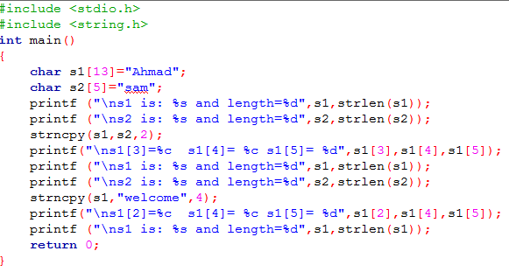
Strings Functions
include string.h library header file in the program
Makes a copy of up to n characters from string2 in string1 (does NOT add a null character)
strncpy() function
Syntax strncpy(string1,string2,n) ;
s1 is: Ahmad and length=5 s2 is: sam and length=3 s1[3]=a s1[4]= d s1[5]= 0
s1 is: samad and length=5
s2 is: sam and length=3 s1[2]=l s1[4]= d s1[5]= 0
s1 is: welcd and length=5

Slide 18
Strings Functions
include string.h library header file in the program
Makes a copy of up to n characters from string2 in string1
(does NOT add a null character)
char s1[13]="Ahmad"; char s2[5]=“sam"; strncpy(s1,s2,2);
0 1 2 3 4 5 6 7 8 9 10 11 12 0 1 2 3 4
s2
A | h | m | a | d | \0
s | a | m | \0
s1
0 1 2 3 4 5 6 7 8 9 10 11 12
s1
s | a | m | a | d | \0

Slide 19
Strings Functions
include string.h library header file in the program
which returns a zero if 2 strings are equal, or a non zero number
if the strings are not the same.
strcmp() function
Syntax strcmp(string1,string2) ;
int result= strcmp (string1,string2); result=0, if string1 equal string2
result>0 , if string1 greater than string2
Result<0 , if string1 less than string2
Strcmp uses ASCII values to compare between two strings.

Slide 20
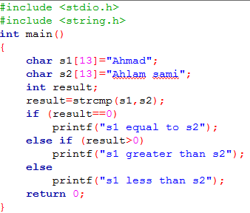
Strings Functions
include string.h library header file in the program
which returns a zero if 2 strings are equal, or a non zero number
if the strings are not the same.
strcmp() function
Syntax strcmp(string1,string2,n) ;
Saturday, July 28, 2018 Abdallah Karakra
s1 greater than s2

Slide 21
Strings Functions
include string.h library header file in the program
which returns a zero if 2 strings are equal, or a non zero number
if the strings are not the same.
char s1[13]="Ahmad"; char s2[13]=“Ahlam sami"; strcmp(s1,s2);
0 1 2 3 4 5 6 7 8 9 10 11 12
A | h | m | a | d |  | \0
A | h | l | a |  | m |  |  |  | s |  | a |  | m |  | i | \0
A equal A
h equal h
m greater than l (109 greater than 108)
→ s1 greater than s2
s1
s2

Slide 22
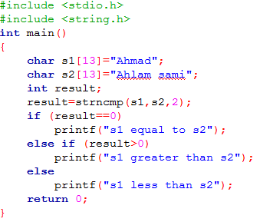
Strings Functions
include string.h library header file in the program
Compares the first n characters of s1 and s2
strncmp() function
Syntax strncmp(string1,string2,n) ;
s1 equal to s2
Saturday, July 28, 2018 Abdallah Karakr

Slide 23
Strings Functions
include string.h library header file in the program
which returns a zero if 2 strings are equal, or a non zero number
if the strings are not the same.
char s1[13]="Ahmad"; char s2[13]=“Ahlam sami"; srncmp(s1,s2,2);
0 1 2 3 4 5 6 7 8 9 10 11 12
A | h | m | a | d |  | \0
A | h | l | a |  | m |  |  |  | s |  | a |  | m |  | i | \0
A equal A
h equal h
→ s1 equal s2
s1
s2

Slide 24
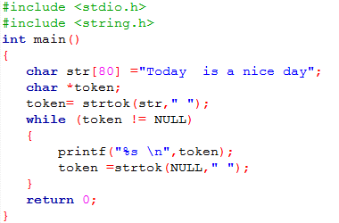
Strings Functions
include string.h library header file in the program
breaks string str into a series of tokens using the delimiter delim.
strtok() function Syntax strtok(str,delim) ;
Today
is a
nice day
Saturday, July 28, 2018 Abdallah Karakra

Slide 25
Strings Functions
include string.h library header file in the program
breaks string str into a series of tokens using the delimiter delim. strtok() function
Syntax strtok(str,delim) ;
0 1 2 ……………………………………………………….79
T | o | d | a | y |  | i | s |  | a |  | n | i | c | e |  | d | a | y
token= strtok(str, "
, ; , \ ") ;

Slide 26

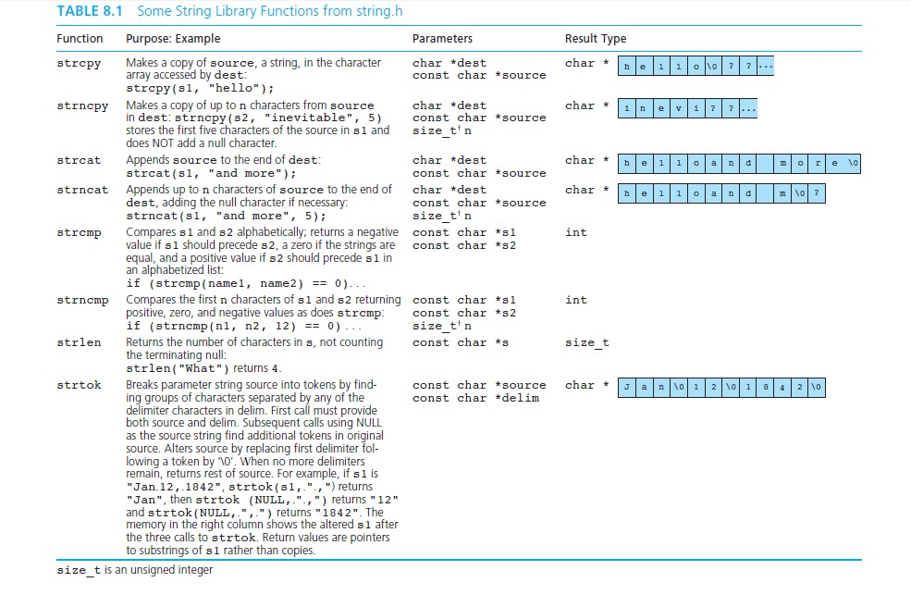
Summary

Slide 27


Question?
GOOD LUCK

Slide 28
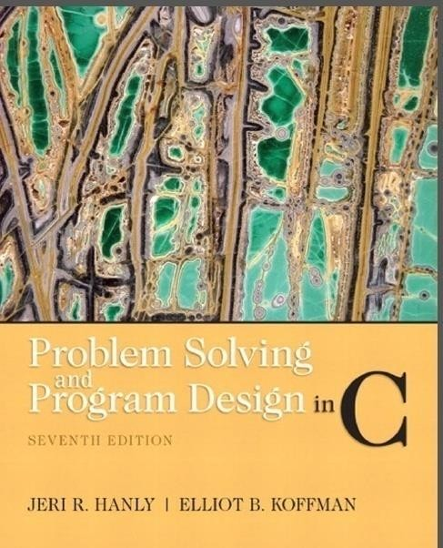
References:
Problem Solving & Program Design in C (main reference)

