Slide 1


Binary Files
Computer Science Department Comp 133

Slide 2
Binary Files
Files containing binary numbers that are the computer’s internal representation of each file component.

Slide 3
Advantages of Binary files
Assume that two bytes are used store an int
value.
– 244 (128+64+32+16+4)
– 11110100
In text files,
Write: 11110100 → 2 4 4 and blank
– Read: 244 → 11110100
It takes more time.
It takes more space. (Four bytes versus two)
Precision

Slide 4
Disadvantages of Binary files
A binary file created on one computer is rarely readable on another type of computers.
A binary file can not be created or modified in a word processor.
fread ←→ fwrite //binary file
fscanf ←→ fprintf //text file

Slide 5
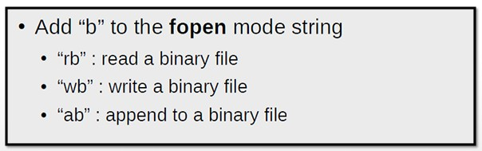
Opening binary files
FILE *fp = fopen("myfile.bin", "rb");//read FILE *fp = fopen("myfile.bin","wb");//write

Slide 6
Writing to binary files
size_t fwrite (const void * ptr, size_t size, size_t count, FILE * stream)
INPUT
A ptr to an array of elements (or just one)
The size of each element
The number of elements
Pointer to a FILE object that specifies an output stream (File pointer)
OUTPUT
Returns the number of elements written
If return value is different than count, there was an error

Slide 7

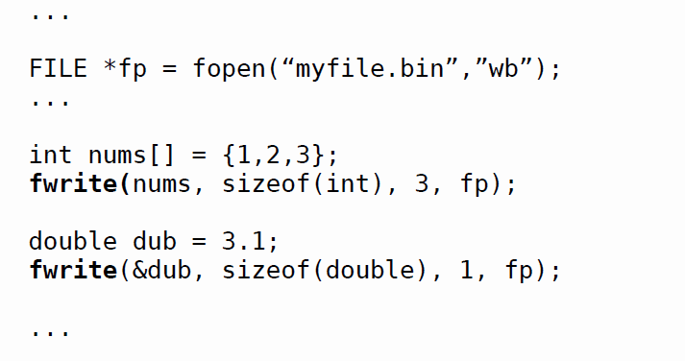
Writing to binary files
sizeof operator used to finds the number of bytes used for storage of a data type

Slide 8
Reading binary files
size_t fread ( void * ptr, size_t size, size_t count, FILE * stream )
INPUT
A ptr to some memory of size at least (size * count)
The size of each element to read
The number of elements to read
Pointer to a FILE object that specifies an input stream (File Pointer)
OUTPUT
Returns number of elements read
If return value is different than count, there was an error or the end of the file was reached

Slide 9

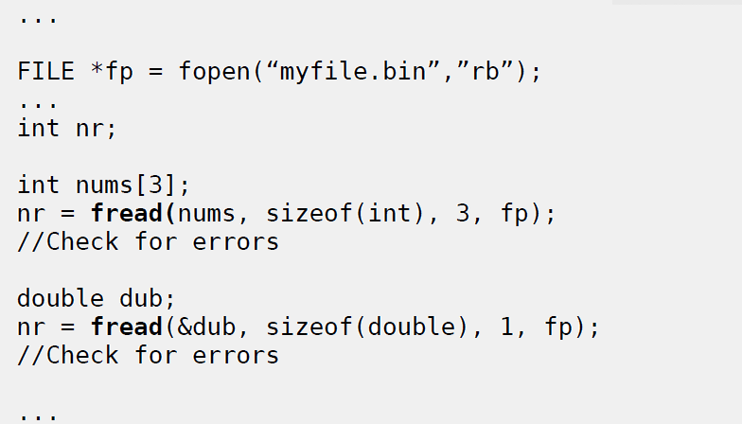
Reading binary files
sizeof operator used to finds the number of bytes used for storage of a data type

Slide 10
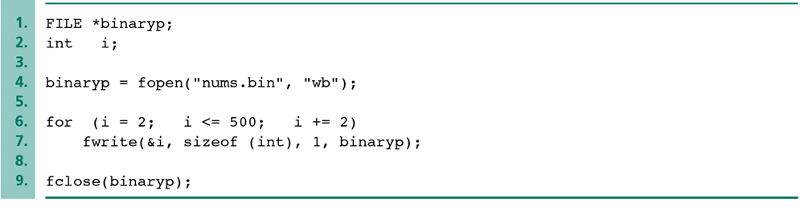
Example: Creating a Binary File of Integers

Slide 11
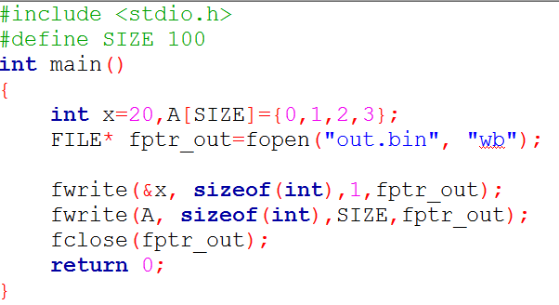
Example: Writing to a binary file

Slide 12
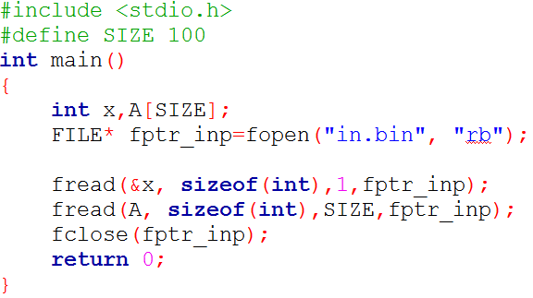
Example: Reading from a binary file

Slide 13

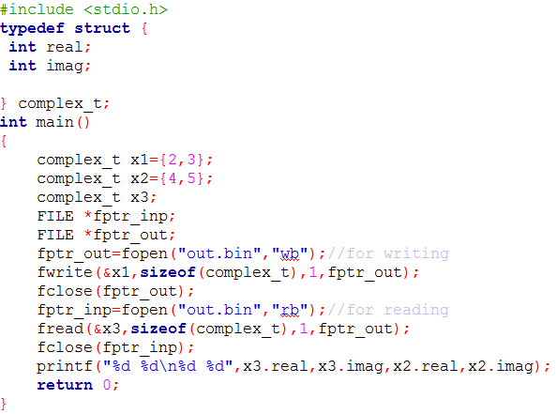
Example: writing and reading a complex number

Slide 14

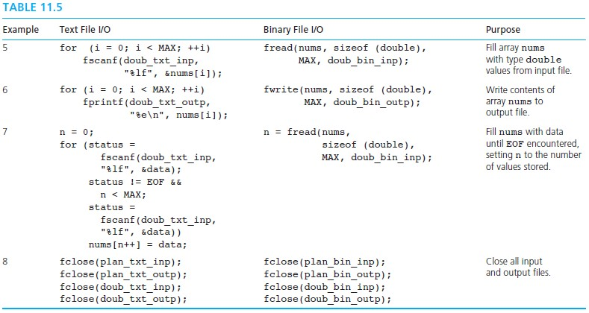
Text File Vs Binary File
sizeof operator used to finds the number of bytes used for storage of a data type

Slide 15

Question?
“Success is the sum of small efforts, repeated day in and day out.”
Robert Collier

Slide 16
References:
Problem Solving & Program Design in C (main reference)
http://www.cplusplus.com/reference/cstdio/

