Slide 1

Brazilian Olist E-Commerce Performance & Delivery Analysis
End-to-End Data Analytics Project — MySQL · Python · Power BI
99,441 ORDERS
9 RELATIONAL TABLES
SEPT 2016 – OCT 2018

Slide 2
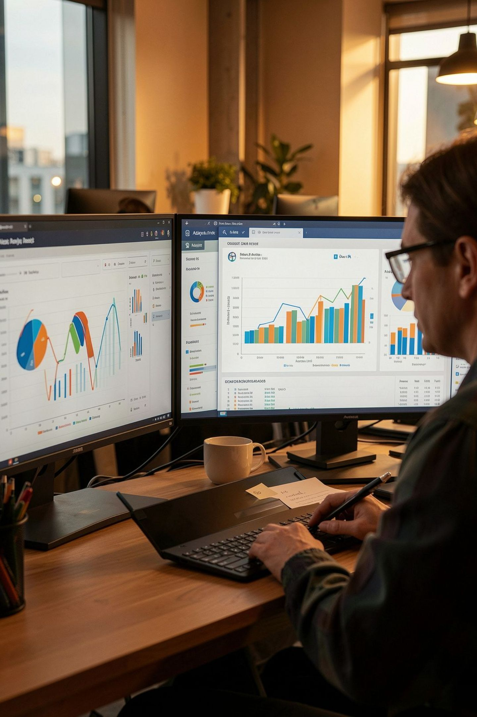
Executive Summary
This project builds an analytics pipeline — from raw data to interactive dashboard — to help Olist understand what drives delivery performance and customer satisfaction. The pipeline moves through three layers: MySQL (storage, validation), Python (cleaning, feature engineering, star-schema modeling), and Power BI (interactive visualization with DAX KPIs).
Core Finding
Retention Gap
Delivery delay is strongly associated with lower review scores.
Only ~3% of customers are repeat buyers.
Actionable
Both findings point to concrete levers for the business.

Slide 3

Business Problem
The Hypothesis
Olist connects independent sellers to major retail channels across Brazil. Leadership flagged declining review scores and unpredictable delivery performance. The core hypothesis: delivery delays drive poor reviews and customer churn.
Key Questions
What are overall sales and revenue trends?
What % of orders are delivered late, and where/why?
Does delivery delay correlate with review scores?
What % of customers return to buy again?
Which states, categories, and sellers need attention?

Slide 4
Dataset Overview
The Olist dataset consists of 9 relational CSV files normalized around a central orders table.
Table | Rows (approx.) | Purpose
customers | 99,441 | Customer identity and location
orders | 99,441 | Order lifecycle and timestamps
order_items | 112,650 | Line-item products per order
order_payments | 103,886 | Payment method and installments
order_reviews | 99,224 | Customer satisfaction scores
products | 32,951 | Product catalog and attributes
sellers | 3,095 | Seller identity and location
geolocation | 1,000,163 | Zip code to lat/lng mapping
category_translation | 71 | Portuguese → English category names

Slide 5





Tools & Technology Stack
MySQL 8
Schema design, storage, SQL analysis
Python (pandas)
Cleaning, feature engineering, star-schema modeling
Power BI
Interactive dashboard, DAX measures, data modeling
Why this order? Data lives in a relational database first (as in a real company); SQL extracts and validates only the needed data; Python performs flexible cleaning and feature engineering; Power BI is strictly a presentation layer receiving already-clean, modeled data.

Slide 6



Phase 1 — MySQL: Foundation & Exploration
Schema Design
9 normalized tables with primary/foreign keys and indexes on frequently joined columns. Foreign key enforcement caught data integrity issues early.
Data Loading
Switched from slow Workbench wizard to Python bulk loader (SQLAlchemy chunked inserts) — all 9 tables loaded in minutes. Deduplicated order_reviews on review_id + order_id before insert.
Data Quality Checks
Validation queries confirmed row counts, no orphaned foreign keys, no duplicate primary keys, and profiled NULLs across delivery-date and review-comment columns.
Business Analysis Queries
20 SQL queries across four themes — Sales & Revenue, Delivery & Logistics, Customer Satisfaction, Customer Behavior — including the core hypothesis test: average review score bucketed by delivery delay range.

Slide 7
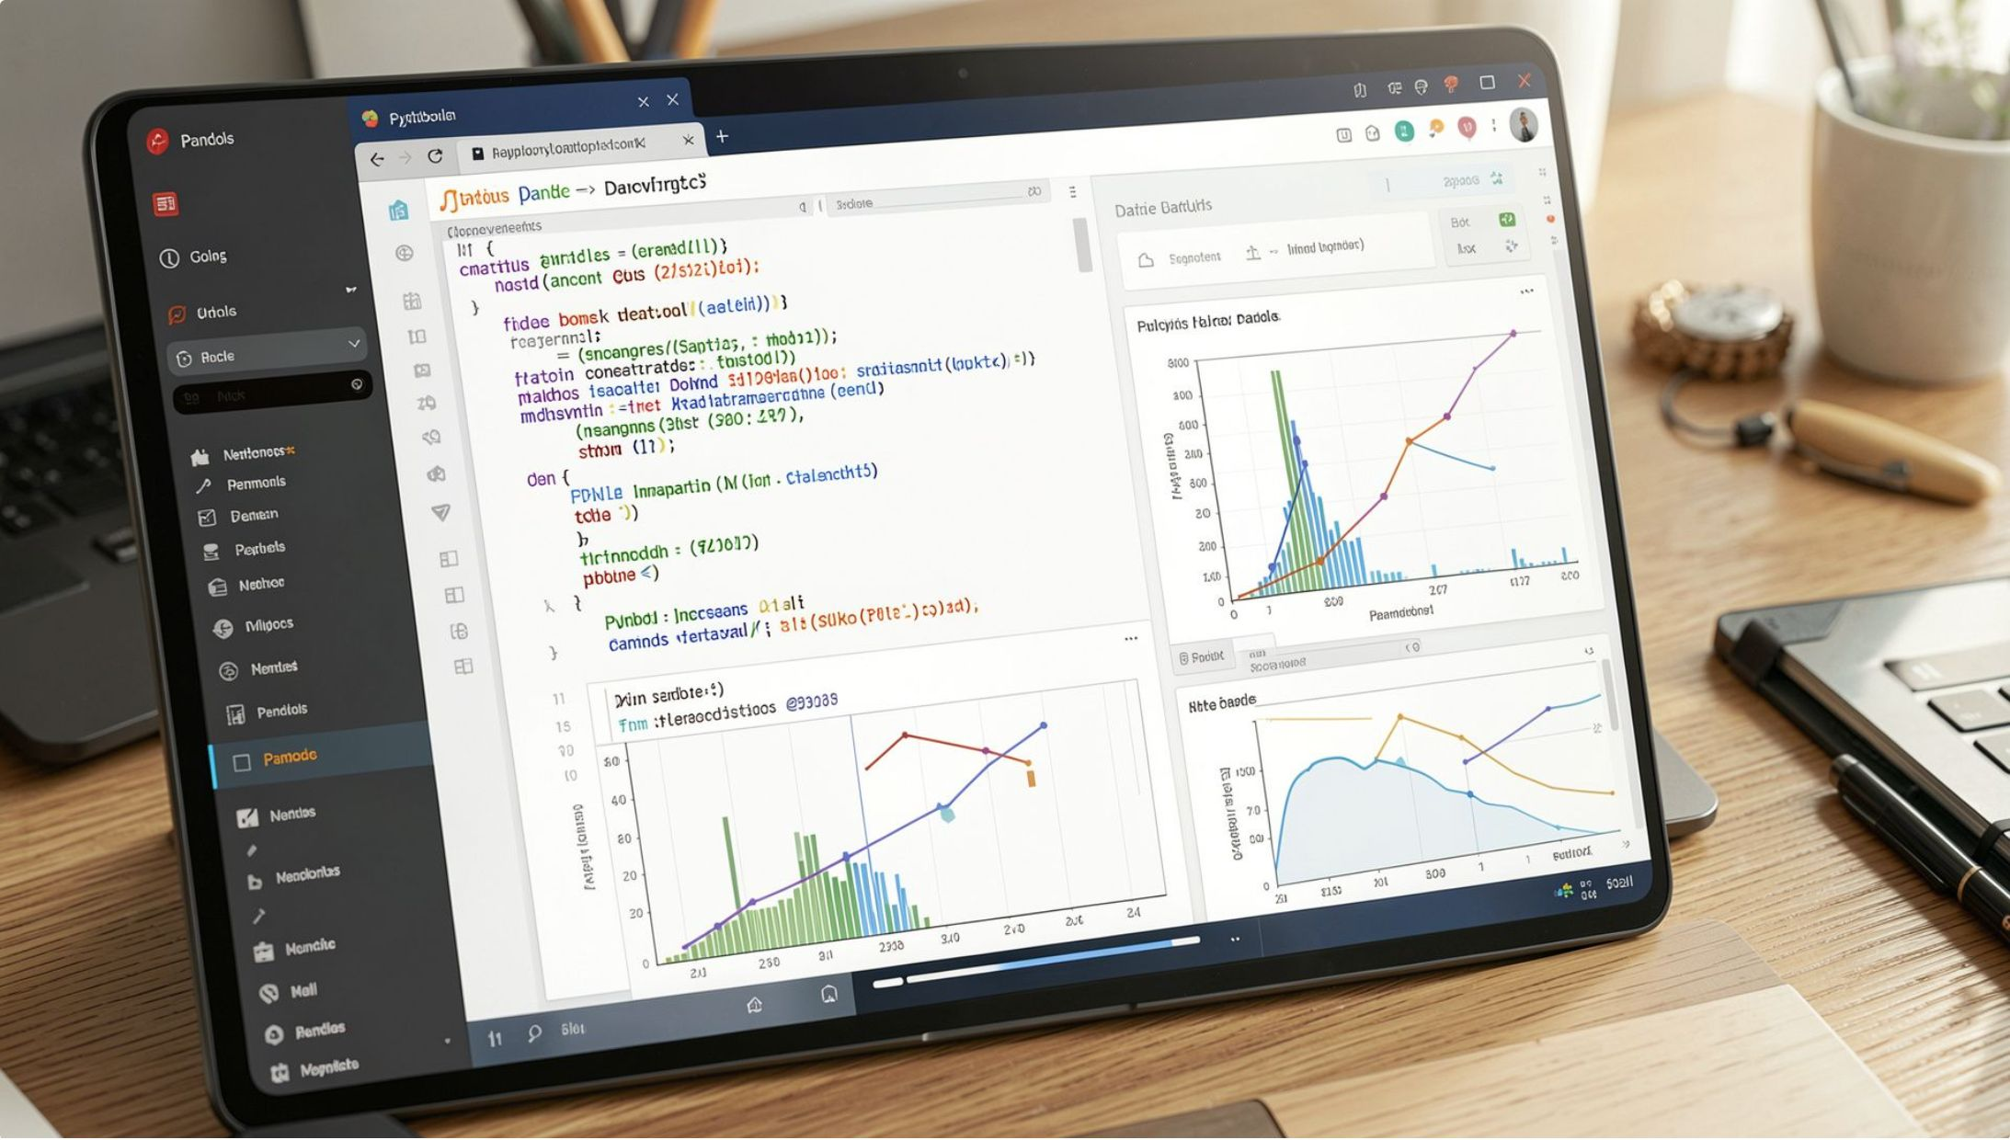
Phase 2 — Python: Cleaning, Feature Engineering & Modeling
Feature Engineering
delivery_delay_days — actual vs. estimated (negative = early)
is_late — boolean flag for delayed delivery
order_to_delivery_days — total fulfillment time
approval_time_days — payment approval latency
is_delivered — delivery-completion flag
Star Schema
Built fact_orders + dim_customers, dim_products, dim_sellers, dim_date for BI consumption. Debugged a row-count inflation bug (99,441 → 99,701) caused by incorrect dedup key in dim_customers — fixed by deduplicating strictly on customer_unique_id.
EDA
Used matplotlib to confirm review scores decline as delivery delay increases — the seed for the dashboard's key visual.

Slide 8
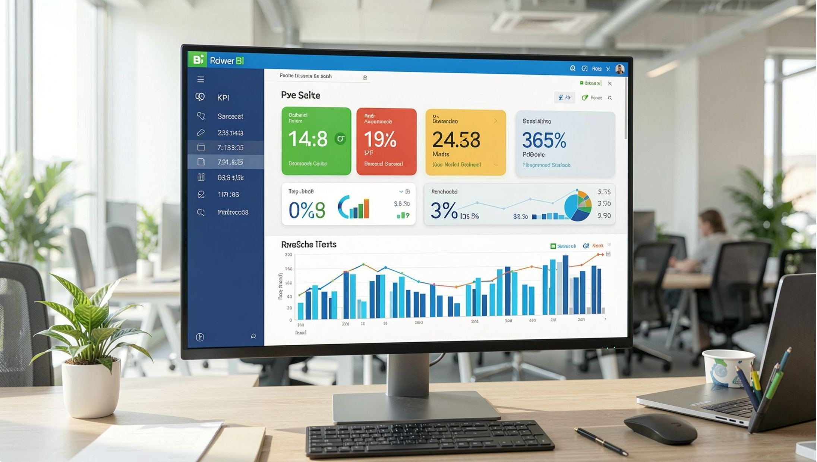
Phase 3 — Power BI: Interactive Dashboard
Dashboard Pages
All pages share slicers for order status, month, state, and product, enabling cross-filtered drill-down.
Page 1 — Sales Overview
Page 2 — Delivery & Logistics
Page 3 — Market & Customer Intelligence
Revenue, orders, AOV, review score KPIs with MoM growth; monthly trends; top 10 categories; on-time delivery SLA gauge.
On-time delivery %, review score by delay bucket (core hypothesis chart), state-level latency, promised vs. actual delivery.
Repeat customer %, regional demand vs. seller presence, category performance table with conditional formatting.

Slide 9
Key Findings
1
Delivery delay → lower reviews
On-time/early orders average meaningfully higher scores; effect most pronounced at 8+ days late.
2
Only ~3.1% repeat buyers
The vast majority purchase once and don't return — a retention opportunity, not just an acquisition problem.
3
Delivery varies by state
States like AP, RR, AM show disproportionately higher latency — regional bottlenecks, not a uniform issue.
4
Freight scales with weight
Heavier categories carry materially higher shipping cost burden, relevant to margin analysis by category.
5
93.2% on-time delivery
Just under the 95% internal SLA target — a small but measurable gap with a clear numeric target to close.

Slide 10
Recommendations, Challenges & Skills
Business Recommendations
Skills Demonstrated
Prioritize logistics review in high-latency states (AP, RR, AM) rather than blanket process changes
Launch post-purchase retention initiatives given the ~3% repeat rate
Flag high-delay, high-negative-review categories for seller-level SLA enforcement
SQL
Python
Schema design, normalization, multi-table joins, CASE WHEN logic, data quality validation
pandas (groupby, merge, datetime), missing-value strategy, feature engineering, star-schema modeling, matplotlib EDA
Key Challenges Solved
1M-row geolocation import → Python bulk loader via SQLAlchemy
Duplicate keys in order_reviews → deduplicated before load
Row-count inflation → fixed dim_customers dedup key
Payments/items multi-row per order → aggregated via groupby() before joining
Power BI
Star-schema relationships, DAX (measures, DATEADD, filter-context debugging), dashboard design, slicers, cross-filtering

