Slide 1

Telecom Customer Churn
Intelligence & Retention Analytics — An end-to-end data analytics project using SQL, Python & Power BI
MYSQL WORKBENCH
PYTHON (PANDAS)
POWER BI DESKTOP

Slide 2

The Business Problem
Customer churn is one of the most expensive problems a telecom company faces. Acquiring a new customer costs 5–7× more than retaining an existing one — making early identification of at-risk customers a high-value capability.
Who is churning?
Churn rate by contract type, payment method, and tenure
Why are they leaving?
Support tickets, service add-ons, and churn relationships
How much revenue?
Annual revenue at risk from highest-risk active customers
What to do first?
A prioritized, revenue-ranked retention action list

Slide 3
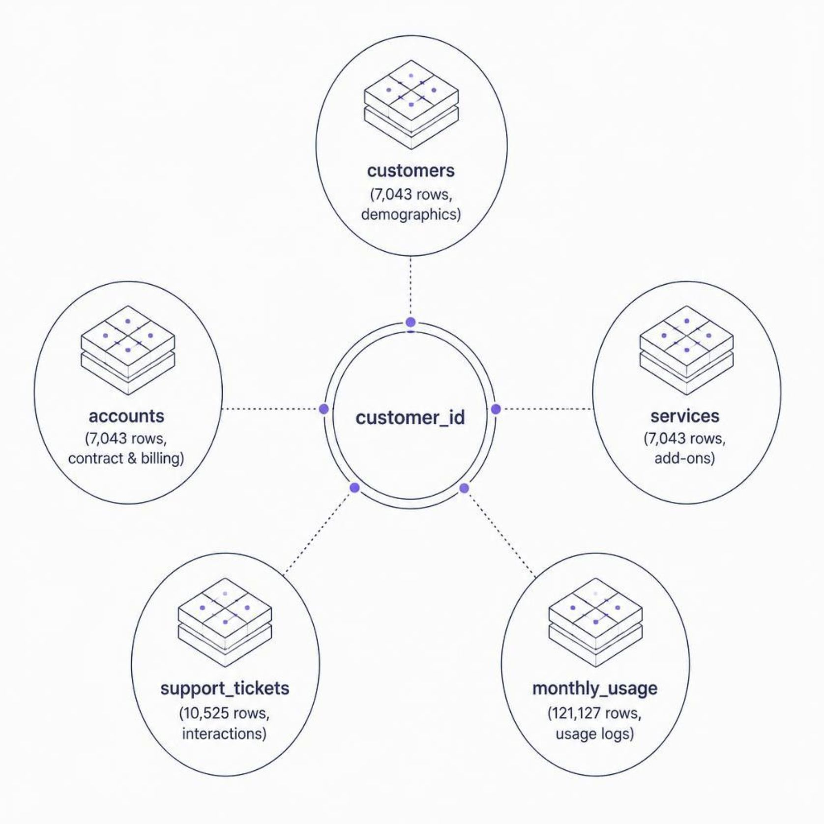
Data Overview
The analysis is built on a normalized relational database (telecom_churn) across five related tables — mirroring how a real telecom's backend stores data.
Key Engineered Columns
total_tickets — support tickets raised per customer
avg_satisfaction_score — average post-resolution rating (1–5)
Churn — 'Yes' if customer has churn, 'No' active customer

Slide 4
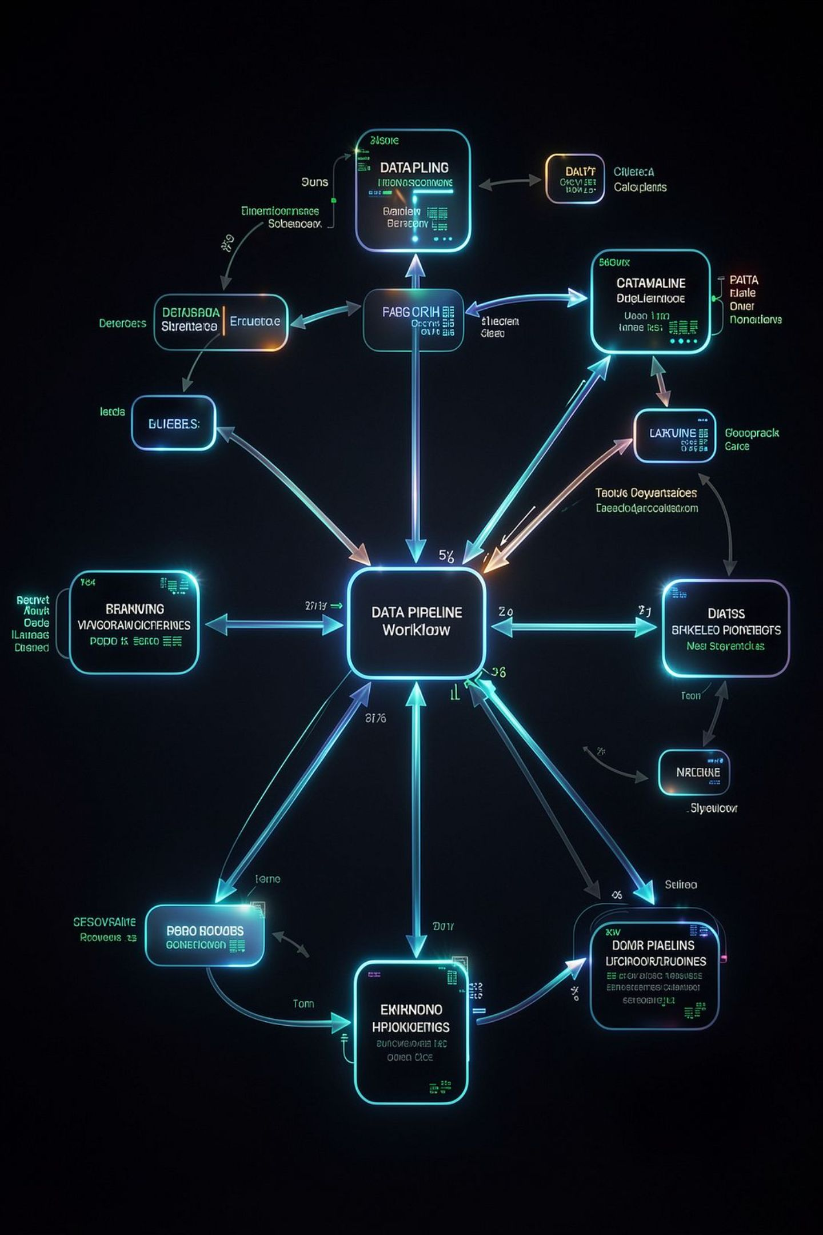



Tools & Workflow
MySQL Workbench
Data storage, exploration, and multi-table extraction via SQL
Python (Pandas)
Data cleaning, missing-value treatment, and feature engineering
Power BI Desktop
DAX measures and a two-page interactive executive dashboard

Slide 5
Phase 1 — SQL: Exploration & Extraction
Structural Checks
Master Extraction Query
Row counts confirmed across all 5 tables
Duplicate key check: 0 duplicate customer_ids
All 5 tables joined into one analysis-ready extract:
INNER JOINs for accounts & services (1-to-1)
LEFT JOINs for tickets & usage (not all customers have them)
COALESCE() converts missing ticket counts to 0
AVG() normalizes usage to per-month (not tenure-biased)
Early Insights
Overall churn rate: 26.54%
Month-to-month contracts churn at dramatically higher rates
Churned customers raise more support tickets on average

Slide 6
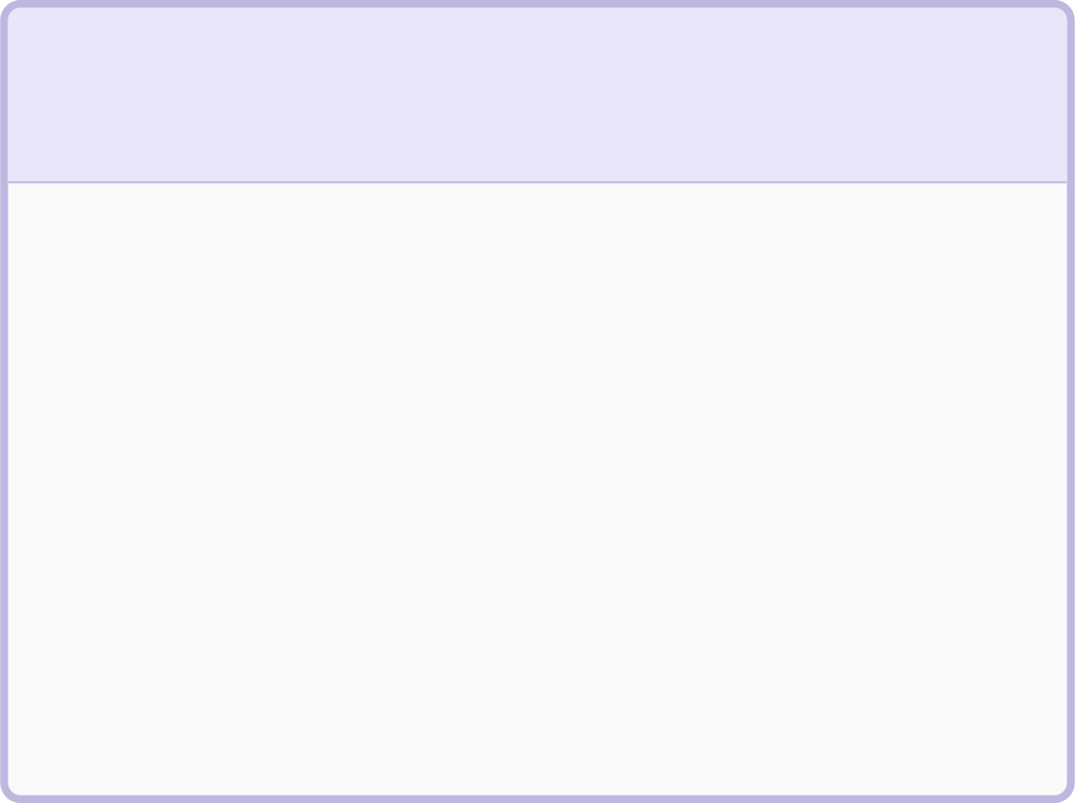
Phase 2 — Python: Cleaning & Feature Engineering
The SQL extract (7,043 rows × 25 columns) was cleaned and enriched to 31 columns.
1
2
3
Data Type Correction
Missing Value Treatment
Feature Engineering
signup_date converted from string to datetime
Usage columns → filled with 0 (no usage). Satisfaction → flagged with has_support_ticket before filling
Created: tenure_bucket, annual_revenue_at_risk, total_addons_subscribed, and is_churned binary flag

Slide 7

Phase 3 — Power BI: Executive Overview
Page 1 — Leadership View
Answers: "What is happening and what is it costing us?"
Four KPI cards: Total Customers, Revenue, Revenue Lost, Avg Monthly Charges
Donut chart confirming 26.54% churn rate (1.87K lost vs 5.17K retained)
Revenue impact by tenure: first-year customers represent the largest share
Churn risk drops from 47.44% (0–1 Year) to 9.51% (4+ Years)
Decomposition tree: contract → internet → payment → tenure drill-down

Slide 8
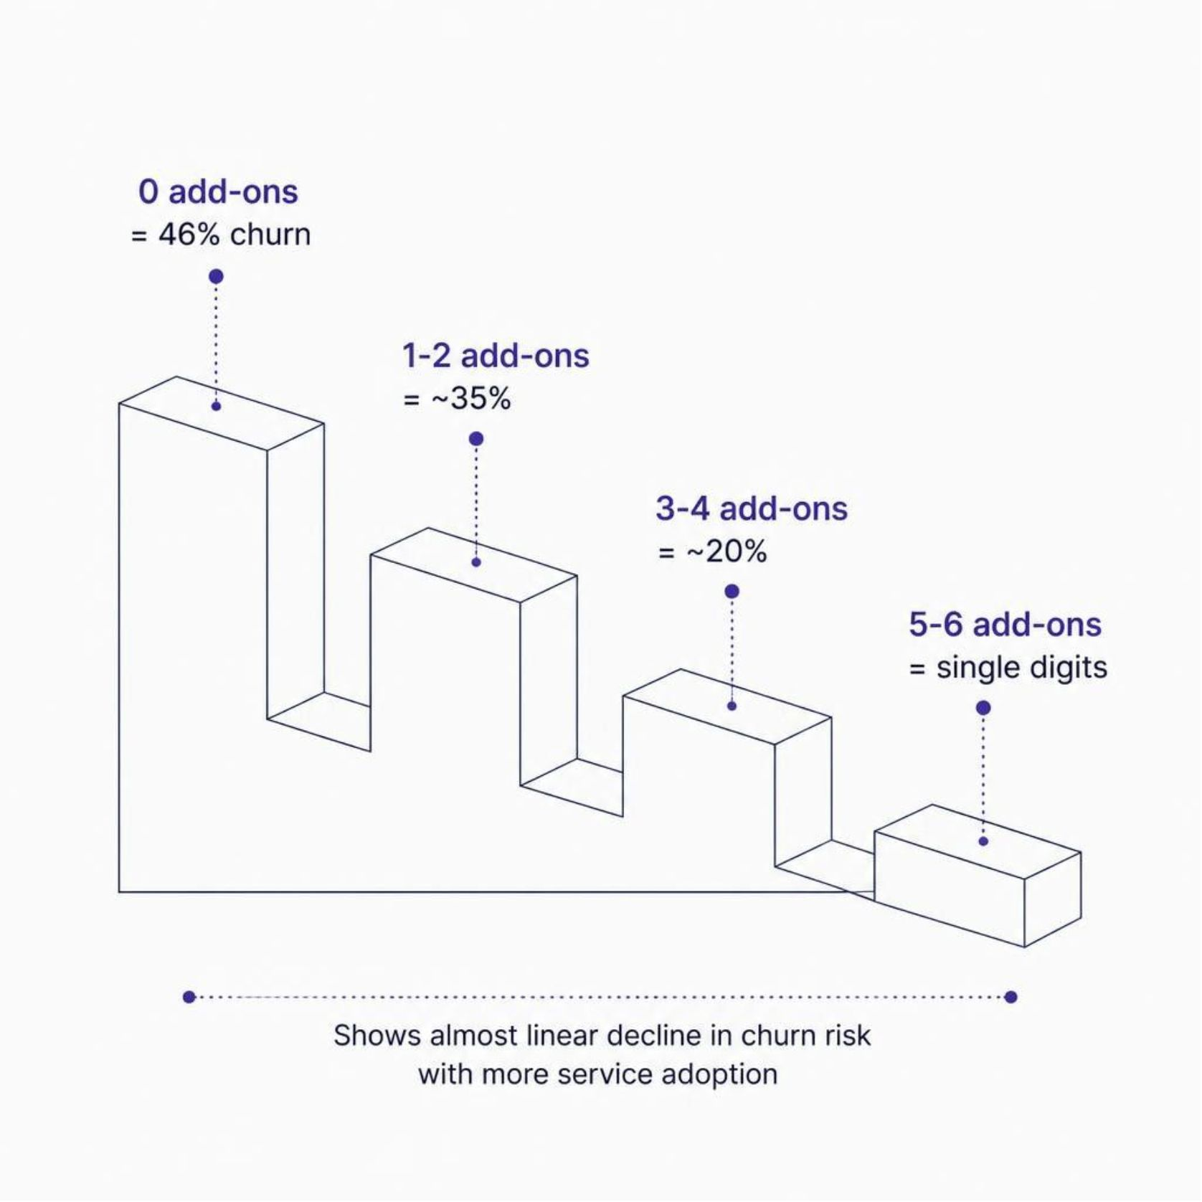
Phase 3 — Power BI: Retention Operations
Page 2 — Action View
Answers: "Why is it happening and who do we act on first?"
Tech Support impact: Fiber customers without it churn at ~49% vs ~23% with it — nearly 2× difference
Add-on effect: Churn falls from ~46% (0 add-ons) to single digits (6 add-ons)
Support tickets: Churn rate peaks at 3 tickets before volume drops
High-Risk Active Customers table: Sorted by annual revenue — first row = highest-value save opportunity

Slide 9
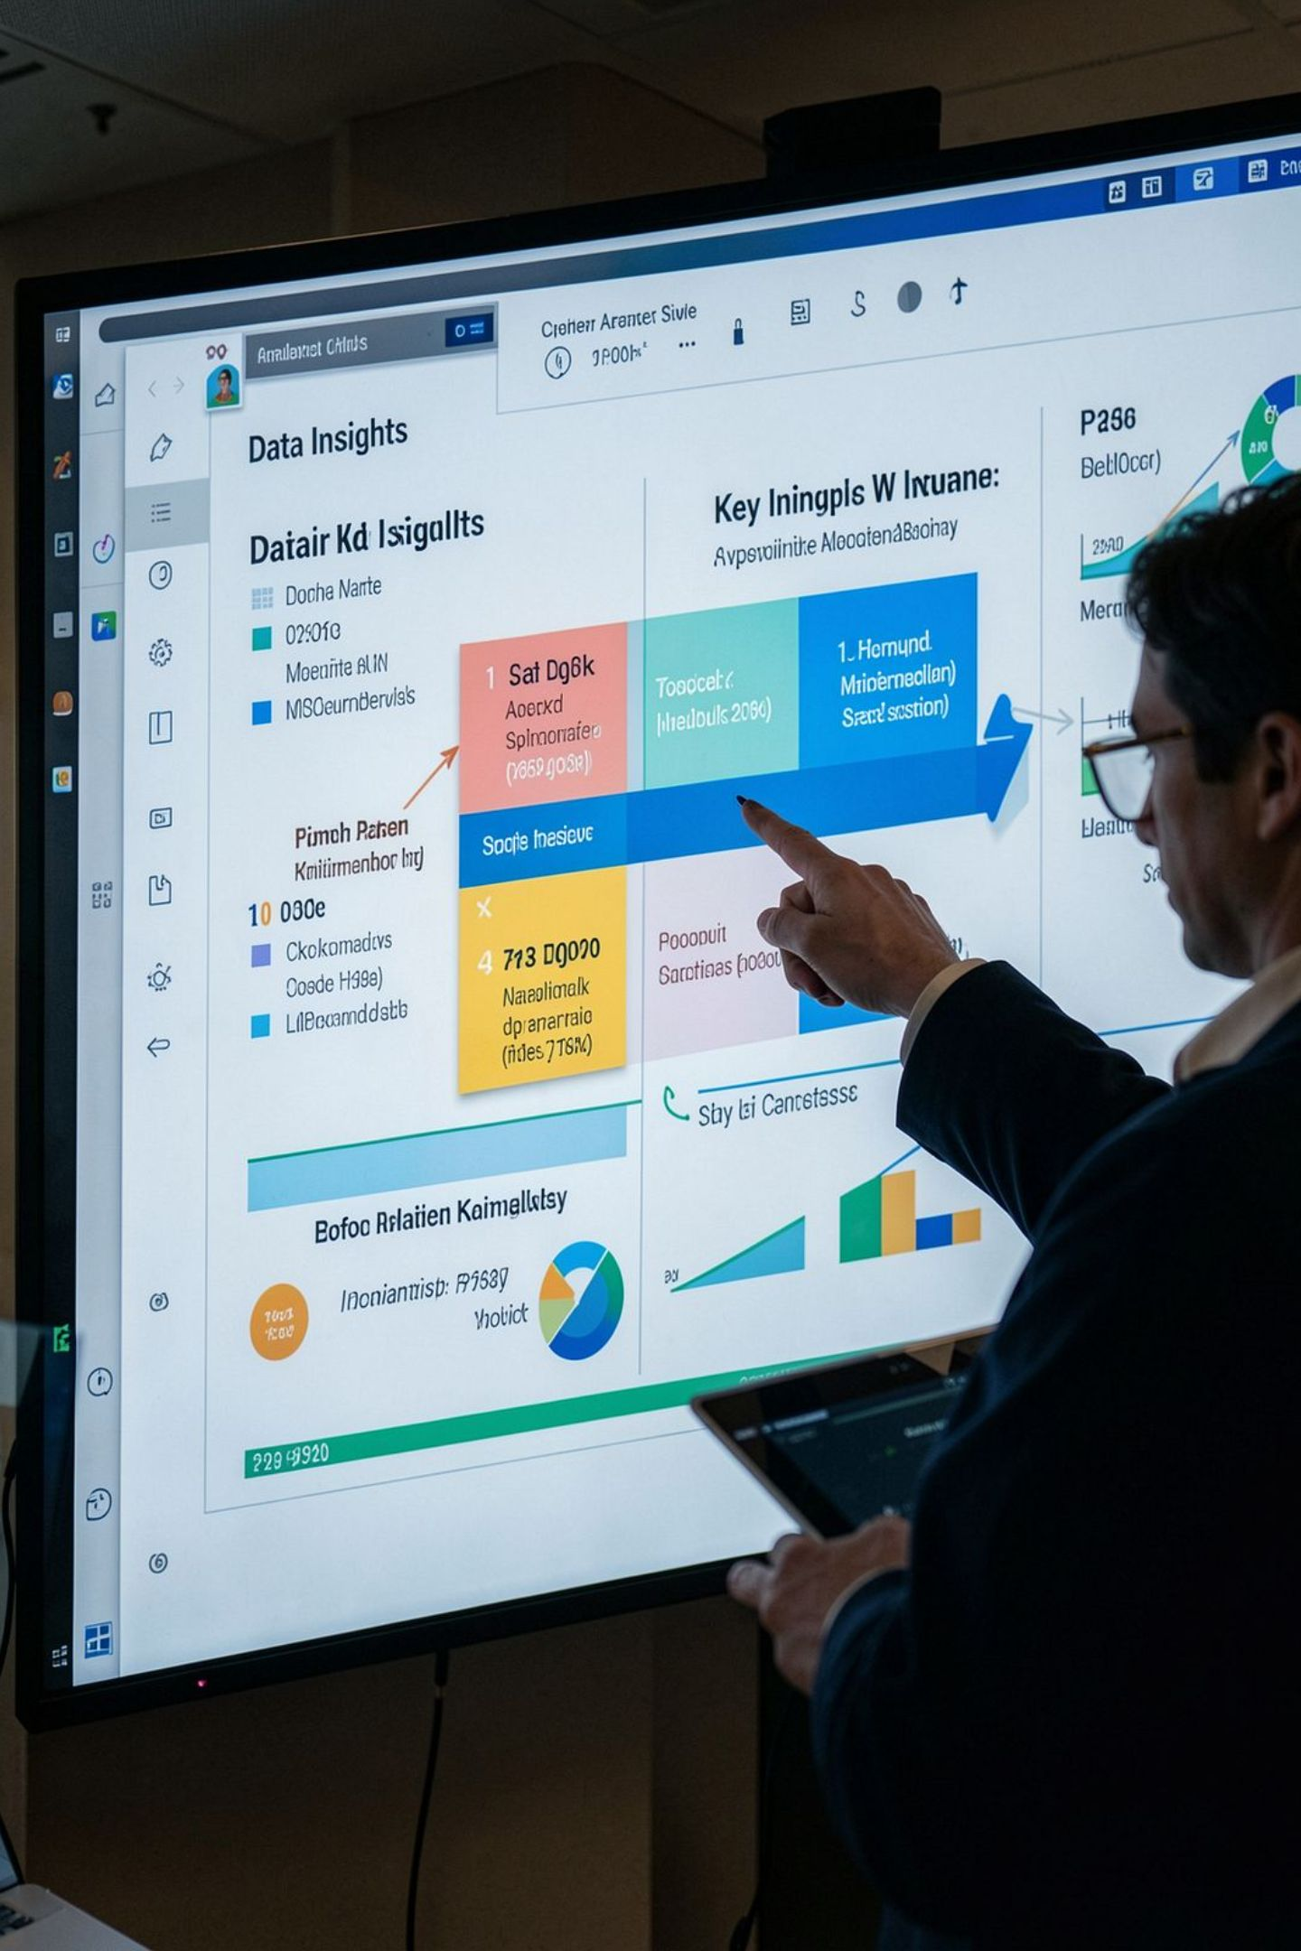
Key Findings
1
26.54% overall churn rate
Roughly 1 in 4 customers has left — well above healthy for a subscription service
2
Contract type is the strongest driver
Month-to-month customers churn far more than annual or two-year holders
3
Churn risk is front-loaded
47.44% in year one vs 9.51% after 4+ years — protect the first 12 months
4
Tech Support cuts Fiber churn nearly in half
~49% without vs ~23% with the add-on

Slide 10

Recommendations & Conclusion
Business Recommendations
Project Takeaway
Prioritize retention in the first 12 months — not evenly across all tenures
A complete, realistic analytics workflow: normalized SQL database → documented Python cleaning → a two-page Power BI dashboard built around two distinct audiences and decisions.
Every dashboard number traces back to an explainable step in the code.
Incentivize month-to-month → annual contract migration
Bundle free Tech Support trials for new Fiber customers
Route customers with 2+ support tickets into proactive retention workflows
Action the High-Risk Active Customers table — already sorted by revenue impact

