Slide 1
Steering meeting: 2
2018-11-19

Slide 2
Outline
Project status
Last week's accomplishments
What we planned to do...
What we actually did...
Time report
This week's plan
Identified issues
Questions

Slide 3
Project status
Feels like we are on time. Need more from client to be able to dig into the project. (Meeting today)

Slide 4
Last week's accomplishments
What we planned to do
Start with project plan
Elicit and specify initial user requirements
Produce a use case diagram
Plan and discuss our working philosophy (meeting routines, time-reporting, tools to use, communication)
Produce initial mockup (to find out if we interpreted the user requirements correctly and to motivate discussion)
Familiarize ourselves with their existing codebase

Slide 5
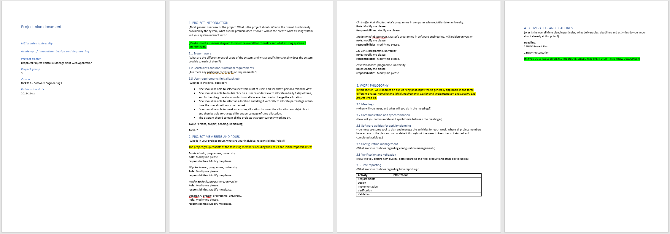
What we actually did...

Slide 6
What we actually did...
"One should be able to select a user from a list of users and see that’s persons calendar view."
"One should be able to double click on a user calendar view to allocate initially 1 day of time, and further drag the allocation horizontally in any direction to change the allocation."
"One should be able to select an allocation and drag it vertically to allocate percentage of full-time the user should work on the task."
"One should be able to break an existing allocation by hover the allocation and right click it and then be able to change different percentage of-time allocation."
"The diagram should contain all the projects that user currently working on."
Etcetera...

Slide 7
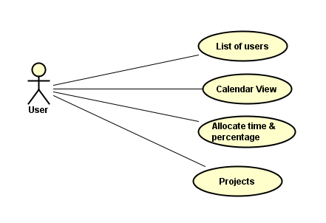
What we actually did...
Use case diagram

Slide 8
What we actually did...
We planned our meeting schedule, every Monday:
Group: 13.00 pm (On this meeting we plan additional meetings for the week if necessary)
Steering: 14.25 pm
Client: 15.00 pm

Slide 9
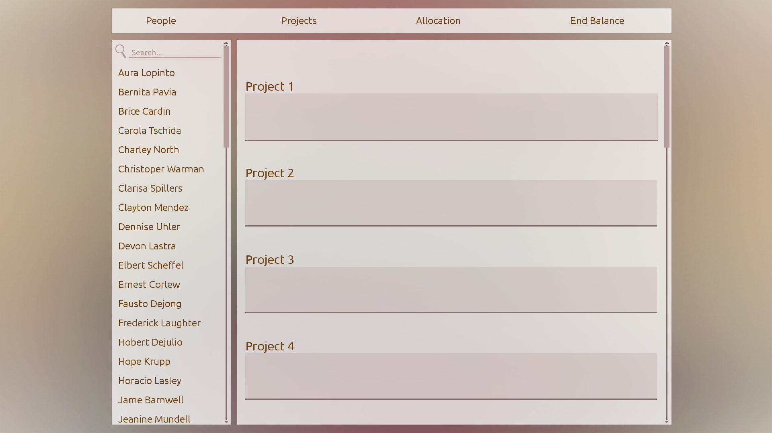
What we actually did...

Slide 10
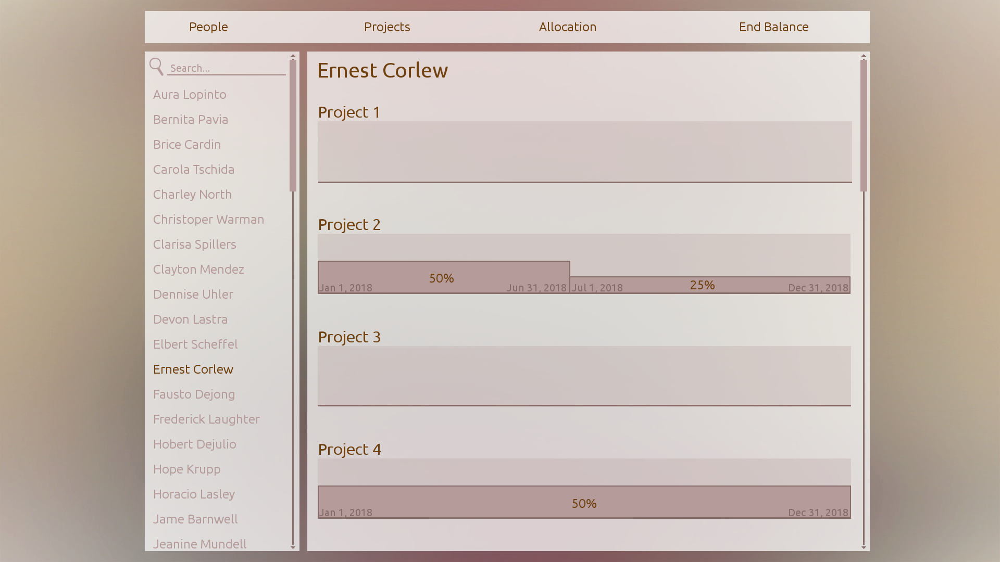
What we actually did...

Slide 11
Time report
How?
Estimated effort on Trello
Individual time in Excel document Approx: 6-8h / person

Slide 12
This week's plan
Client meeting today
Group meeting today and Wednesday
Presumably Architectual design
Report writing
Look into FrameWorks and technologies
Familirize with client codebase
Start discussing implementation

Slide 13
Identified issues
Missing files from client
Different experiences
Lack of experience working in large groups

Slide 14
Questions
Meetings on Trello?

