Slide 1
Steering meeting: 3
2018-11-26

Slide 2
Outline
Project status
Last week's accomplishments
What we planned to do...
What we actually did...
Time report
This week's plan
Identified issues
Questions

Slide 3
Project status
Feels like we are on time.
Feels like we know what parts of the project that will require the most effort and time.

Slide 4
Last week's accomplishments
What we planned to do
Finish the project plan
Familiarize ourselves with their existing codebase
Look into FrameWorks and technologies
Start discussing implementation

Slide 5
What we actually did...
Project plan
- Finished the project plan document, almost.

Slide 6
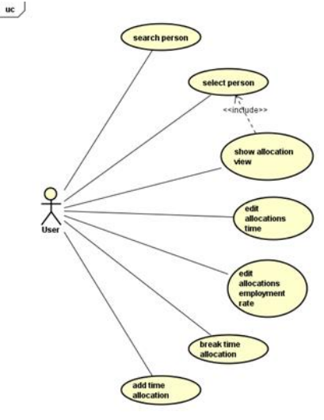
What we actually did...
Diagrams
Expanded on the use case diagram.

Slide 7
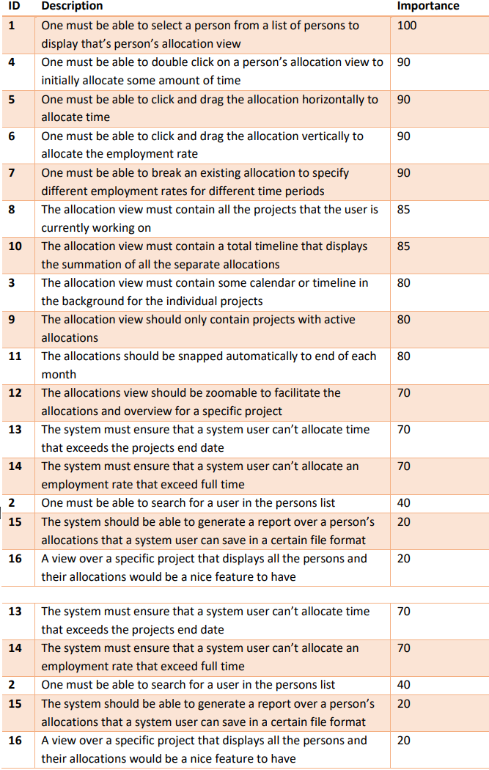
What we actually did...
User requirements
Identified and assigned importance
values to the elicited user requirements.

Slide 8
What we actually did...
Roles and responsibilities
Assigned more specific roles and responsibilities now that we have more information about the project from the client.
Zaid – Backend, Documentation creator.
Filip – Frontend, PowerPoint creator.
Matko – Backend.
Osamah – Backend, Documentation creator.
Christoffer – Frontend, GitHub, time report.
Mohammed – Backend, validation and verification.
Sai - Frontend, taking notes in meetings.
Erika - Project manager, client contact, frontend.

Slide 9
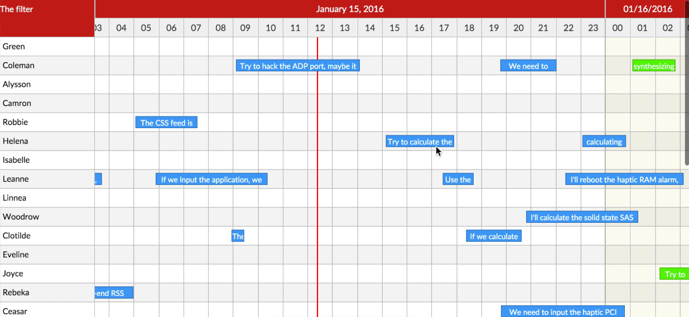
What we actually did...
Frameworks and technologies
Looked into existing tools that could help us with the development.
React Calendar
Interact.js

Slide 10
What we actually did...
Time Report document
Created a shared spreadsheet for everyone to fill in their time spent on the project, as well as adding comments of what they did during that time.

Slide 11
This week's plan
Finish the redo of the report
Prepare for presentation on Wednesday
Decide framework(s) for use
Start on implementation - BackEnd: try to send data, wamp - FrontEnd: decide framework, start code
Start writing design requirements document

Slide 12
Identified issues
8 people – suggestion needed to work in large groups with project which is hard to divide.

Slide 13
Name | Hours | TOTAL | What has been done
Filip | 3 | 6 | Explored client-provided files, looked for useful tools, prepared slides.
Matko | 8 | 10 | Getting to know with Git, recap in PHP and MySQL, making client files work, reviewing on project plan requirements, taking notes from meetings.
Osamah & Zaid | 7ea | 7ea | Modify the presentation PowerPoint, Launch the code and repository we get from client, Gather information about how to connect servers, how to implement with php.
Christoffer | 12 | 16 | Reading GitPro, created an example repo, experimented a lot with it. Looked in to different frameworks/tools for the front-end and tried them out if they were useful. Added requirements and reviewed the project plan.
Mohammed | 4 | 4 | Reviewed the current project we have from the client. Created use case diagram.
Sai | 2.5 | 5 | Reading about frameworks etc
Erika | 10 | 14 | Project plan writing, reading about GIT and understand, reading about frameworks and tools, administrative stuff as well (trello, email etc).
GROUP | 8 | 12.5 | Meetings, project plan writing, etc...

Slide 14
Questions
Gender neutral pronoun singular they
Can all talk 3 minutes on the presentation?
Use case issues about "adding new ones" ?
Upload time report on GIT?

