Slide 1
AMBULANCE APP
By
Mabirizi Vicent – 2018/MHIT/027/PS
Nyomukiza Pascal - 2018/MHIT/023/PS

Slide 2
Abstract
Injury and medical emergencies are among the leading causes of morbidity and mortality in Uganda.
This burden has costed the country extremely both in terms of human life and resources.
Currently, pre-hospital care is given on an ad hoc basis, by disjointed providers including the Police and community by standers near crash scenes in case of road traffic crashes

Slide 3
Abstract
In spite of the high emergency ring, the emergency services are clearly insufficient and there is low capacity to manage the injured. Many injured and ill arrive at health facilities by any means of transport that is possible for example Boda-bodas, police trucks, private cars, etc.
Despite the presence of ambulances across the country, the majority of which are attached to health facilities and a few run by private institutions, less than 7% of patients arrive at health facilities by ambulance().

Slide 4
Problem
There has been increased death among Ugandans especially in busy urban centers, many resulting from accidents and delays in ambulance services which would have saved the injured victims.
It is estimated that 8% of deaths in Uganda are as a result of accidents, and by 2018 the figure increased by 67%, this call for an intervention if we are save lives.
It also argued that most of victims do not die on spot but their death happens after a certain period if they do not get immediate treatment.

Slide 5
Solution
Emergency ambulance mobile application is designed to help patients/care takers to seek for a nearby ambulance in case of an emergency.

Slide 6
PROJECT STRUCTURE
The application has two modules one for the ambulance and the other for patients/care takers.
Platforms utilized.
Firebase real time database used to store, retrieve and keep track in real time.
Google Maps Api, to truck ambulance/patient’s current location in real time.
Glide library, this helped us to retrieve ambulance and patient’s images from the database.

Slide 7
PROJECT STRUCTURE
Paypal Api to quicken the payments for the services, after the ambulance service has been given patients will be able to pay in case of any charges that may arise.

Slide 8
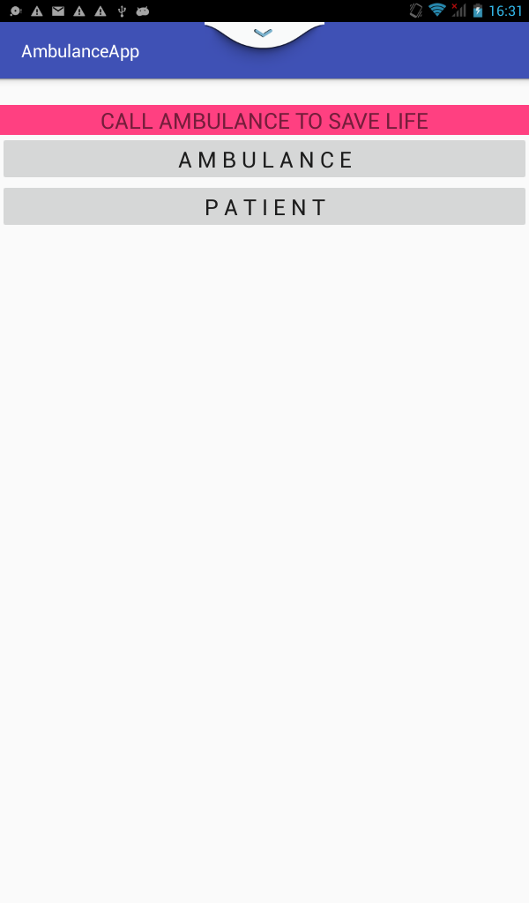
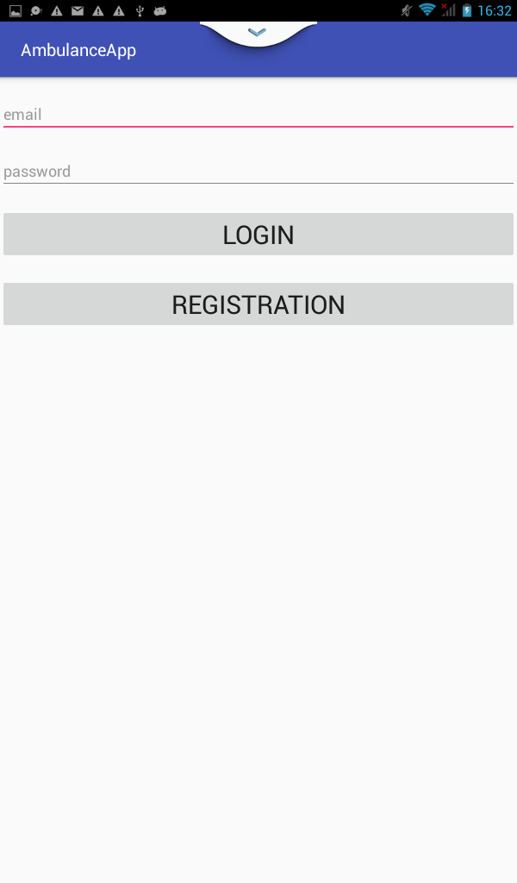
Main activity for the two module
Log in

Slide 9
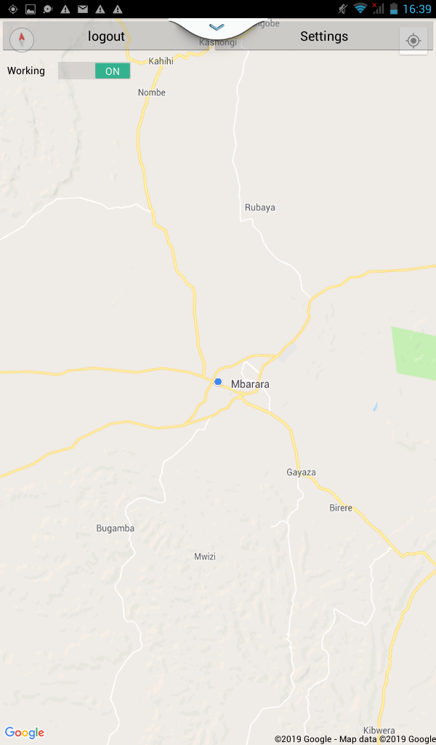
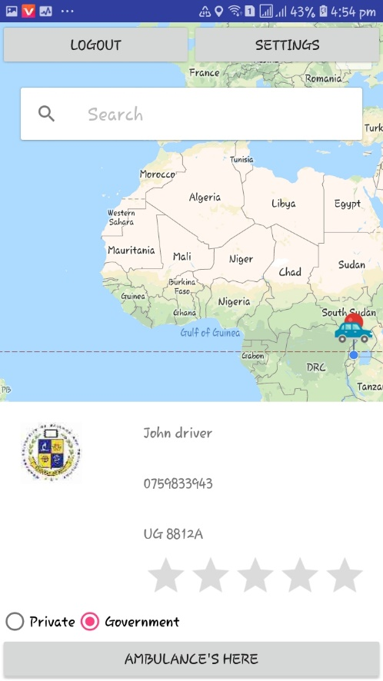
Ambulance home activity
Patient after getting assigned to an ambulance

Slide 10
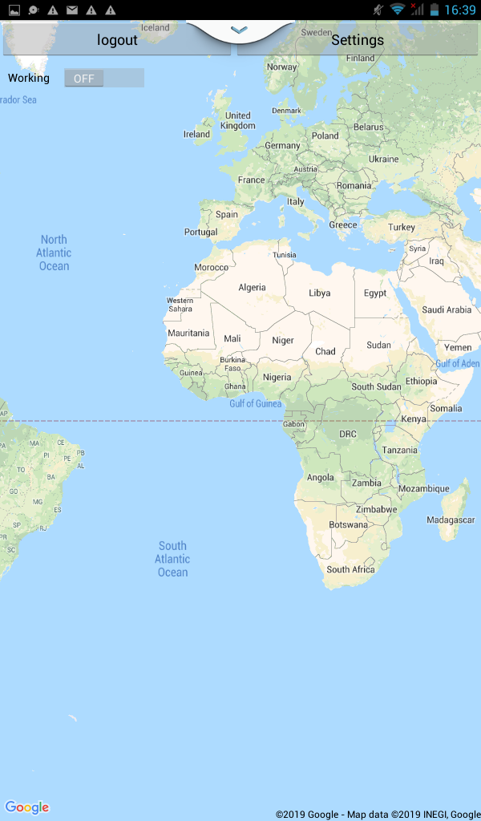
Ambulance home screen when offline

Slide 11
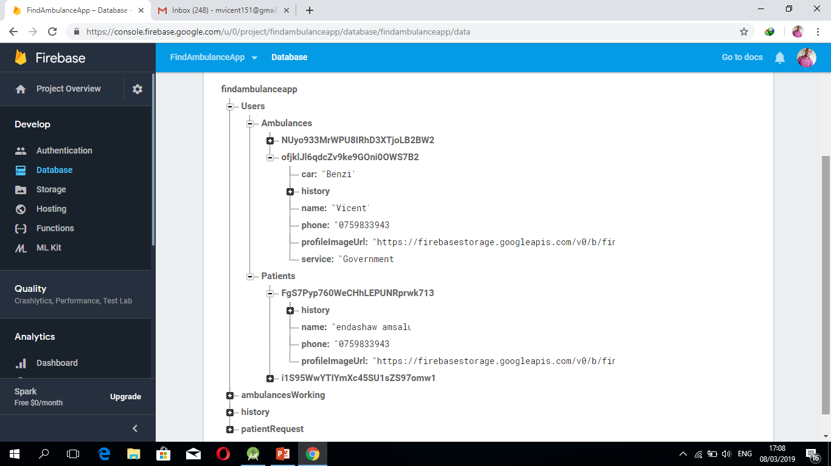
Data base structure

