Slide 1

A1
A2
A3
A4

Slide 2

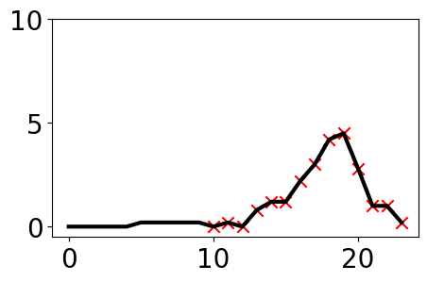
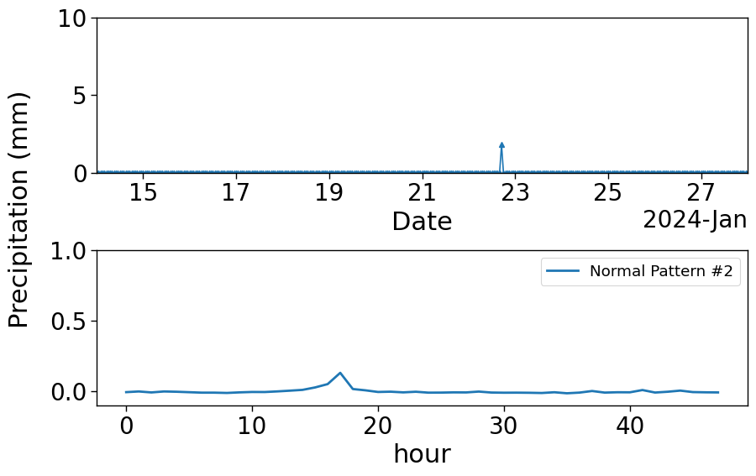
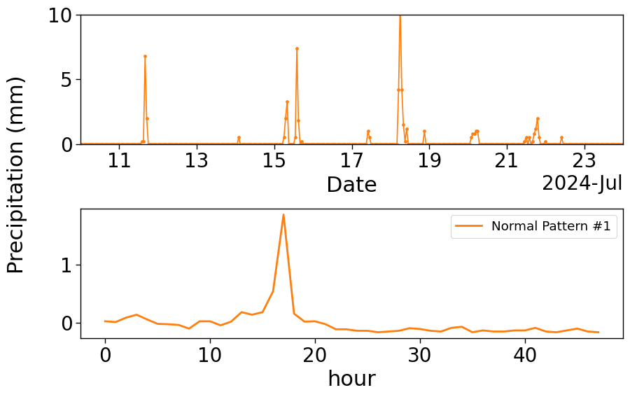
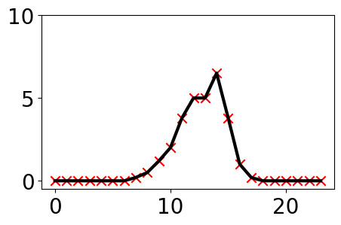
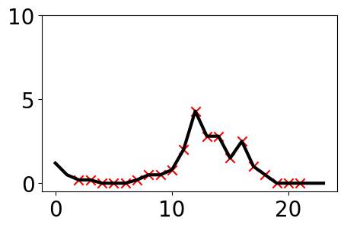
Drift-Anomaly Ambiguity
Winter
Summer
Low-frequency rainfall
High-frequency rainfall

Slide 4

