Slide 1

A1
A2
A3
A4

Slide 2

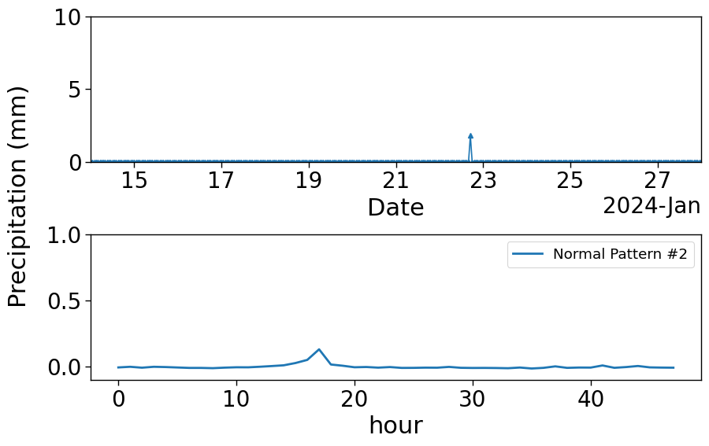
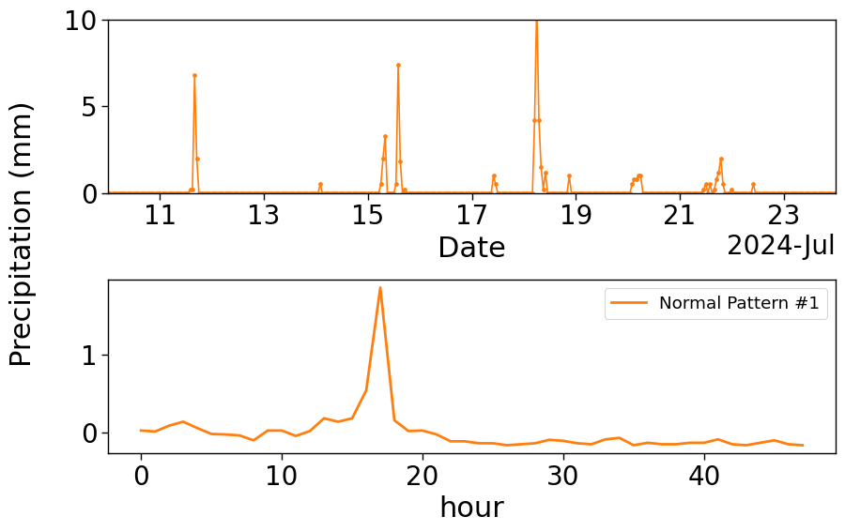
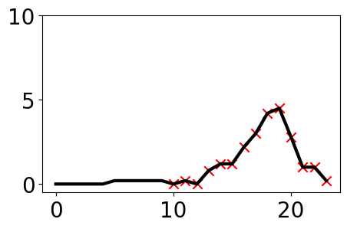
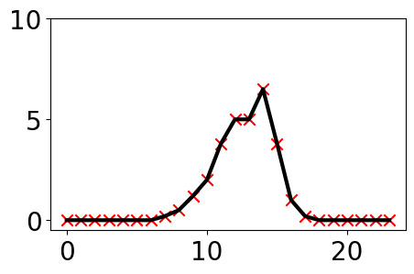
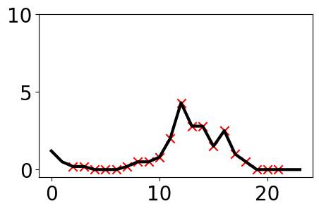
1. Drift-Anomaly Ambiguity
2. Short-lived Normality
Winter
Summer
3. Recurring Anomalies
Low-frequency rainfall
High-frequency rainfall

Slide 4

